Slide 1
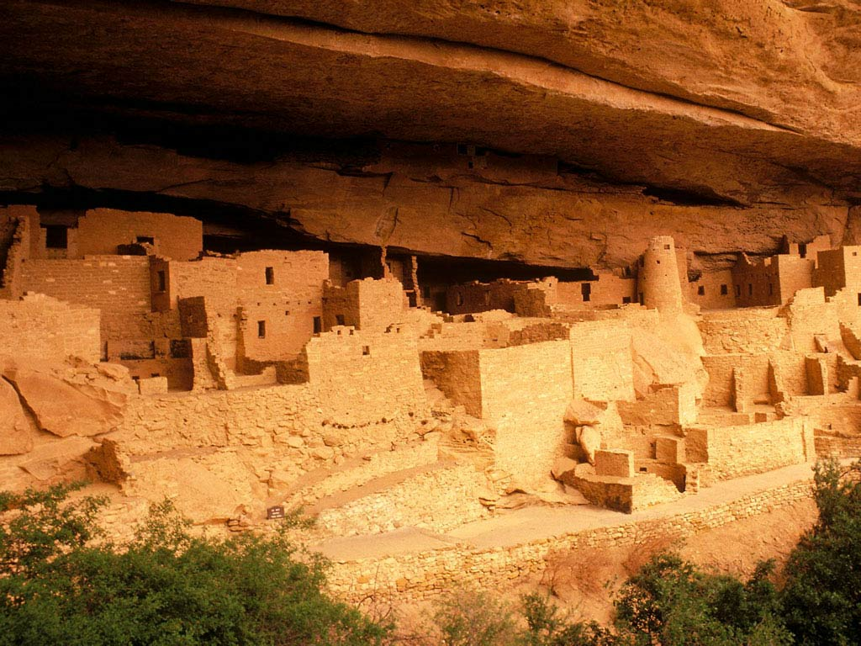
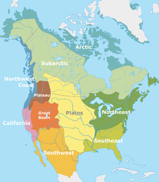
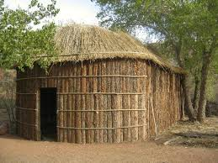
Pre-Columbian North America

Slide 2
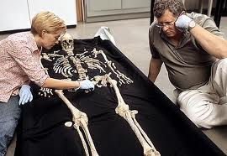
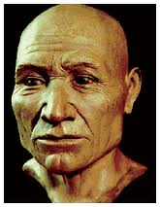
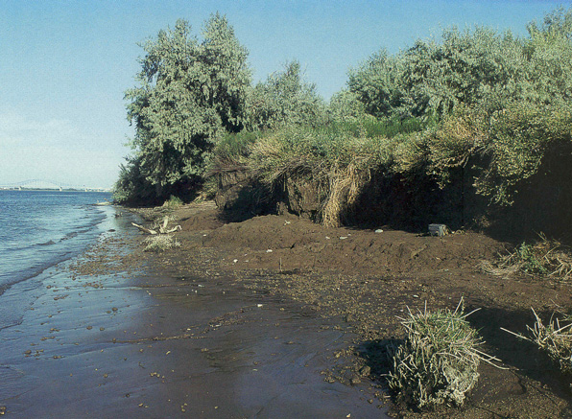
Ancient America
Kennewick Man found in 1996
40 years old, 5’9” tall, dead for 9,400 years

Slide 3
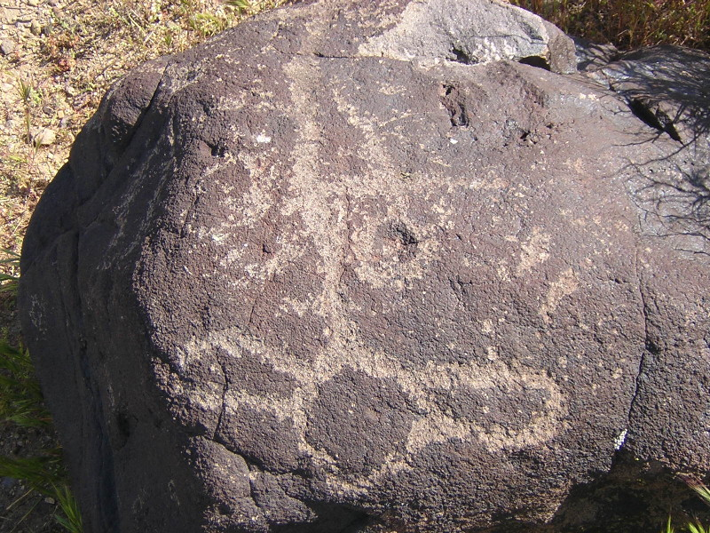
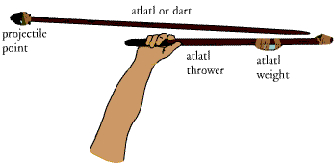
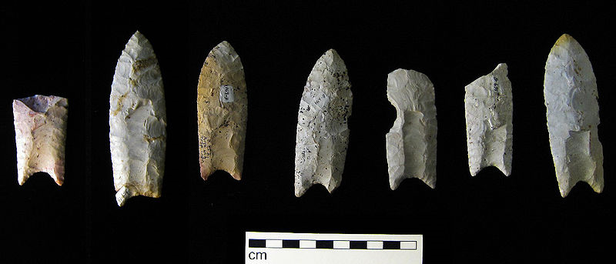
Historical Sources for Ancient America
Petroglyphs = paintings on rocks
Pictographs = drawings on rocks
Pictograph
Clovis Points

Slide 4
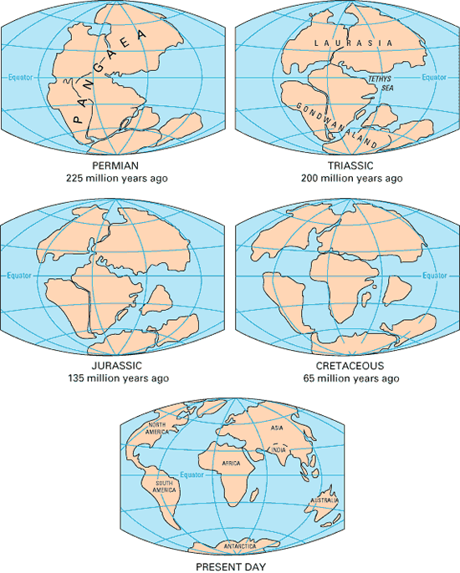
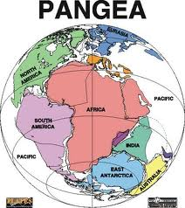
Pangea
Split into 7 continents nearly 240 million years ago

Slide 5
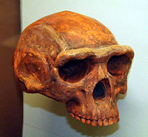
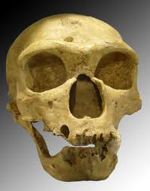
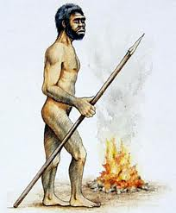
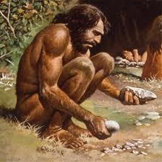
Homo erectus
Homo sapiens

Slide 6
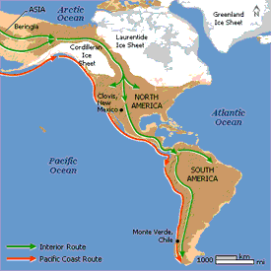
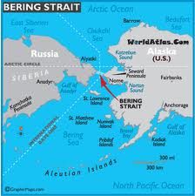
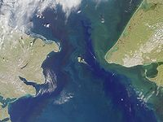
Bering Strait
13,000 BCE = Paleo-Indians crossed Bering Strait from Siberia into North America

Slide 7
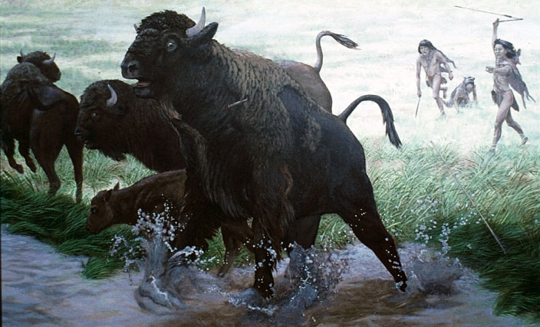
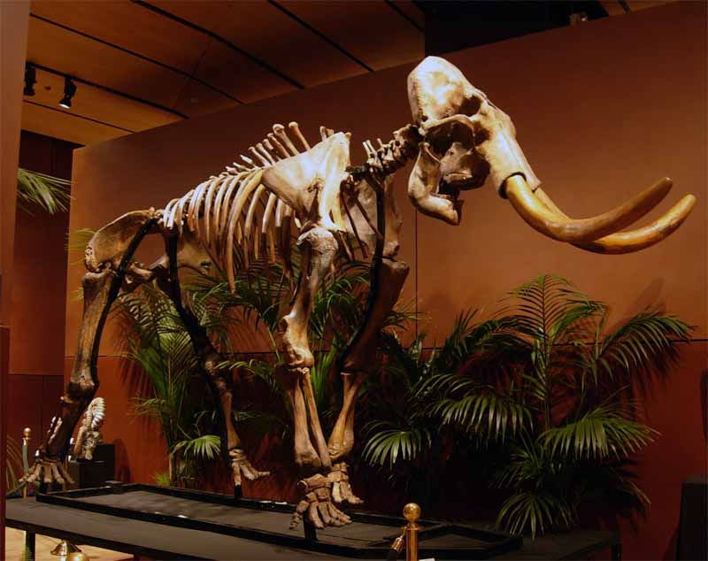
A Turning Point
11,000 BCE = Paleo-Indian Hunters become Archaic-Indian Hunter-Gatherers

Slide 8

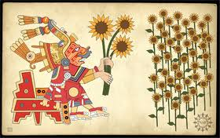
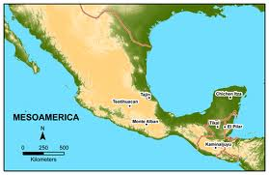

Agriculture in Mesoamerica
5,000 BCE = farming developed in Mesoamerica

Slide 9
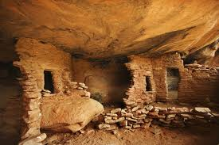
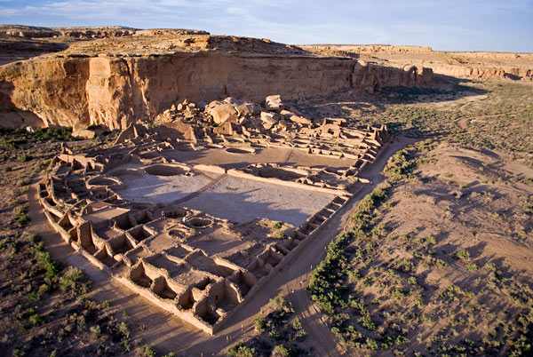
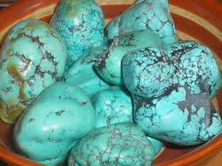
The Anasazi
Built “pueblo” apartments in the Southwest
Existed during the 1st century CE

Slide 10
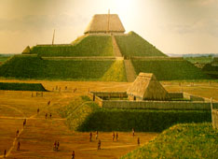
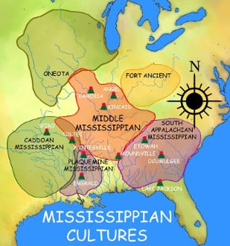
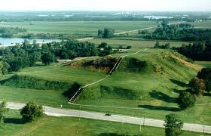
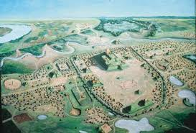
Mississippian Mound Builders
800 – 1500 CE
Cahokia is near St. Louis, MO

Slide 11
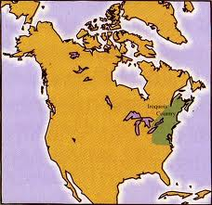
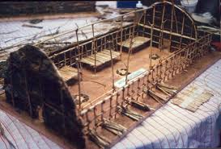
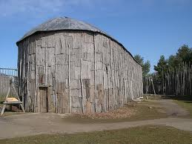
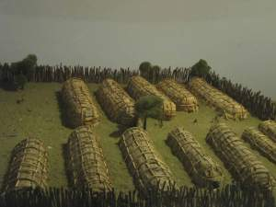
Iroquois Confederacy/5 Nations Confederacy
Mohawk, Oneida, Onondaga, Cayuga, Seneca
Lived in Longhouses
Matrilineal

Slide 12
Demographics
At 1492 = 50 million people in North America, Mesoamerica, & South America
Estimates vary = 1/5 along Pacific Coast, ¼ in Southwest, 1/3 East of Mississippi River, ¼ in Great Plains, Great Basin & Arctic

