Slide 1
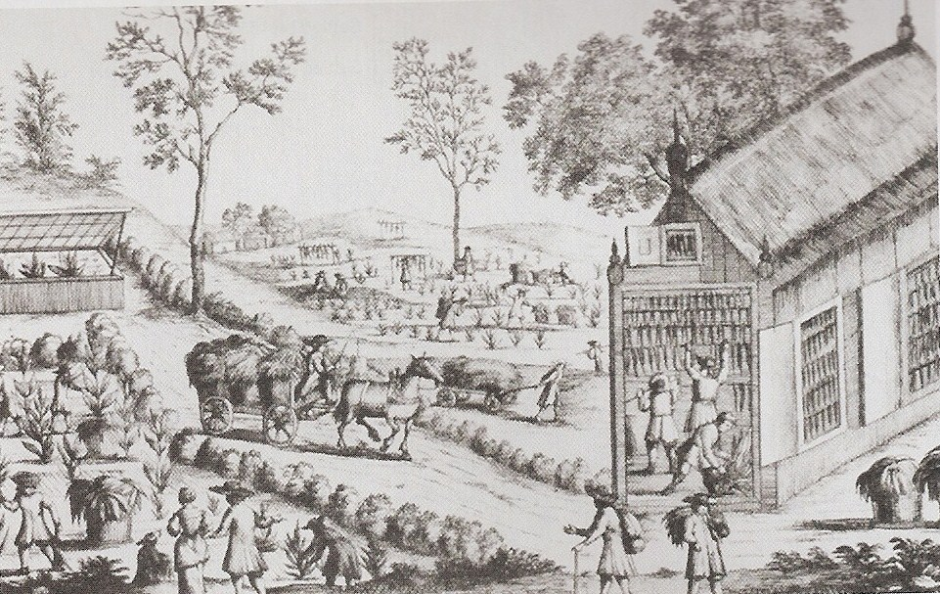
Life in the Chesapeake
Tobacco plantation in Virginia

Slide 2
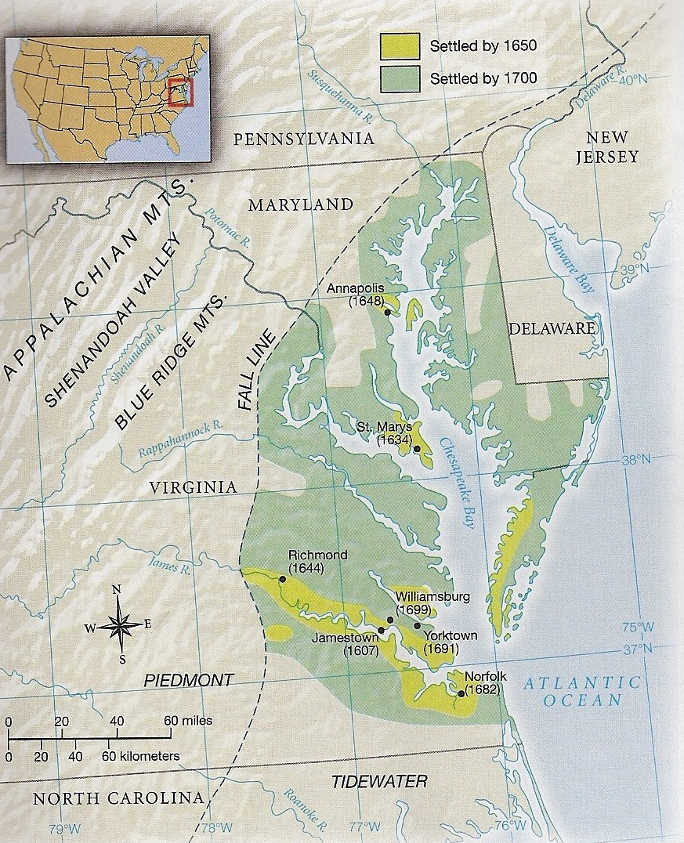

Slide 3
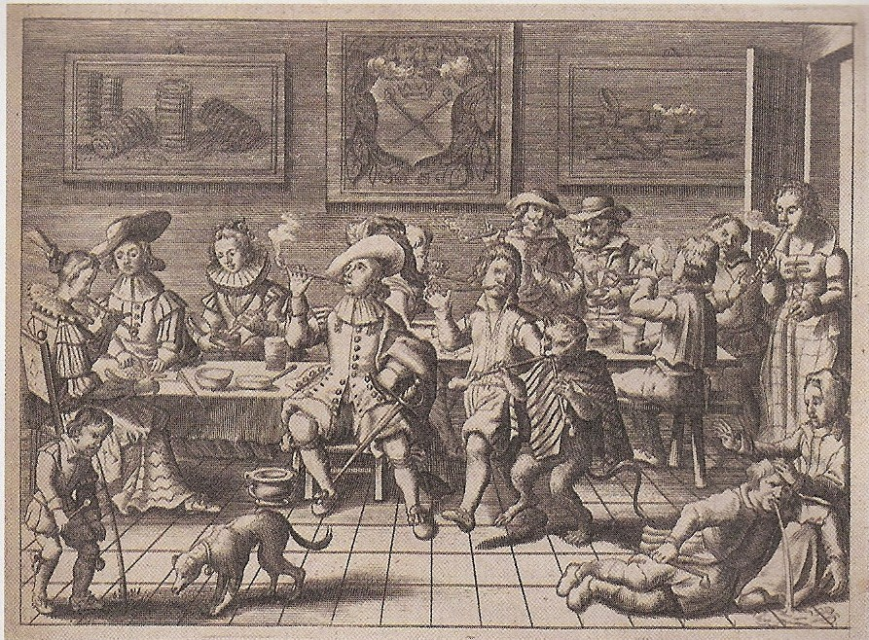
Tobacco in Virginia
John Rolfe introduced tobacco
Role of wife Pocahontas
Tobacco used for pleasure and medicine in England
Economic salvation for Virginia

Slide 4
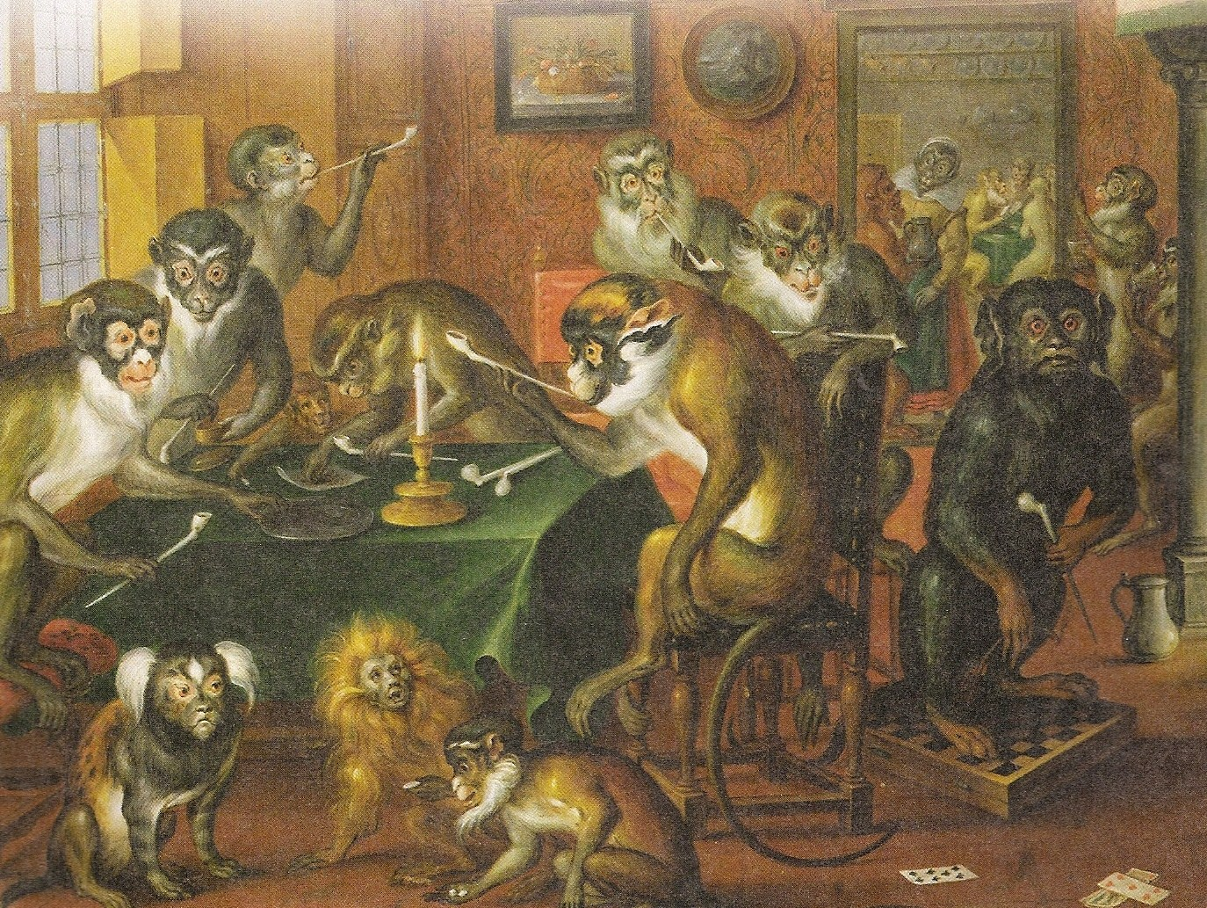
What can the year 1619 tell us?
1st Legislature set up in Virginia
90 women sent to Jamestown & sold for 120 pounds of tobacco
1621 = Women sold for 150 pounds of tobacco
20 African slaves arrived in North America

Slide 5
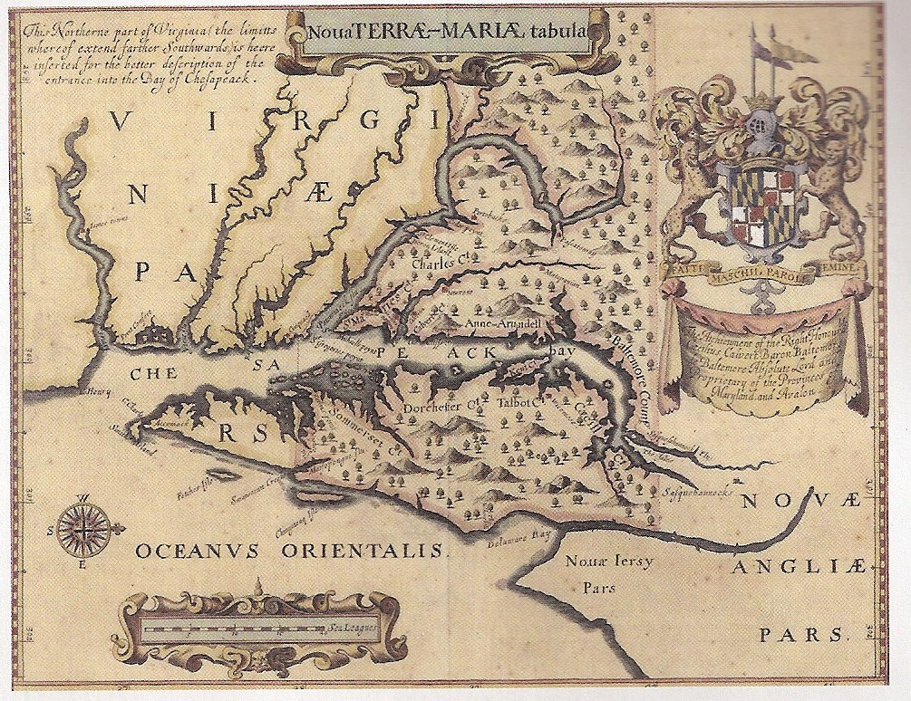
Maryland
Proprietary colony for Lord Baltimore & family
Designed as a Catholic refuge
Early map of Maryland

Slide 6
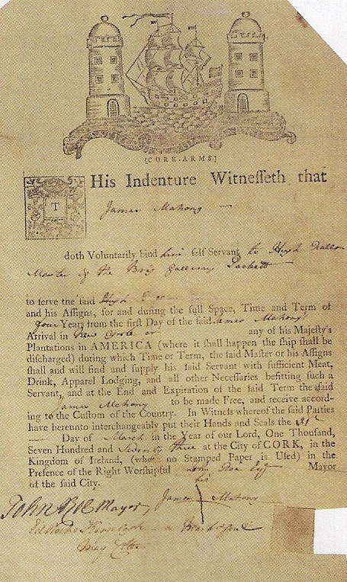
Indentured Servants
3 – 7 years of work
Not allowed to marry
1600 = 1,500 – 2,000 arrived in Virginia
Mostly men
Some women, Irish families, & American orphans

Slide 7
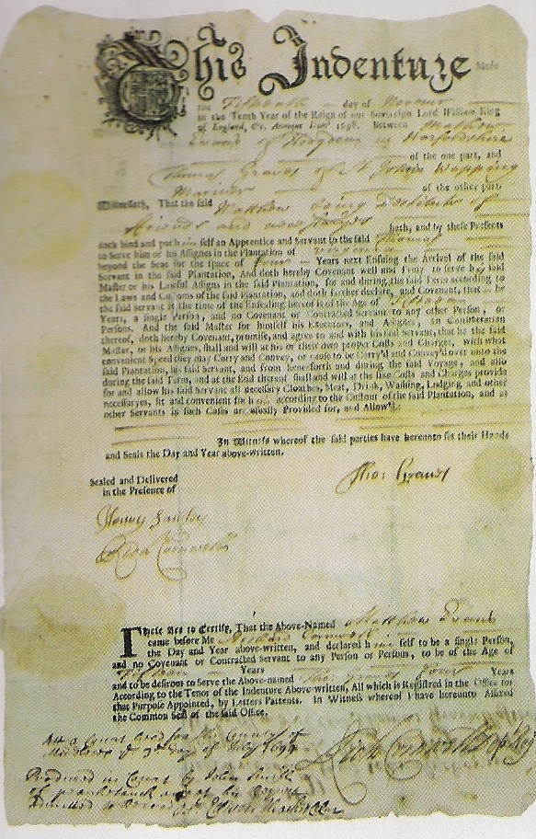
Convict Labor
50,000 convicts arrived after 1718
Most went to the Chesapeake & Georgia
Property crime
Did not receive benefits after servitude

