Slide 1
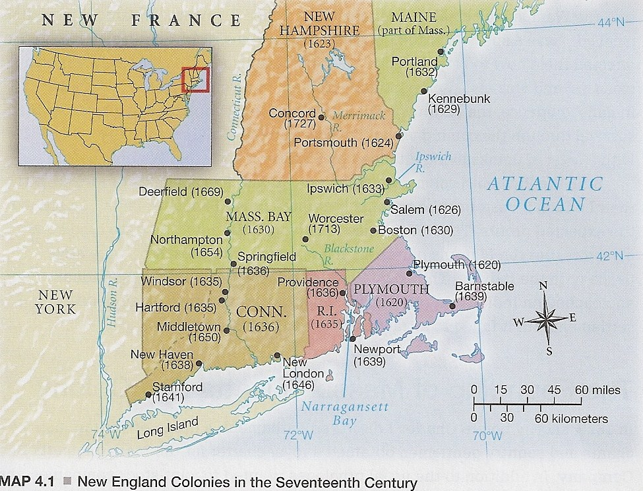
New England

Slide 2
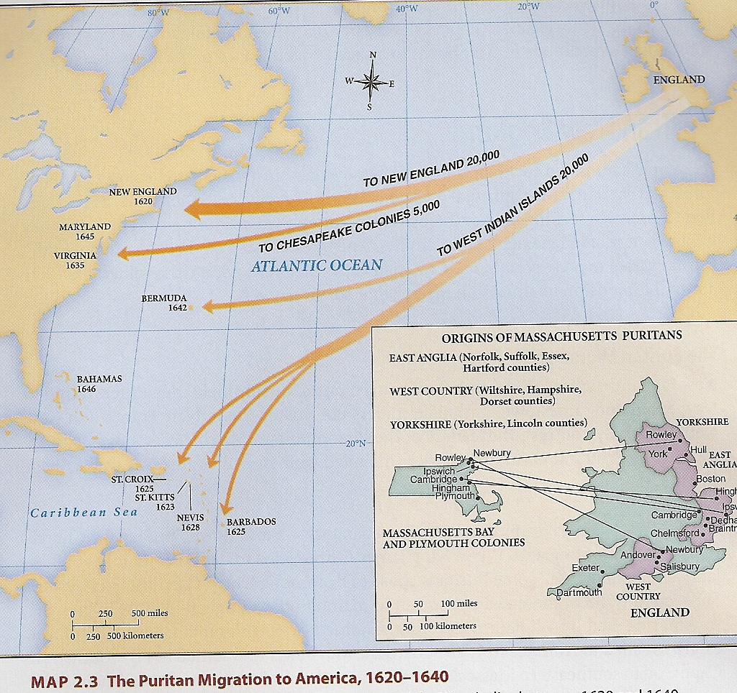
Early New England
Virginia Company of Plymouth
1608 = Separatists/Pilgrims fled to the Netherlands
Puritans & Separatists wanted to settle in North America

Slide 3
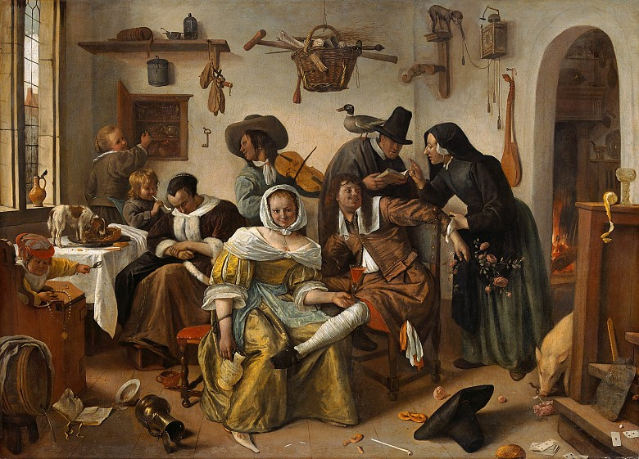
Topsy Turvy World by Jan Steen, 1663

Slide 4
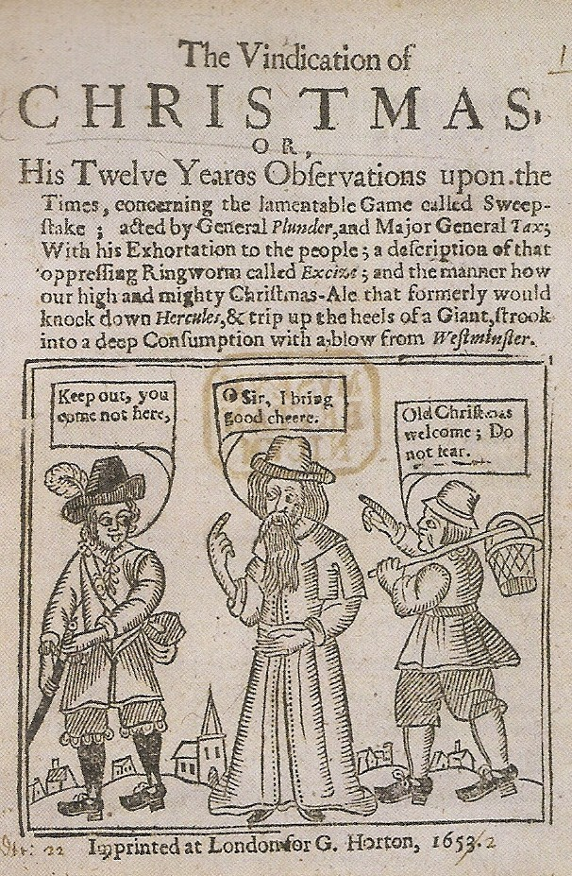
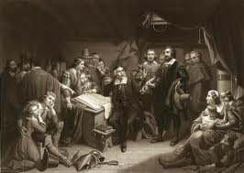
Pilgrims/Separatists
1620 = On Mayflower, 35 Pilgrims, 67 non-Pilgrims sailed from England to Virginia
Landed on Cape Cod, Massachusetts
1620 = Mayflower Compact written
½ of the colonists died before 1621

Slide 5


Slide 6
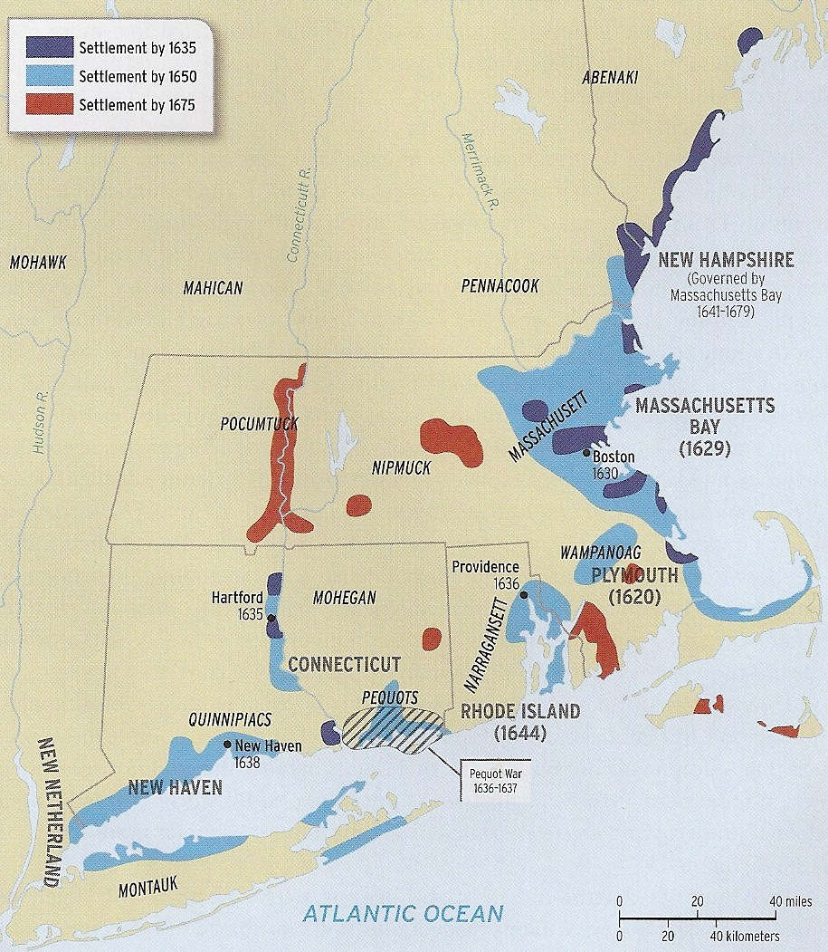
Massachusetts Bay Colony
John Winthrop, first Governor
Founded in 1630
“City upon a Hill” for Puritans

Slide 7
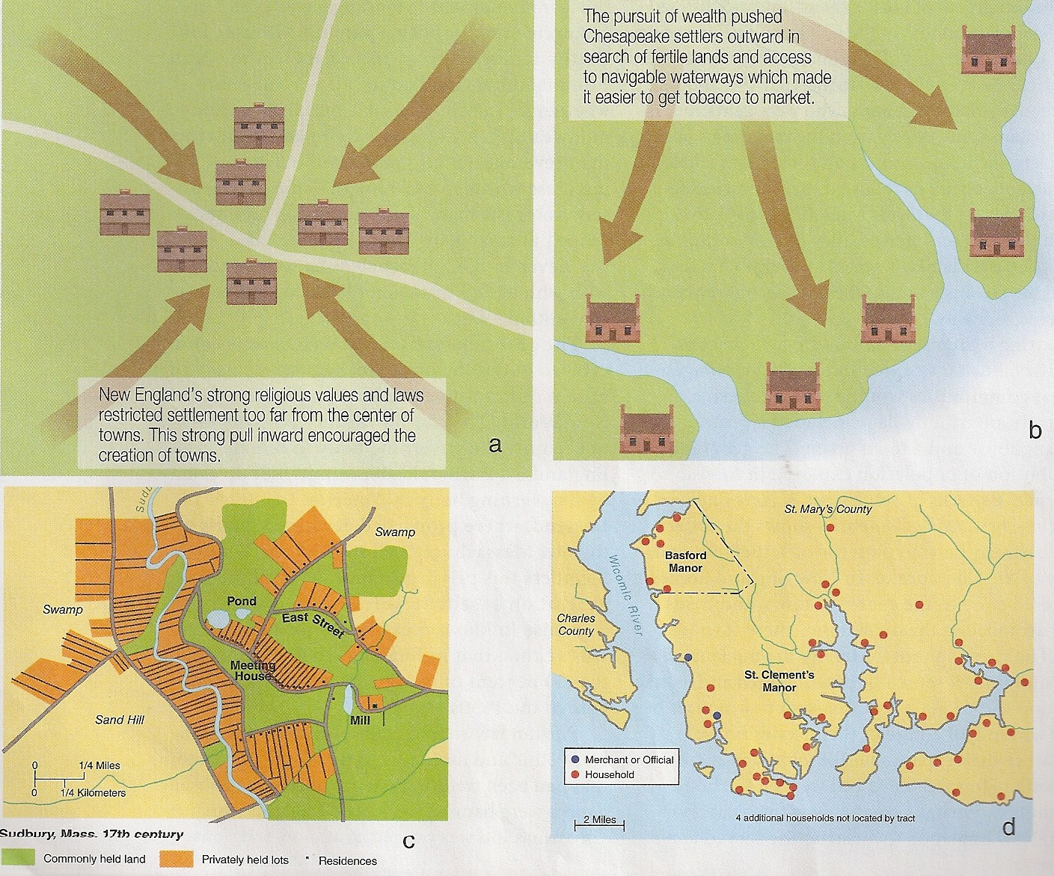
Towns centered around meeting
house
1630 = New England had 11 towns
1647 = 33 towns
1700 = 100 towns

Slide 8
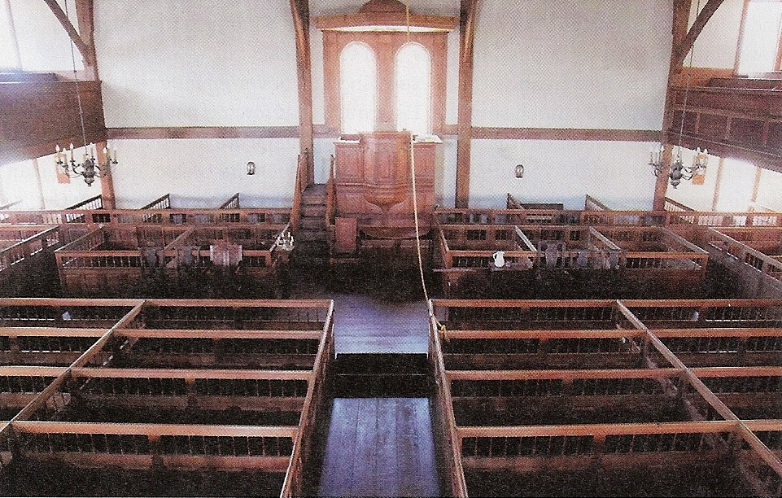
Puritan Meetinghouse
Sabbath Laws
Extensive prayer meetings

Slide 9
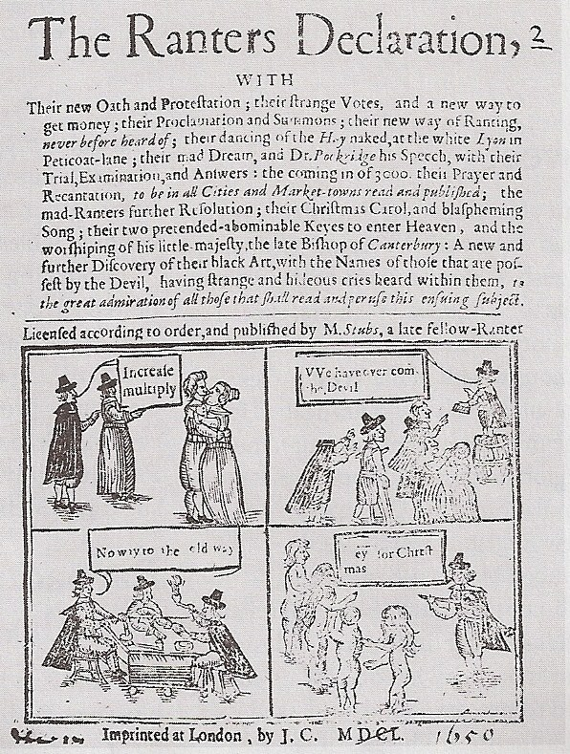
Puritan Family
Migrated to New England in families
5th Commandment extended to all superiors
1630s = 40% of New England’s male population could vote due to church member status

Slide 10
New England vs. Chesapeake
1600s = men lived to 65, women lived to 60
Almost equal # of men and women
Family performed labor
Encouraged sobriety
Eliminated Christmas
Men lived to 48, women lived to 44
Far more men than women
Indentured servants & slaves performed labor

Slide 11
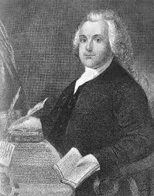
Challenges to Puritan Orthodoxy
1635 = Roger Williams, “A man godly and zealous, having many precious parts, but very unsettled in judgment”
Fled to Providence, Rhode Island in 1644

Slide 12
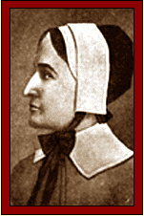
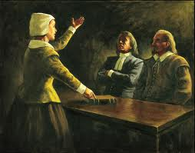
Anne Hutchinson
Covenant of Works vs. Covenant of Grace
Fan of Cotton Mather
Banished from Massachusetts & fled to Long Island

Slide 13
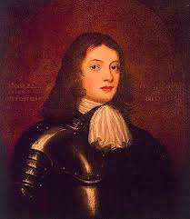
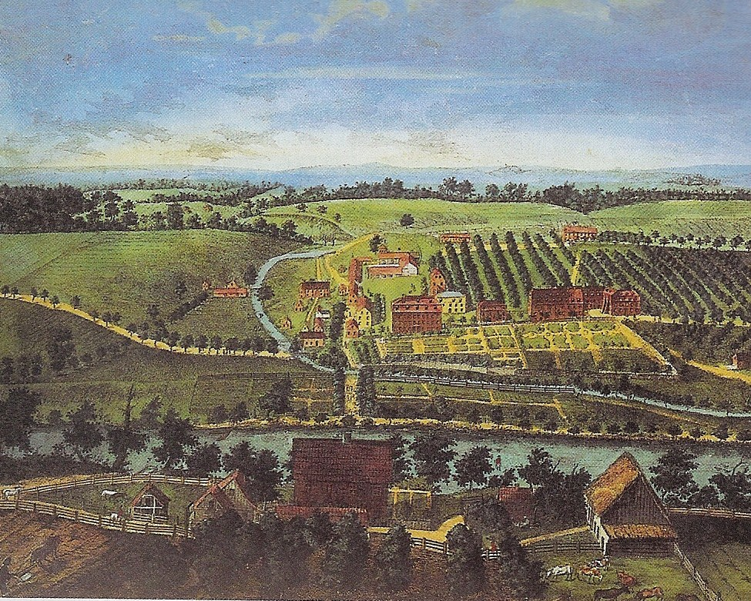
Quakers
William Penn wanted to create a religious refuge
Pennsylvania became a “holy experiment”
Bethlehem, Pennsylvania

