Slide 1
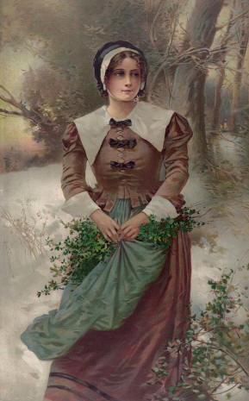
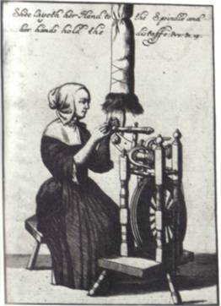
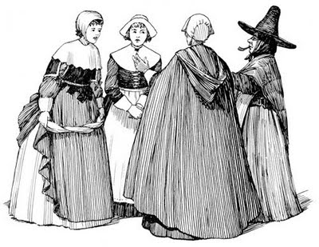
Women in 17th Century New England

Slide 2
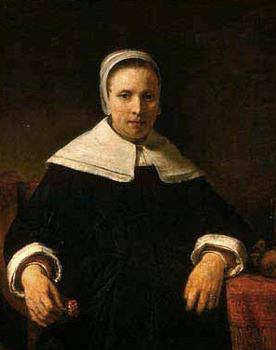
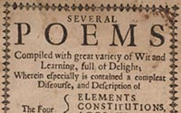
Puritan Women
Anne Bradstreet, 1612-1672
Average Puritan life except: 1st American poet
½ of Puritan women could not read, over ½ could not write

Slide 3
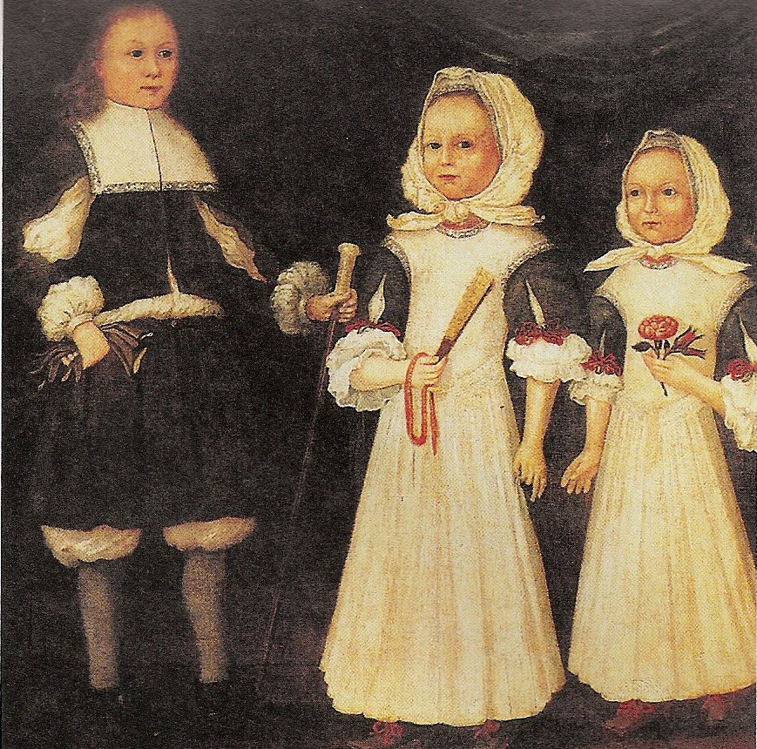
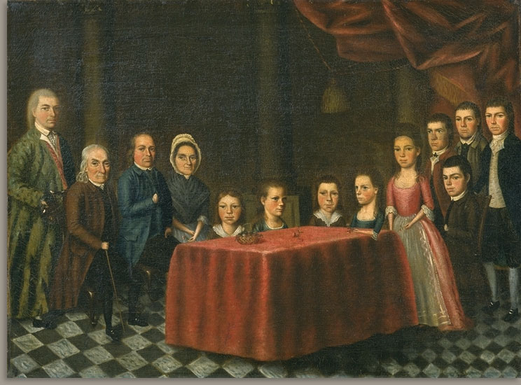
Puritan Marriage
Average age of bride: 24 -25
Large families encouraged
¼ - ½ of children died before reaching adulthood
1/5 of adult women died in childbirth
The Savage Family, 1779, by John Savage

Slide 4
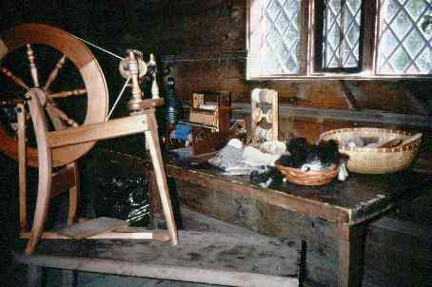
Households Labors for Puritan Women
Housecleaning
Cooking meals
Childcare
Mend clothes
Spin Wool
Churn Butter
Bake Bread
Preserve Food
Plant Vegetable Gardens
Make Soap, Wax Candles, & Brooms
Milk Cows
Feed Hens & Cows
And….teach daughters how to do all of the above

Slide 5
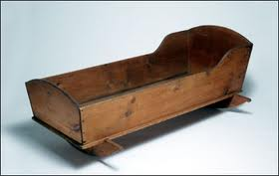
Femme Covert v. Femme Sole
Femme Sole: Single, divorced, or widowed woman who could sue, own land, enter business contracts
Femme Covert: Married woman with virtually no legal rights, her identity “covered” under her husband’s
Pre-nuptial agreement rare but possible
18th Century Oak Baby Cradle

Slide 6
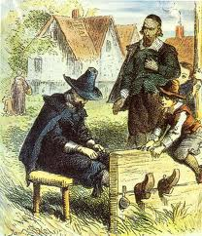
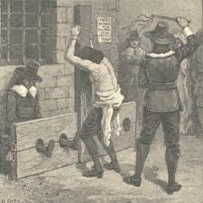
Divorce in New England
Women faced public humiliation & loss of child custody
Grounds for divorce: Adultery, desertion, long absence, failure to provide, bigamy, cruelty

Slide 7
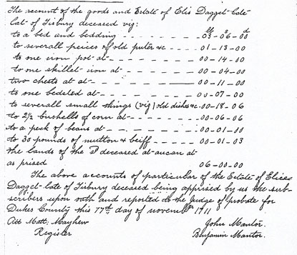
Rights of Widows in New England
Entitled to 1/3 of late husband’s estate
Could only control her inheritance as long as she did not remarry
Dependent upon adult male children for survival
Inventory of Ellis (Alice) Daggett, 1705

Slide 8
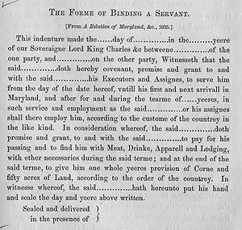
Female Indentured Servants
Women 18 -25 years old
1/3 of colonial households had indentured servants
1 year of extra time added for pregnancy

Slide 9
Importing Women
140 single women imported between 1620 – 1622
120 - 150 pounds of tobacco to “buy” a wife
Carolina’s advertisement: “If any Maid or single Woman have a desire to go over, they will think themselves in the Golden Age, when Men paid a Dowry for their Wives; for if they be but civil, and under 50 years of Age, some honest Man or other, will purchase them for their Wives.”

Slide 10
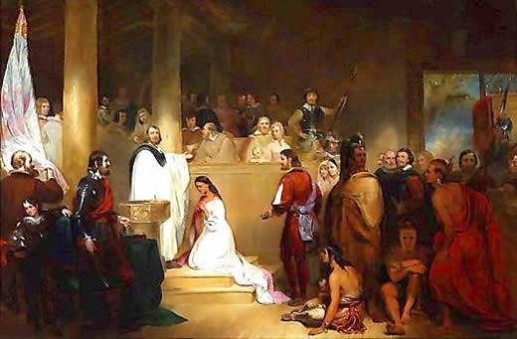
Interracial Marriage in the Colonies
Higher rates of interracial marriage in New France
1661: Maryland banned interracial marriage
1691: Virginia
1705-1750: Pennsylvania, Massachusetts, Delaware, & all of the South
The Baptism of Pocahontas by John Chapman, 1837

Slide 11
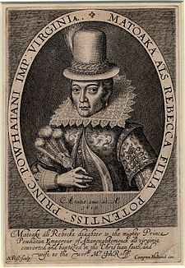
Pocahontas & John Rolfe
Daughter of Chief Powhatan
Assisted settlers at Jamestown
Died around 18 years old in 1616

Slide 12


