Slide 1
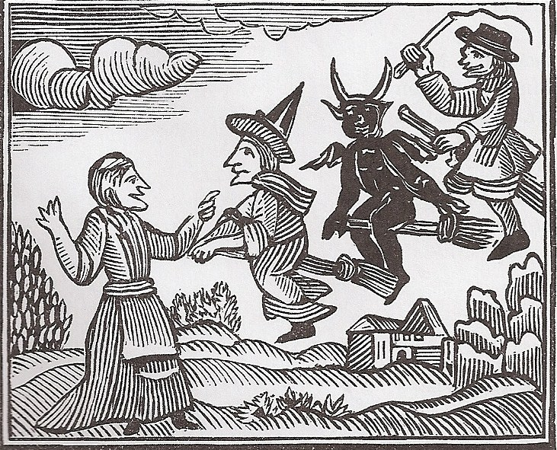
Salem Witch Trials

Slide 2
What Happened?
10 months in 1692
Betty Parris & Abigail Williams “bitten and pinched by invisible agents; their arms, necks, and backs turned this way and that way, and returned back again…beyond the power of any Epileptick Fits, or natural Disease to effect.”

Slide 3
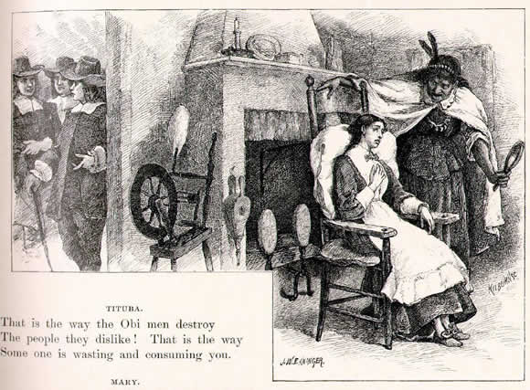
Finding a Cause
Neighbor Mary Sibley & Indian slave Tituba baked a “witch’s cake” & fed it to a dog
February 29, 1692 = 3 suspects arrested for witchcraft in Salem

Slide 4
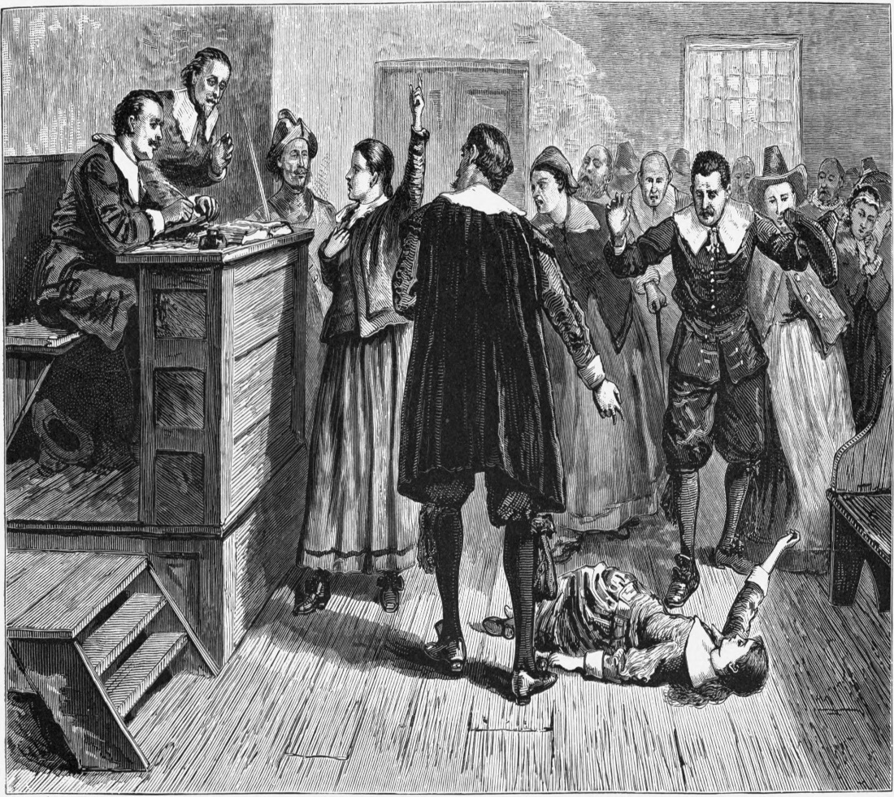
Who Was Accused?
Unpopular Sarah Good, Sarah Osbourne, & Indian slave Tituba
By April 1692, the girls had named prominent church women & a former male minister

Slide 5
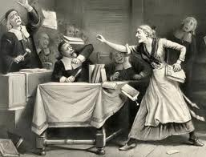
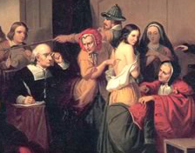
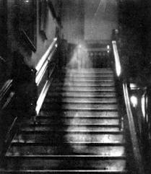
What About Proof?
Physical evidence like voodoo dolls
“Witch’s Teat”
Spectral Evidence

Slide 6
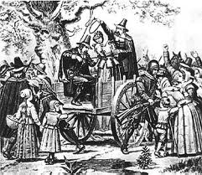
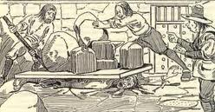
Witch’s Hill
June 1692 = 1st accused witch executed
Peine fort et dure
Accused witches who confessed & named others were not executed
September 1692 = 100 accused witches in jail

Slide 7
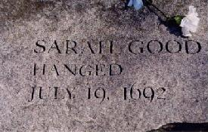
Pressure to Stop
Ministers of Salem spoke out against spectral evidence
In Salem = 20 accused witches executed
In Early Modern Europe =
40,000 – 60,000 accused
witches executed

Slide 8
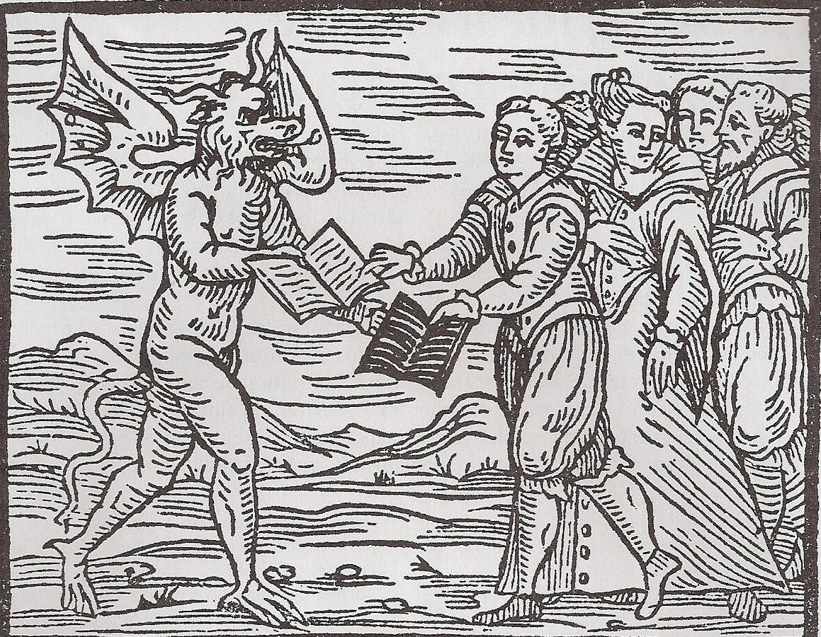
Invisible World of Salem
Puritans believed spirits and Satan were present around them
Satanic contracts
“Cunning Folk”
Conversion hysteria

Slide 9
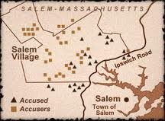
Visible World of Salem
East Salem vs. West Salem
Salem Town vs. Salem Village
Femme Soles & assertive Femme Coverts targeted

Slide 10

Latest Theories

