Slide 1
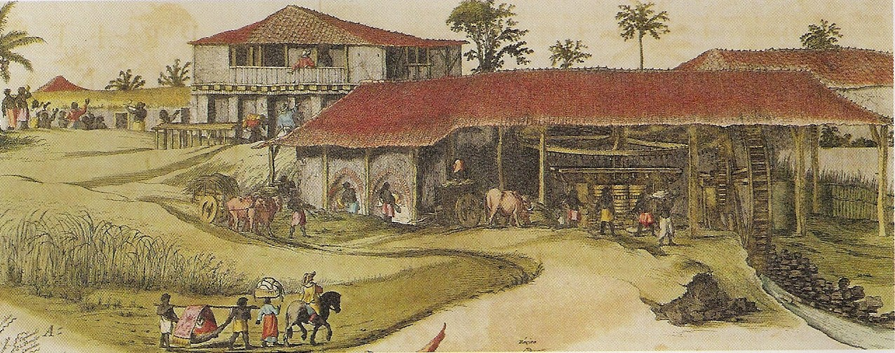
Slavery in America
Sugar Plantation in the Caribbean

Slide 2
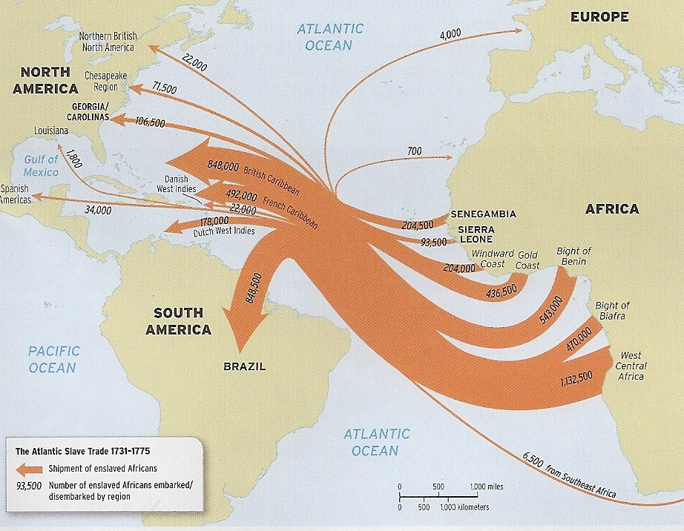
The Atlantic Slave Trade

Slide 3
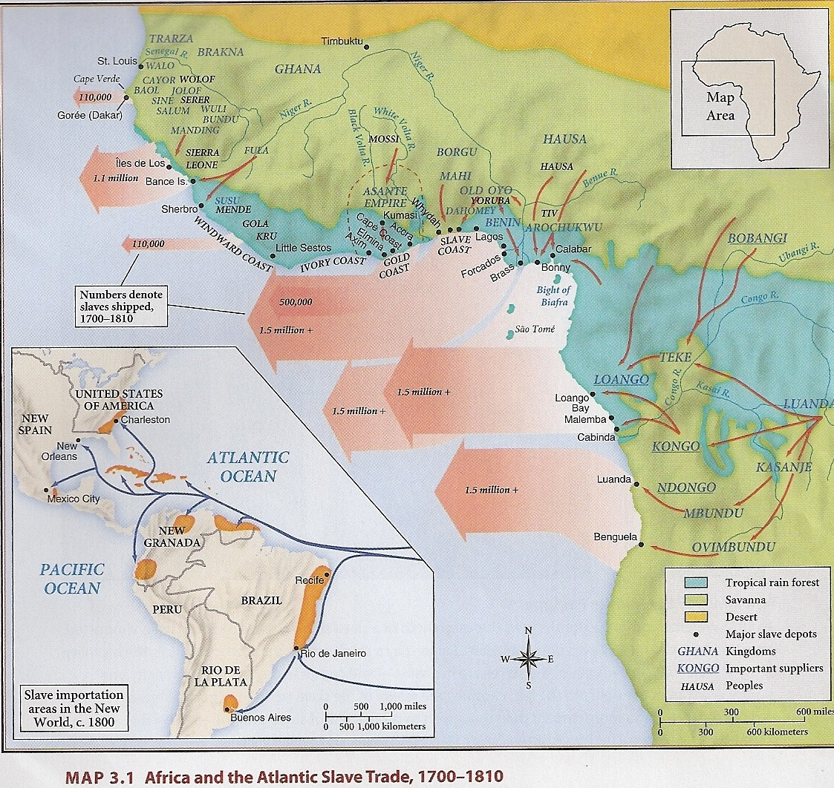
Where in Africa?
“Slave Coast”: Bight of Benin, Congo, Angola, Mozambique, Nigeria
Over 800 languages spoken within Africa

Slide 4
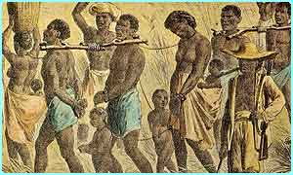
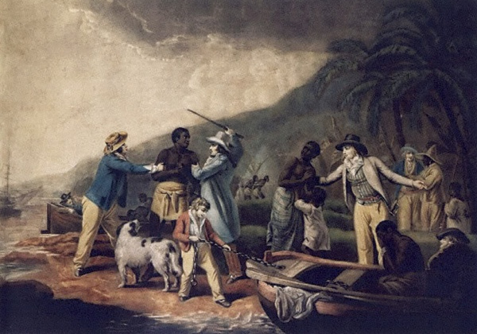
African Slavery
Slaves of rival tribes captured through war
Slavery was not always permanent nor hereditary
Europeans controlled slave trade after 1600

Slide 5
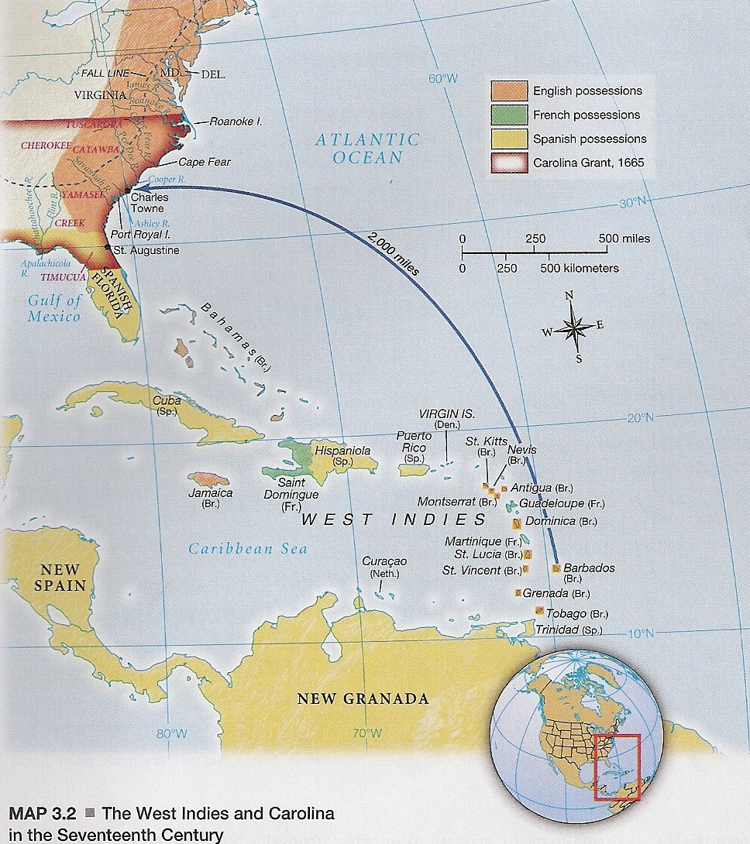
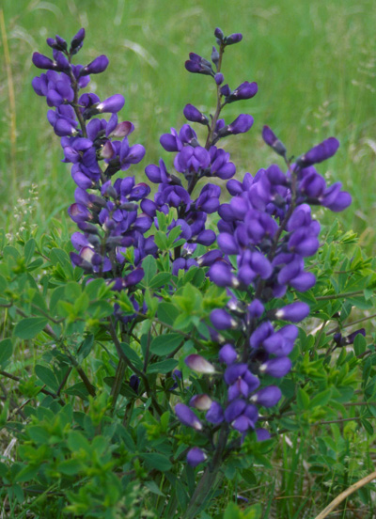
The Carolinas
Many residents came from Barbados
Charleston, South Carolina
1720 = 2/3 population of South Carolina were African or African American
Rice and Indigo

Slide 6
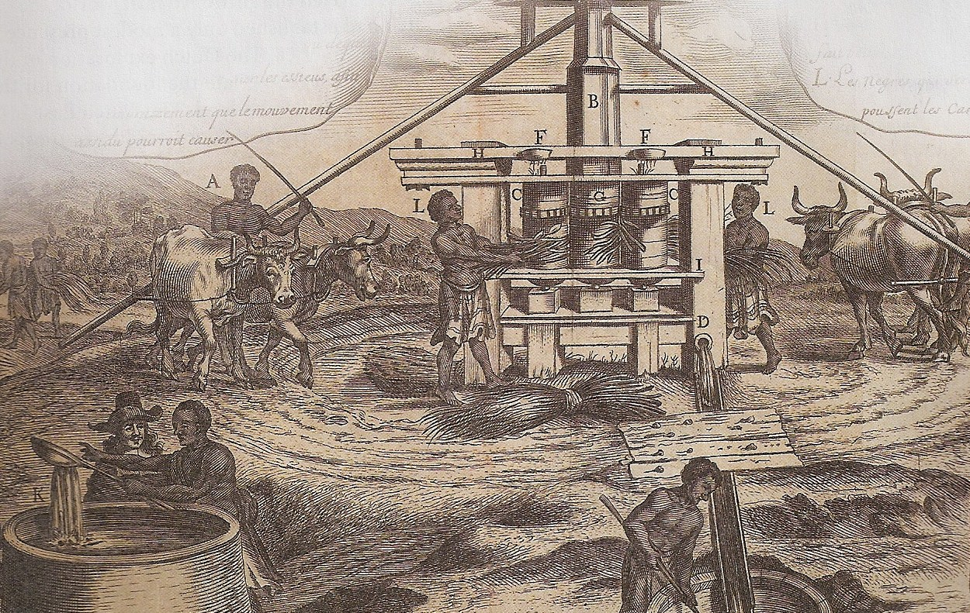
Slavery & the Caribbean
Mid-1600s = 44,000 English lived in Caribbean
Barbados & Jamaica = Key sugar producing islands
Sugar in England used for food, medicine, & to display wealth
Absentee owners
1713 = Barbados population ratio: 4 slaves to every 1 white settler

Slide 7
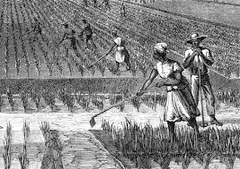
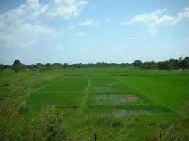
Southern Slavery
1690s = Rice cultivation began
Who brought the knowledge about rice?
1698 = 10,000 pounds of rice exported from South Carolina
1730 = 20 million pounds exported from South Carolina

Slide 8
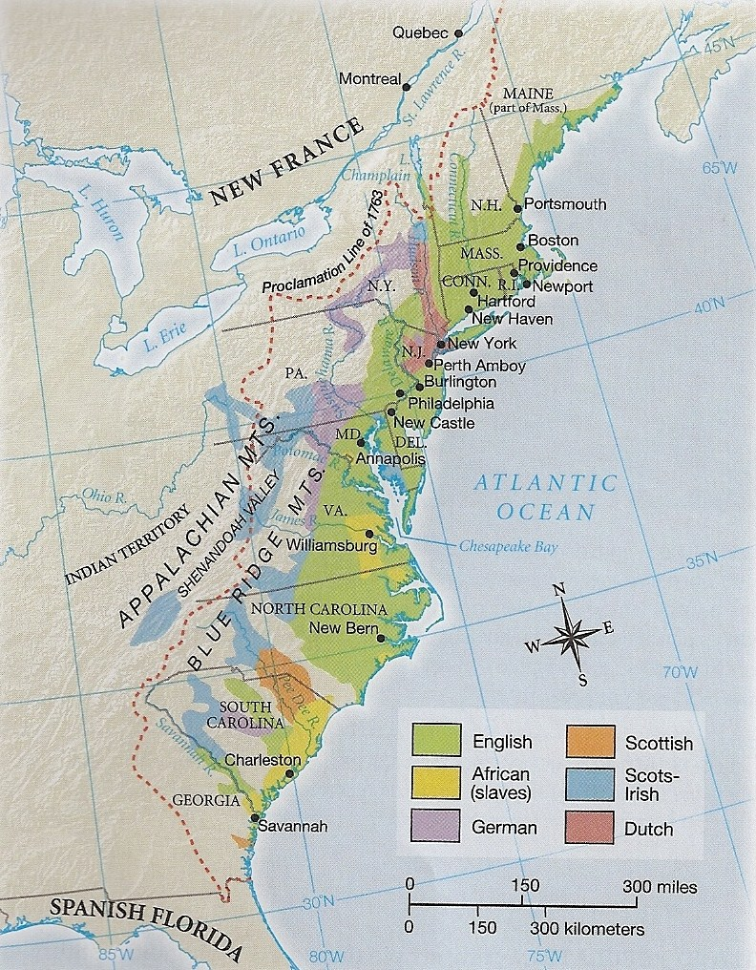
Georgia
Experiment to reform criminals
1732 = James Oglethorpe started colony
1732 - 1738 = Banned slavery and rum

Slide 9
Forms of Slave Resistance
Violence
Feigning Illness
Breaking Tools
Injuring Livestock
Poisoning Master’s Food
Burning Barns
Running Away
Syncretic Religious Beliefs
Child Naming

Slide 10
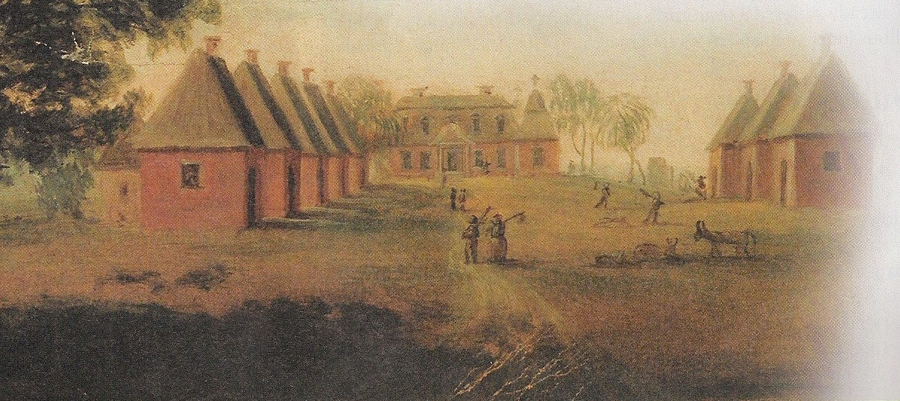
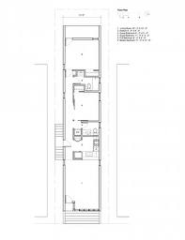
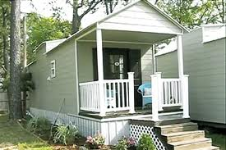
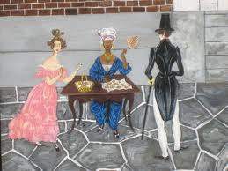
Everyday Resistance
Cone-shaped thatched roof huts & shotgun shacks
“Dressing your station”

Slide 11
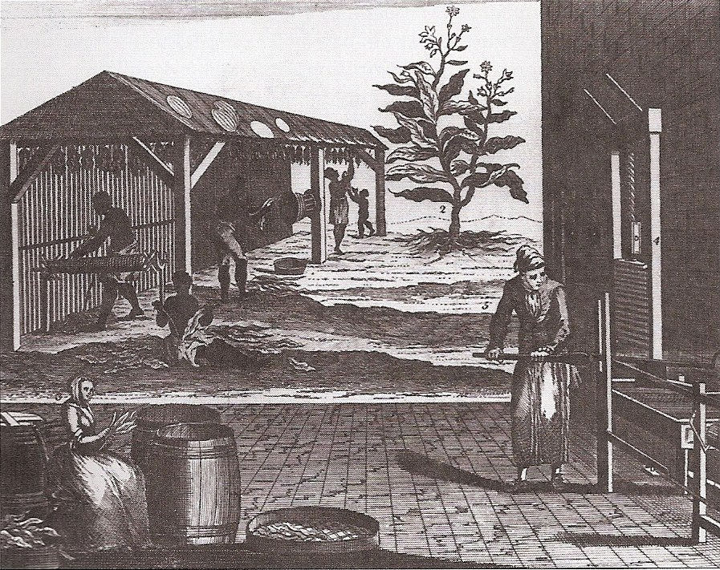
Forms of Slavery
3 types of slaves: skilled workers, house workers, and field hands

Slide 12
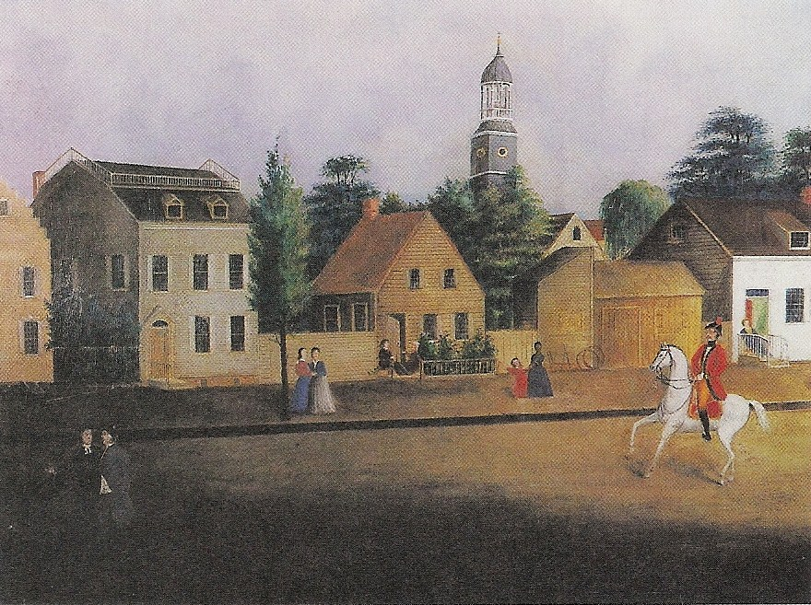
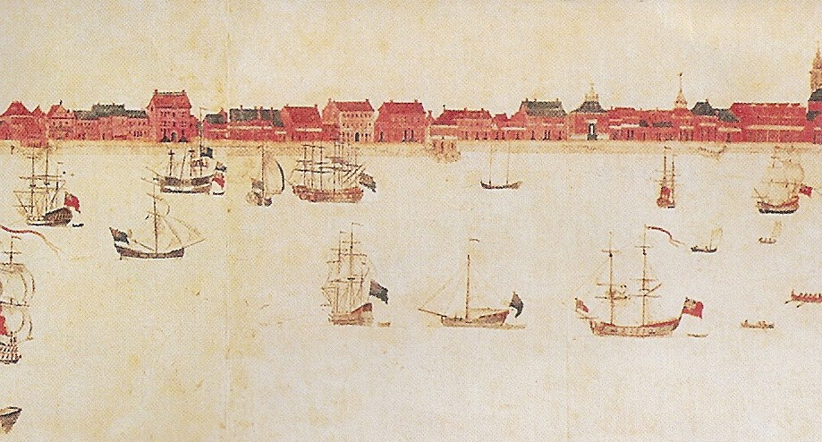
Slavery in the North
New York & New Jersey = slave populations of
15% - 30%
Shipyards, small farms, and domestic slave labor
Philadelphia, Boston, New York had substantial free black communities
Northern & Southern slave codes

Slide 13
Slave Codes
1632 = Bermuda created first British colonial slave codes
1682 = Virginia developed first North American slave codes
Slaves legally defined as “chattel”
Slaves not allowed to trade, read, own weapons, meet in groups, leave plantations without a pass, or defend themselves

Slide 14
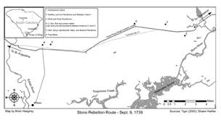
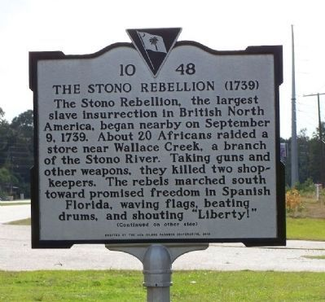
The Stono Rebellion
1739 = South Carolina slave rebellion led by former Angola soldiers
44 slaves and 21 whites killed
Over 100 slaves marched south to Florida

Slide 15

From the PBS documentary Slavery & the Making of America

