Slide 1
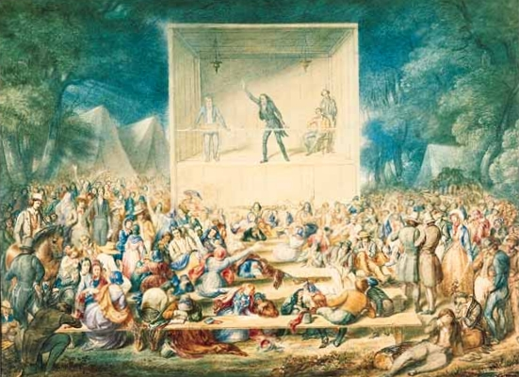
The Great Awakening

Slide 2
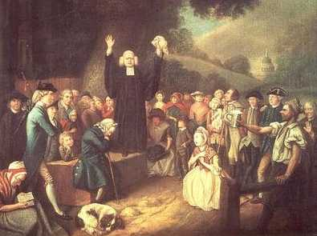
What was it?
1740 -1770 = 1,200 new churches across colonies
Presbyterian, Baptists, Methodists, & other denominations
Highly emotional outdoor revival events
“Conversion”

Slide 3
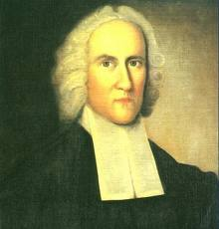
Jonathan Edwards
“The God that holds you over the pit of hell, much as one holds a spider, or some loathsome insect, looks over the fire; he looks upon you as worthy of nothing else, but to be cast into the fire.”

Slide 4
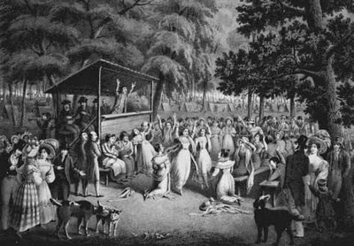
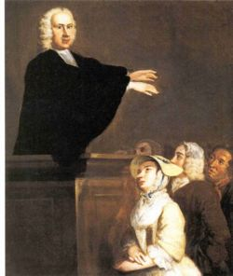
New Colleges Across the Colonies
1750s & 1760s = Colleges founded to train ministers
Princeton, Brown University, Rutgers, Dartmouth
George Whitfield

Slide 5
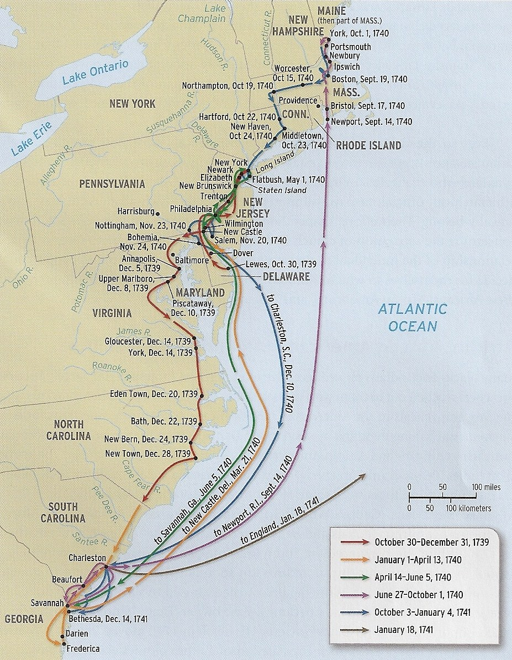
George Whitfield
1739 -1740 = itinerant British minister tours the American colonies
Criticized as a “peddler of divinity”

Slide 6
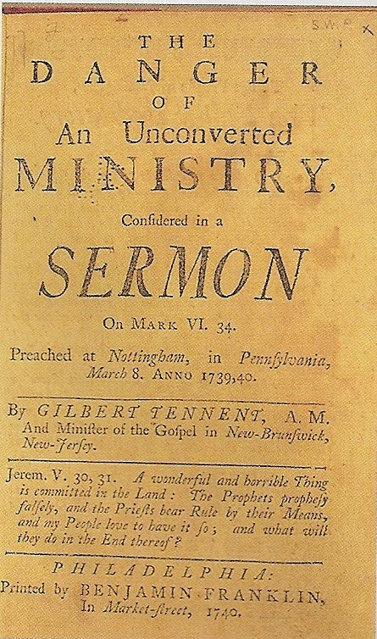
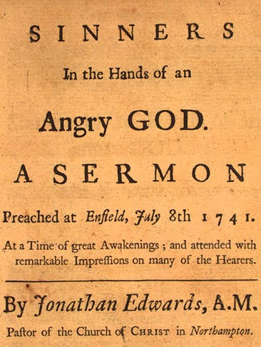
How did the Great Awakening change American society?
Less hierarchy within the church and society
Northern and Southern colonies connected for the first time
Old Lights vs. New Lights

