Slide 1
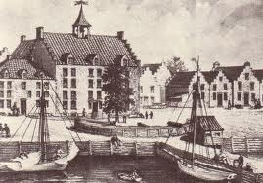
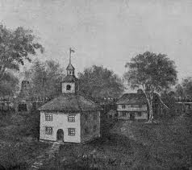
Life in a Colonial Town

Slide 2
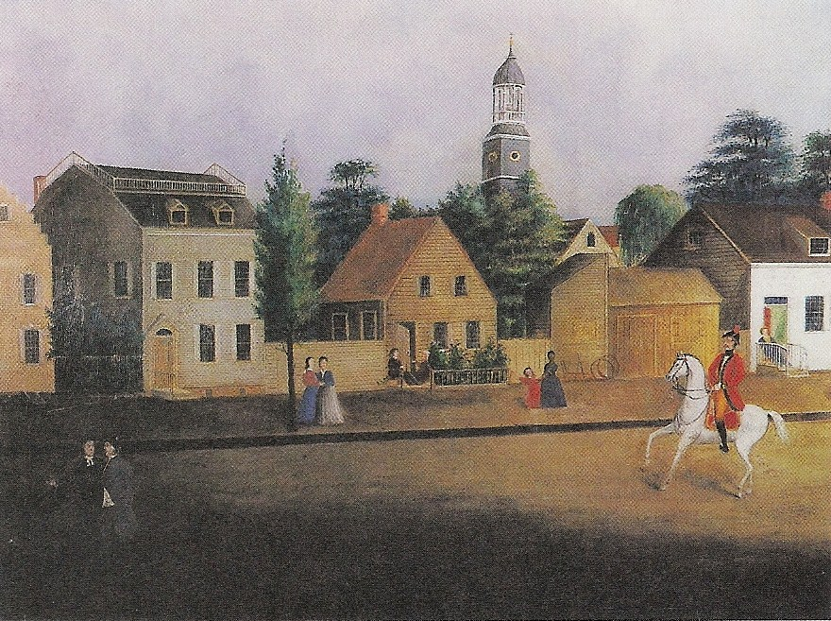
5 Major Colonial Towns
Boston
Philadelphia
New York
Newport, Rhode Island
Charleston, South Carolina
John Street, New York City, 1787

Slide 3
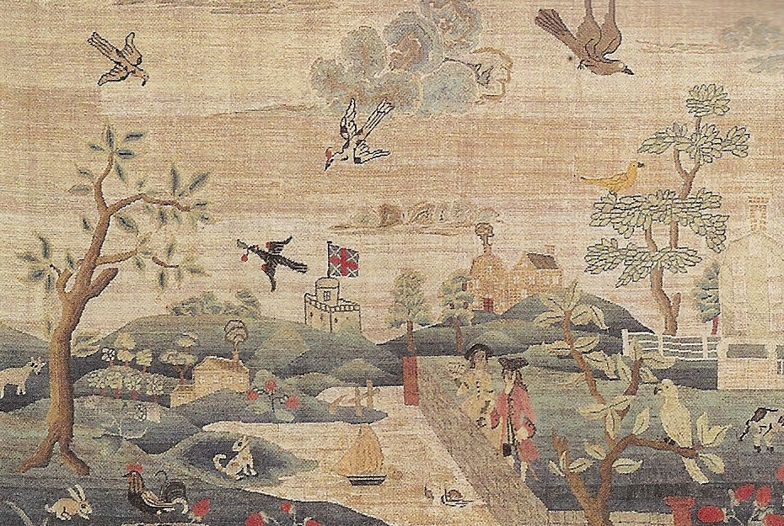
Problems Faced by Colonial Towns
Trash in the streets
Sewage
Poor lighting at night
Boston Commons

Slide 4
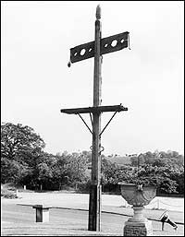
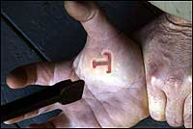
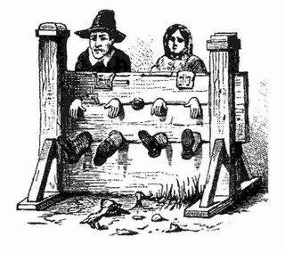
Public Humiliation as Punishment
Whipping
Stocks & Pillory
Wearing a Letter on Clothing
Branded with letter

Slide 5
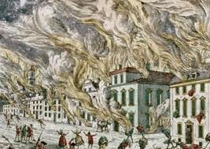
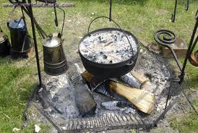
Fire in Colonial Towns
Boston’s first fire engine

Slide 6
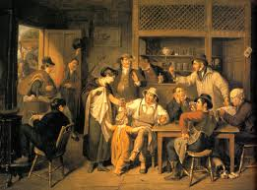
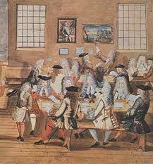
Entertainment in the Colonial Era
Taverns
Coffee houses

Slide 7
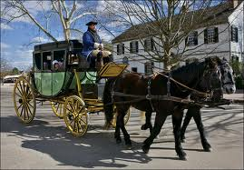
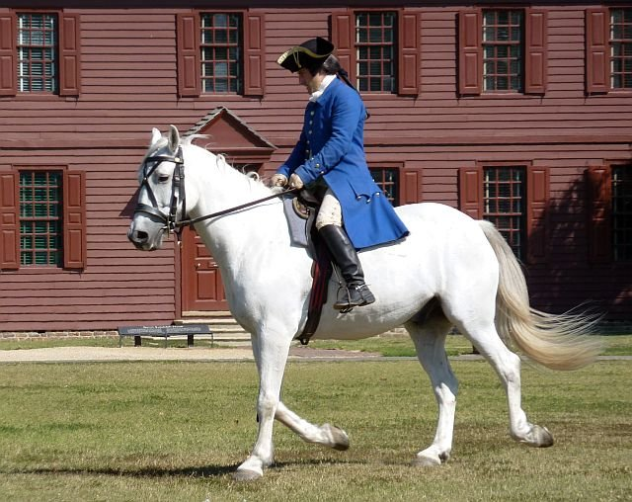
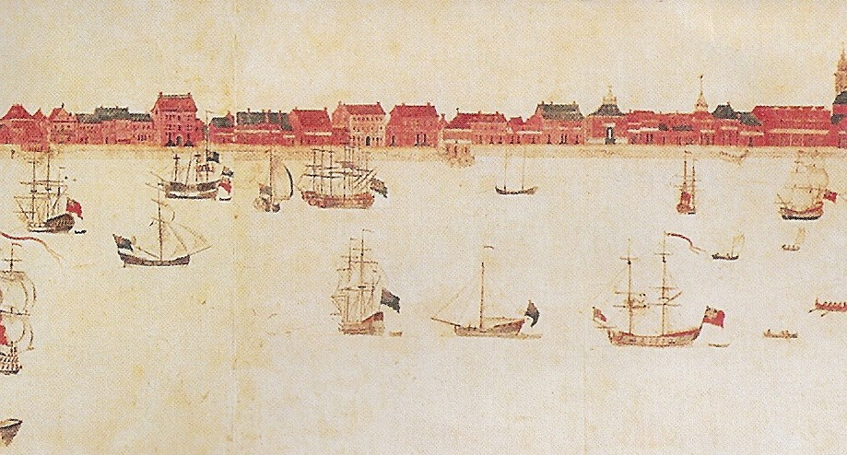
Transportation
Stagecoaches
Post riders

Slide 8
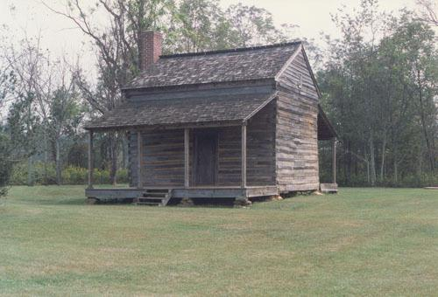
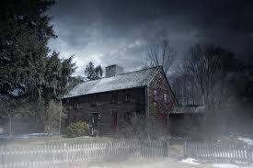
Colonial Era Homes
“Salt Box,” 1 or 2 room houses
Wooden homes

Slide 9
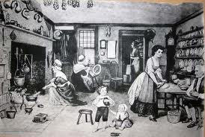
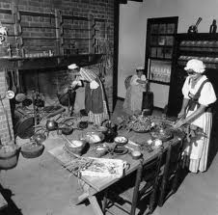
Kitchens
Cauldrons & Heavy Iron Kettles

Slide 10
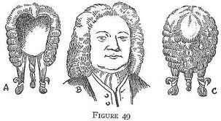
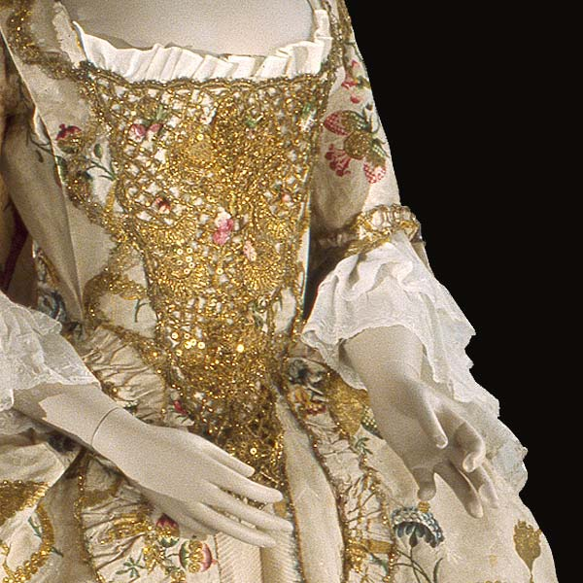
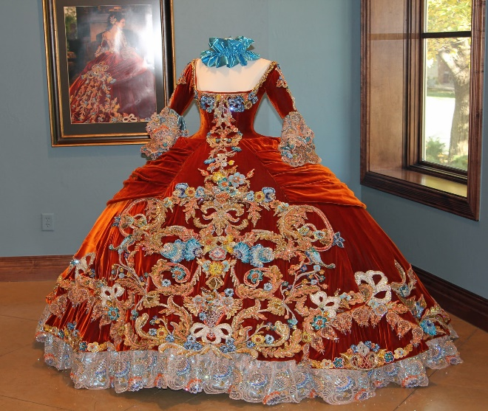
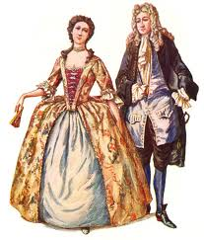
Wigs & Clothing
Silks, satins, velvets, lace
Wigs made of human hair & horse hair

