Slide 1
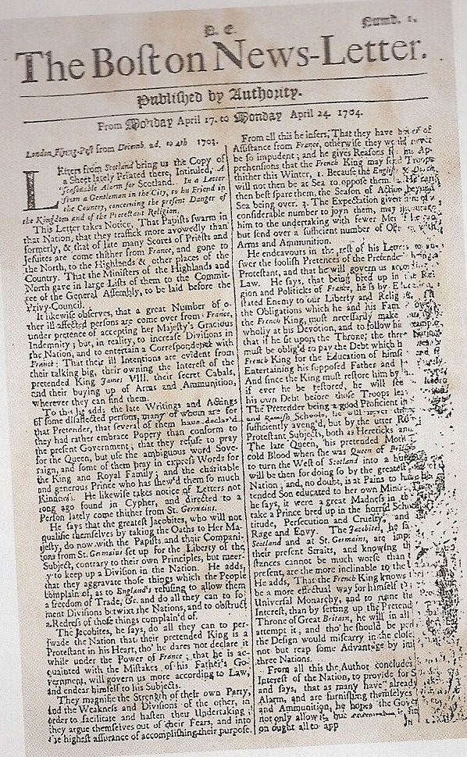
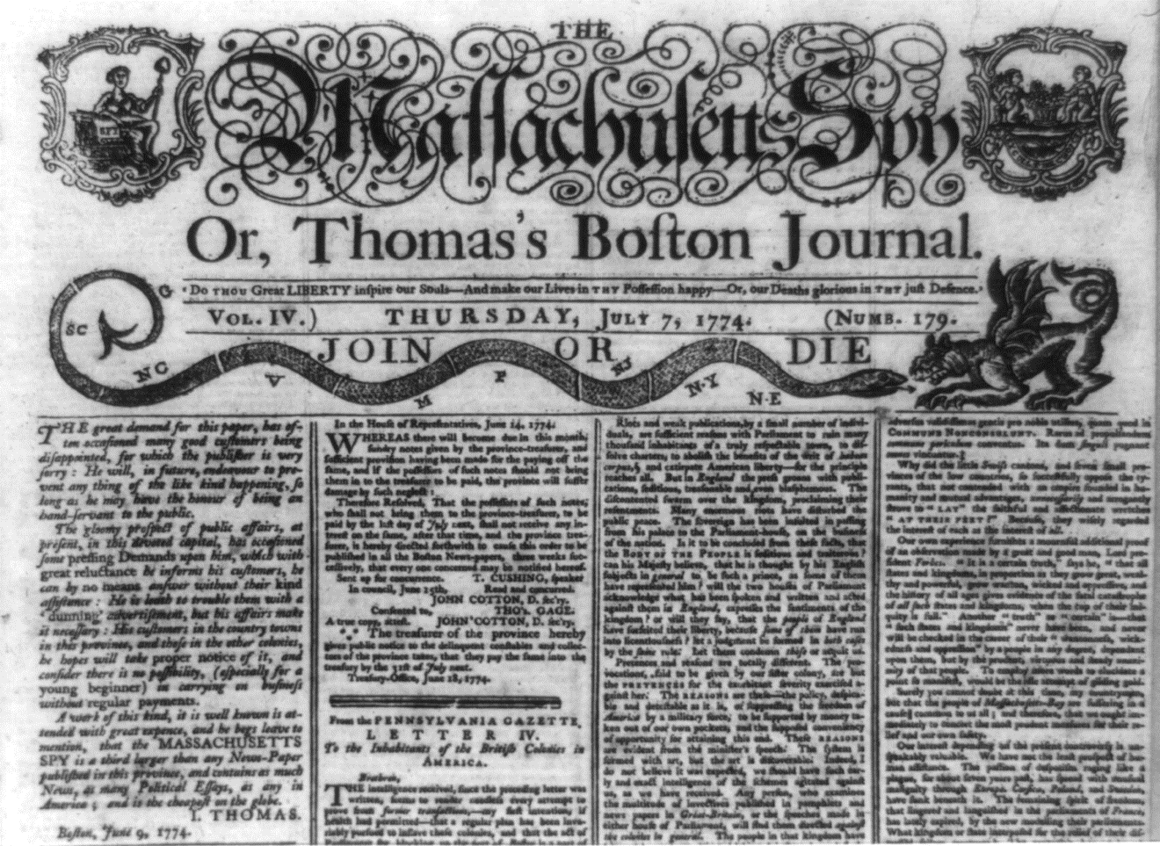
Education & Literacy in the Colonies

Slide 2
Language & Literacy
New “American” language words: buffalo, corn, robin, bluebird, groundhog, catfish, bullfrog, eggplant, sleigh, yacht, boss, dollar, pretzel, chowder, prairie
New slang words = handy, chunky, fall
Americans wrote promotional books, history, & poetry

Slide 3
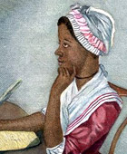
Phyllis Wheatley
Brought to Boston as a slave in 1761
Granted freedom in 1763
Wrote poems on religious morals and other subjects
Died in childbirth in 1784

Slide 4
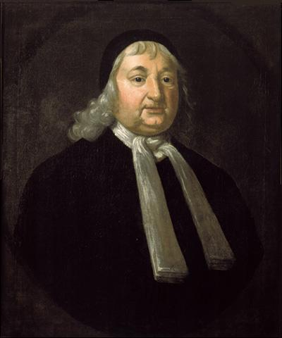
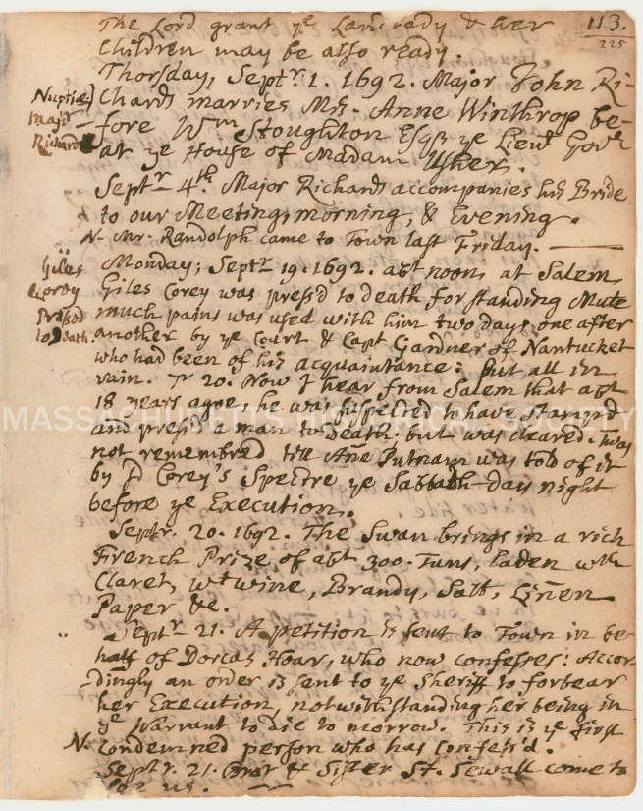
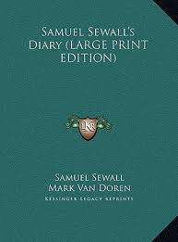
Diaries
Samuel Sewall = Boston merchant wrote diary from 1674 – 1729

Slide 5
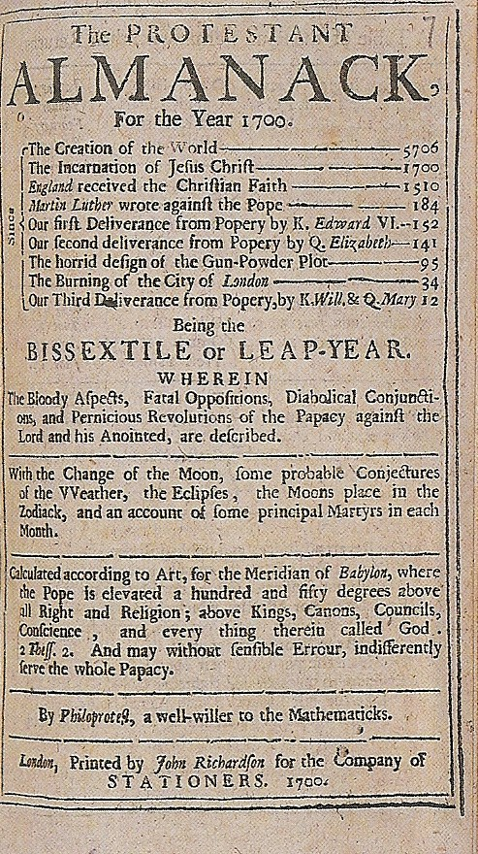
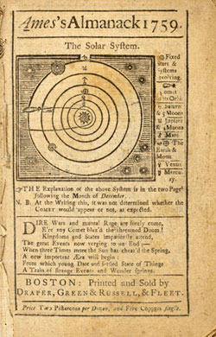
Other Books
Almanacs first printed in 1639
1700s = only the Bible sold more copies than Almanacs

Slide 6
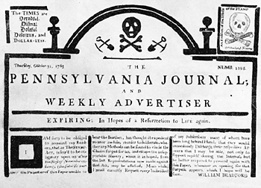
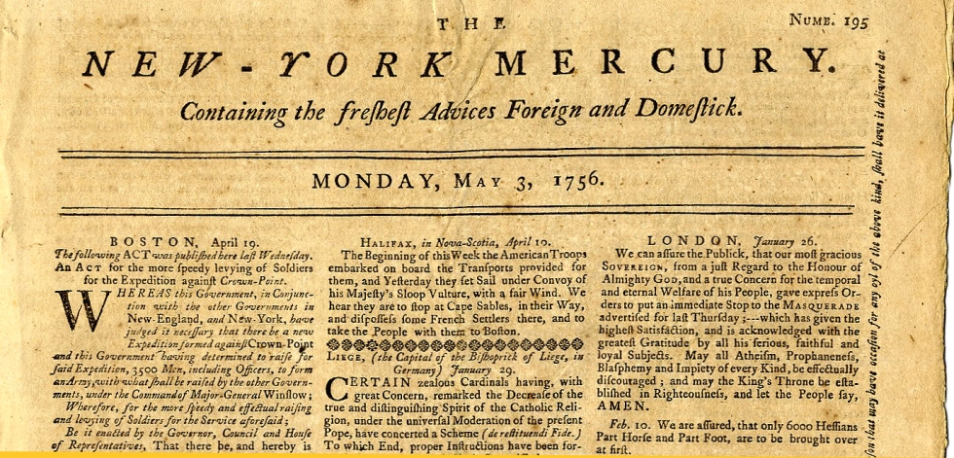
Newspapers & Magazines
1739 = Newspapers in Philadelphia, New York, Newport, Annapolis, Williamsburg, Charleston, Boston
1776 = 37 newspapers across colonies
4 pages printed weekly

Slide 7
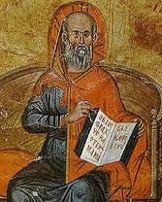
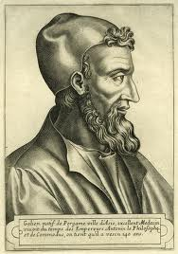
Medicine
Hippocrates & Galen = 4 humors & 4 elements out of balance caused disease
Doctors self-taught & lacked regulation
No anesthesia
Indian and African remedies
1760s = 1st medical schools founded in Philadelphia, New York, and New Jersey

Slide 8
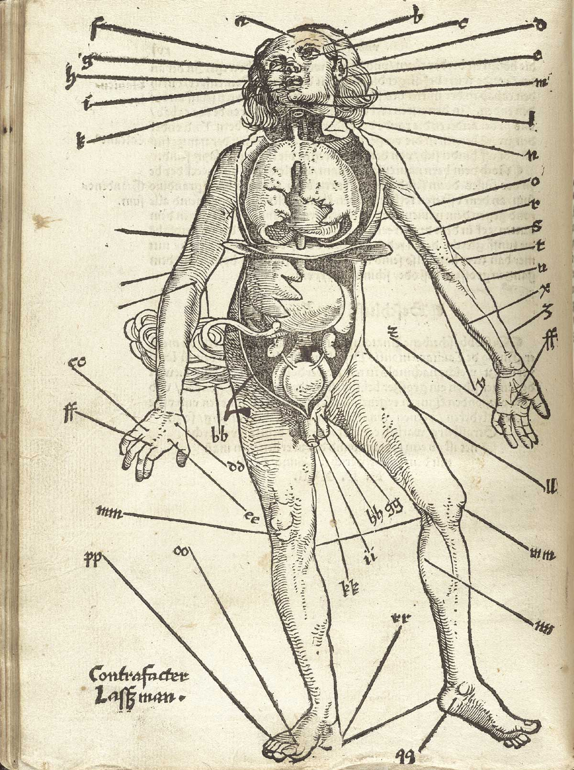
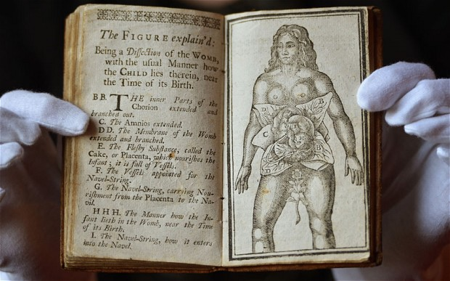
Medical Handbook
Aristotle’s Masterpiece
Bloodletting Instruction Chart

Slide 9
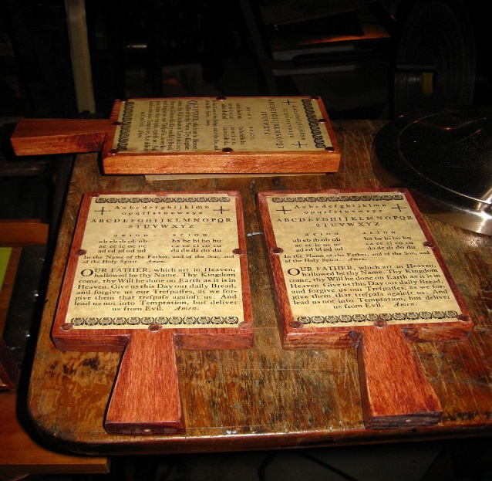
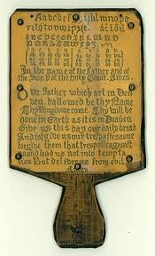
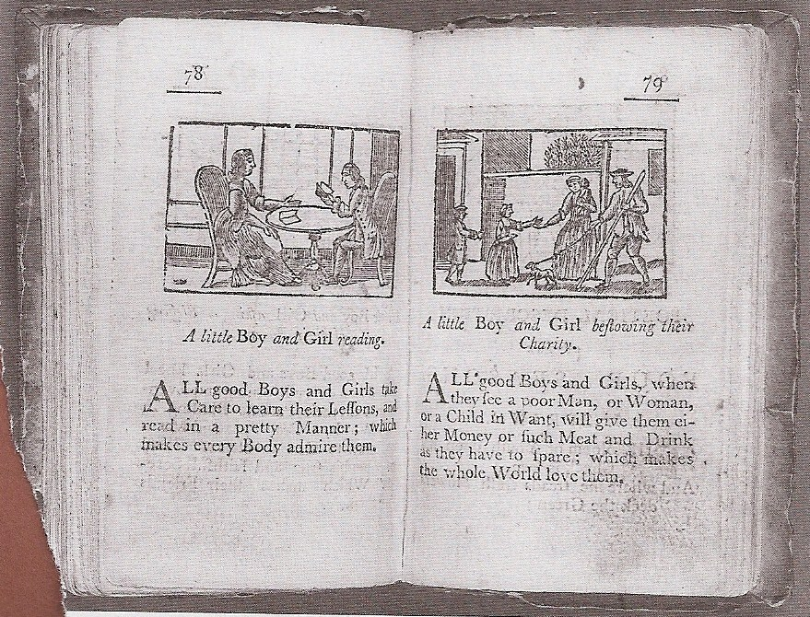
Education
Southern “Old Field Schools”
1640s = New England passed compulsory education laws
Girls limited to “Dame Schools”
A Little Pretty Pocketbook, 1787

Slide 10
1690 – The New England Primer
A – In Adam’s Fall
We Sinned All
I – The Idle Fool
Is Whipt at School
X – Xerxes the Great did Die
And So Must You and I
He Who Ne’er Learns His
A, B, C
Forever a Blockhead be;
But He Who Learns His Letters Fair
Shall have a Coach to take the Air

Slide 11
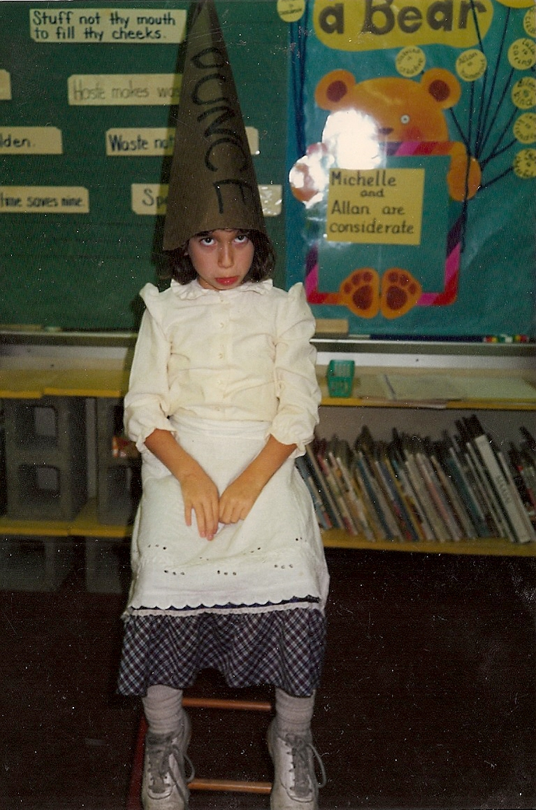
Classroom Discipline
“Spare the Rod and Spoil the Child”
Corporal punishment, dunce caps, wood in nostrils, balancing on 1-legged stool
“Steal Not This Book For If You Do, The Devil Will Be After You”

Slide 12
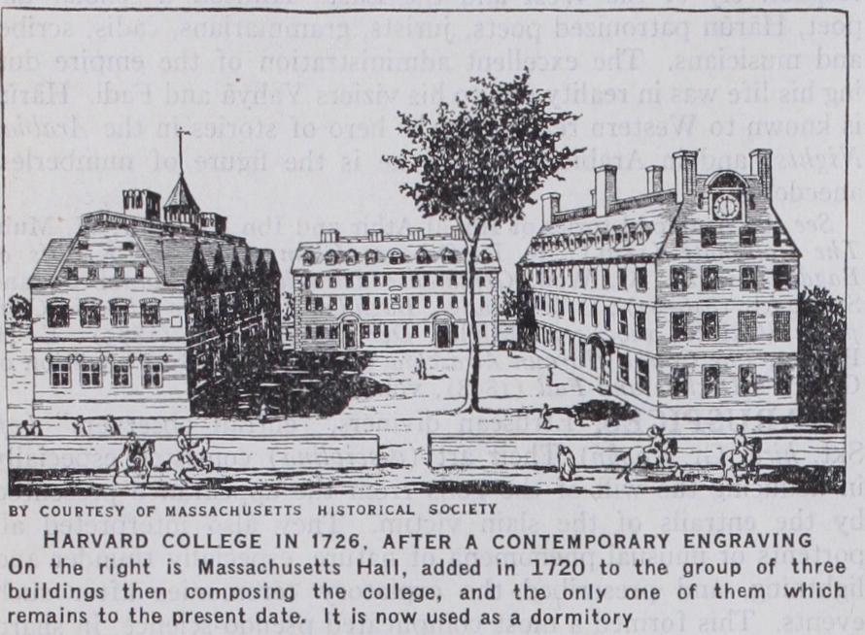
Higher Education
1638 = Harvard founded as a theological seminary
By 1700 = 600 students had attended, 1/3 of them had dropped
Most colleges had less than 100 students
1600s = Harvard tuition was 4 hogs per year
Scholarships & work exchange possible

