Slide 1
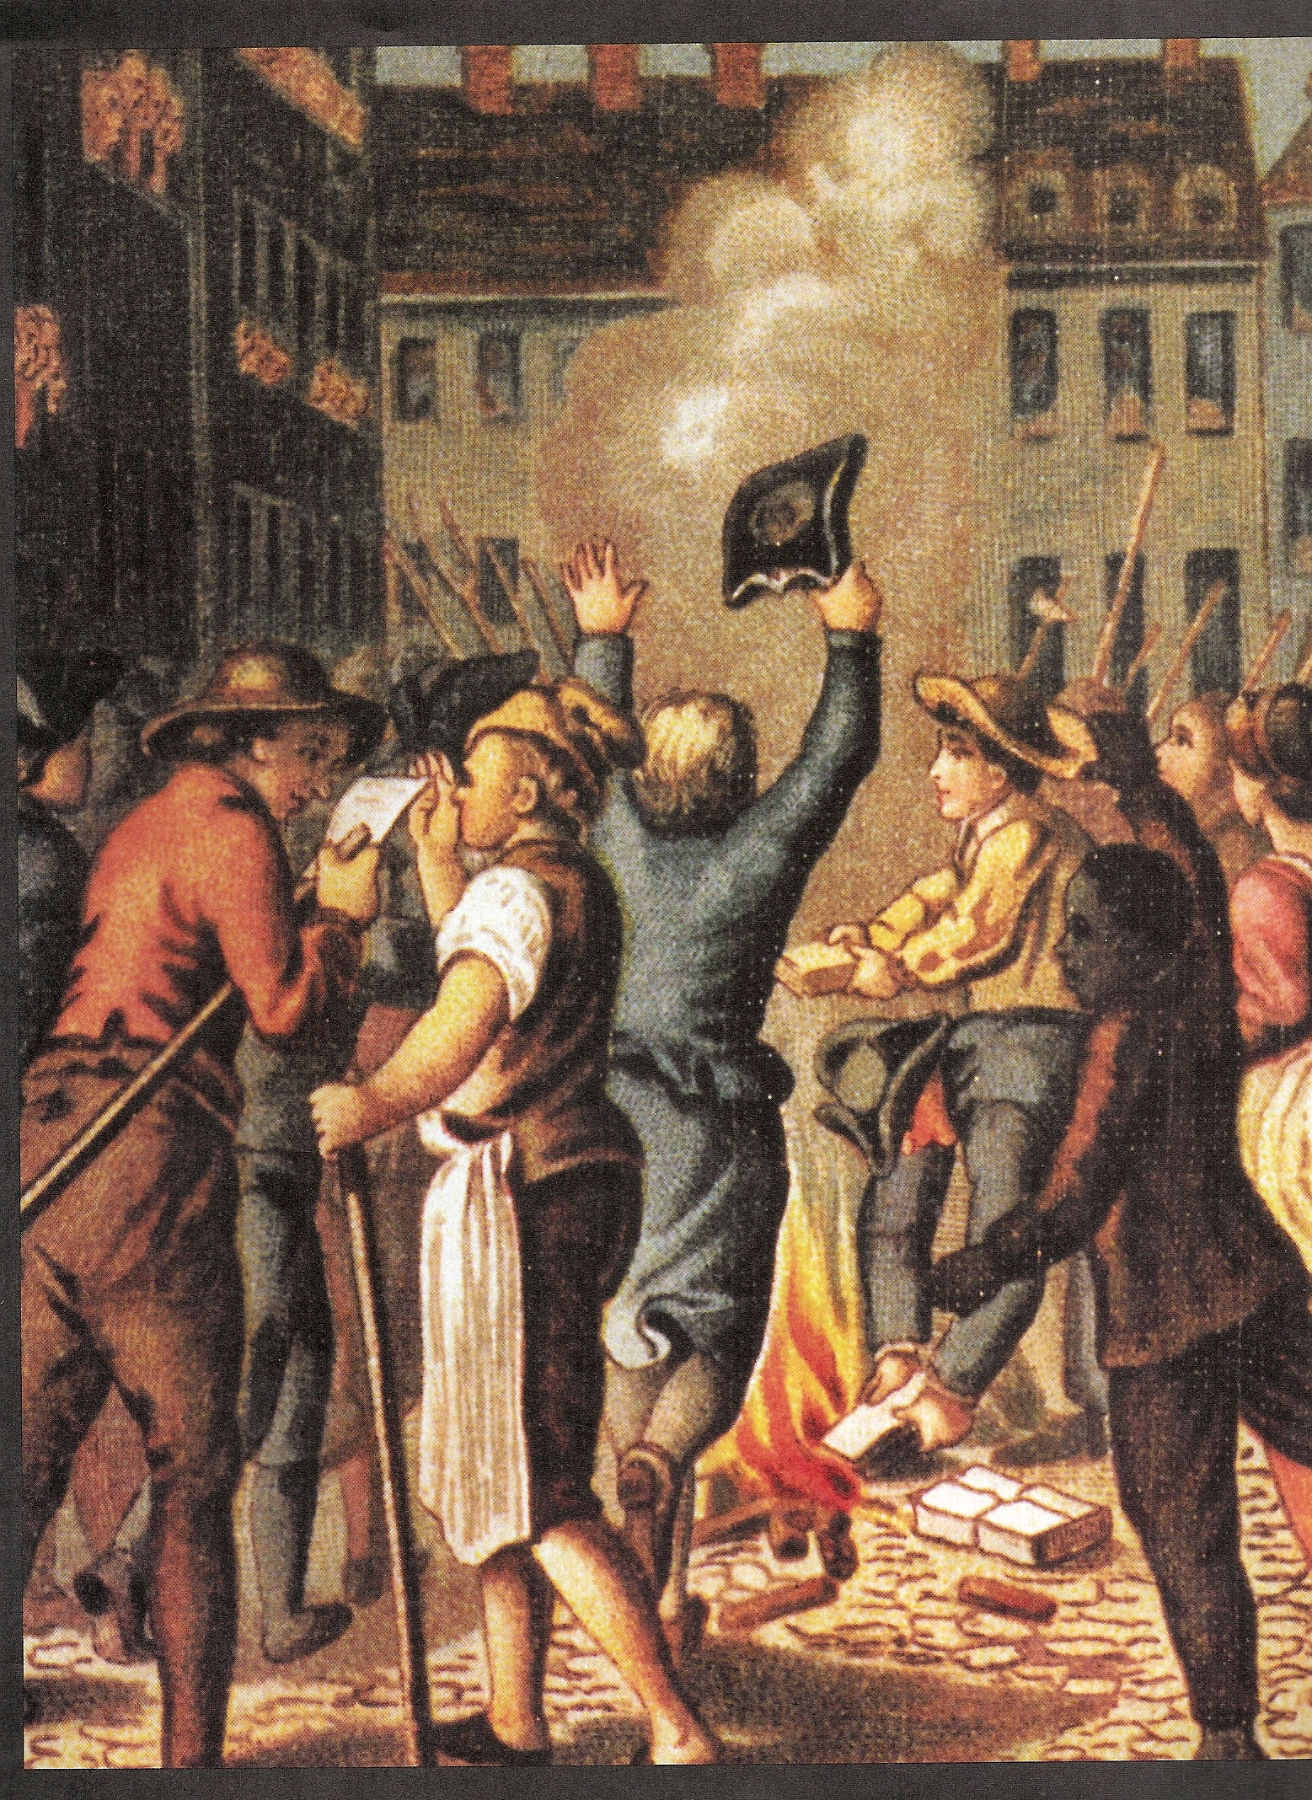
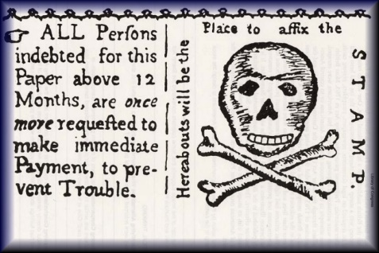

The Road to Revolution

Slide 2
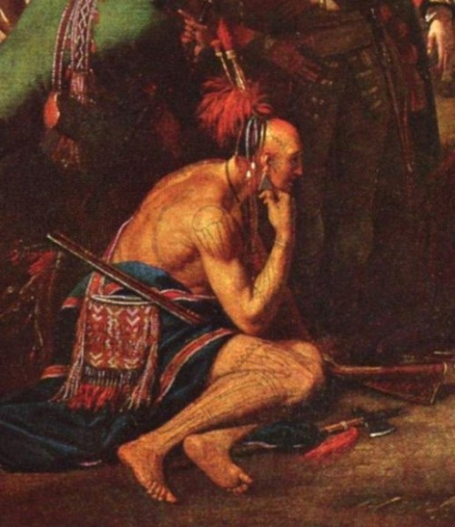
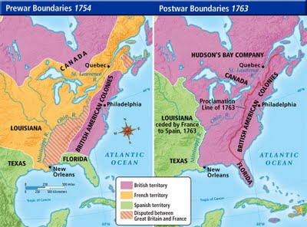
French & Indian War/7 Years War
France & England competed over the North American fur trade
French allied with most Native Americans
Little change in land boundaries, resentment grew in America

Slide 3
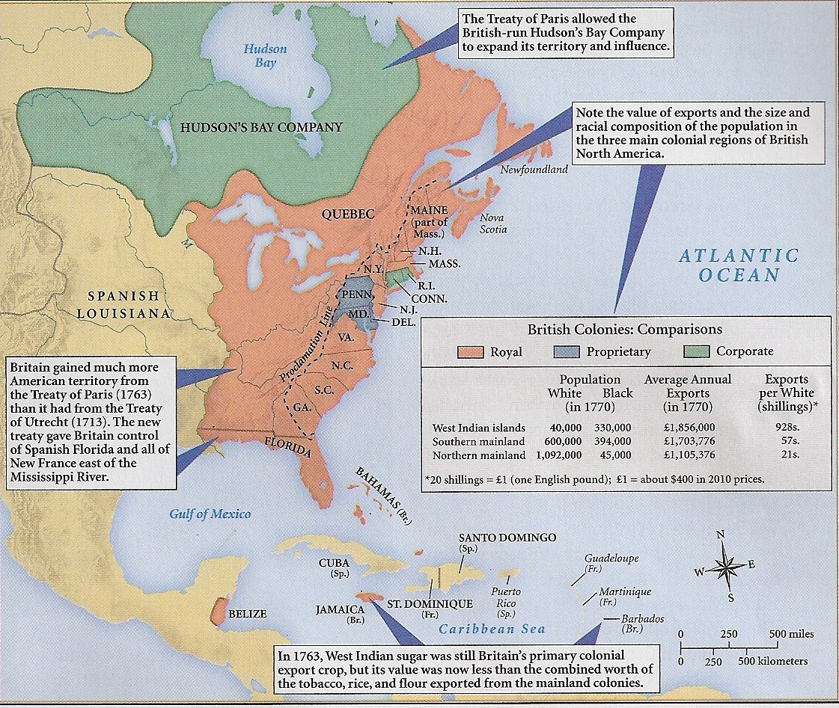
Results of The Peace of Paris, 1763
France gave England Canada & land East of the Mississippi River
Spain gave Florida to England
France gave Louisiana to Spain
England now viewed colonies as marketplace for manufactured goods

Slide 4
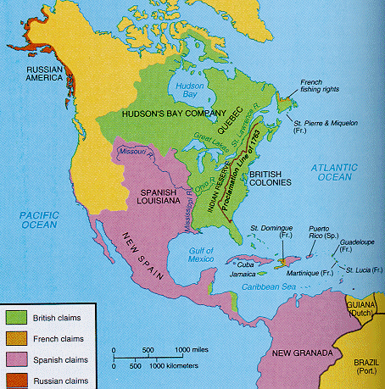
Map of America in 1763

Slide 5
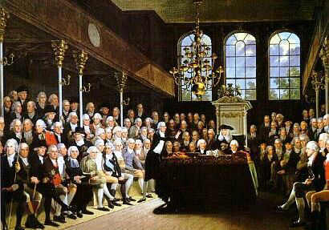
England in 1763
British angry about economic crisis, inflation, elections, & Parliament
Whigs vs. Tories
George Grenville wanted colonies to help pay for maintenance of colonies
1754 – 1764 = English debt grew from 3 million to 170 million pounds

Slide 6
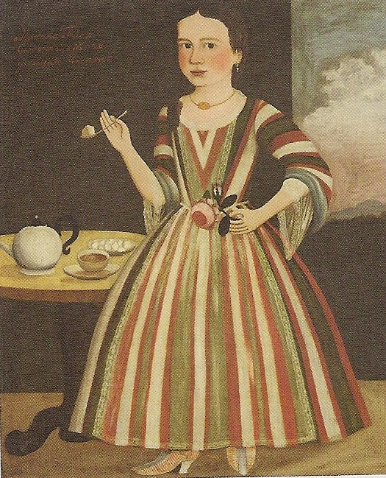
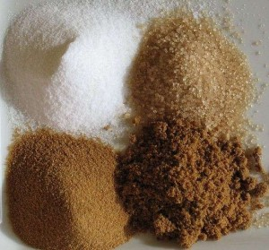
Plantation Act/Sugar Act, 1764
Meant to prevent smuggling of rum, molasses, sugar
Less corrupt British customs officials placed in the colonies
Resistance = Nasty letters, Non-Importation Acts, pamphlets

Slide 7
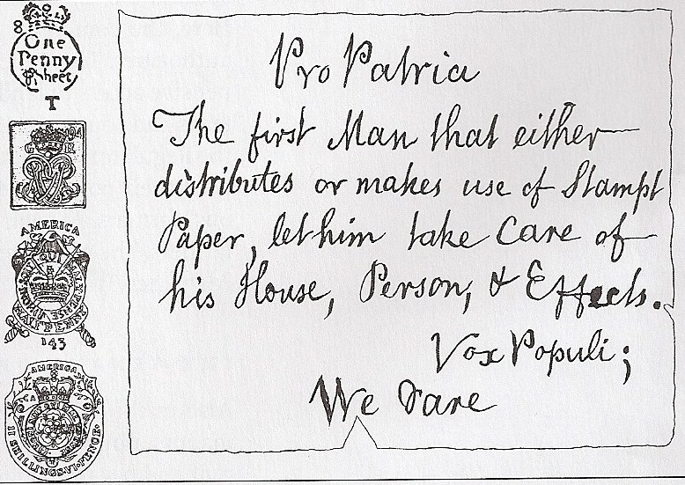
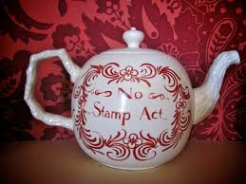
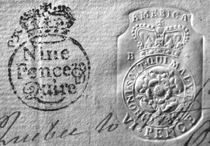
Stamp Act, 1765
Revenue measure
Paper products required stamps
Resistance: “No taxation without representation,” colonial assemblies wrote “Stamp Act Resolves”

Slide 8
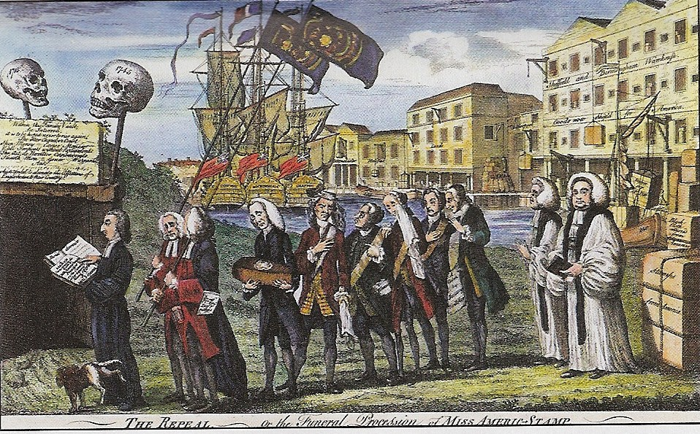
Which Representation?
  Virtual
  representation
vs.
Actual representation
Funeral Procession for the Repeal of the Stamp Act

Slide 9
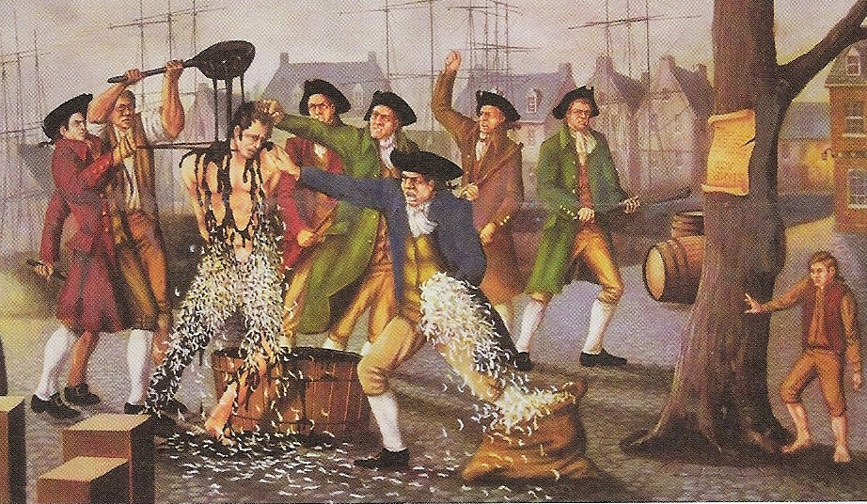
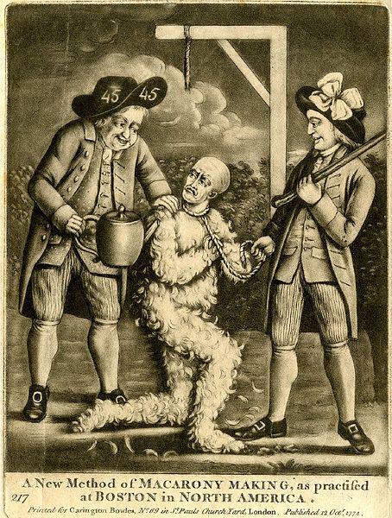
Sons of Liberty
Sam Adams
Andrew Oliver, tax collector
August 14, 1765 = House of Thomas Hutchinson destroyed by Boston mobs
November 1765 = no stamp collector in colonies
Repealed in 1766
Tarring & Feathering of Stamp Collector

Slide 10

A Loyalist being tarred and feathered, scene from HBO’s John Adams miniseries
*Warning: this is a graphic scene with brief nudity

Slide 11
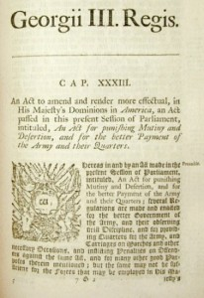
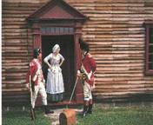
Quartering Act
Colonists required to find homes for soldiers
Provided bedding, utensils, condiments, and alcohol to the British soldiers

Slide 12
How Effective Was Non-Importation?
Townshend Acts of 1767 = Britain wanted 40,000 pounds
English merchants convinced Parliament to repeal in 1769
1774 = New York imported 437,000 pounds of British goods
1775 = New York imported 1,000 pounds of British goods

Slide 13
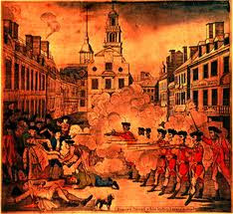
Boston Massacre, 1770
British soldiers competed for jobs
5 people killed, 6 soldiers acquitted, 2 convicted of manslaughter & branded on thumb
Became inspiration for anti-British propaganda

Slide 14
Dumping of the Tea
May 1773 = Tea Act
Massachusetts Governor Thomas Hutchinson
East India Tea Company

Slide 15
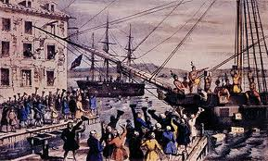
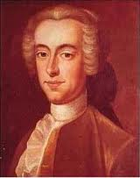
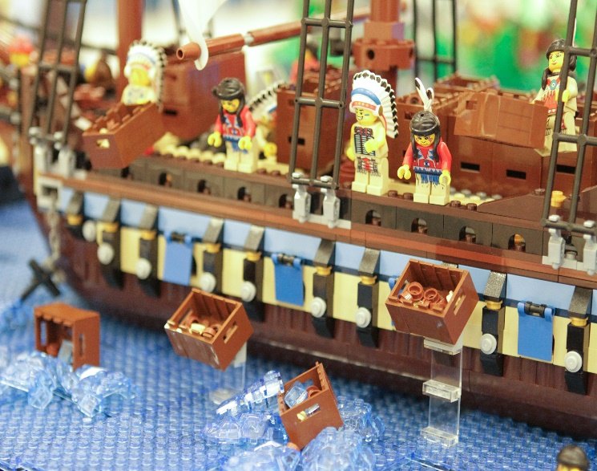
Dumping of the Tea
Governor Hutchinson gave 20 days to unload tea
Dec. 16, 1773 = Sons of Liberty dumped over 300 crates of tea into Boston Harbor

Slide 16
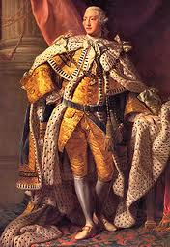
The Coercive Acts/Intolerable Acts, 1774
King George III closed Boston Harbor in order to punish the colony
General Gage became new Governor of Massachusetts
Massachusetts placed under military rule
King George III

Slide 17
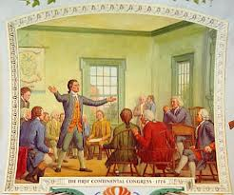
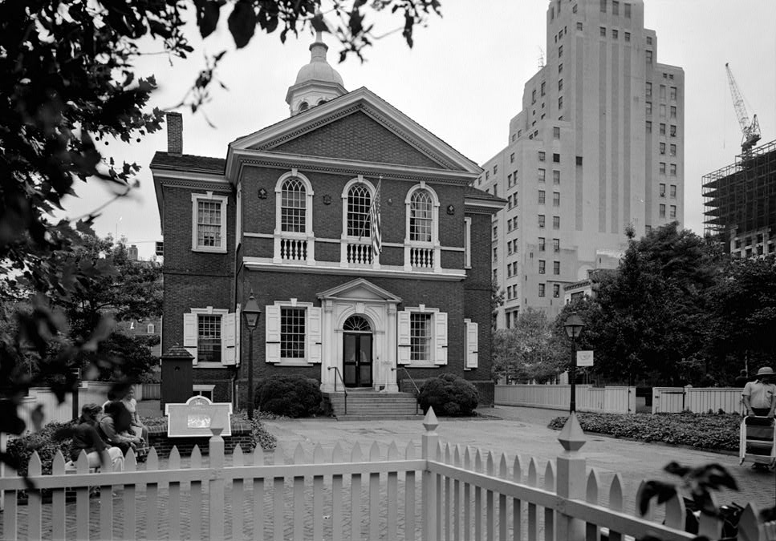
First Continental Congress
Sept. 1, 1774
Met for 4 months
Did not aim for independence
Agreed on =
Non-Importation
No exportation to England
Repeal of Coercive Act
Removal of troops

Slide 18
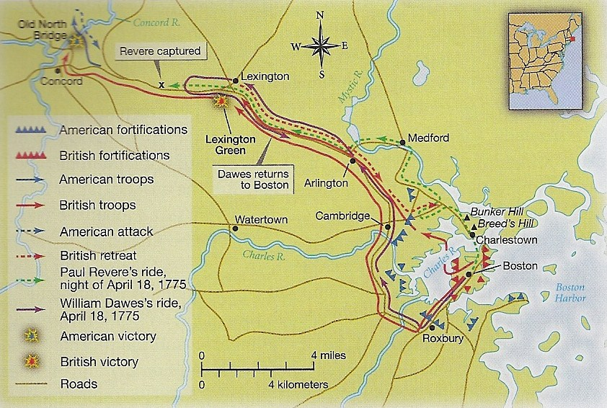
Lexington & Concord, 1775
April 17, 1775 = British troops march to two towns to remove stockpile of weapons
Paul Revere, “The British are Coming!”
70 British killed, over 170 wounded

Slide 19
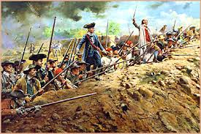
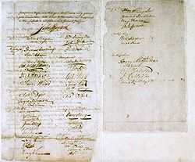
Important Events in 1775
2nd Continental Congress met in Philadelphia
Rejection of “Olive Branch Petition”

Slide 20
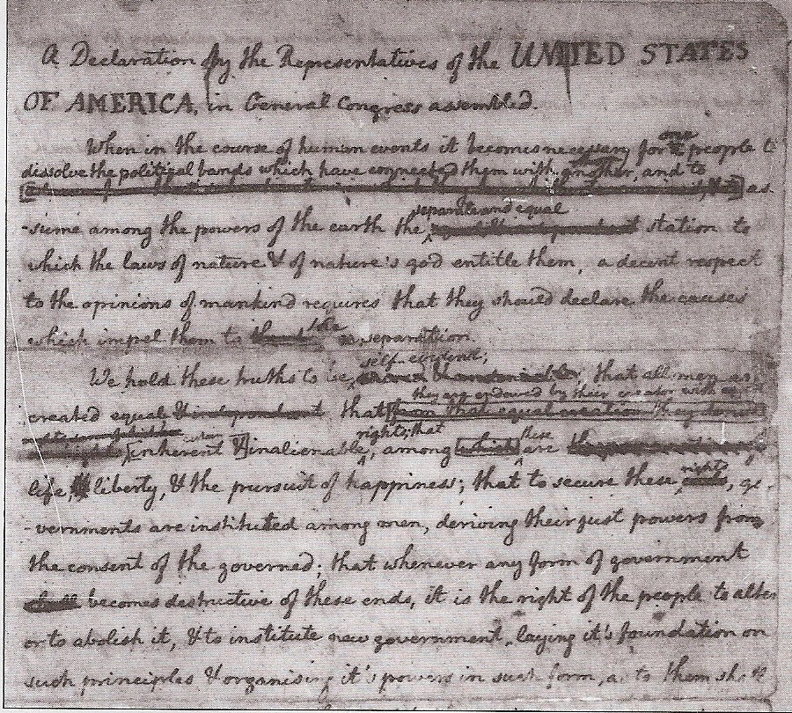
Declaration of Independence, 1776
90 towns drafted declarations
June 1776 – August 1776
Thomas Jefferson inspired by John Locke
King referred to as “He”

Slide 21
Declaring Independence, from HBO’s John Adams miniseries

Slide 22
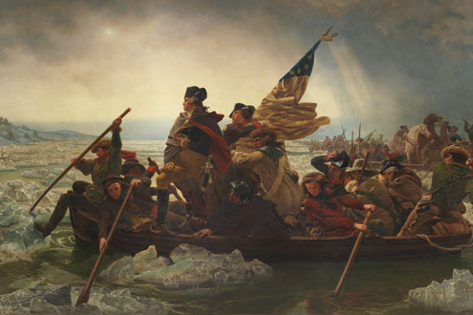
British Disadvantages
Lack of supplies in the colonies
Large span of land to fight (Canada to Florida)
Lack of British soldiers
Hired Hessian soldiers
French entered war in 1778
Fought against an American guerilla army
Assumed Loyalists would help fight the war

Slide 23
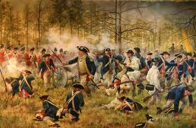
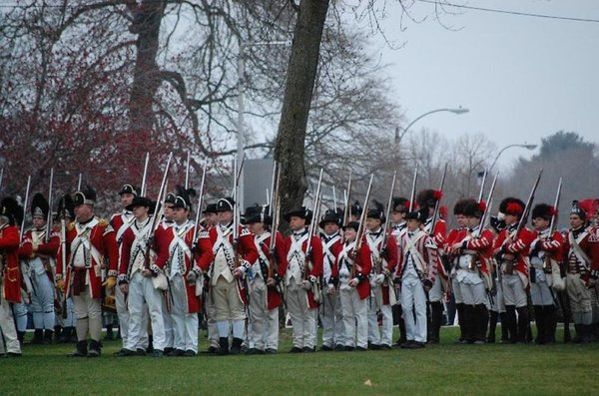
Lessons Learned from The War
U.S. needed a more centralized government
U.S. needed to overcome regionalism
Continental Congress had to:
Govern 13 states
Worry about finances
Conduct diplomacy Create & Supply an Army

Slide 24
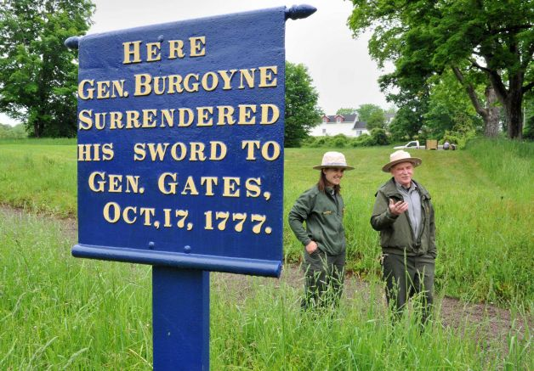
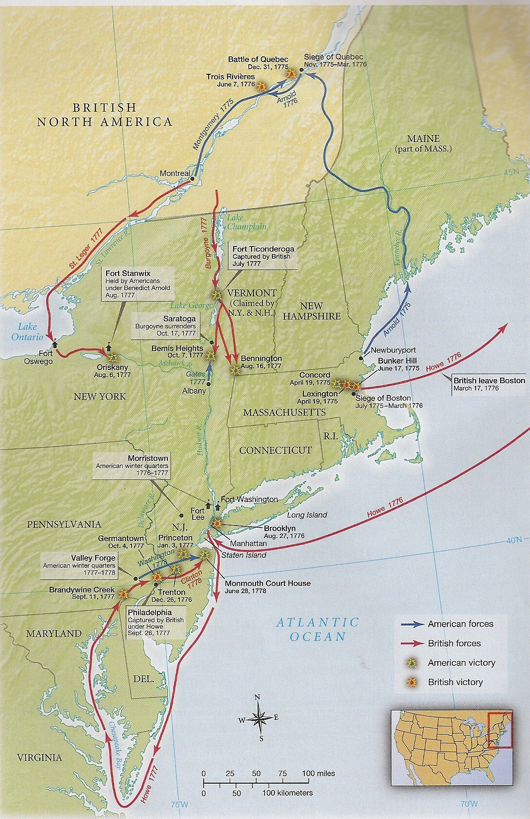
Battle of Saratoga, NY
British General Burgoyne
1,200 British men dead or wounded
October 17, 1777 = Burgoyne surrendered
American victory convinced France to join on our side

Slide 25
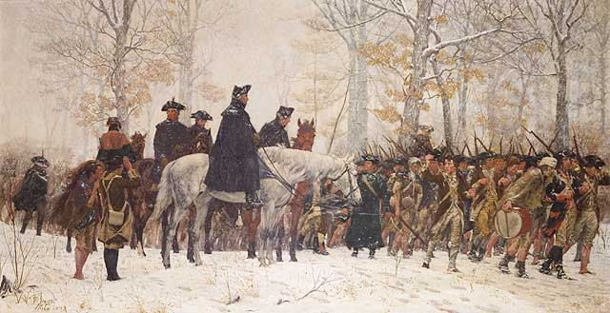
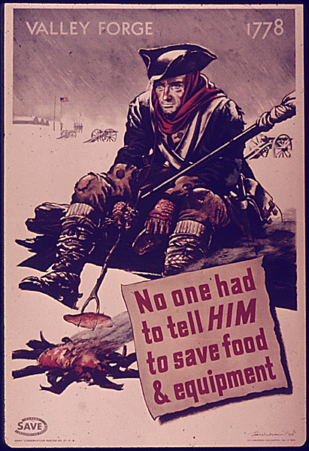
Valley Forge, Winter of 1777 – 1778
2,000 Americans deserted
2,000 died from illness
Army ran out of food and supplies

Slide 26
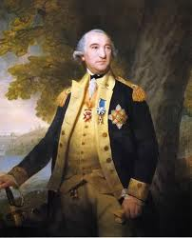
Supply Shortage
Continental Congress could not force states to supply food, soldiers, blankets
2 million pounds of beef, 2 million pounds of flour, 2 million tons of hay needed every 3 months
Baron von Steuben of Prussia trained the incompetent Patriots
Soldiers often deserted before completion of 1 year of service

Slide 27
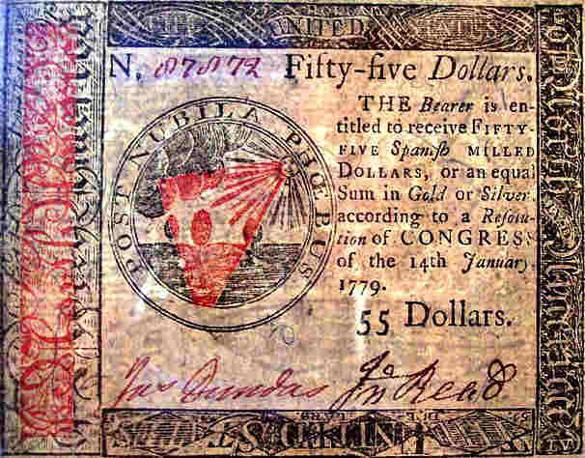
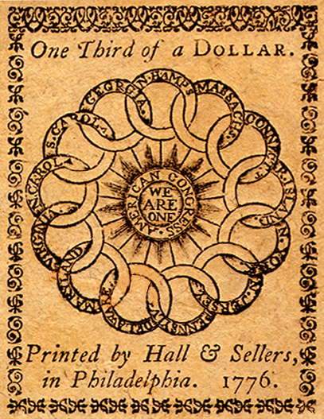
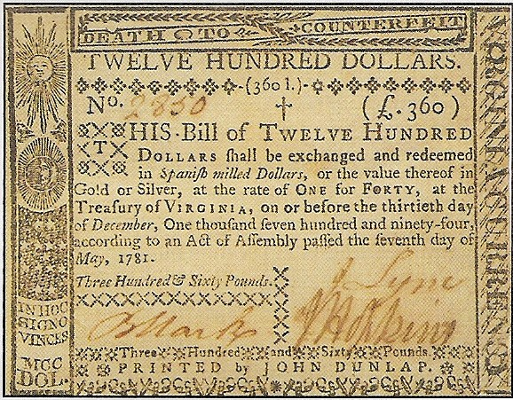
Financial Instability
High inflation in the colonies
States and U.S. printed their own money
Soldiers paid in I.O.U.s & Land Certificates

Slide 28
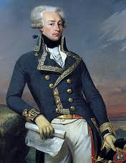
France’s Role in the War
France recognized U.S. as a country
Official alliance = Feb. 1778
Gave supplies, soldiers, naval power to block Britain from shipping supplies
Marquis of Lafayette

Slide 29
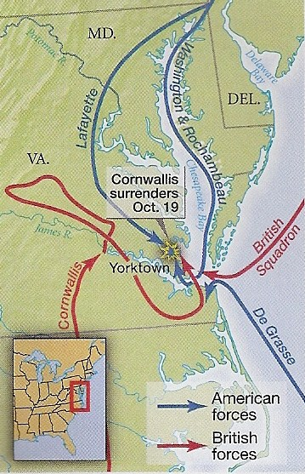
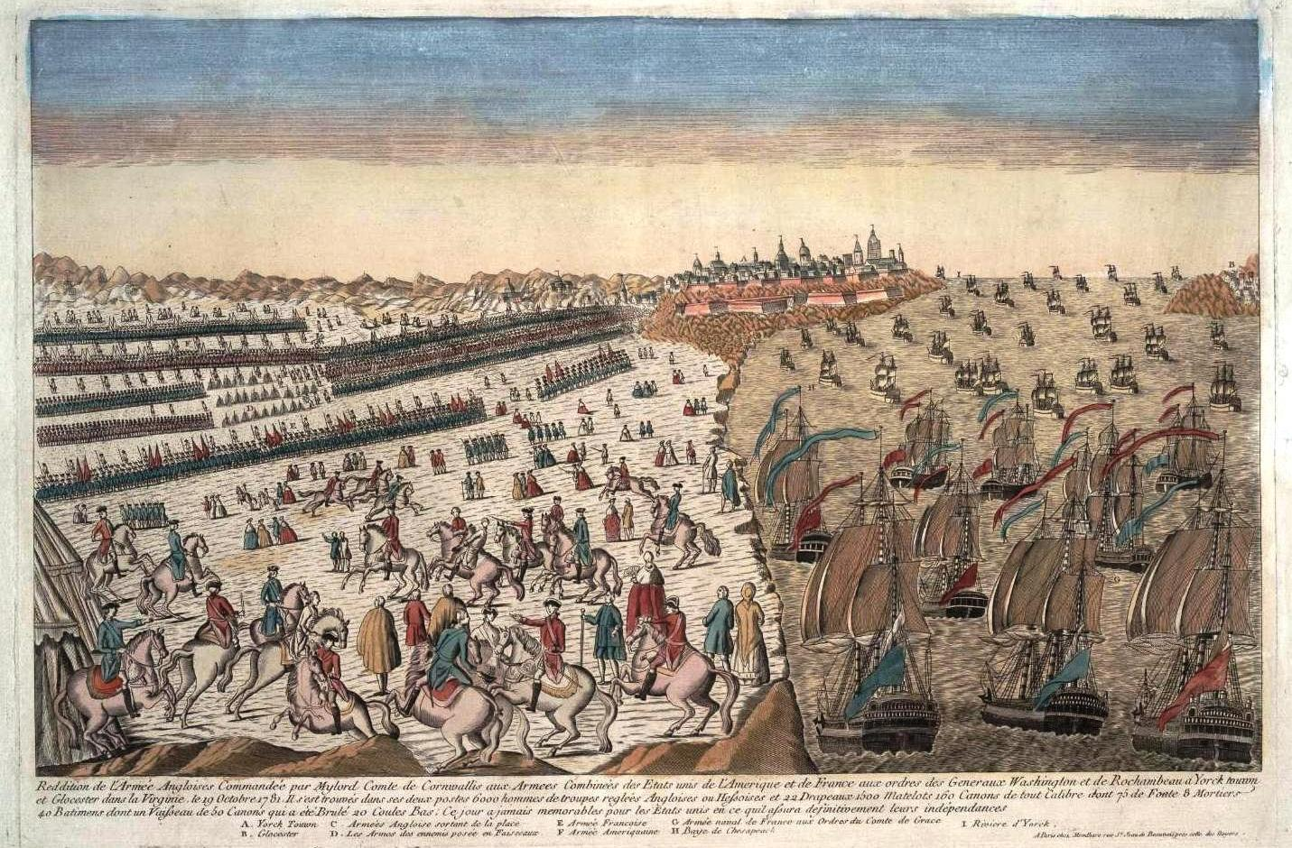
Surrender at Yorktown
French navy blocked coastline of Virginia
16,000 French and American troops vs. 7,500 British
12 day battle
General Cornwallis surrendered in October 1781

Slide 30
Surrender Scene from The Patriot

Slide 31
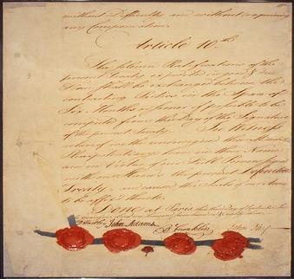
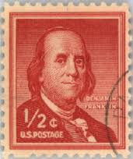
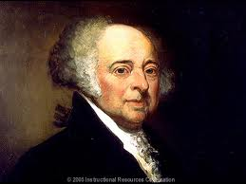
Treaty of Paris
Not signed until 1783
Ben Franklin, John Adams, John Jay negotiated for U.S.
U.S. got all land up to Mississippi River
British withdrew troops
Allowed to collect debts
Benjamin Franklin
John Adams

Slide 32
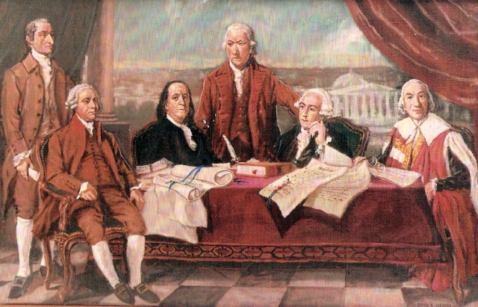
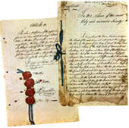
Why did the British lose?
Logistical Issues
Too worried about food to fight aggressively
Inability to rule the areas captured
French assistance

