Slide 1
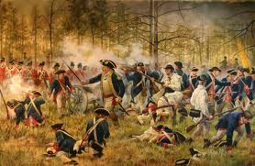
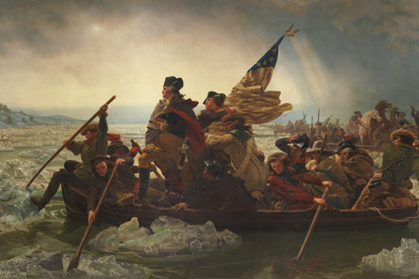
The American Revolution

Slide 2
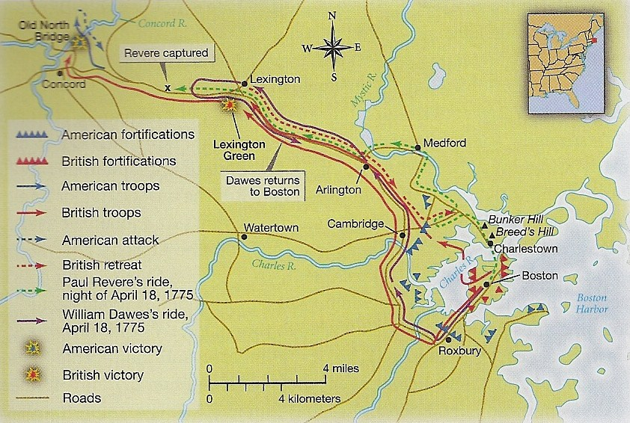

Lexington & Concord, 1775
April 17, 1775 = British troops march to two towns to remove stockpile of weapons
Paul Revere, “The British are Coming!”
70 British killed, over 170 wounded

Slide 3
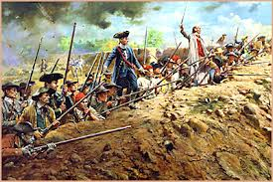
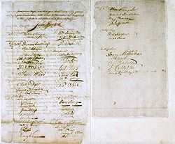
Important Events in 1775
2nd Continental Congress met in Philadelphia
Rejection of “Olive Branch Petition”

Slide 4
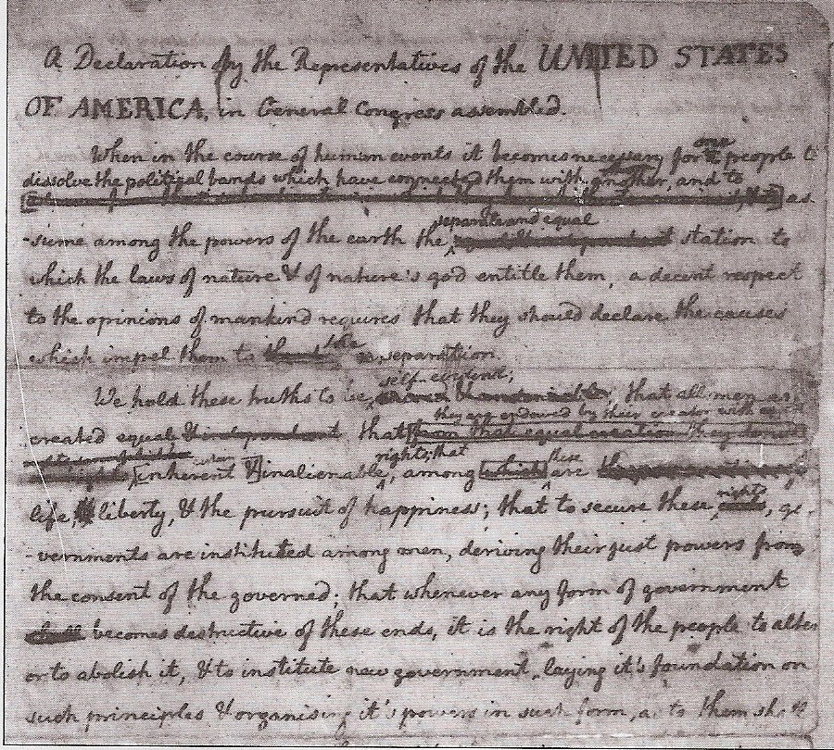
Declaration of Independence, 1776
90 towns drafted declarations
June 1776 – August 1776
Thomas Jefferson inspired by John Locke
King referred to as “He”

Slide 5
Declaring Independence, from HBO’s John Adams miniseries

Slide 6
British Disadvantages
Lack of supplies in the colonies
Larger span of land to fight (Canada to Florida)
Lack of British soldiers
Hessians hired to fight
French entered war in 1778
Fought against an American guerilla army
Assumed Loyalists would help fight the war

Slide 7
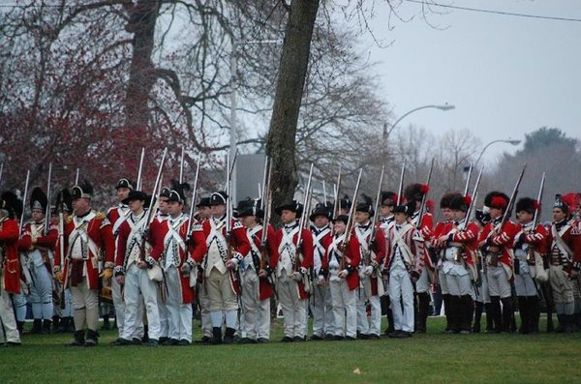
Lessons Learned from The War
U.S. needed a more centralized government
U.S. needed to overcome regionalism
Continental Congress had to:
Govern 13 states
Worry about finances
Conduct diplomacy Create & Supply an Army

Slide 8
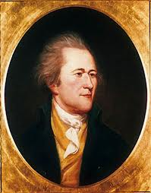
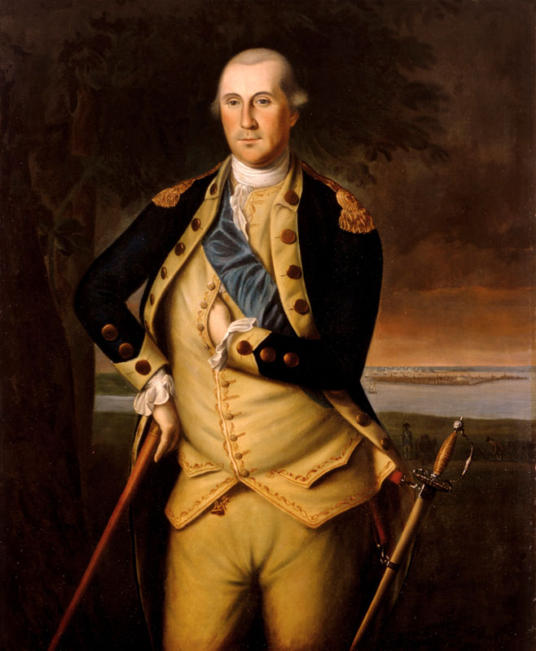
Picking a Commander-in-Chief
Could New England militia men trust a Southern officer?
John Hancock vs. George Washington
John Hancock
George Washington

Slide 9
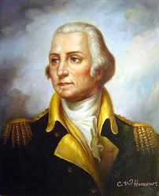
George Washington
“New Englanders are an exceedingly dirty & nasty people.”

Slide 10
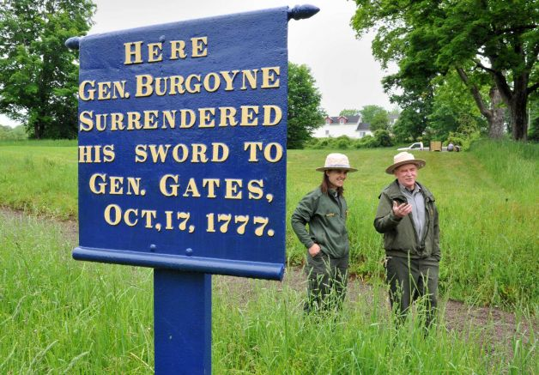
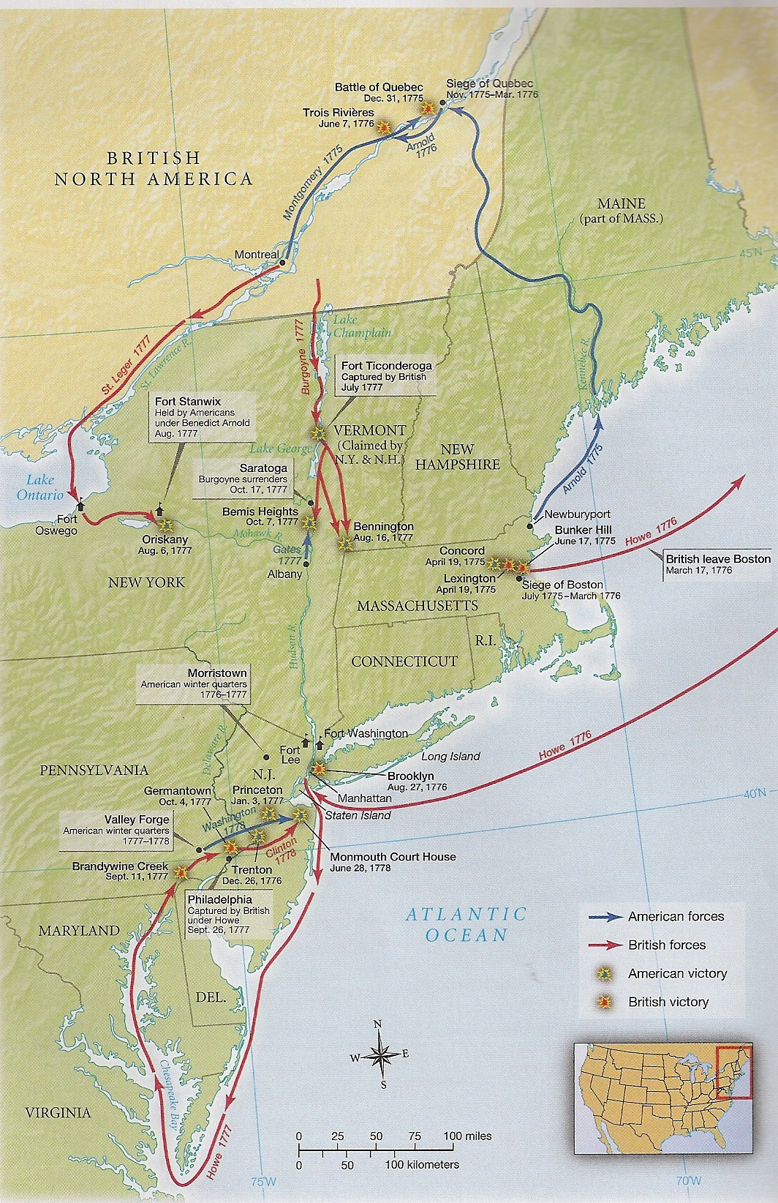
Battle of Saratoga, NY
British General Burgoyne
1,200 British men dead or wounded
October 17, 1777 = Burgoyne surrendered
American victory convinced France to join on our side

Slide 11
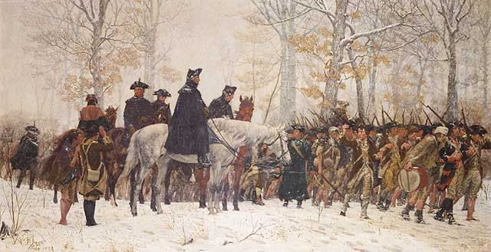
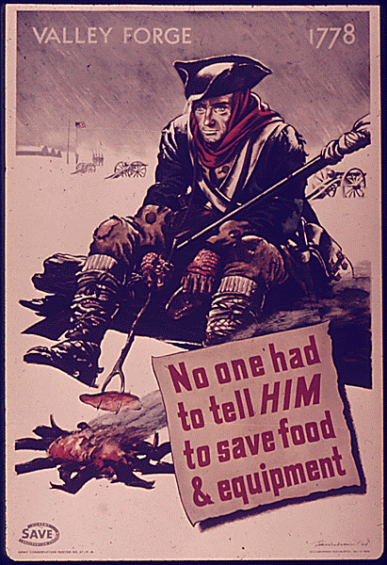
Valley Forge, Winter of 1777 – 1778
2,000 Americans deserted
2,000 died from illness
Army ran out of food and supplies

Slide 12
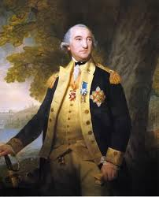
Supply Shortage
Continental Congress could not force states to supply food, soldiers, blankets
2 million pounds of beef, 2 million pounds of flour, 2 million tons of hay needed every 3 months
Baron von Steuben of Prussia trained the incompetent Patriots
Soldiers often deserted before completion of 1 year of service

Slide 13
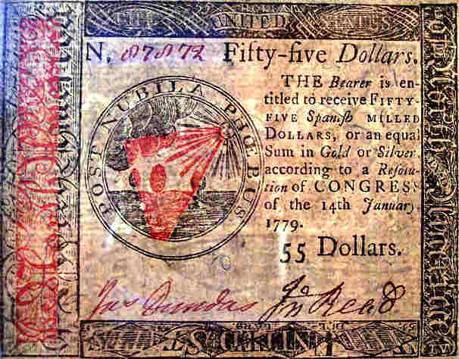
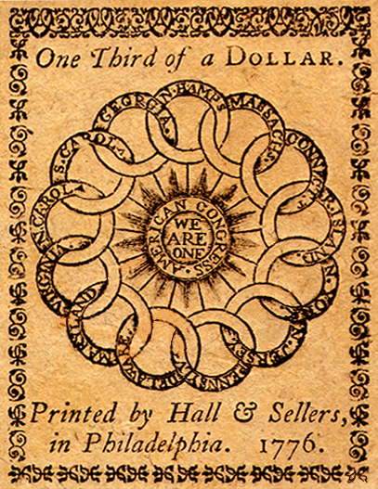
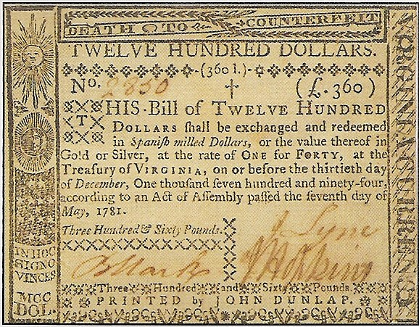
Financial Instability
High inflation in the colonies
States and U.S. printed their own money
Soldiers paid in I.O.U.s & Land Certificates

Slide 14
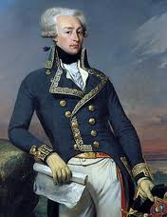
France’s Role in the War
France recognized U.S. as a country
Official alliance = Feb. 1778
Gave supplies, soldiers, naval power to block Britain from shipping supplies
Marquis of Lafayette
Lafayette

Slide 15
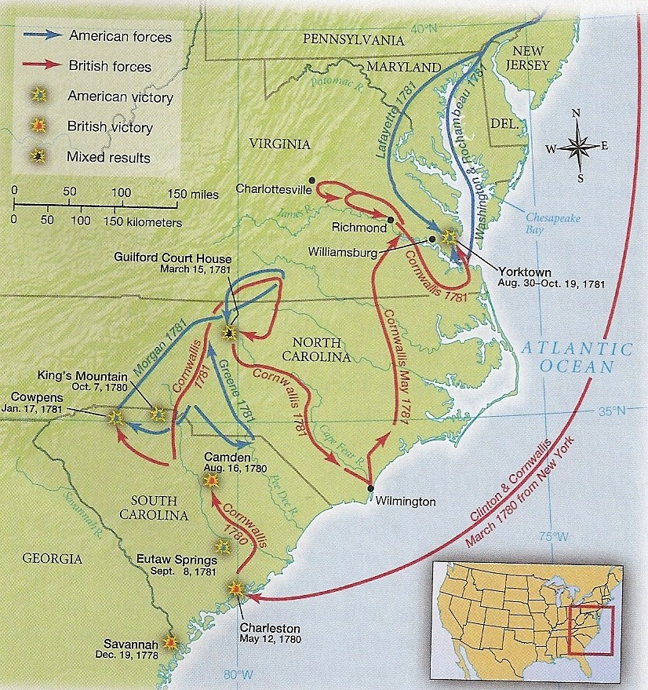
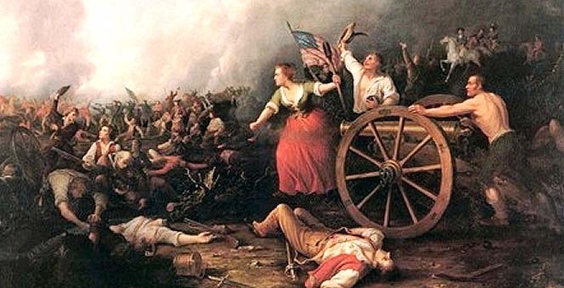
Georgia & South Carolina
Britain moved south towards the end of the war
Britain took control of Georgia & Charleston, South Carolina
Worst battles for U.S. in South Carolina

Slide 16
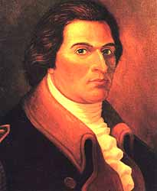

Benedict Arnold
1779 = Traded information with British General Clinton
Tried to sell West Point Fort in New York to the British
1780 = Arnold’s plan captured
Treason increased patriotism

Slide 17
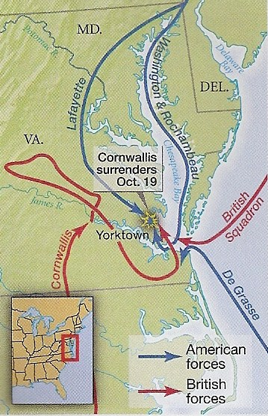
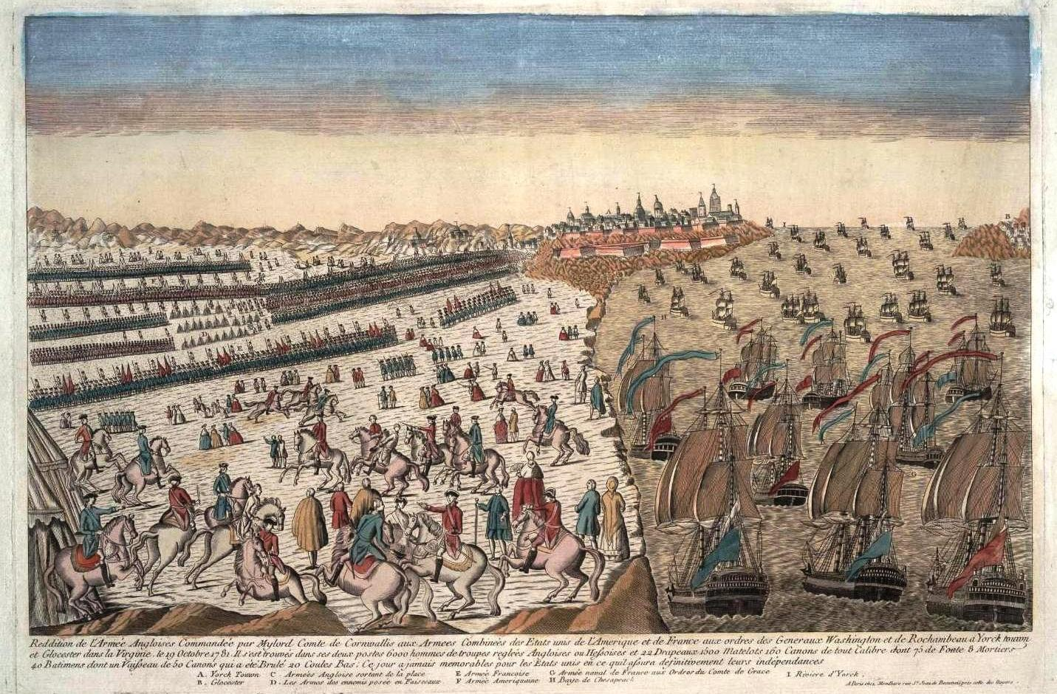
Surrender at Yorktown
French navy blocked coastline of Virginia
16,000 French and American troops vs. 7,500 British
12 day battle
General Cornwallis surrendered in October 1781

Slide 18
Surrender Scene from The Patriot

Slide 19
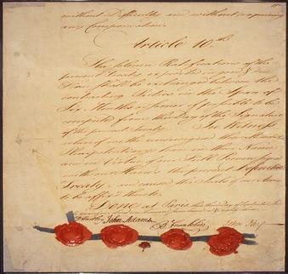
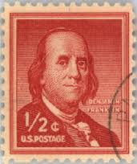
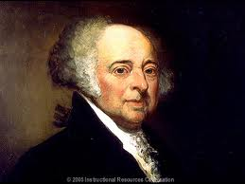
Treaty of Paris
Not signed until 1783
Ben Franklin, John Adams, John Jay negotiated for U.S.
U.S. got all land up to Mississippi River
British withdrew troops
Allowed to collect debts
Benjamin Franklin
John Adams

Slide 20
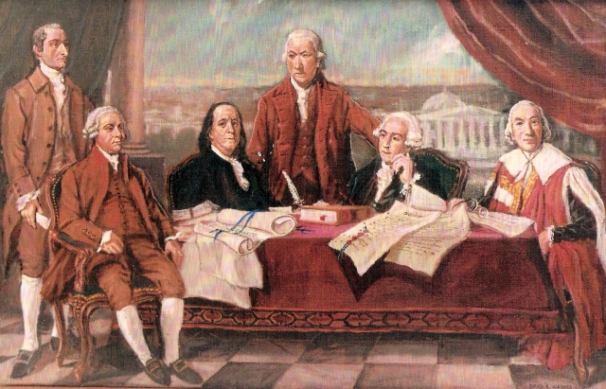
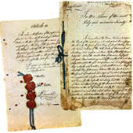
Why did the British lose?
Logistical Issues
Too worried about food to fight aggressively
Inability to rule the areas captured
French assistance

