Slide 1
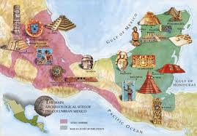
Ancient Mesoamerican Civilizations

Slide 2
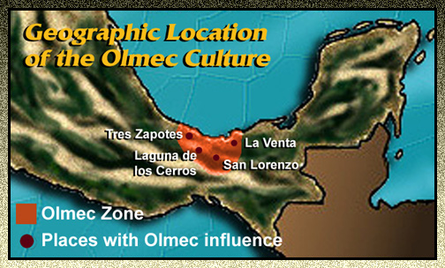
Olmec, 1500 BCE – 400 BCE

Slide 3
What is a “civilization”?
Dependent upon agriculture
Large and dense populations
Trade
Range of settlements (rural – urban)
Central governments
Social stratification
Specialized occupations

Slide 4
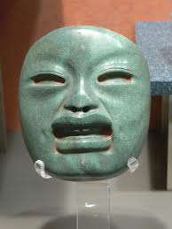
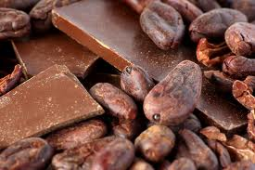
Who are the Olmec?
Tropical lowlands of Mexico
The “mother civilization”
“People of the land of rubber”
The rubber ball game
Trade

Slide 5
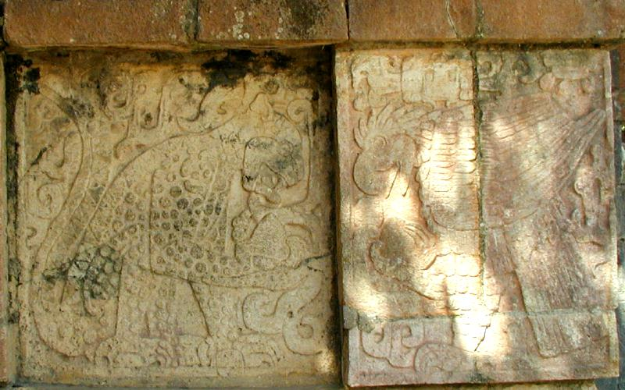
Olmec Religion
Cult of the Jaguar
Spread of religion as a factor in their rise to power
Toltec depiction of the jaguar at Chichen Itza

Slide 6
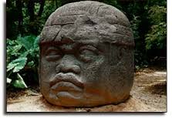
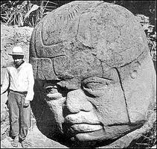
Olmec Heads
Basalt stone
8 statues of rulers or gods?

Slide 7
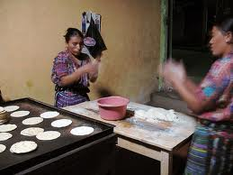
Olmec Trade
Jewelry, feathers, cotton, cacao beans, ceramics, jade figurines
Invention of the tortilla
Women and the comal
Cooking tortillas on a comal

Slide 8
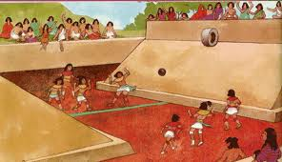
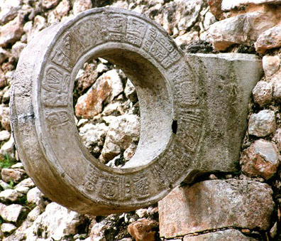

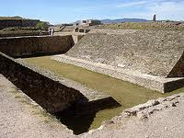
The Rubber Ball Game

Slide 9
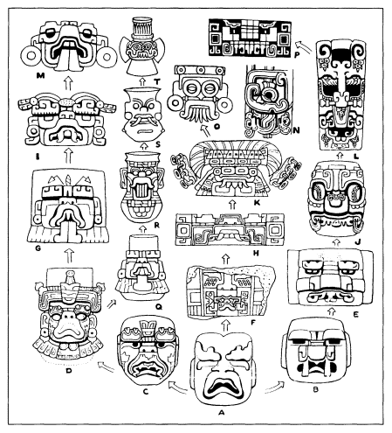
Olmec’s Legacy
Cult of the jaguar
Religious calendar
Astronomy
Trade
Agriculture/Food technologies
Hieroglyphic writing
Olmec rain god at A. Oaxaca, Central Mexico, and Maya regions from left to right.

Slide 10
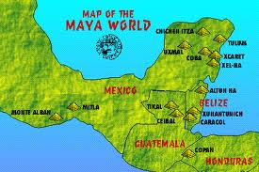
The Maya, 200 BCE – 900 CE

Slide 11
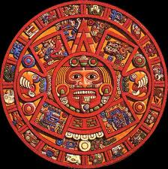
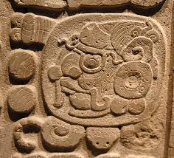
Regions of the Maya
Chiapas, Campeche, Tabasco, Quintana Roo, Yucatan peninsula (Southern Mexico)
Guatemala
Honduras
Belize
El Salvador

Slide 12
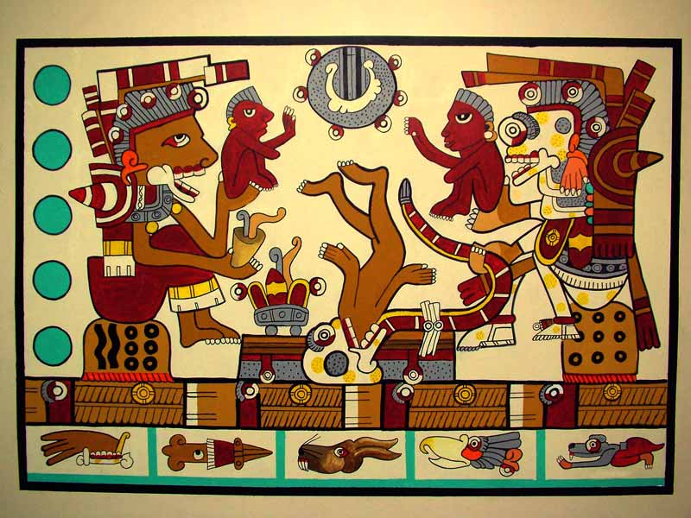
Characteristics
No central government
Roughly 50 independent city-states in constant competition

Slide 13
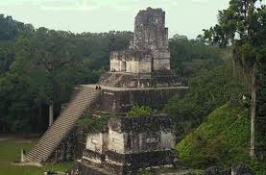
Tikal, 250 – 900 C.E.
Guatemala
Established around 250 CE
50,000 – 100,000 people

Slide 14
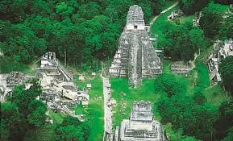
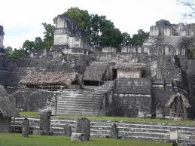
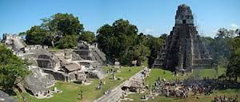

Slide 15
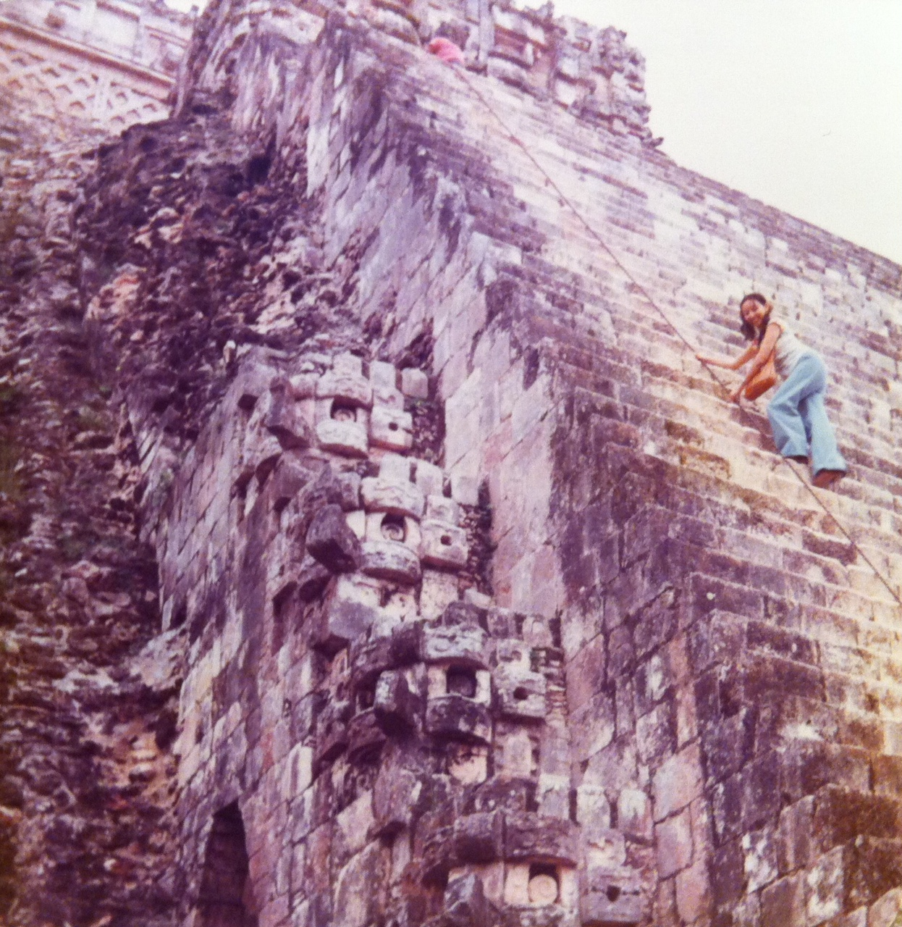
Climbing a Temple in Chichen Itza

Slide 16
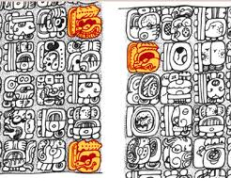
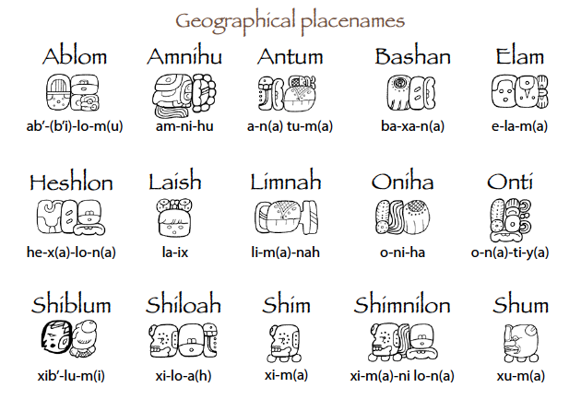
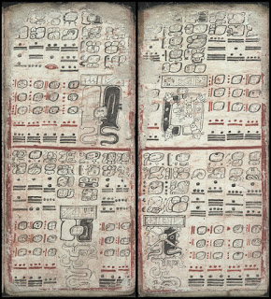
Writing
90% of the symbols have been defined
Bark paper books
Most destroyed during colonial period

Slide 17
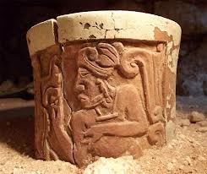
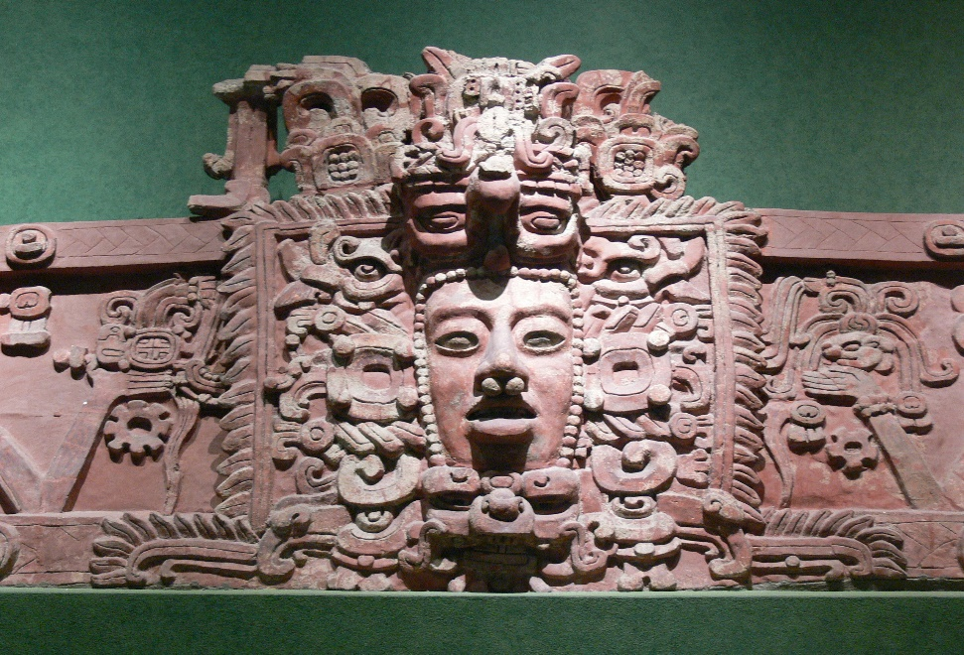
Mayan Society
Ahau (king)
Tribute system
Strict gender roles
Monogamy vs.
plural marriages
Extended families

Slide 18
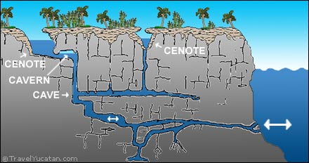
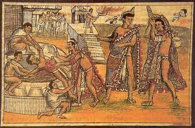
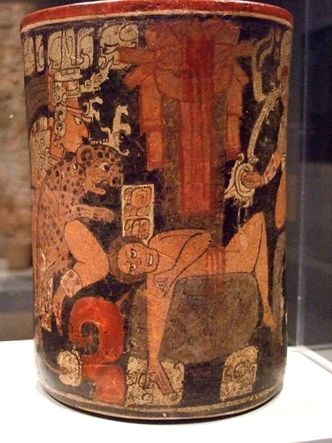
Mayan Bloodletting
Each day + special occasions
Cenote
Ear piercings

Slide 19
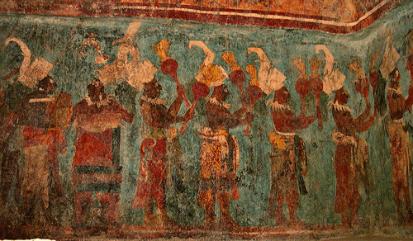
What happened?
Collapse of city-states began in 800 CE
12 million people in 700 CE
Population drops to 2 million

