Slide 1
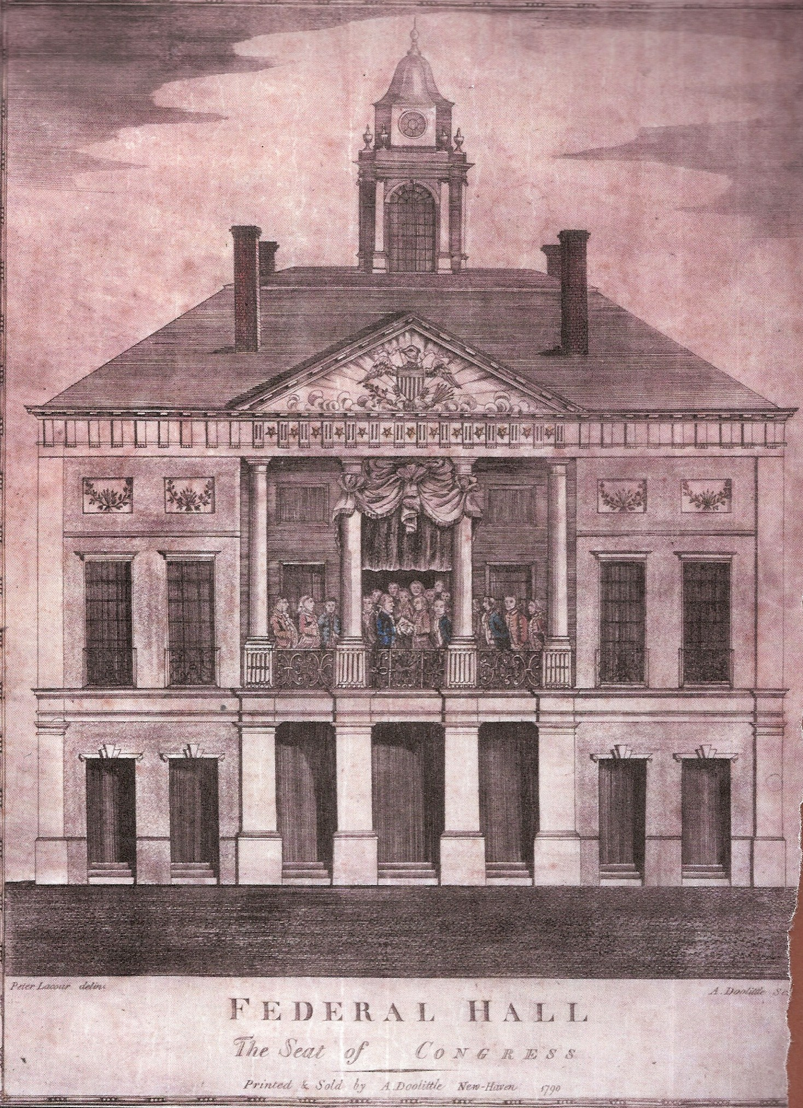
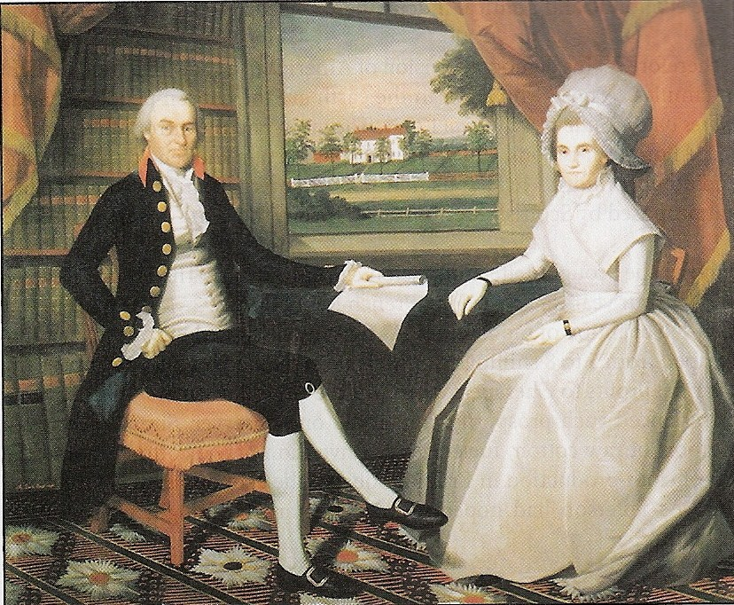
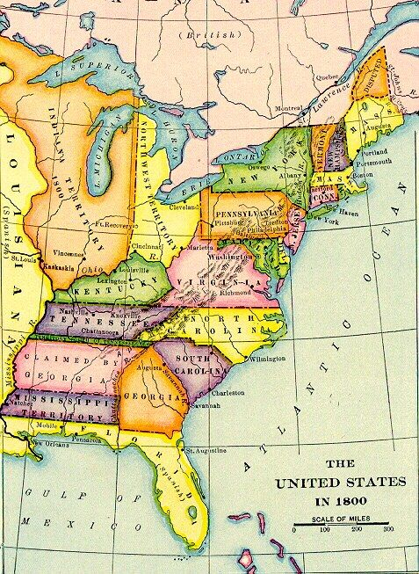
The Early National Period, 1781 – 1800

Slide 2
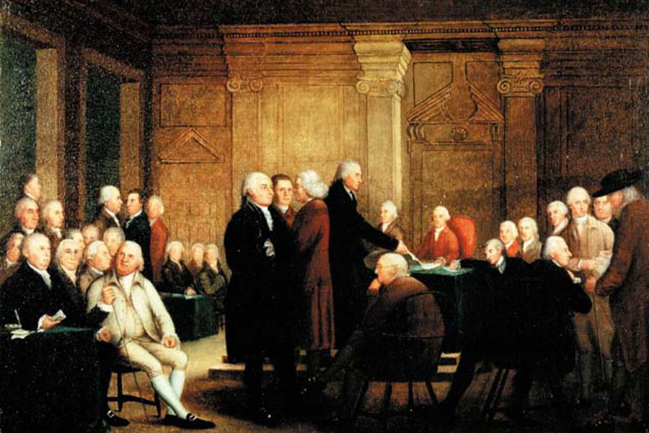
What Was Our 1st Government Like?
Confusion about American vs. British identity
1775 – 1781 = Continental Congress was main body of government
Still angry at Parliament: “Less government is better”

Slide 3
Articles of Confederation
November 1777 = 13 states agreed to it
“League of Friendship”
2 – 7 state delegates met in congress and had 1 vote per state
9 out of 13 states had to approve the passage of new laws
Not allowed to tax people
Could not force states to give them money

Slide 4
Problems of the Confederation
National debt was $42 million & state debts were $25 million
Strong state identity & weak national identity
Tasks =
  Pay war debt
  Build relationships with Native Americans
  Settle Western Frontier

Slide 5
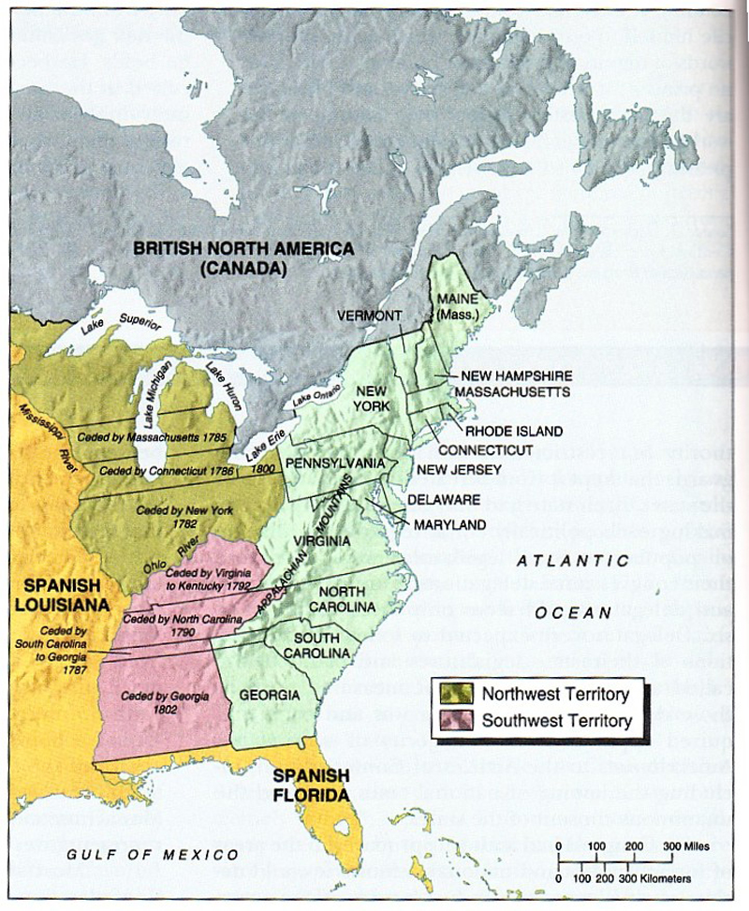
State Identities
States were more powerful than the national government
People defined themselves by their state

Slide 6
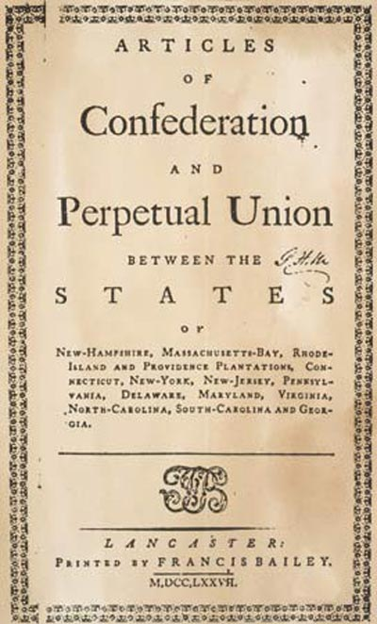
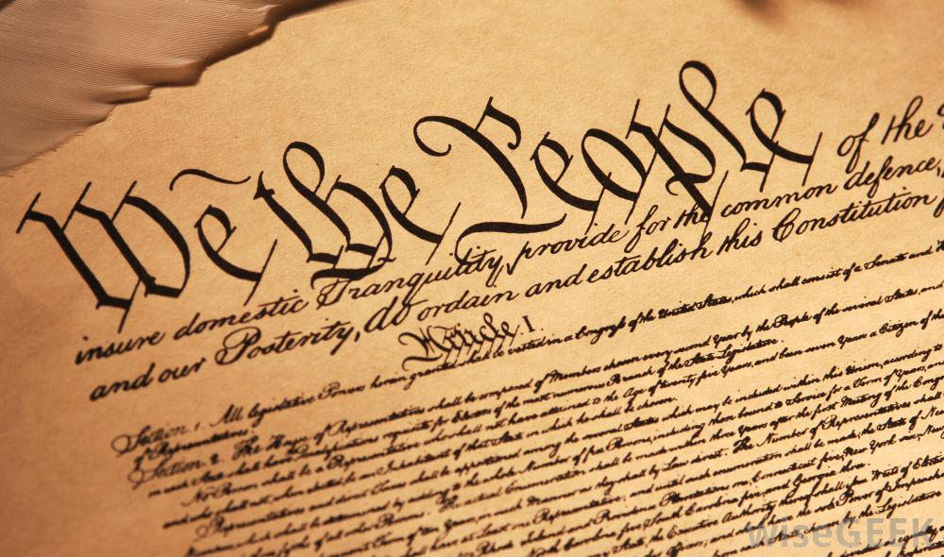
Republicanism
Popular elections
Belief that leaders represented the people & put the interests of the people before their own
A positive view of government

Slide 7
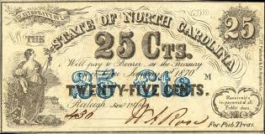
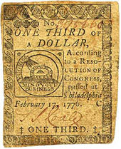
Who were “the people”?
Maryland voters needed 50 acres of land or 30 dollars
Pennsylvania voters needed property
1776 – 1807 = Only New Jersey allowed free blacks and women with property to vote

Slide 8
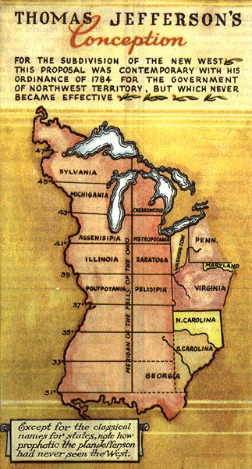
Western Lands
7 states claimed western areas
Small states wanted government to sell land to pay war debt
Northwest Ordinance of 1787 = Created territories out West

Slide 9
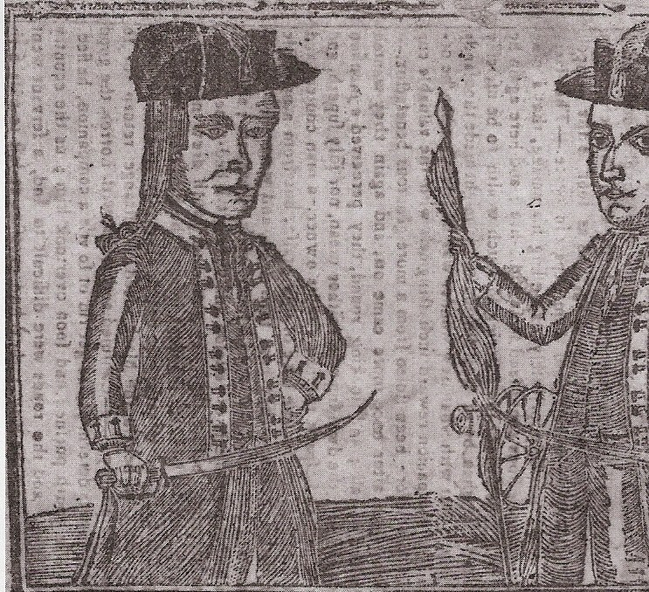

Shay’s Rebellion
September 1786
1,100 Massachusetts farmers protested when land was foreclosed on because of taxes
Massachusetts militia refused to suppress them
Daniel Shays

Slide 10
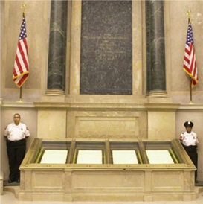
Constitutional Convention
September 1786 = 5 states met in Annapolis
James Madison of Virginia led reform effort to revise Articles of Confederation
Re-scheduled for May 1787 in Philadelphia

Slide 11
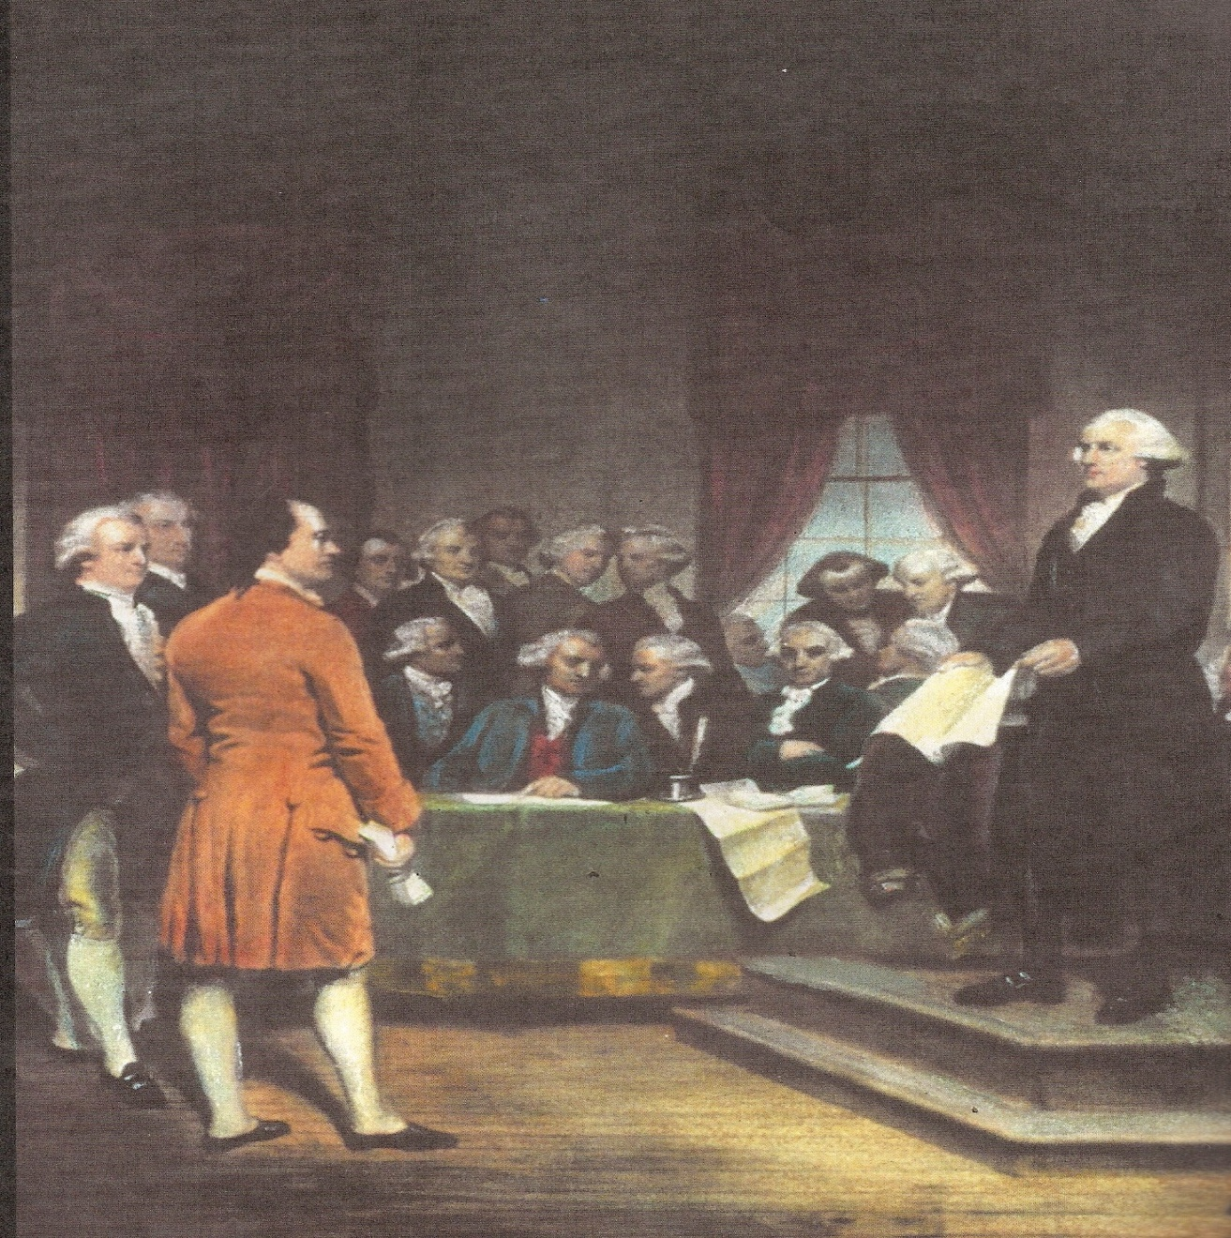
Constitutional Convention in Philadelphia
May – September 1787
All states present except Rhode Island
55 elite men = 2/3 were lawyers, 7 former state governors

Slide 12
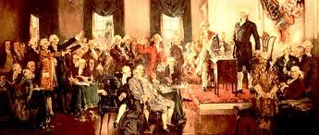
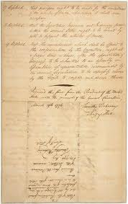
Virginia Plan
Would have reduced state power
3 branches of government
Would have given smaller states less power

Slide 13
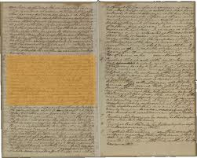
New Jersey Plan
Led by smaller states
Would have created 3 presidents
Single congress
Congress had the right to tax

Slide 15
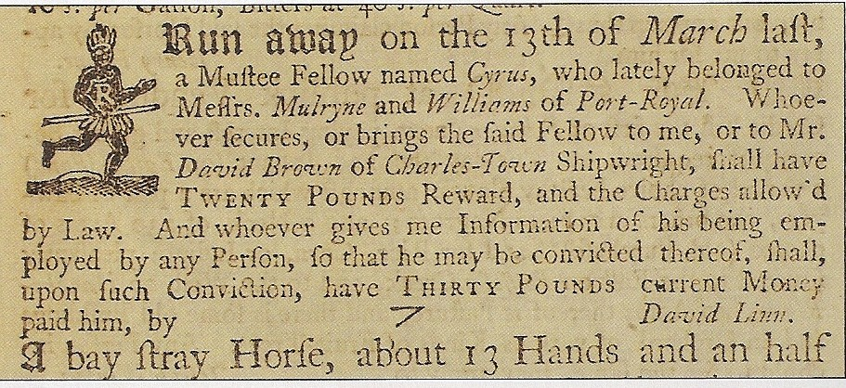
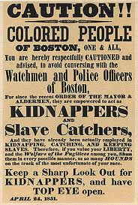
The Great Compromise
House of Representatives decided by population
All states had 2 representatives in Senate
3/5 Compromise

Slide 16
3/5 Compromise
3/5 of slave population would be counted for state population
“Slavery,” “Slaves,” “Slave Trade” never mentioned
International slave trade allowed to continue
Fugitive slaves allowed to be captured across state lines
No changes to 3/5 clause allowed for 20 years

Slide 17
Federalists vs. Anti-Federalists
38 out of 55 representatives approved
9 out of 13 states had to ratify it
Federalists = wanted stronger federal government
Anti-Federalists = Anti-constitution, wanted state power

Slide 18
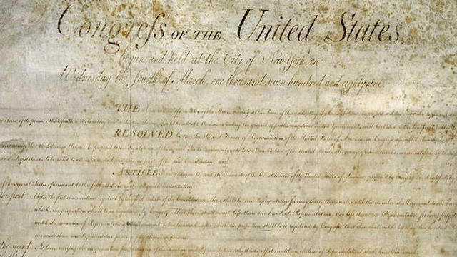
Bill of Rights
A compromise for 7 states before they ratified
1791 = 10 states approved 10 out of 12 amendments
#1 – 8 = About individual liberties
#9 – 10 = About boundaries between federal and state authority

Slide 19
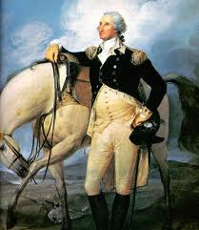
Washington as President
February 1789 = Unanimously chosen as president by electoral college
John Adams elected as VP
Projected an honest and virtuous image

Slide 20
Federalists vs. Democrat-Republicans
By 1790 = 2 informal parties
George Washington & early national government officials were Federalists
Democrat-Republicans had Anti-Federalist roots
Washington warned against party politics & international affairs in Farewell Address

