Slide 1
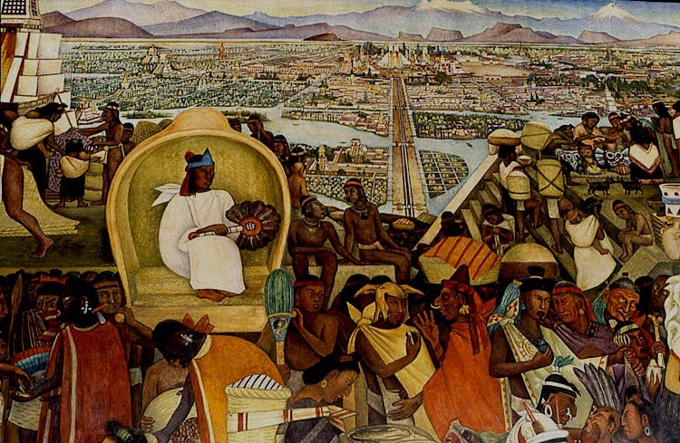
The Aztec
Diego Rivera mural, La Gran Tenochtitlàn

Slide 2
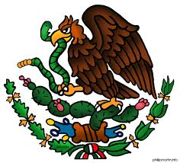
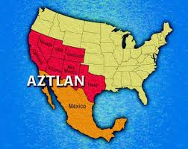
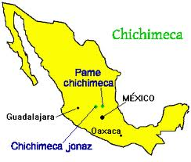
Chichimeca Migration
Came from Aztlàn
Chichimecas first left in 900 CE

Slide 3
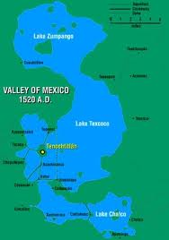
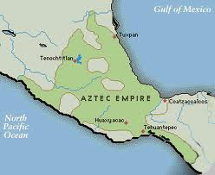
Aztec Empire
Mexica migrated to Lake Texcoco in 1325 CE
Worshipped Huitzilopchtli
200,000 – 700,000 people
in Tenochtitlàn

Slide 4
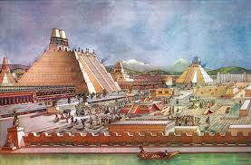
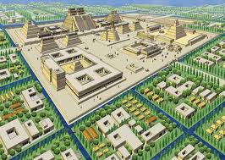
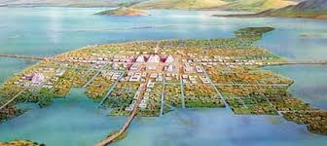
Tenochtitlàn
Aztec capital, founded in 1325 CE

Slide 5
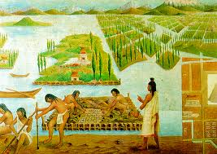
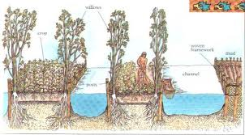
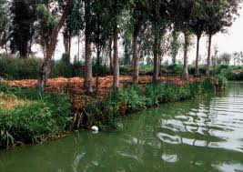
Chinampas “Floating Gardens”

Slide 6
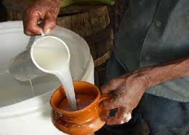
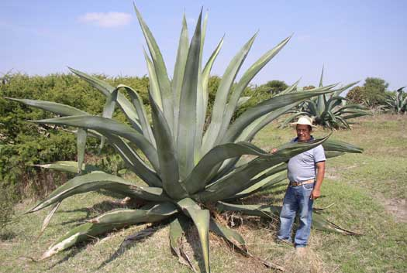

Pulque

Slide 7
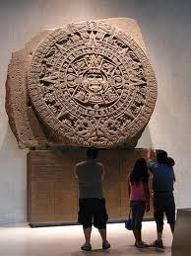
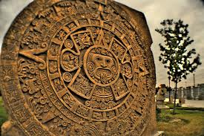
Aztec Society
Highly stratified
Elites were 5 – 10% of population
Macehualtin = Peasants + Artisans
Slaves = 5% of Tenochtitlàn

Slide 8
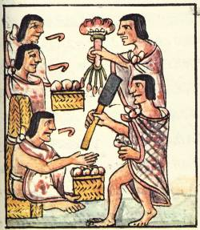
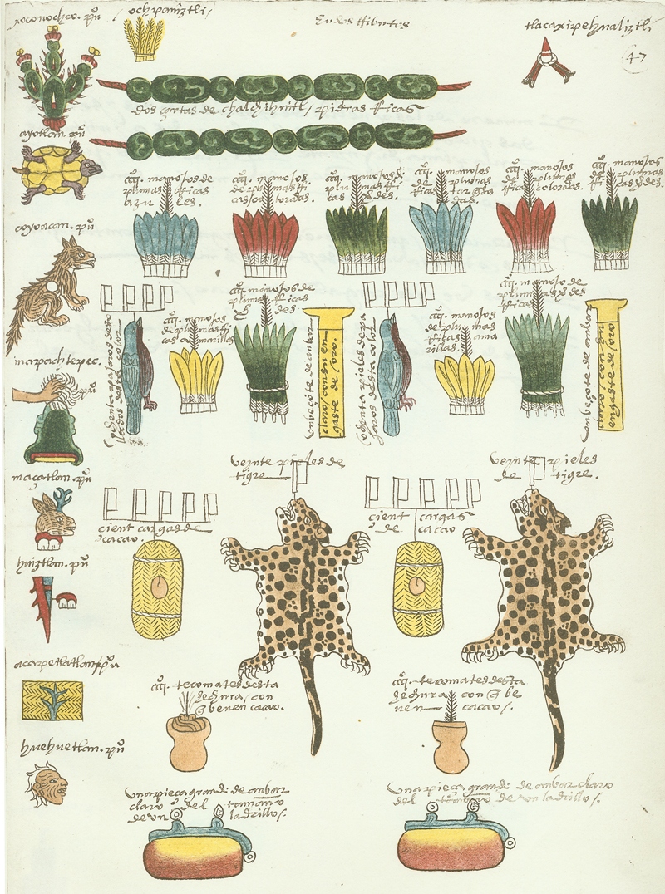
Tribute
Once or twice per year
Clothing, maize, animals, stones, jewelry

Slide 9
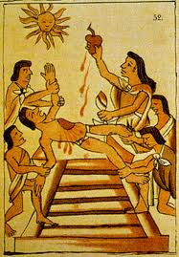
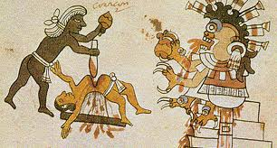
Why did human sacrifice matter?
Pleasing gods
A way to prevent destruction
Projecting power of rulers

Slide 10
Religion
Ometeotl = “Two God” mother/father to all gods
Texcatlipoca = “Smoking Mirror,” supreme power
Xochiquetzal = (Goddess) Pregnancy, weaving
Tlazolteotl = (Goddess) Carnal love, sin, filth
Mixcoatl = Patron of Chichimecas
Huitzilopochtli = War & sun
Quetzalcoatl = Wind
Tlaloc = Rain

Slide 11
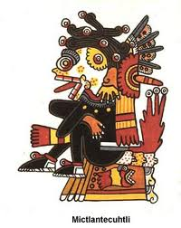
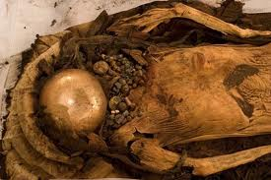
Death
Mictlan
Dog as “soul companion”
4 years of wandering
Cremation vs. burial
Mummies

Slide 12
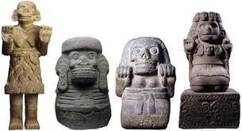
Cihuateteo
“The Divine Women”
Goddesses who died during childbirth
Accompany the sun from zenith to sunset

Slide 13
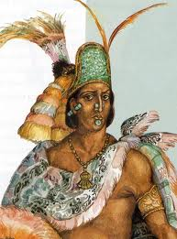
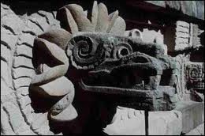
Moctezuma
Became Aztec emperor in 1500
Waited for return of Quetzalcoatl

