Slide 1
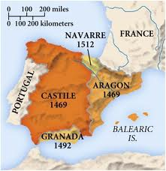
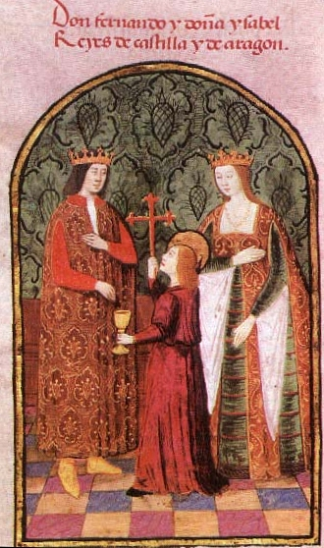
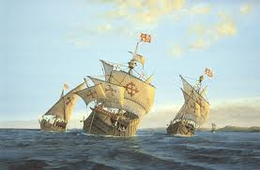
Spain: Why Explore in 1492?

Slide 2
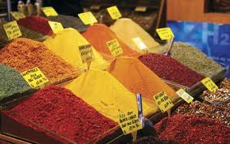
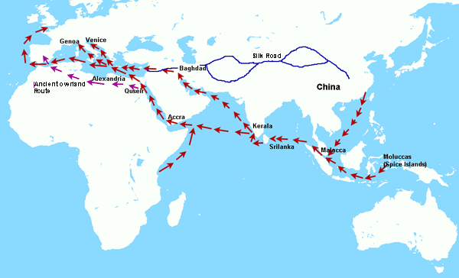
Seeking Faster Trade Routes to Asia
Spices, silk, & cotton from China and Asia
Overland trade routes controlled by Muslim rulers

Slide 3
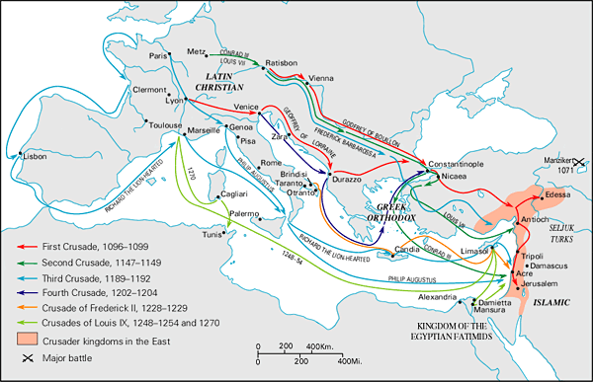
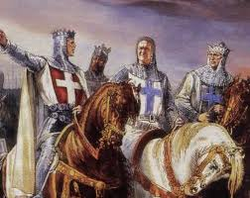
Desire to Spread Christianity
Crusades = 300 year holy war to control Jerusalem

Slide 4
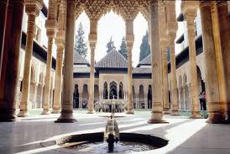
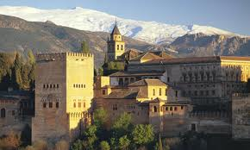
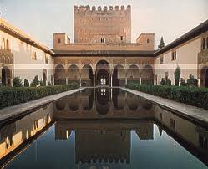
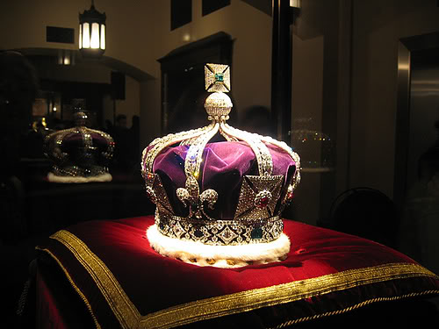
The Need to Fund the Monarchy
The Alhambra

Slide 5
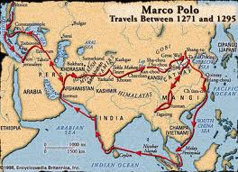
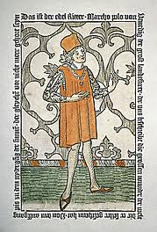
Marco Polo
Venetian merchant who explored Asia in the 1270s

Slide 6
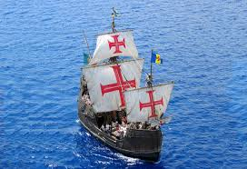
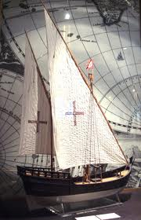
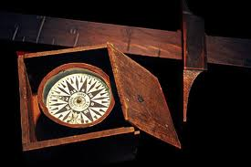
Advances in Technology

Slide 7
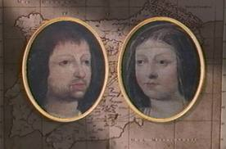
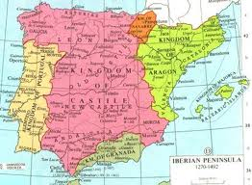
The “Catholic Kings”
King Ferdinand of Aragon & Queen Isabel of Castile unite Spain in 1469 through marriage

Slide 8
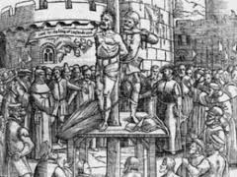
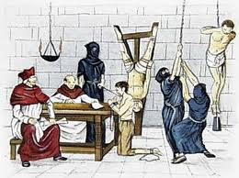
The Reconquista
1478 = Formation of Inquisition in Spain
1492 = Expulsion of Jews from Spain
1492 = Conquest of Granada, the last Islamic kingdom in Spain

Slide 9
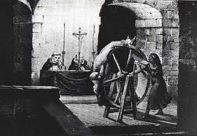
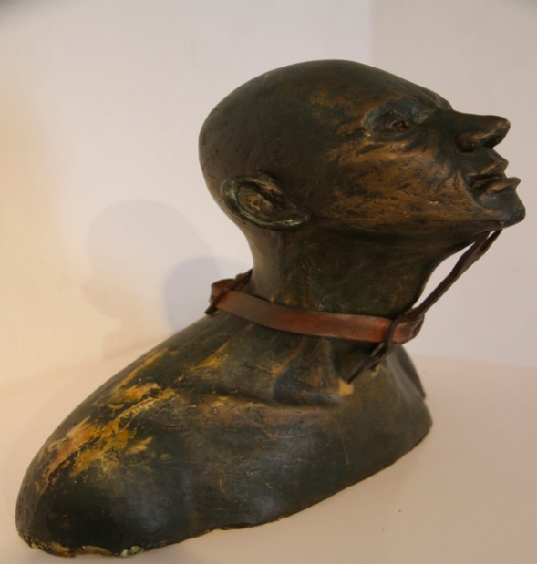
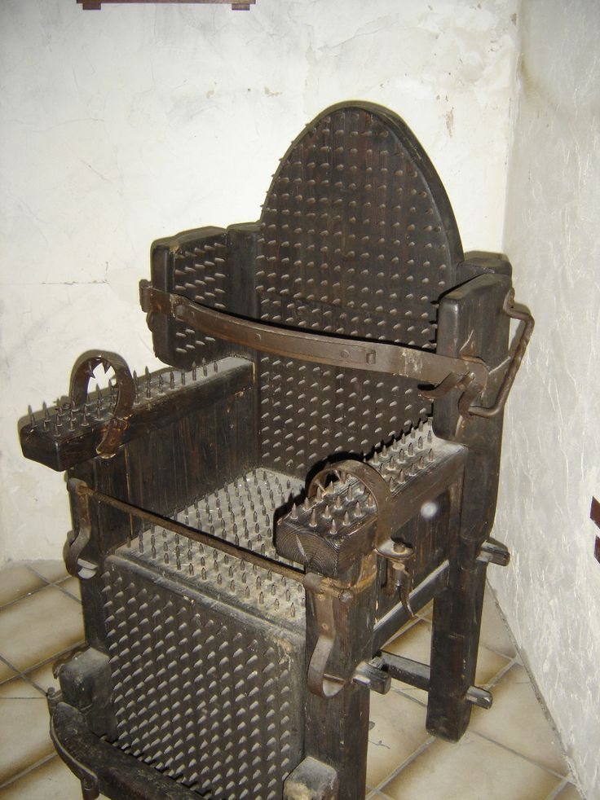
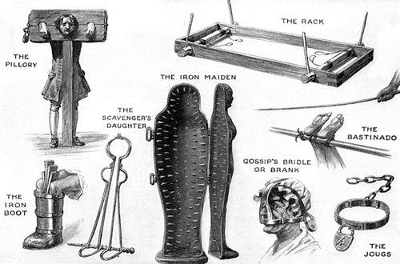

Inquisition Torture Devices

Slide 10
http://explorethemed.com/reconquista.asp?c=1

