Slide 1
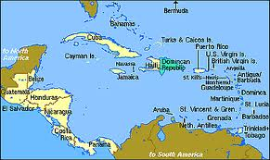
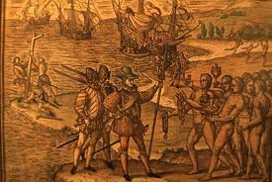
Columbus & the Caribbean

Slide 2
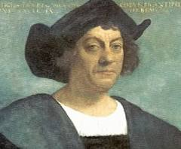
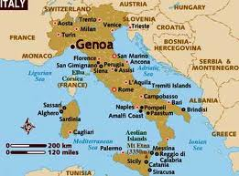
Who was Columbus?
Born in Genoa, Italy around 1451
Experienced sailor who worked with Portuguese traders
May have been Jewish
Devout Catholic

Slide 3
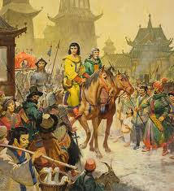
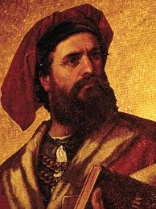
Marco Polo’s Image of Asia

Slide 4
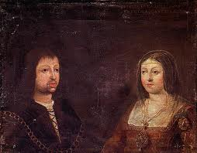
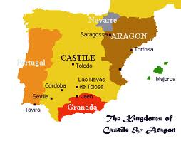
Columbus Sets Sail
Denied funding by Portugal, France, & England
Queen Isabel and King Ferdinand had the right to rule any land found by Columbus
3 ships funded for exploratory mission to find a faster route to Asia

Slide 5
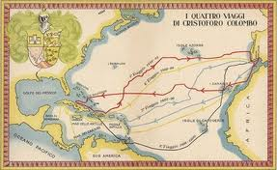
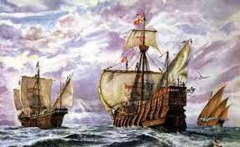
Niña, Pinta, Santa Maria

Slide 6
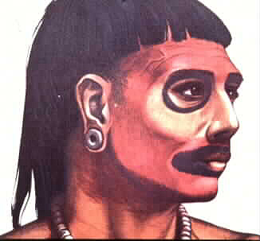
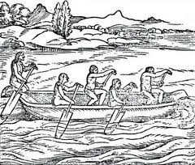
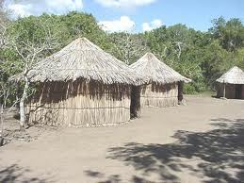
Who did Columbus Encounter?
Taino and the Carib
Landed first in the Bahamas
Noticed the Taino’s gold jewelry on Hispaniola

Slide 7
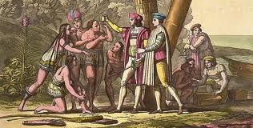
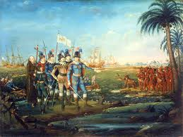

Slide 8
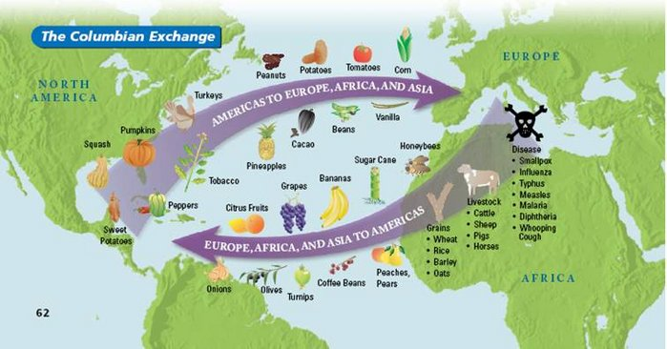
The Columbian Exchange

Slide 9
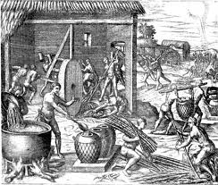
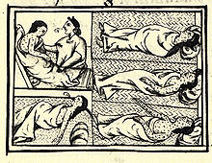
The “Great Dying”
About 95% of the Caribbean Indians died in the first 25 years of Spanish contact
Illustration by Theodor de Bry
Florentine Codex

Slide 10
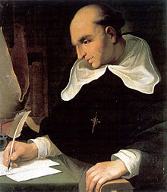
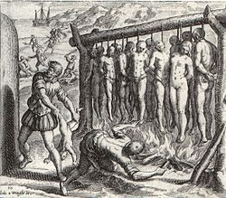
Changes in Hispaniola
First Royal Governor Fray Ovando established repartimiento system
African slaves brought for labor in 1505 & 1518
Bartolome de las Casas, The Destruction of the Indies, 1552
Bartolome de las Casas
Theodor de Bry’s Depiction of the Indies

Slide 11
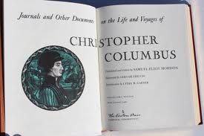
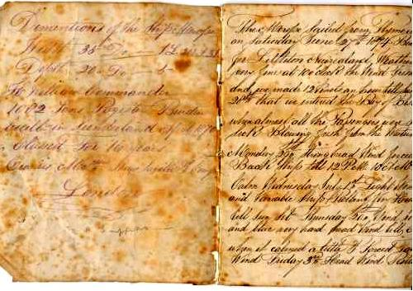
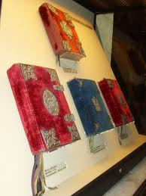
End of Columbus’ Life
Returned to Spain before his death in 1506
Conflict with his sailors & arrest for mismanagement of Hispaniola harmed his reputation

