Slide 1
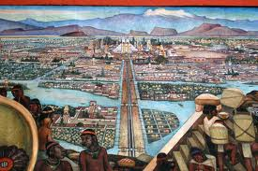
Cortès and the Conquest of Mexico

Slide 2
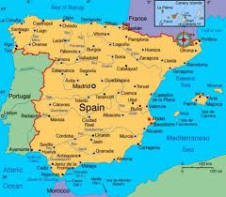
Who were the Conquistadores?
Most had experience in the Caribbean
Most were lower middle class, a small # were “hidalgos”
All expected wealth, land, slaves, & political positions
Most died in Mesoamerica & South America

Slide 3
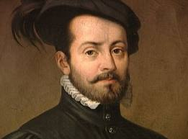
Cortès & the Maya
First encountered in the Yucatan in 1519
1,500 Yucatan Maya & 37 Spaniards died
Geronimo de Aguilar, shipwrecked for 8 years

Slide 4
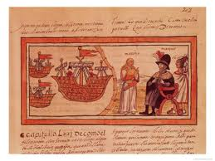
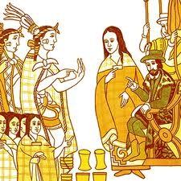
Who was Malinche?
Malintzìn, Doña Marina, Malinche
Given to Cortès as a slave
Spoke Nahuatl, Maya, & Spanish

Slide 5
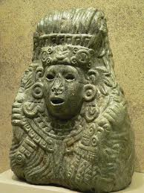
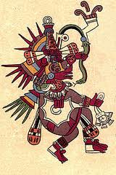
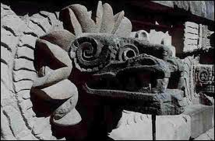
Quetzalcoatl
“The Feathered Serpent”
Tall, bearded, white god who was going to return

Slide 6
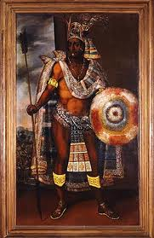
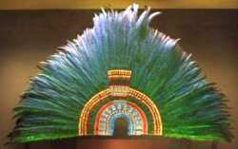
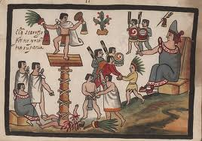
Moctezuma

Slide 7
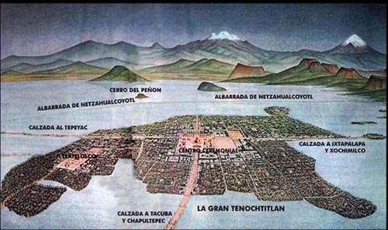
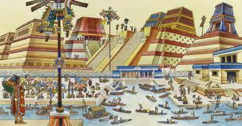
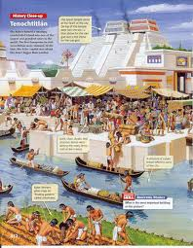
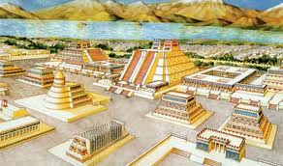
Tenochtitlàn

Slide 8
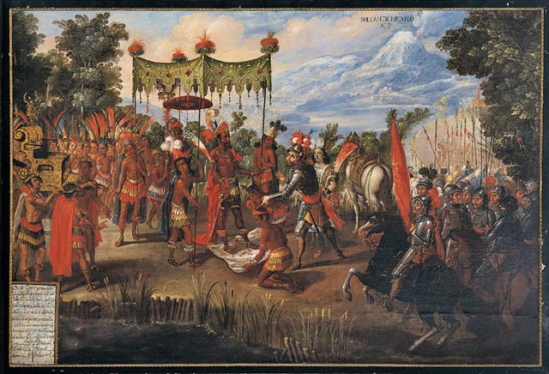
18th Century Spanish Depiction of Cortès & Moctezuma’s First Meeting

Slide 9
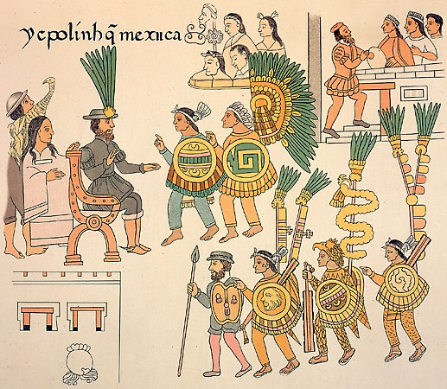
Reasons for the Fall of the Aztecs
Disease: Smallpox, typhoid, cholera, malaria, influenza
Technology &
Weaponry
Native Allies angry
with the Aztecs

Slide 10
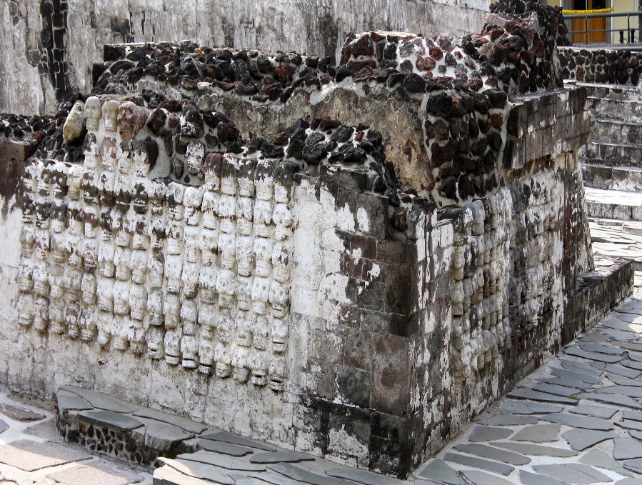
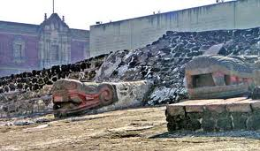
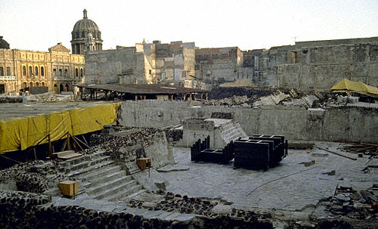
Skulls in the Templo Mayor ruins
Tenochtitlàn today

Slide 11
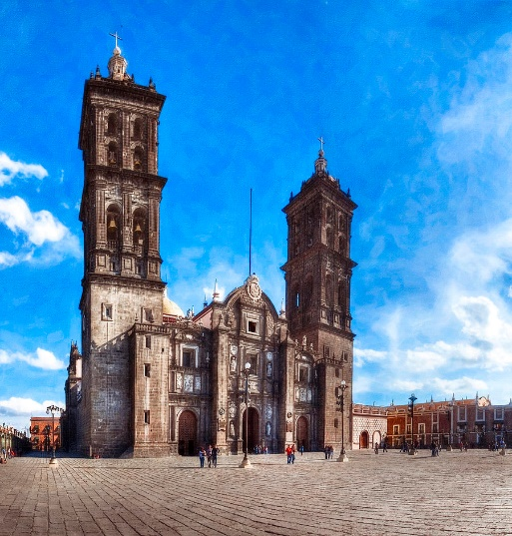
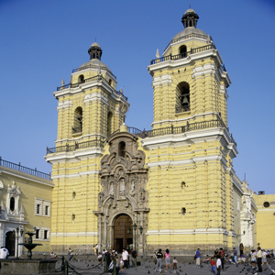

Religion & Colonization
Aztec temples destroyed
Franciscan, Dominican, Augustinian friars in charge of conversion to Catholicism

