Slide 1
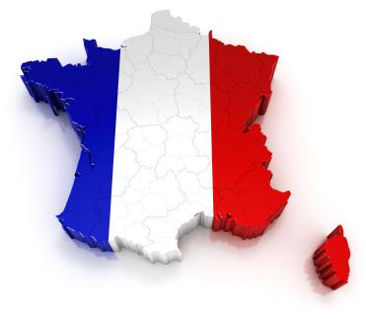
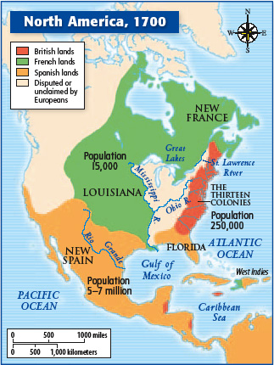

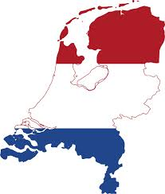
Portugal, France, & the Netherlands

Slide 2
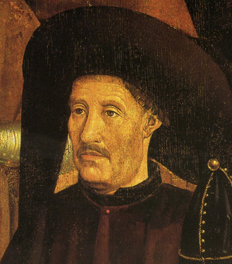
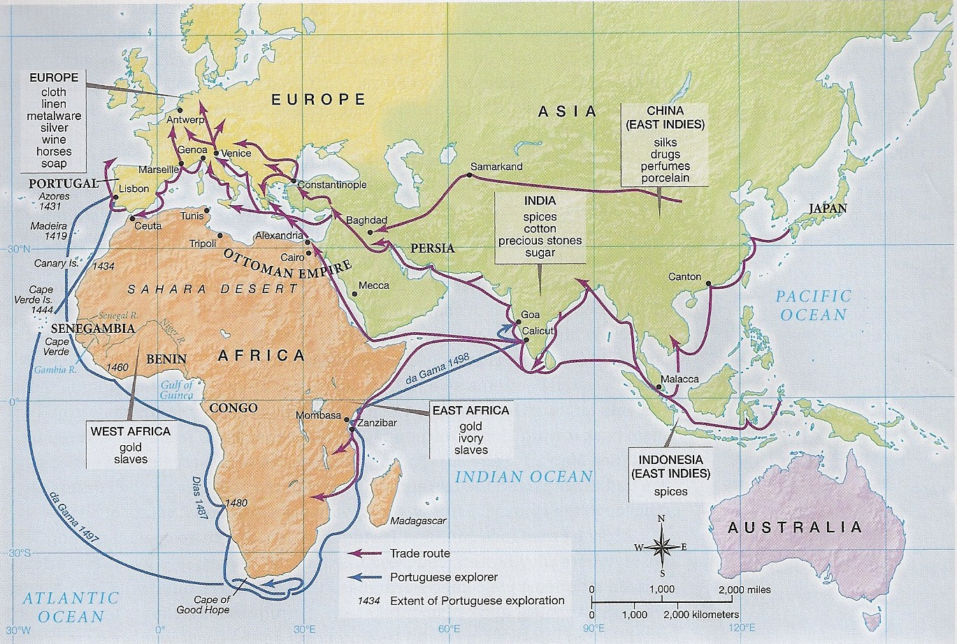
Portugal
Navigation & Influence of Prince Henry the Navigator
1420s -1430s = Established sugar plantations on Madeira, Canary Islands, Cape Verde, & Azores

Slide 3
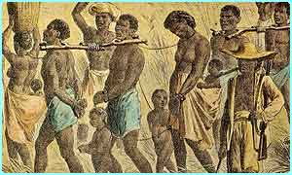
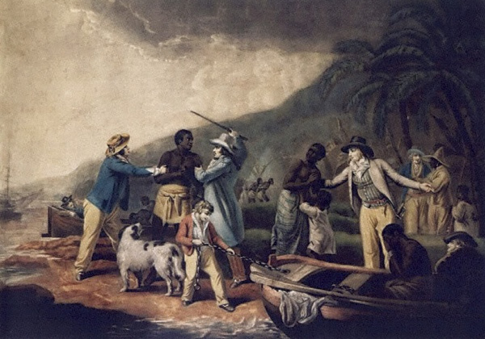
Portugal’s Role in the Slave Trade
Set up trading posts in West Africa
Established model of slave labor used by other European powers

Slide 4
African Slavery
Slaves of rival tribes captured through war
Slavery was not always permanent nor hereditary
Europeans controlled slave trade after 1600

Slide 5
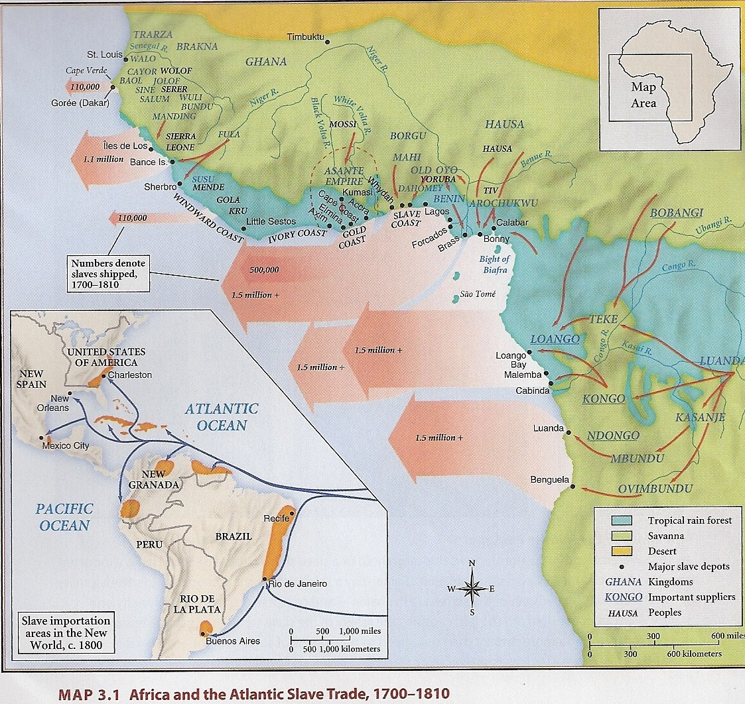
Areas of African Slave Trade

Slide 6
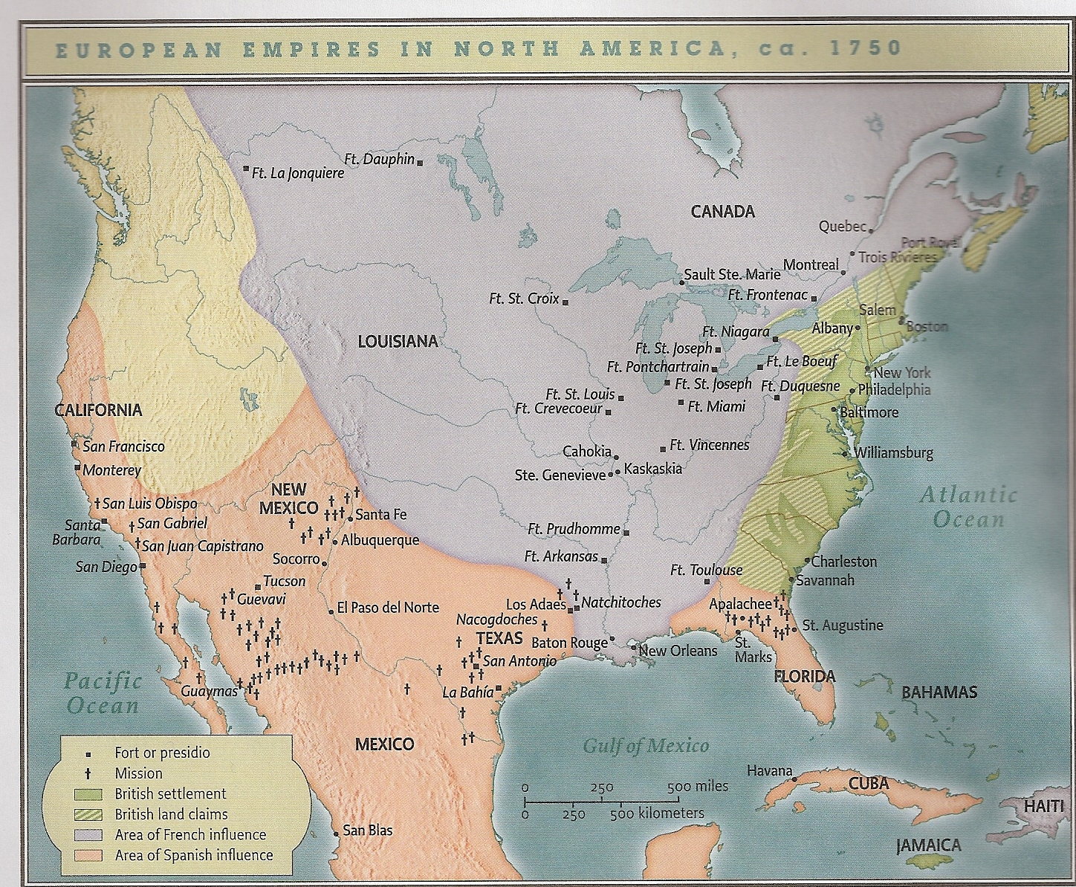
France
1534 = Cartier traveled up St. Lawrence River
1555, 1562, 1564 = Huguenots set up failed colonies in Brazil, South Carolina, & Florida

Slide 7
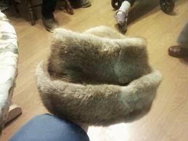
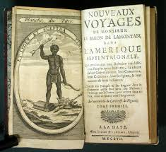
The French & Native Americans
Early 1600s = Fur trading posts established in Quebec & Nova Scotia
French allied with Hurons
English & Dutch allied with the Iroquois (enemy of the Hurons)
Early contact limited to fur trade

Slide 8
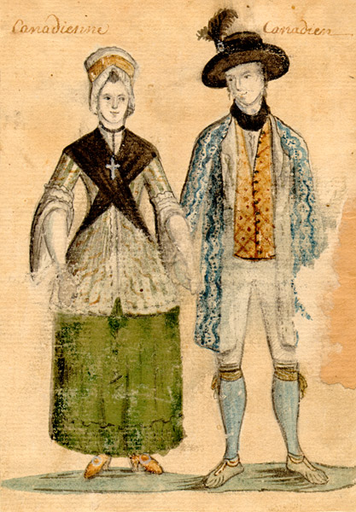
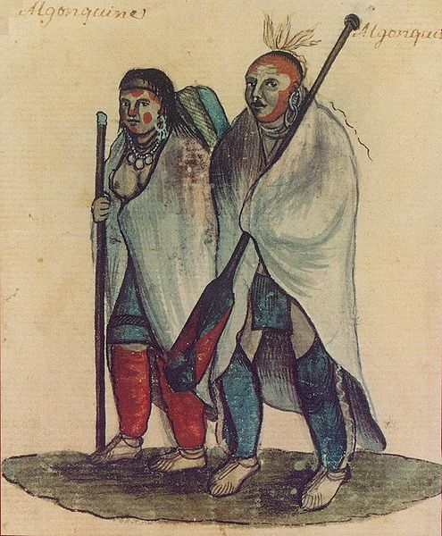
Settlement in New France
French intermarried Native American women
Jesuits involved in conversion
1680 = Canada’s population was 10,000 people
1/3 of French settlers involved in the fur trade

Slide 9
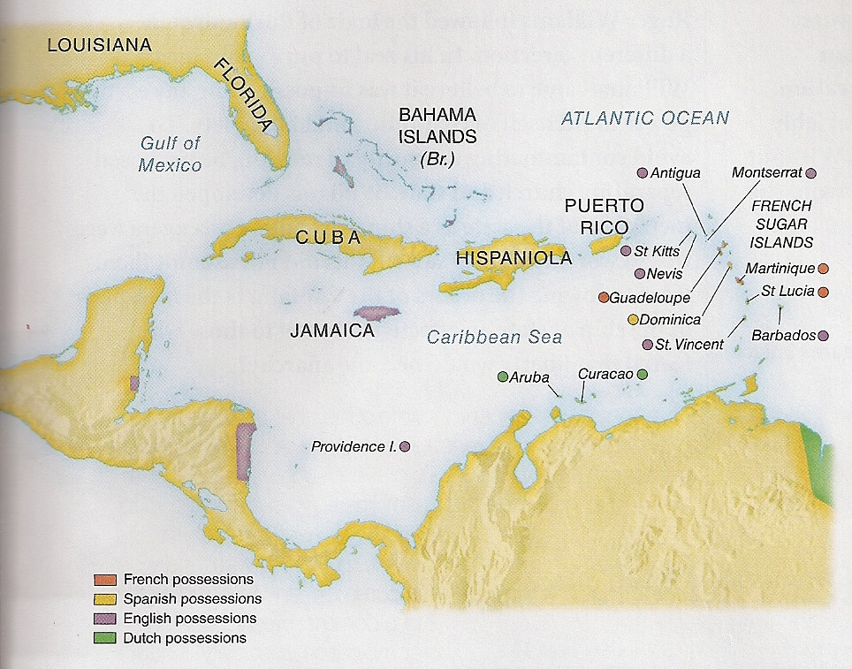


French Caribbean
Sugar, coffee, rice, cotton, indigo, tobacco, cocoa
1/3 of new slaves died within first 3 years in the Caribbean

Slide 10
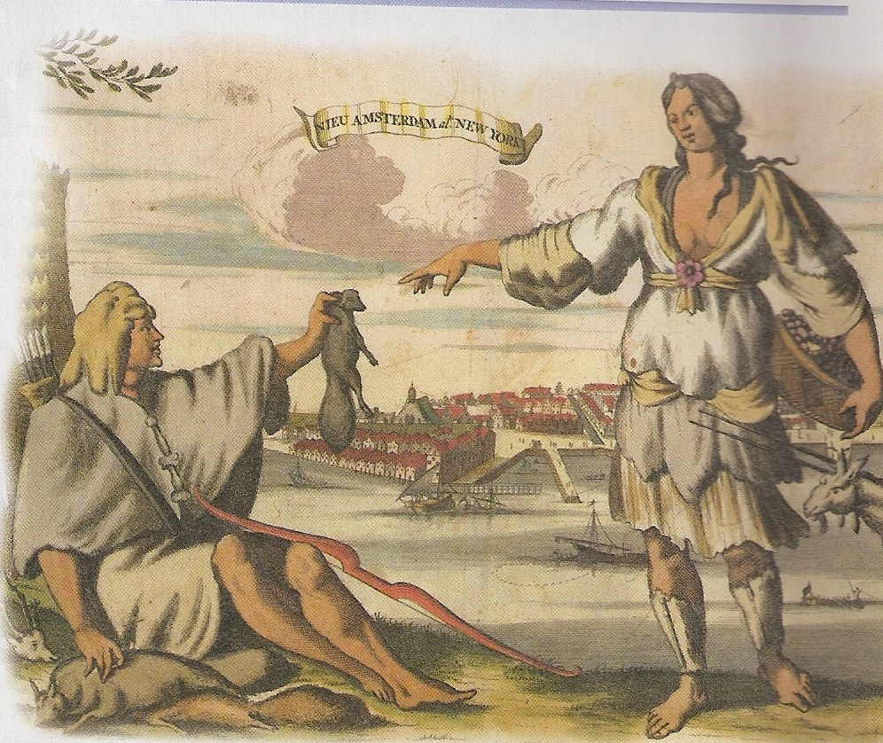
Dutch in the New World
New Netherlands established around 1613
Dutch bought Manhattan & did not try to convert the Indians

Slide 11
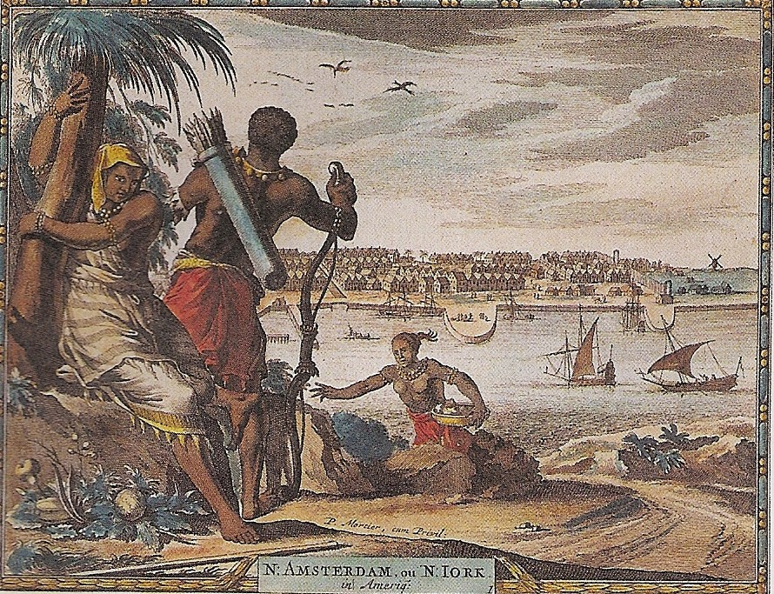
Diversity in New Amsterdam
1643 = 18 different languages spoken
Religious toleration = Catholics, Puritans, Lutherans, Anabaptists, Mennonites, Quakers, & Jews
1664 = Slaves were 1/10 of the population
1650 = ½ of Long Island went to England

