Slide 1
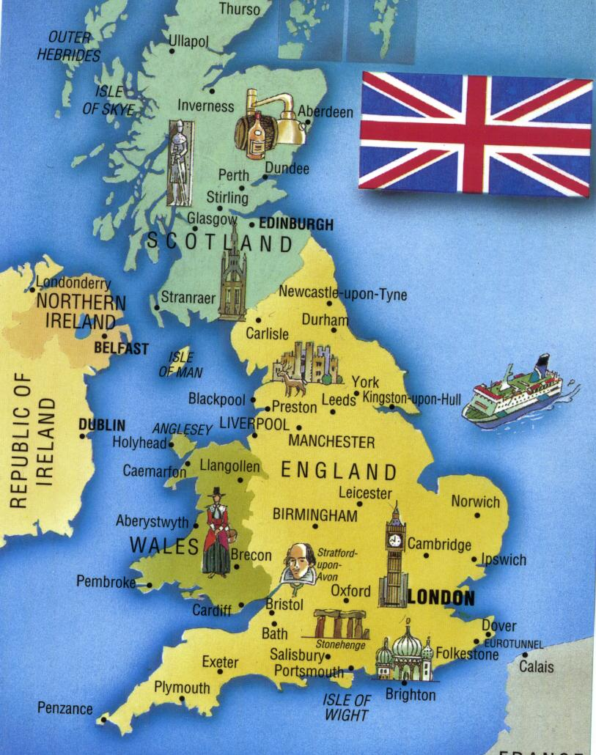
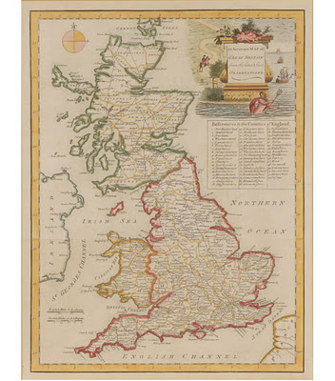
England

Slide 2
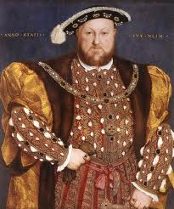
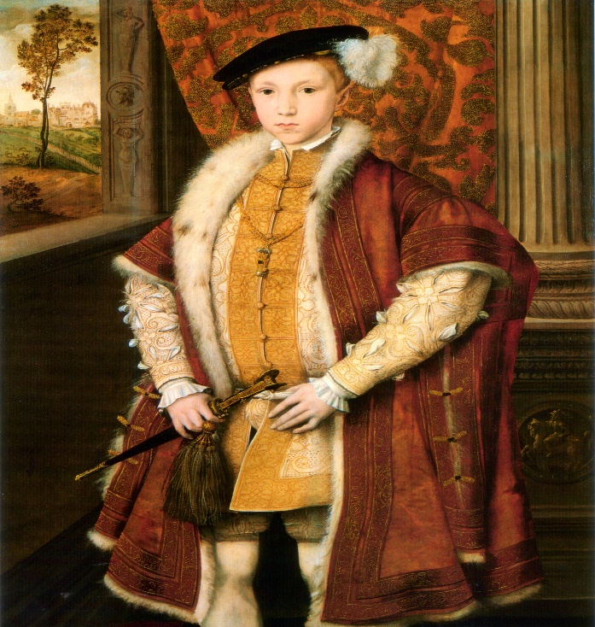
Why did England wait until the 1600s to colonize?
Preoccupied with leadership crisis after the death of King Henry VIII in 1547

Slide 3
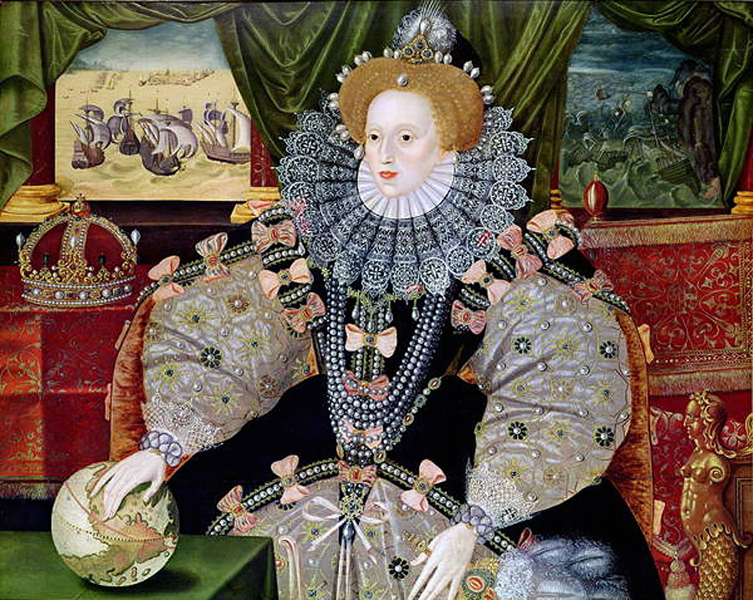
Queen Elizabeth I
“Then shall her Majesty’s dominions be enlarged, all odious idleness from our realm utterly banished, dives decayed towns repaired, and the ignorant and barbarian idolators taught to know Christ.”
--Sir George Peckham,
1582

Slide 4
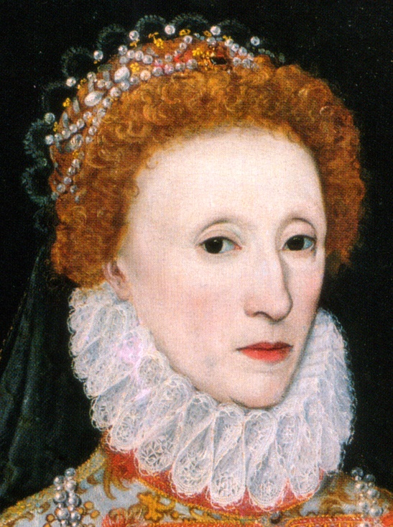
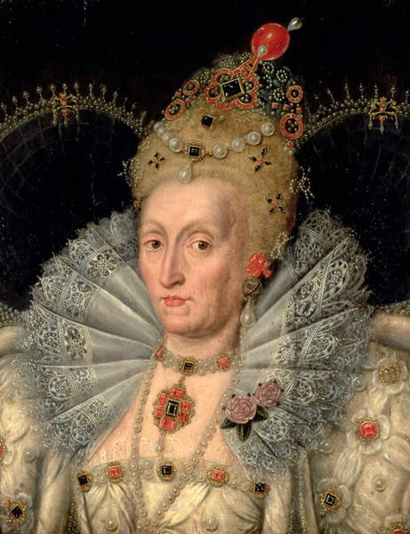
1497 = John Cabot sailed from England
1500s = England was a minor power in Europe
English doubted the value of North America
1558 – 1603 = Queen Elizabeth’s attitude changed during her reign

Slide 5
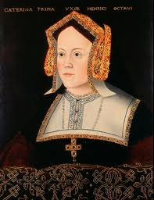
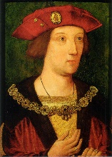
Henry the VIII
Henry 7th built an alliance with Spain by marrying son Arthur with Spain’s Catherine of Aragon
Henry VIII married Catherine after Arthur died

Slide 6

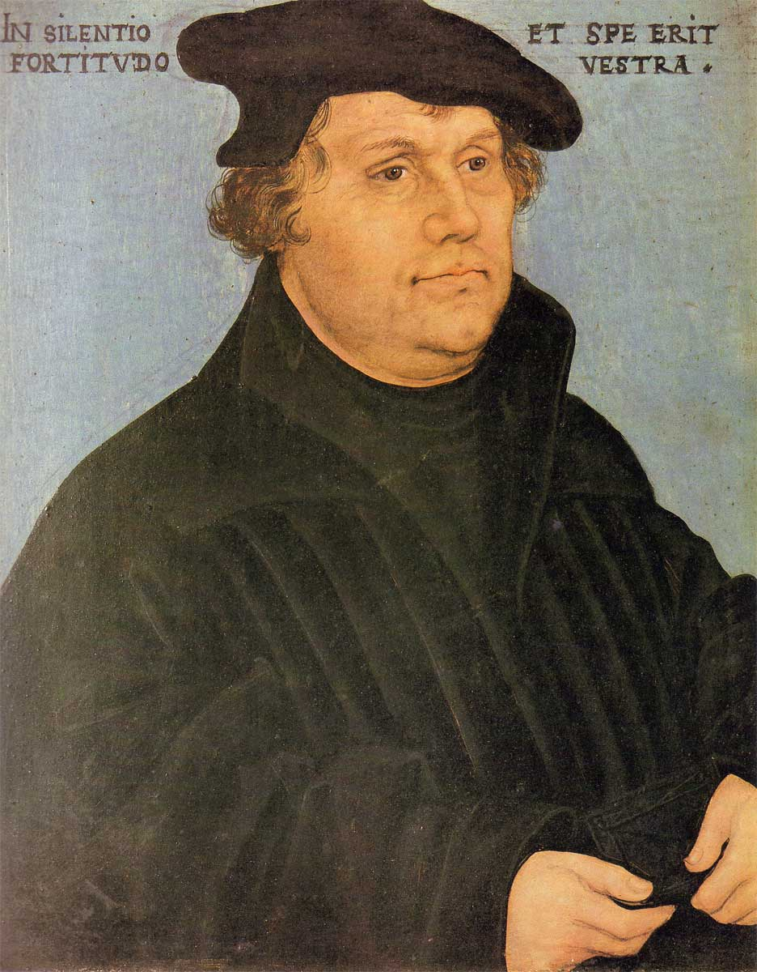
The English Reformation
1517 = Martin Luther’s 95 Theses & the Protestant Reformation
Anne Boleyn
Henry VIII formed Protestant Church of England (Anglican Church)

Slide 7
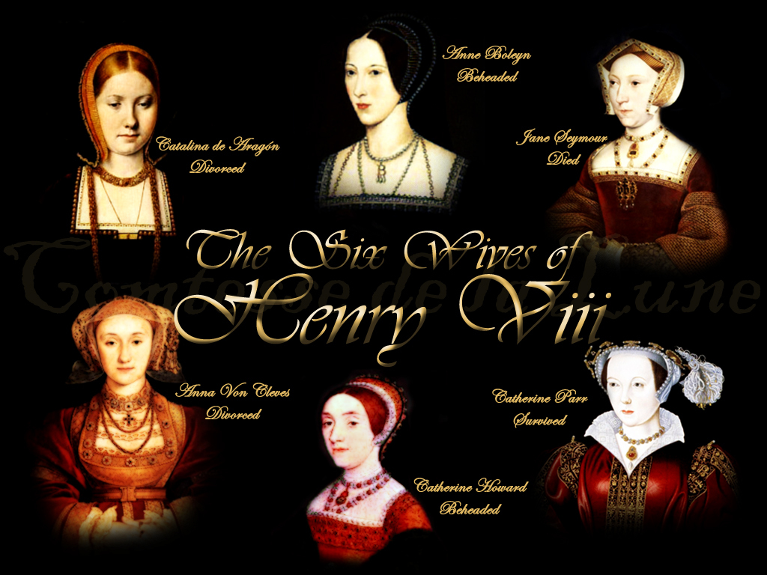

Slide 8
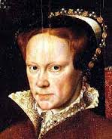
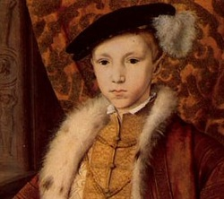
Henry VIII’s Heirs
1547 – 1553 = Protestant, young King Edward
1553 – 1558 = Catholic “Bloody Mary”
Protestants persecuted under “Bloody Mary”
1558 – 1603 = Elizabeth restored England back to Protestantism

Slide 9
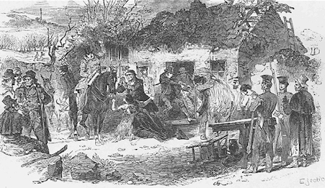
Ireland
Large Catholic population persecuted by English military conquest
Similarities to American settlement
Eviction of Catholic tenants in Ireland

Slide 10
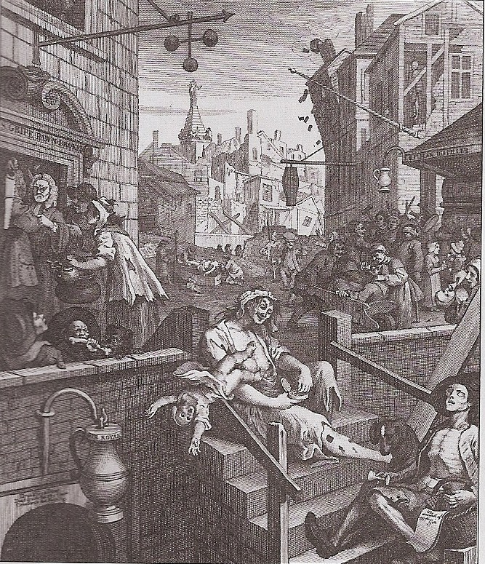
The Social Crisis
1500s = Overpopulation in England
1550 = 3 million people
1600 = 4 million people
Decreased food production
“Enclosure” movement
End of 1600s = ½ of England lived in poverty
William Hogarth, Gin Lane

Slide 11
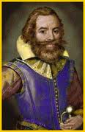
America: Land of Opportunity
“Every man may be the master and owner of his own labor an land.”
--John Smith from Virginia, 1607

