Slide 1
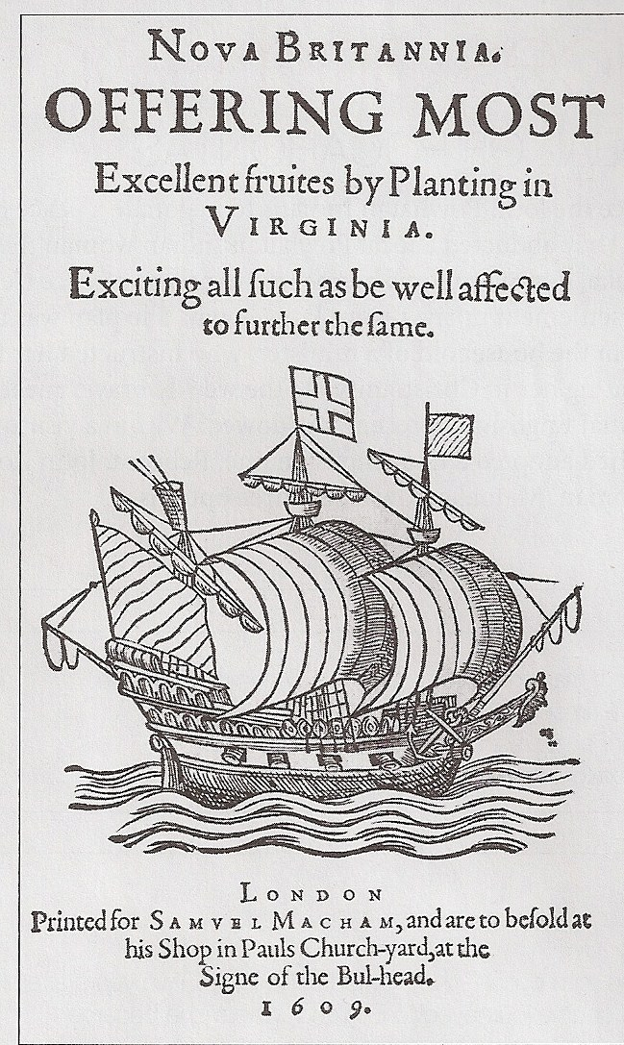
England’s Early Colonization

Slide 2
Religion in England in the 1500s
1530s = Henry VIII forms Church of England (English Reformation)
1553 – 1558 = “Bloody Mary” returns England to Catholicism
1558 = Elizabeth I returns England to Protestantism

Slide 3
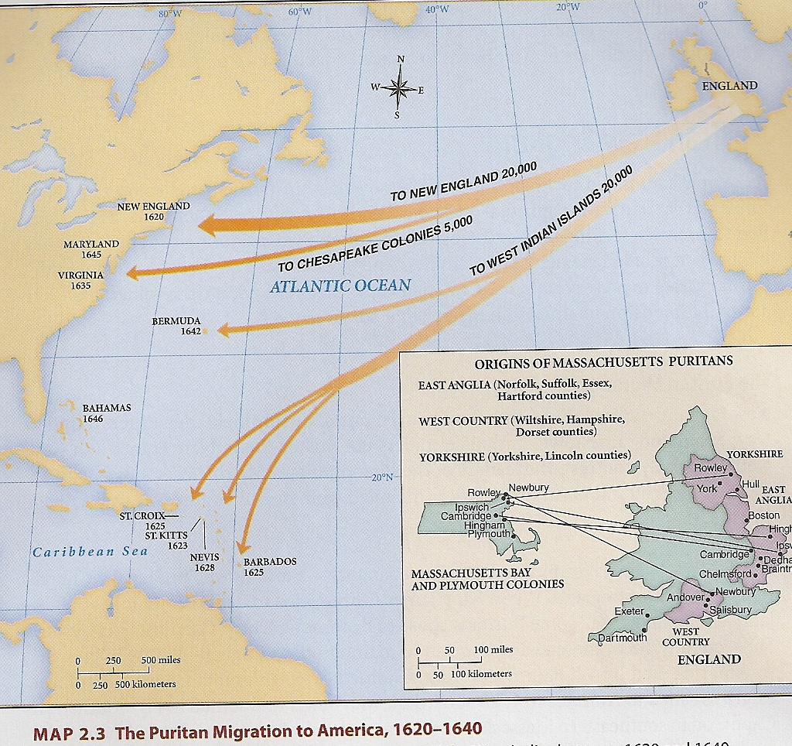
The Puritans
Anglicans who felt the Church of England was still too Catholic
Disliked church hierarchy & pressured King James in early 1600s

Slide 4
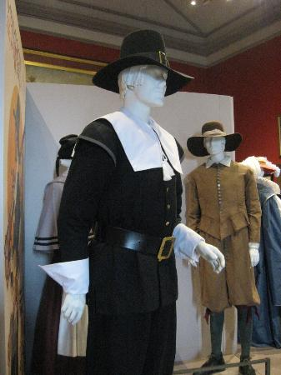
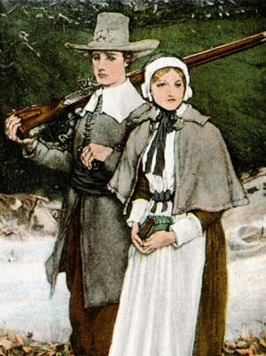
Separatists/Pilgrims
Persecuted in England
Broke with Church of England
Fled England to Leiden, Holland

Slide 5
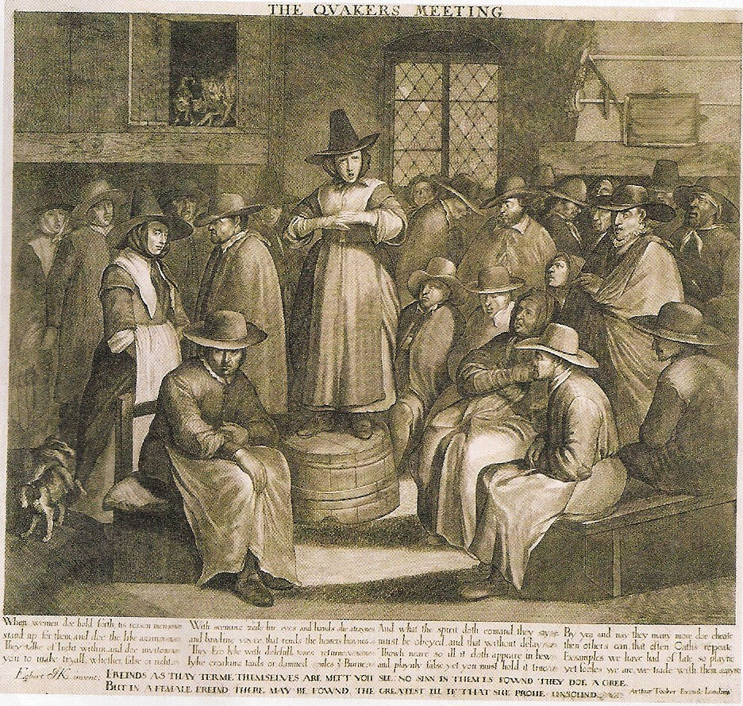
The Quakers
1649 = Society of Friends founded
1665 = 80,000 followers in England
Pacifists
Eventually settle in Pennsylvania

Slide 6
Mercantilism
Economic philosophy of 1500s & 1600s
Colonies existed to supply raw materials to the Mother Country
Colonies would supply tobacco, sugar, rice, & indigo

Slide 7
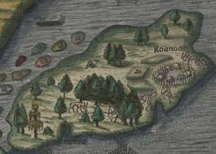

Failed Beginnings: Roanoke
1587 = Sir Walter Raleigh in charge of settlement of Roanoke Island
1590 = Governor John White returned after 3-year absence
What happened?

Slide 8
Joint Stock Company
A business company given the monopoly to trade overseas
Investors bought shares to fund the voyages & Joint Stock Company given right to govern settlers (under the authority of the Crown)
Made settlement easier

Slide 9
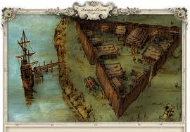
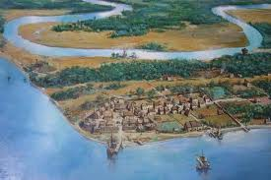
Jamestown
1606 = King James I issued charter to the Virginia Company of London to create colony in North America
1607 = 144 men sailed to Virginia, 105 arrived
Only 38 of the 105 survived the first year

Slide 10
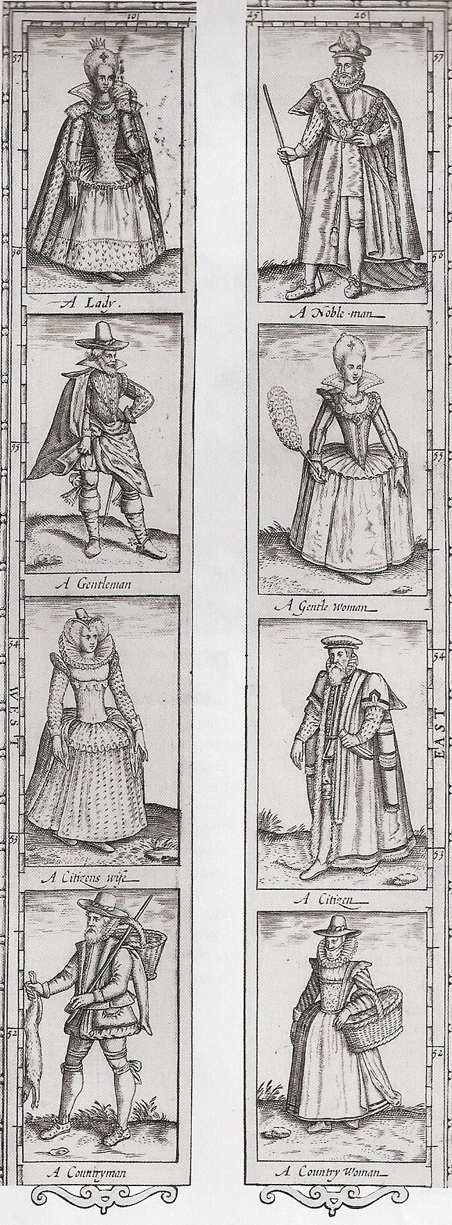
Virginia Company promoted Jamestown as “earthly paradise”
1/3 of early settlers were country gentlemen who didn’t want to work

Slide 11
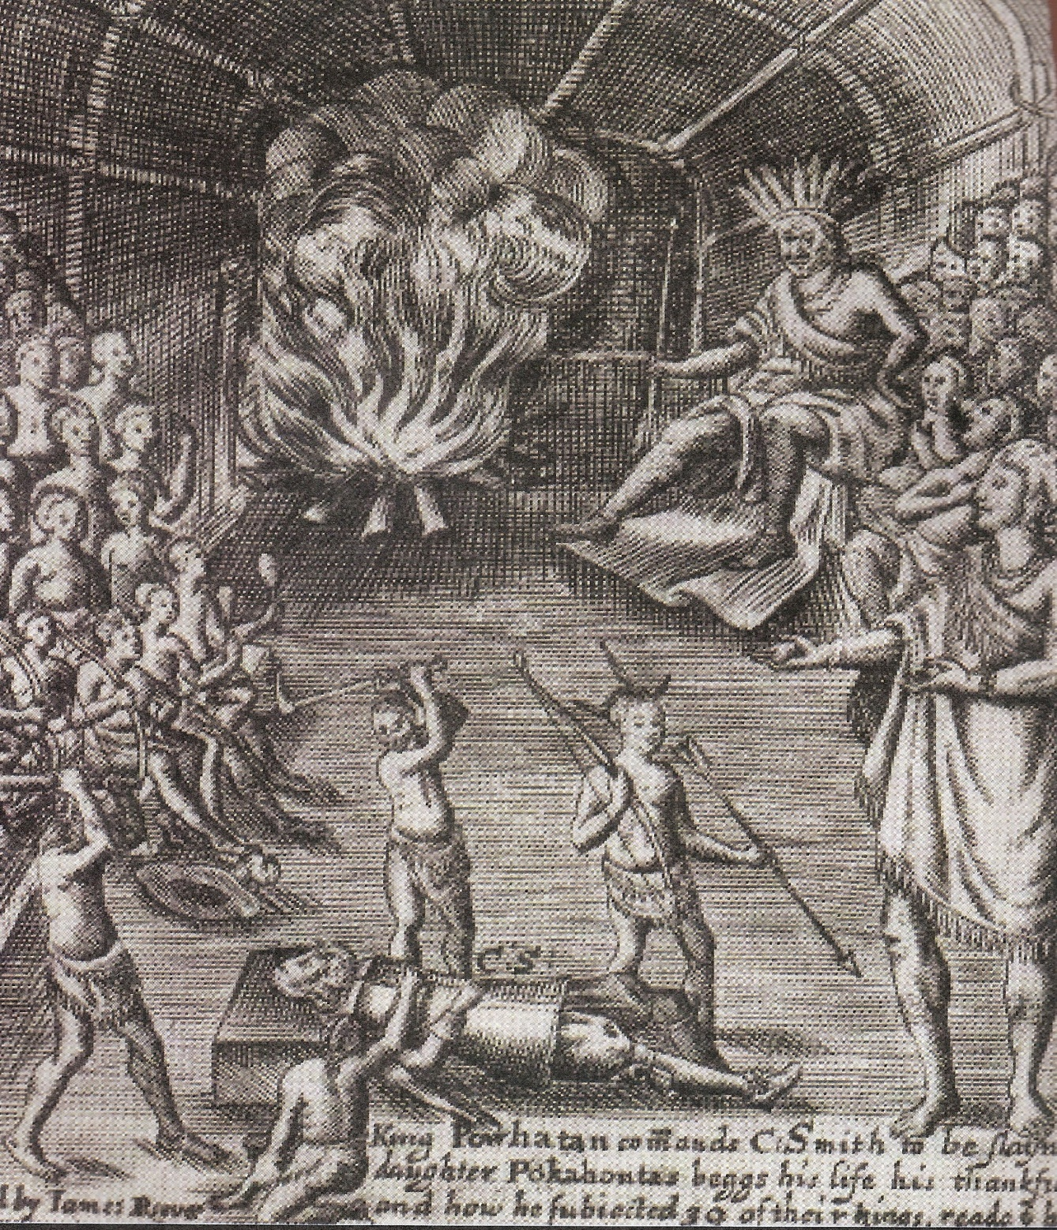
Chief Powhatan
Powhatan Indian Confederacy traded with the English settlers
Captain John Smith, A General History of Virginia, 1624

Slide 12
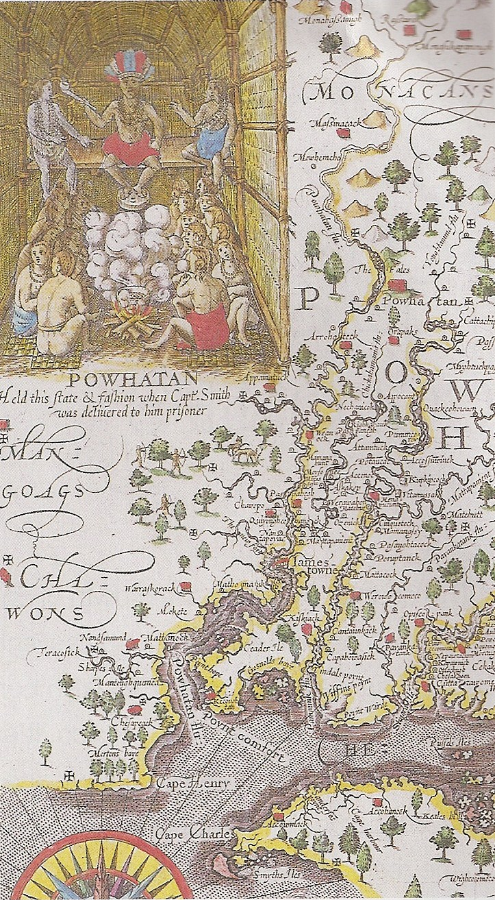
Life in Jamestown
Jamestown became royal colony of Virginia
Marriage with Native Americans considered taboo
1609 – 1610 = “Starving Time” when population of 500 – 600 shrank to 60
1616 = Virginia had 350 people
John Smith’s Map of Virginia, 1612

Slide 13

Tour of Jamestown, Virginia

