Slide 1
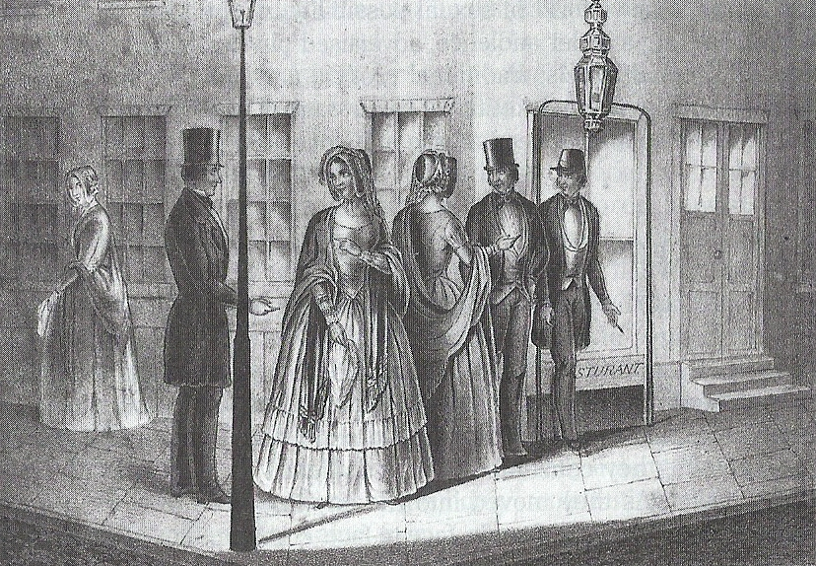
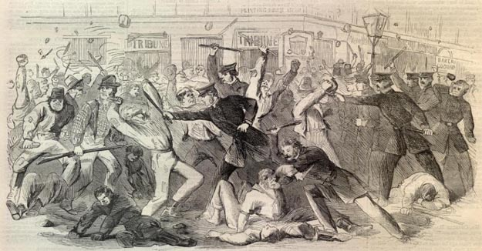
Antebellum City Life

Slide 2
Quick Facts
1820 = Less than 10% of U.S. population lived in cities
1860 = 20% lived in cities
Immigration from abroad & migration from rural America
Irish, Scottish, Welsh, English, Scandinavian, German

Slide 3
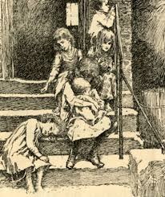
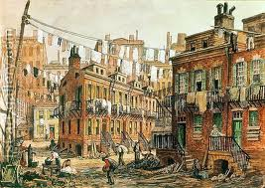
New York City’s Five Points
Multicultural, multiethnic neighborhood
Notorious symbol of urban decay for New York’s middle class

Slide 4
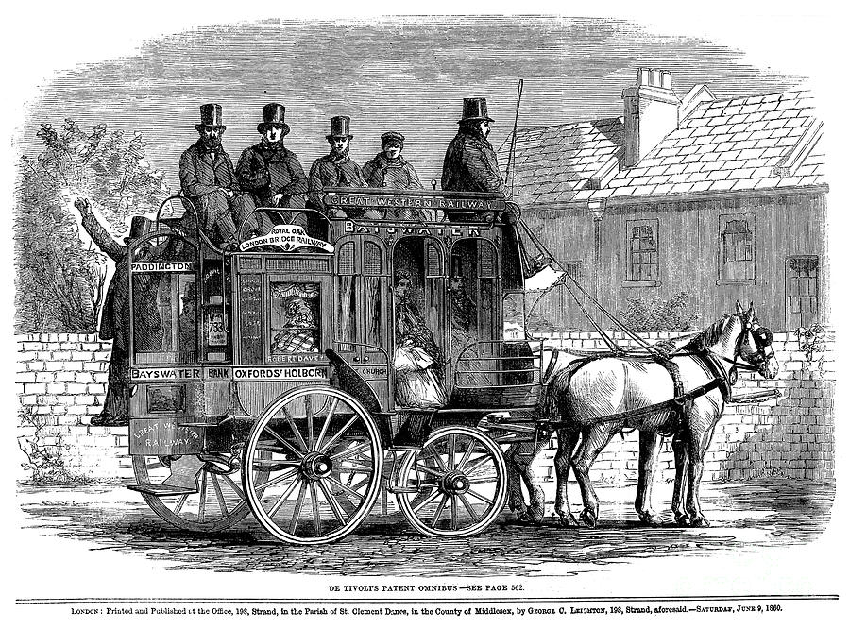
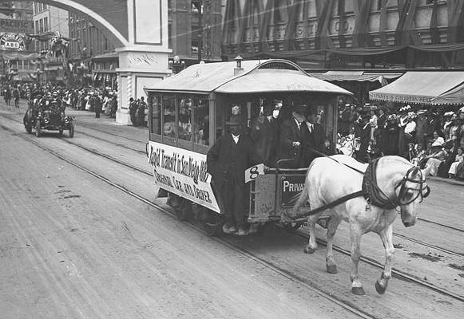
Transportation
“Walking Cities”
1827 = Omnibus stagecoach covered 80 miles in NY
1840s = Streetcar ran on tracks

Slide 5
Urban Immigration
1830 = 23,000 immigrants
1854 = 428,000 immigrants
1845 = Ireland’s potato famine killed over 1 million and inspired 1 million to immigrate to the U.S.
Irish in NY & Massachusetts = Low-skilled factory jobs & domestic servants
Germans = inland farmers, skilled artisans

Slide 6
Free Black Communities
Segregated neighborhoods in Boston, NY, Chicago, Philadelphia
Excluded from most professions
Pro-slavery population in North

Slide 7
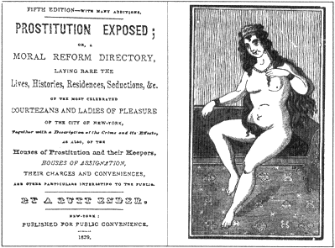
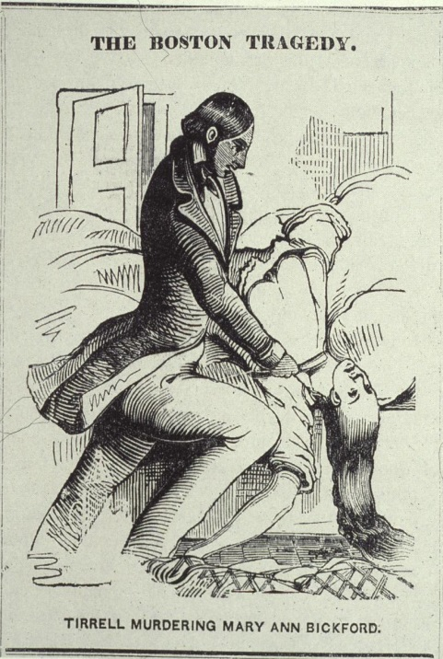
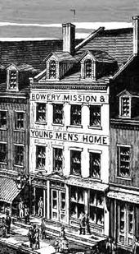
Crime
Mob and gang violence
1830s & 1840s = Anti-Catholicism
Masculine subculture & poor young women
1845 = 1st modern professional police force in NY
“Young people are thrown upon the bosom of our city and corrupted by sensuality”
--Reverend Lyman
Beecher

Slide 8
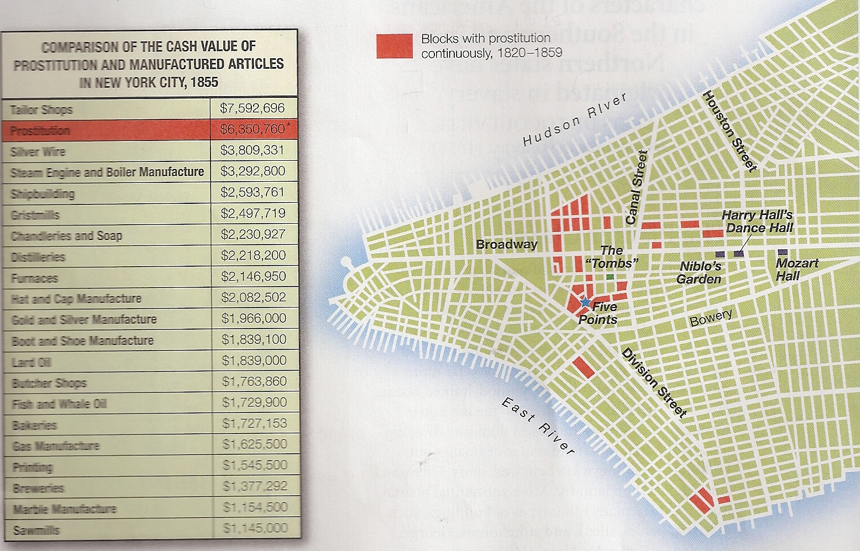

Slide 9
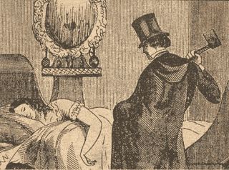
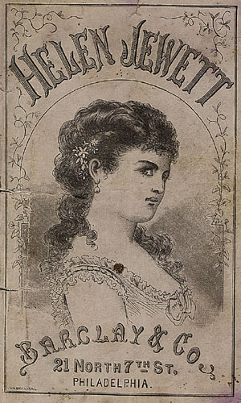
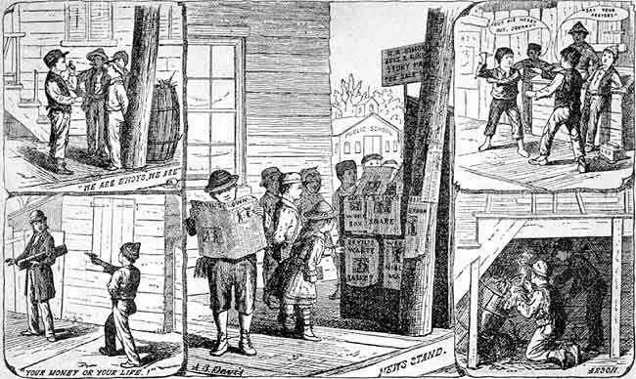
Murder of Helen Jewett, 1836
1830s = Rise of Penny Papers
NY prostitute murdered by drugstore clerk Richard Robinson
Antebellum America= Change in meaning of freedom of the press

Slide 10
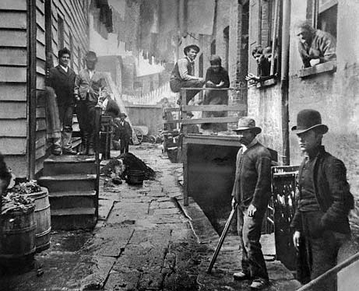
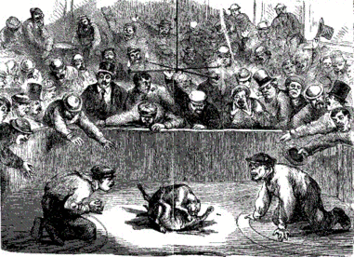
Sporting Men
Gamblers, confidence men, fight organizers
Resisted pressure to conform to middle class standards
“Frail ones” & “nymphs”

Slide 11
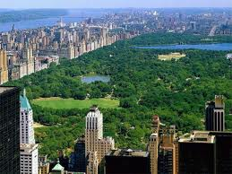
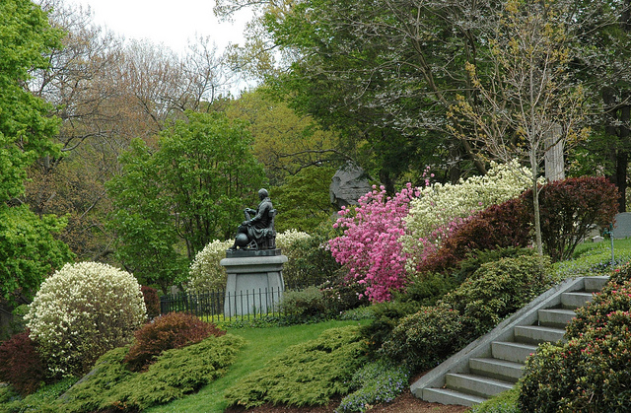
Parks & Cemeteries
Central Park, Frederick Law Olmstead, 1858
Rural Cemetery Movement = 1830s
Mount Auburn Cemetery in Cambridge
30,000 visitors annually in 1830s

