Slide 1
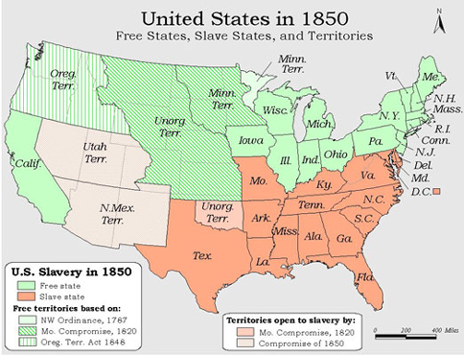
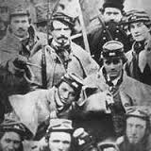
Building Up to the Civil War

Slide 2
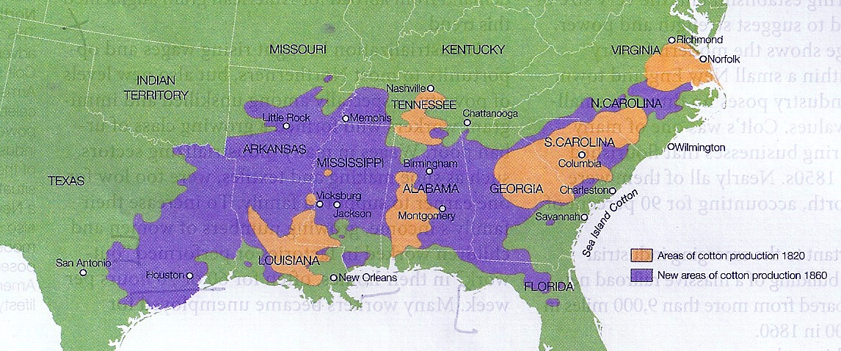
King Cotton
1810 – 1860 = Movement West to Georgia, Alabama, Mississippi, Louisiana, Arkansas, Texas
1842 = 1.3 million bales of cotton produced
1860 = 4.8 million bales
1860 = Cotton made up 3/5 of U.S. exports

Slide 3
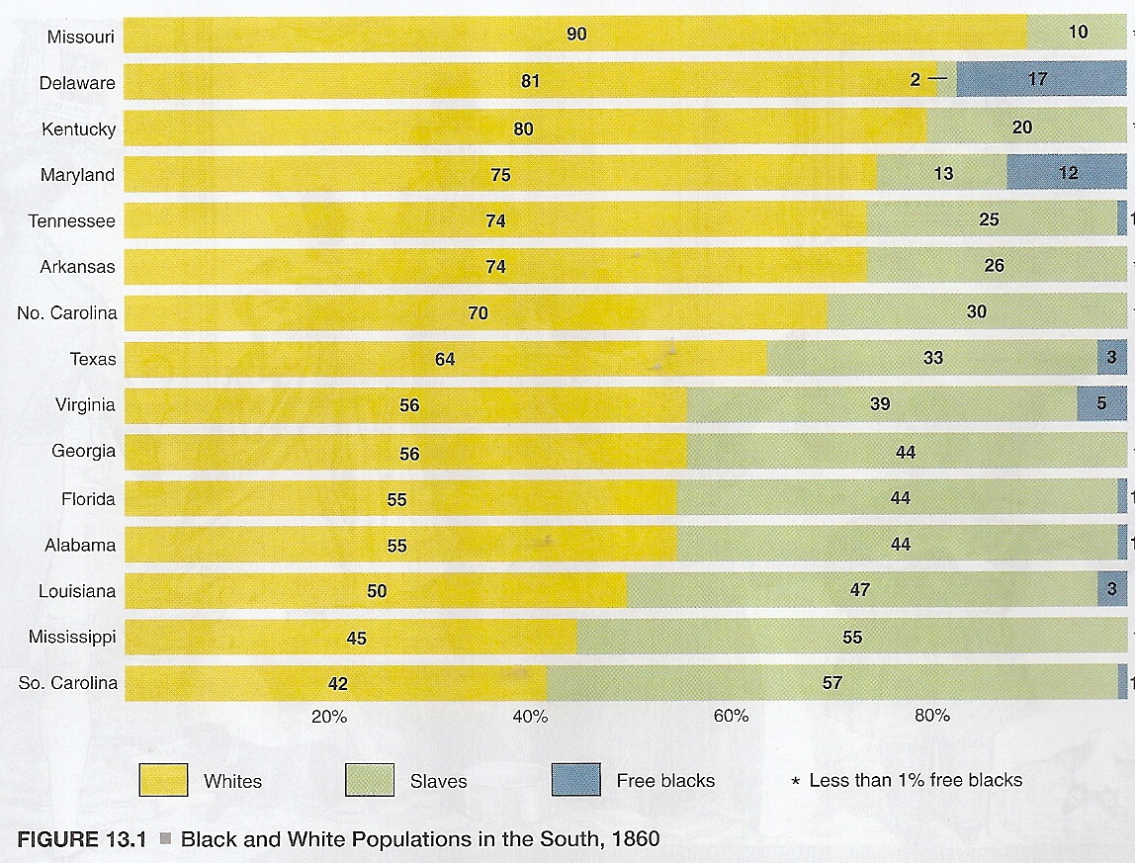

Slide 4
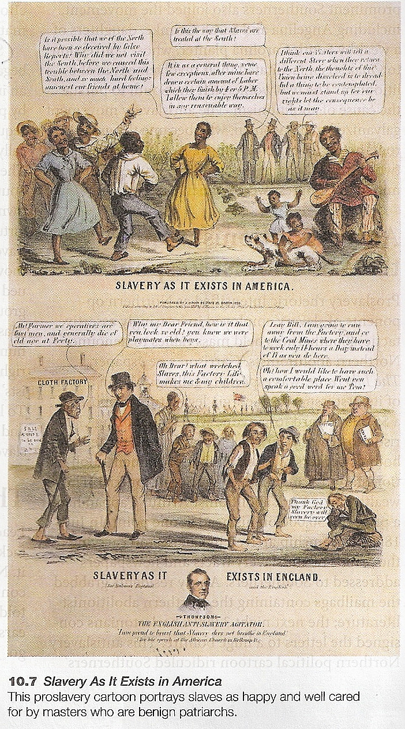
Slavery Ideologies
1770s = Anti-slavery tied to the American Revolution
Slavery relied upon the Constitution & 2-Party System
Pro-slavery argument

Slide 5
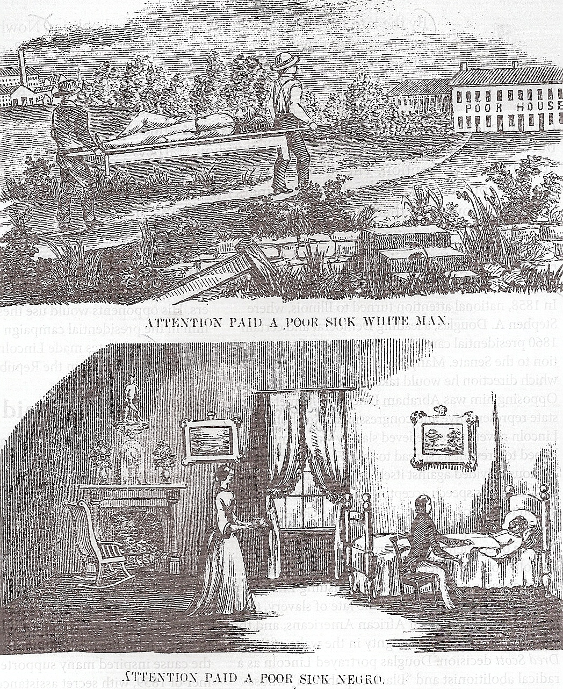
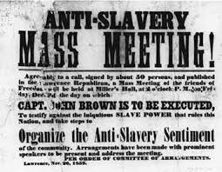
Wage Slavery
1850 = # of Wage earners exceeded # of slaves in the U.S.

Slide 6

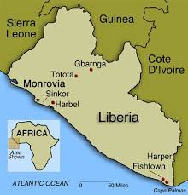
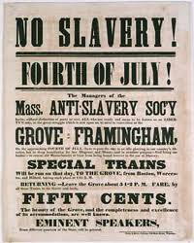
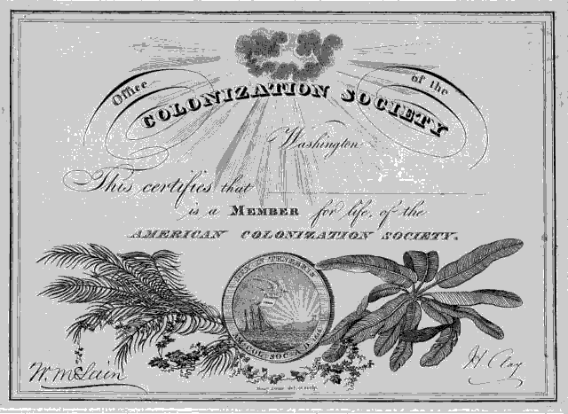
Anti-Slavery & Colonization
“Back to Africa” campaigns to Liberia
American Colonization Society, 1817
By 1830 = Only 1,400 made it to Liberia

Slide 7
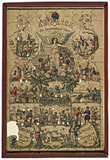
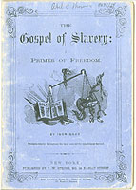
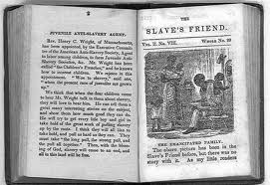
Abolition in the North
Republican Party founded in 1854
Influence of Quakers & Britain
By 1840 = Over 1,350 Anti-Slavery groups with 250,000 members

Slide 8
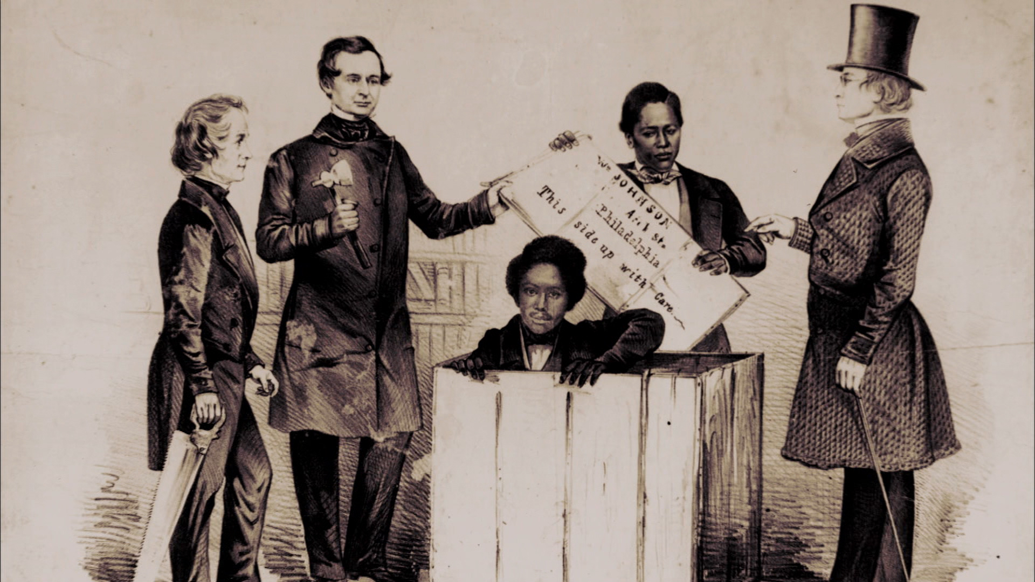

Henry “Box” Brown
Richmond, Virginia to Philadelphia
26 hours

Slide 9
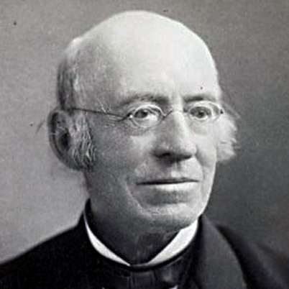
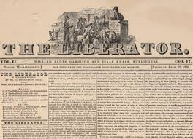
Gradualism vs. Immediatism
1825 = Gradualism replaced by Immediatism
William Lloyd Garrison
The Liberator published weekly until the 13th Amendment was signed, 1865

Slide 10
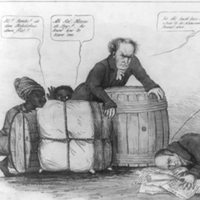
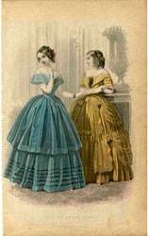
Southern Response to Anti-Slavery Movement
Mass rallies, bounty hunters, suppression of the mail
“Gag Rule,” House of Representatives, 1836
1837 = 70,000 abolitionist signatures sent to Congress

Slide 11
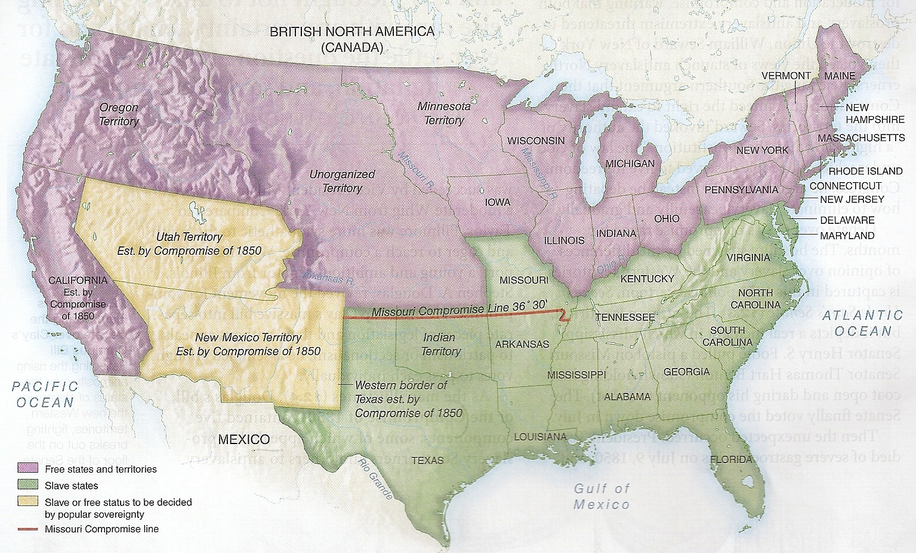
The Missouri Compromise
Prohibited slavery north of parallel 36°, 30’ except for Missouri
Response to Louisiana Purchase
Dred Scott v. Sandford (1854) declared it unconstitutional

Slide 12
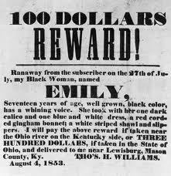
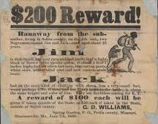
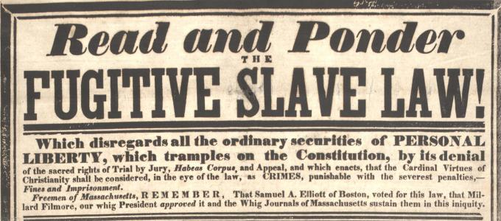
The Compromise of 1850
5 components
California = free state
New Mexico & Utah Territories = popular sovereignty
Texas boundaries shrank
Slave trade banned in D.C.
Fugitive Slave Act

Slide 13
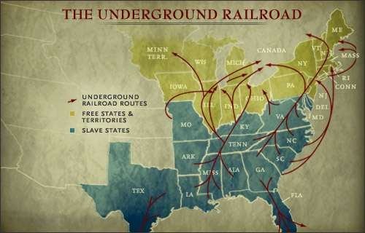
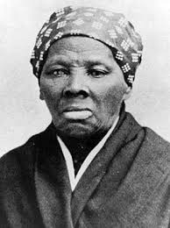

The Underground Railroad
South to Northern U.S. & Canada
1830 – 1860 = 5,000 slaves
Harriet Tubman made 19 trips

Slide 14
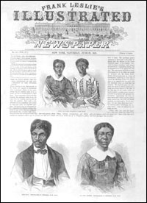
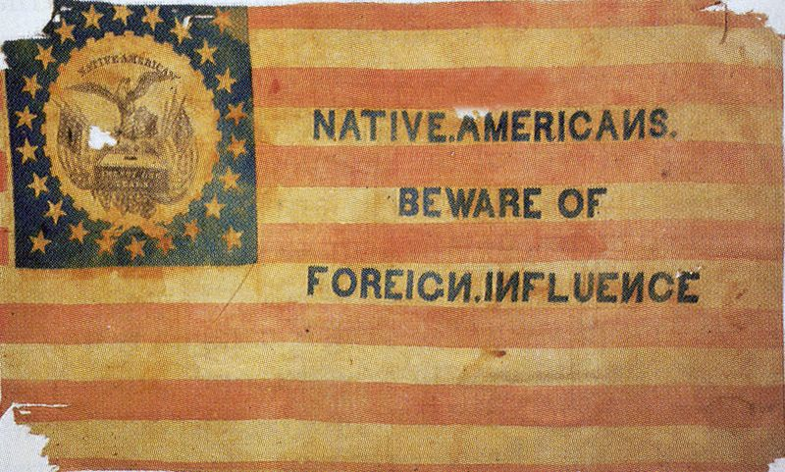
Changes in the 1850s
1854 = Creation of the Republican Party
American Party of “Know-Nothings”
Dred Scott v. Sandford (1854)

