Slide 1
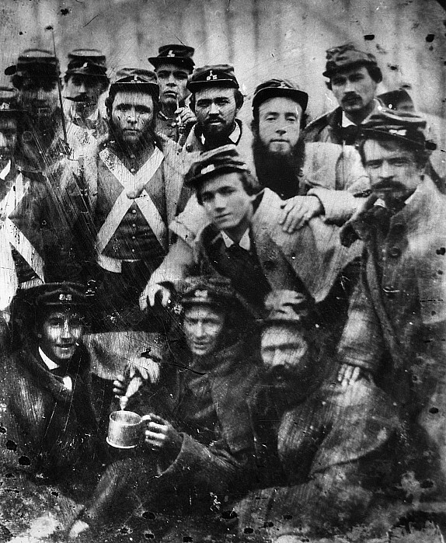
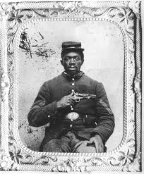
The Civil War, 1861 – 1865

Slide 2
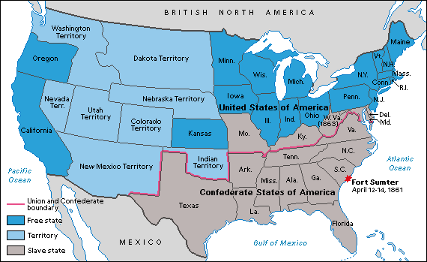
Secession
December 1860 = South Carolina
Within 2 months = Mississippi, Florida, Alabama, Georgia, Louisiana, Texas
Process of secession
Border states

Slide 3
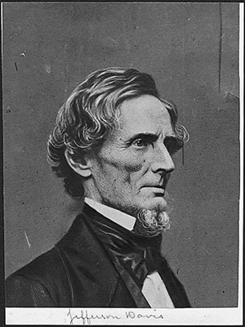
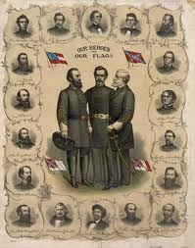

Confederate States of America
President Jefferson Davis of Mississippi
Reaction of U.S. President James Buchanan

Slide 4
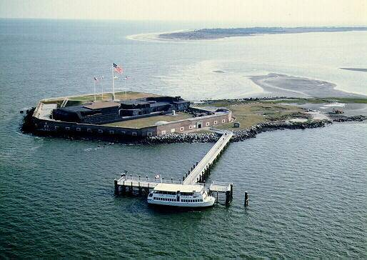
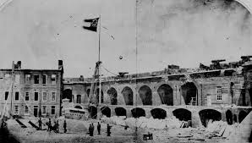
Fort Sumter
Charleston, South Carolina
Confederacy ordered U.S. Major Robert Anderson to surrender

Slide 5
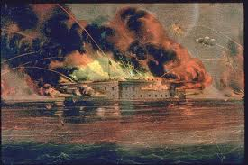
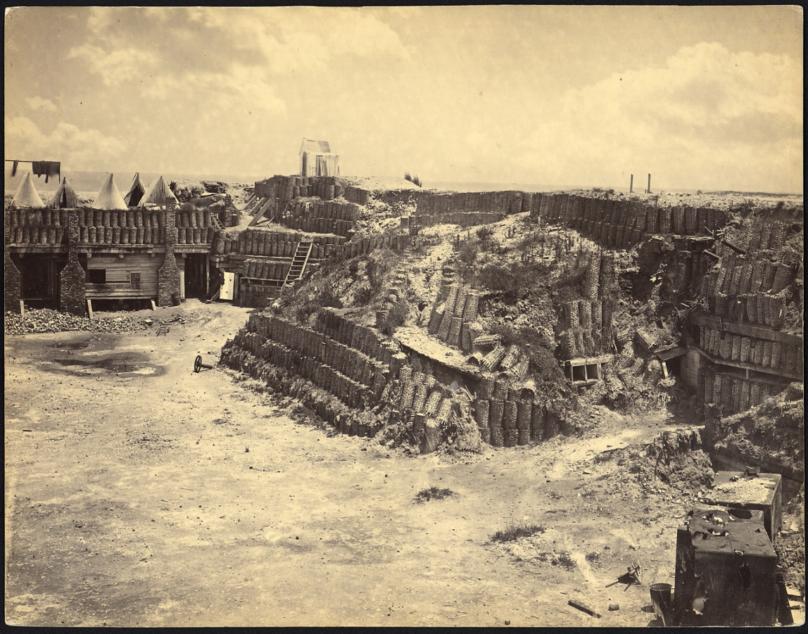
April 12, 1861 = artillery assaults on Union soldiers
April 15, 1861 = Lincoln declared lower south in state of “insurrection”
Lincoln issued call for enlistment of 75,000 men

Slide 6
“The union of these states is perpetual. Prepare to any is implied, if not expressed, in the fundamental law of all national governments. It is safe to assert that no government proper ever had a provision in its organic law for its own termination… No State upon its own mere motion can lawfully get out of the union; that Resolves and Ordinances to that effect are legally void; and that acts of violence, within any State or States, against the authority of the United States, are insurrectionary or revolutionary, according to circumstances…In view of the Constitution and the laws, the Union is unbroken; and to the extent of my ability I shall take care, as the Constitution itself expressly enjoins upon me, that the laws of the Union be faithfully executed in all the States…In doing this there needs to be no bloodshed or violence; and there shall be none, unless it be forced upon the national authority. In your hands, my dissatisfied fellow-countrymen, and not in mine, is the momentous issue of civil war. The government will not assail you. You can have no conflict without being yourselves the aggressors. You have no oath registered in heaven to destroy the government, while I have the most solemn one to preserve, protect, and defend it. I am loath to close. We are not enemies, but friends. We must not be enemies.”
--Lincoln’s Inaugural Address, March 1861

Slide 7
Quick Facts
What was the rationale at the start?
618,000 Americans died in the Civil War vs. 117,000 in World War I & 417,000 in World War II
400,000 wounded
4 million slaves in the South
North produced 97% of the U.S. firearms, 94% cloth, 90% shoes

Slide 8
 | North (U.S.A.) | South (C.S.A.)
Population (1860) | 22 million | 9 million (5 million whites + 4 million slaves)
Potential soldiers (men 15 -40 years old) (1860) | 4,010,000 | 1, 140,000
Industrial Strength (# of factories) | 110,000 | 18,000
Railroad miles | 21,973 | 9,283
North |  | South
+ | - | + | -
--Population --Infrastructure --Industry --Army --More $$ --Larger Navy | --Non-military traditions --Unpopular president --Political weakness | --Slaves --Defending their own backyard --Ideology --Military Tradition | --Slaves --Smaller Navy --Material weakness

Slide 9
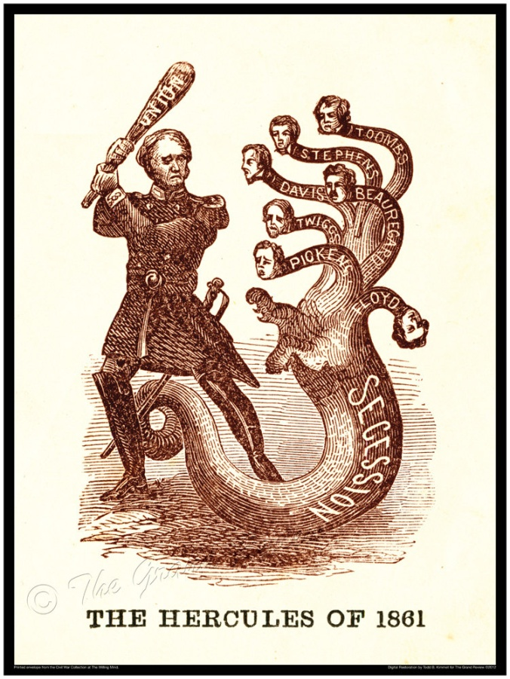
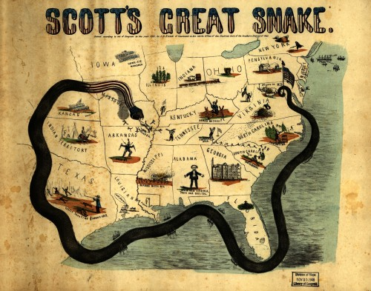
Early Strategies
Anaconda Plan
King Cotton Diplomacy
2 Different Objectives

Slide 10
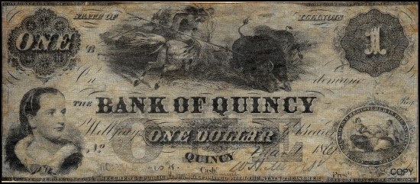
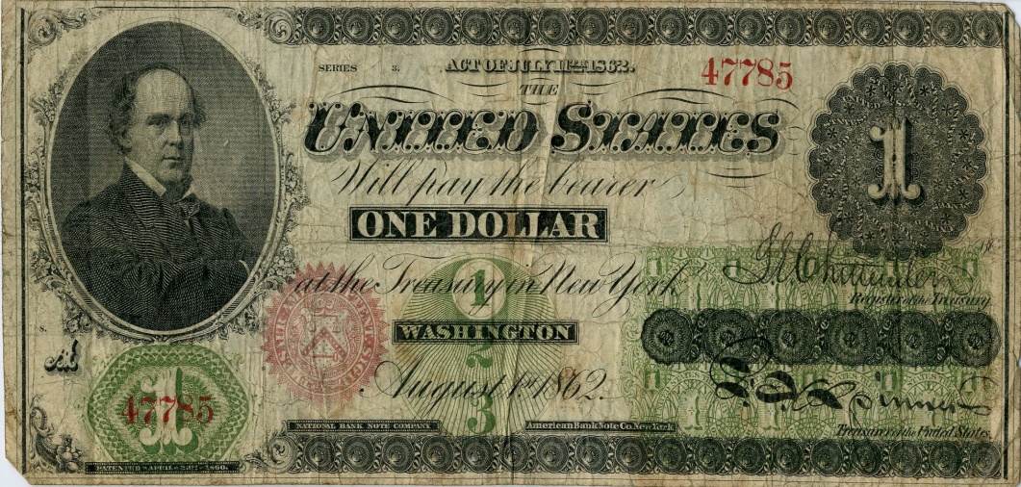
How did the Union fund the war?
Bank Notes Greenbacks
1790 = 3 Banks in U.S. vs. 1890 = 327 Banks
National Bank Acts of 1863 & 1864
Government bonds, $2.6 billion bank loans, & nation’s 1st Income Tax

Slide 11
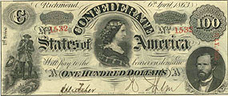
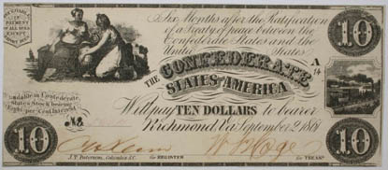
C.S.A. Government Infrastructure
Created Army & Navy from scratch
1864 = Over $1 billion new bills
State resistance

Slide 12
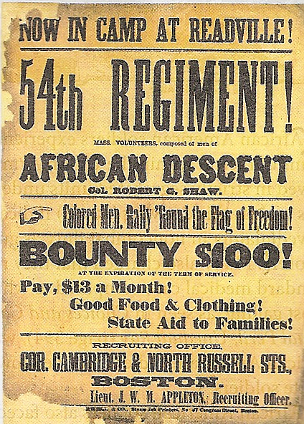
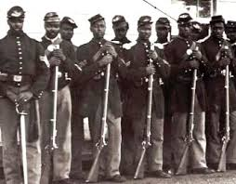
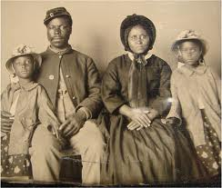
African American Soldiers
Segregated units in Union Army
C.S.A.’s reaction

Slide 13
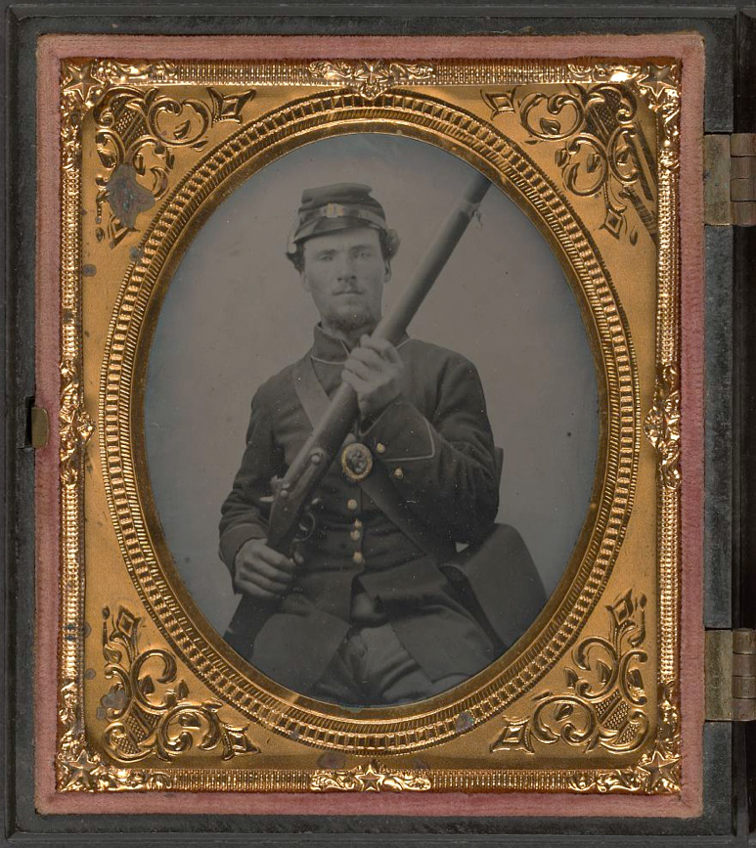
1st Modern War
Cause?
Instant Communication
New approaches to civilian casualties
Railroad
New muskets = 100 yard shot vs. 400 yard shot

Slide 14


Slide 15
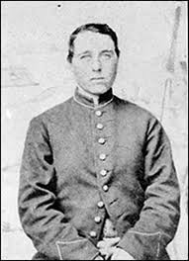
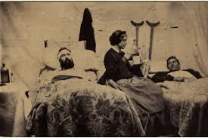
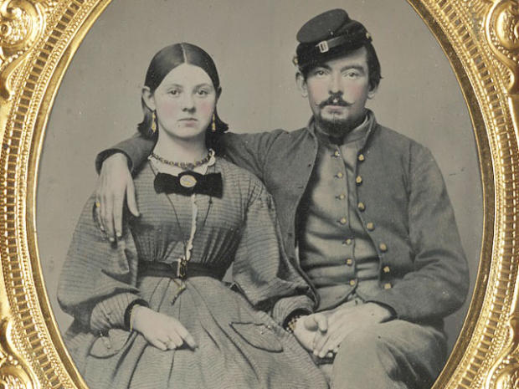
Opportunities for Women
Nursing
Ran farms, shops, factories, offices

Slide 16
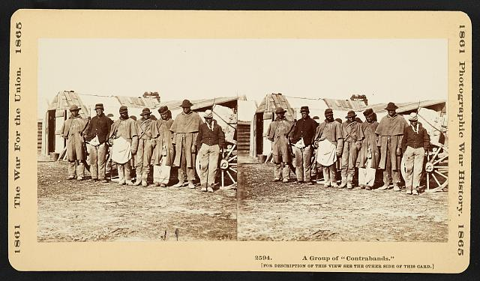
Towards Emancipation
Rationale for delay
“Contraband of War”
September 1862 = Lincoln issued Emancipation Proclamation for Jan. 1, 1863

Slide 17
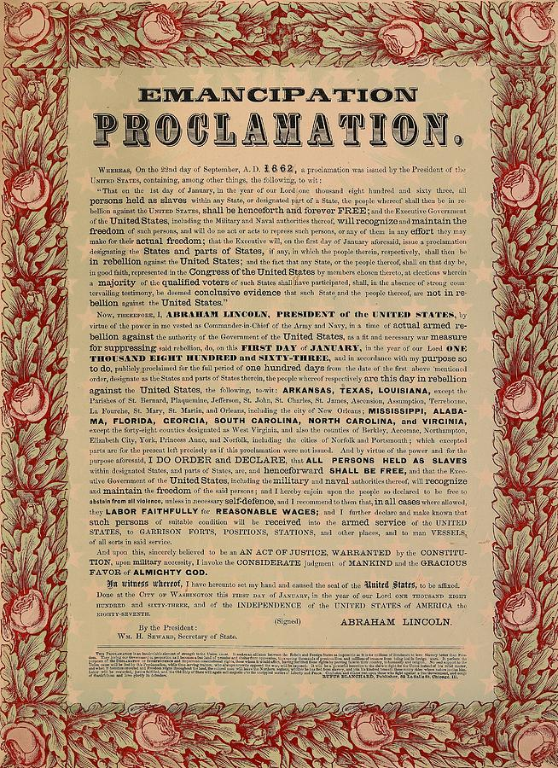
Why did Lincoln change?
Constitutional limitations vs. “military necessity”
Status of border states
Failure of southern Unionists
Presence of slaves in Union Army camps

Slide 18
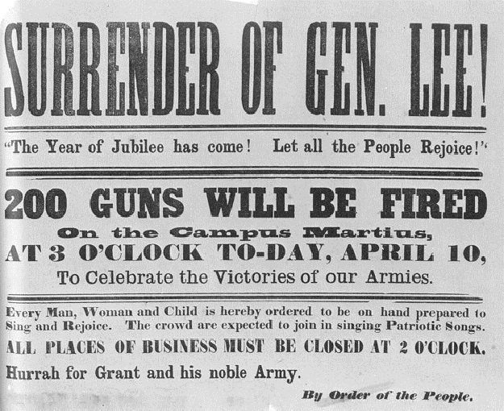
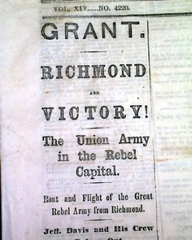
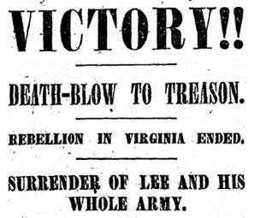
The End of the Civil War

Slide 19
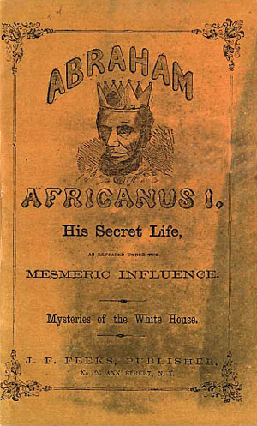
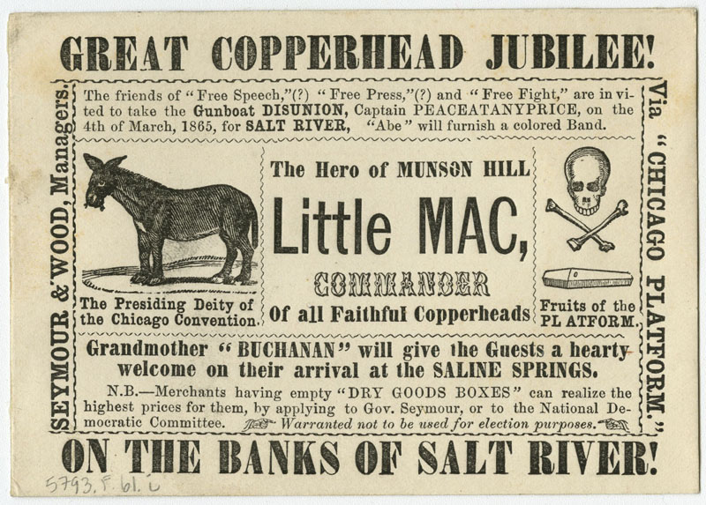
Copperheads
Northern Democrats
Lincoln labeled them seditious
Suspension of habeas corpus
“The privilege of the writ of habeas corpus shall not be suspended, unless when, in cases of rebellion or invasion, the public safety may require it.”

Slide 20
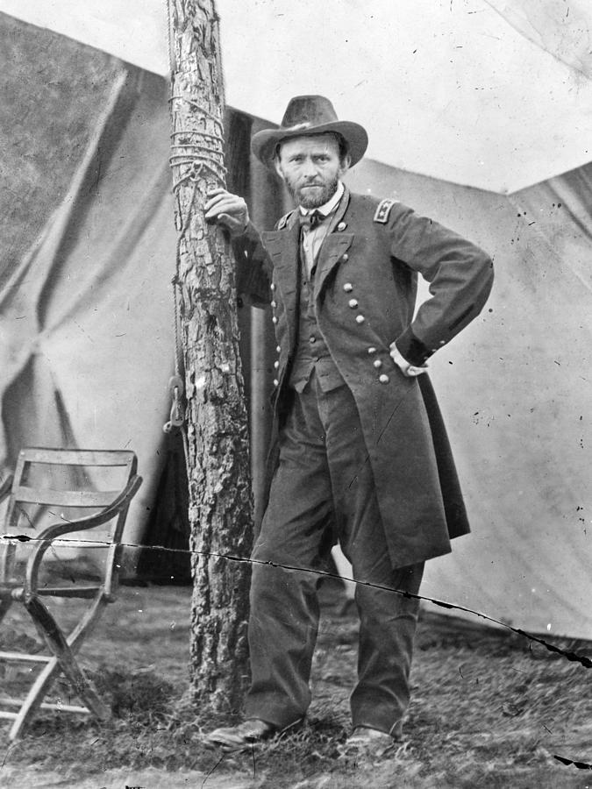
Turning Point, 1863
July 1863 = Gettysburg, Vicksburg, and control of the Mississippi River
Southern economic weaknesses revealed
Flight of slaves
1864 = Ulysses Grant chosen as Commander of the Union Army

Slide 21
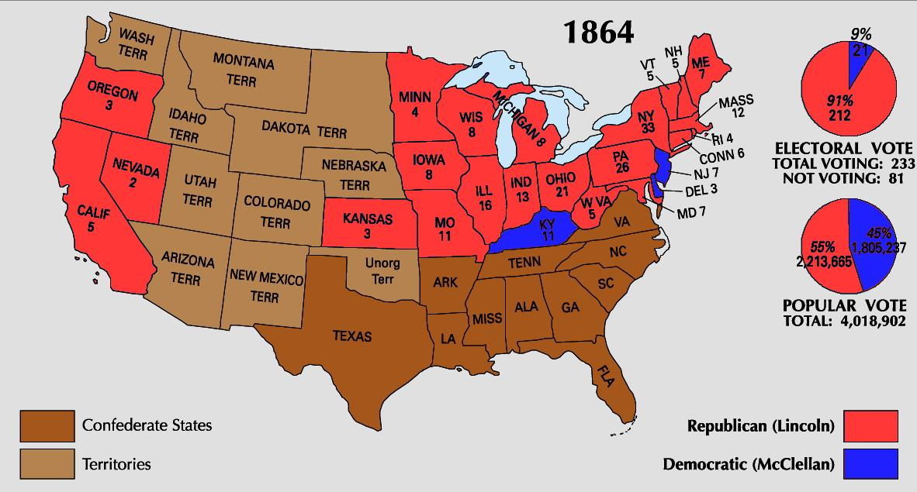
Lincoln’s Re-election
VP Andrew Johnson, Pro-Union Democrat from Tennessee
Won 55% of the popular vote
Helped by Sherman’s capture of Atlanta

Slide 22
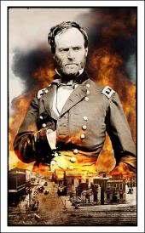
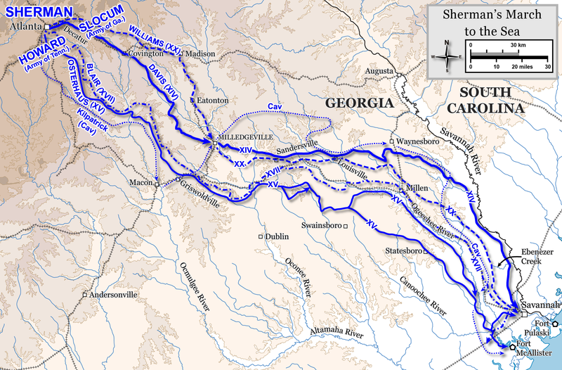
“Scorched Earth”
Sherman’s 285-mile march across Georgia
“We are not only fighting hostile armies, but a hostile people, and we must make old and young, rich and poor, feel the hand of war, as well as their organized armies.”
--Gen. William Tecumseh Sherman

Slide 23
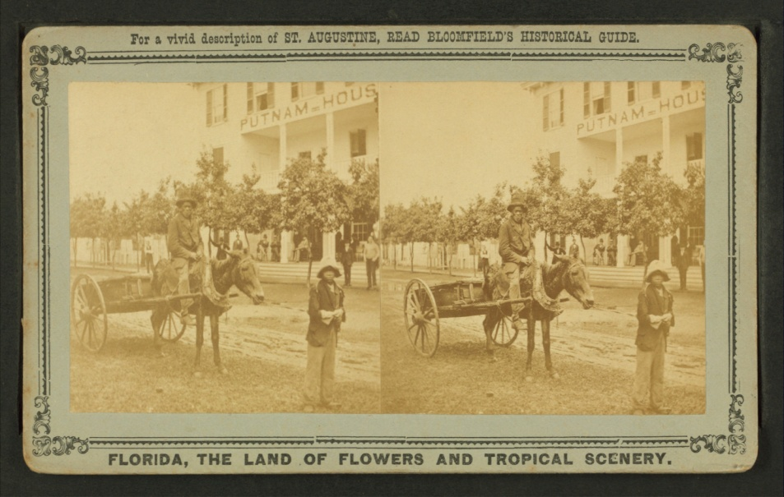
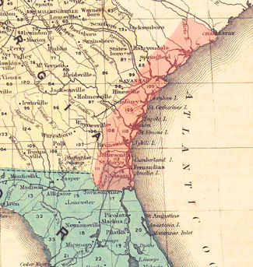
Field Order No. 15
Issued by General Sherman
400,000 acres of seized Confederate property
Northern Florida through South Carolina Sea Islands
40 acre + 1 mule plots
June 1864 = 40,000 freed men involved
Success?

Slide 24
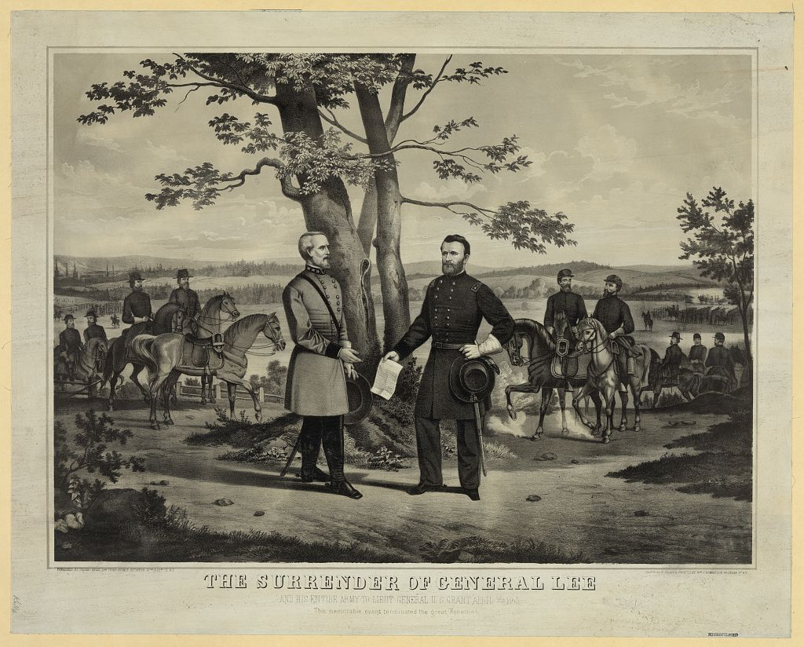
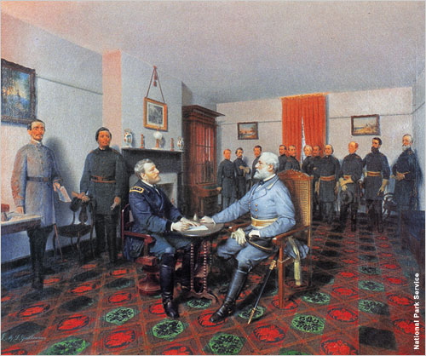
Final Phase
C.S.A.’s 2 slave regiments
April 9, 1865 = Lee’s surrender
Lee’s 30,000 soldiers allowed to go home

Slide 25
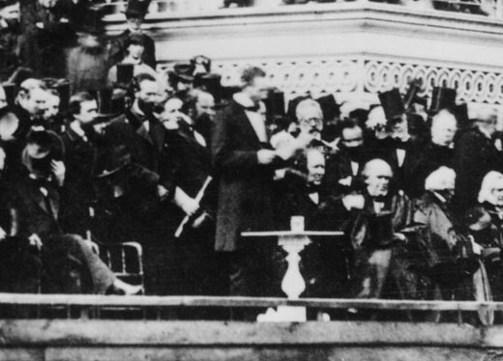
“With malice toward none, with charity for all, bind up the nation’s wounds, to care for him who shall have borne the battle and for his widow and his orphan, to do all which may achieve and cherish a just and lasting peace among ourselves and with all nations.”
--Lincoln’s 2nd
Inaugural Address

Slide 26
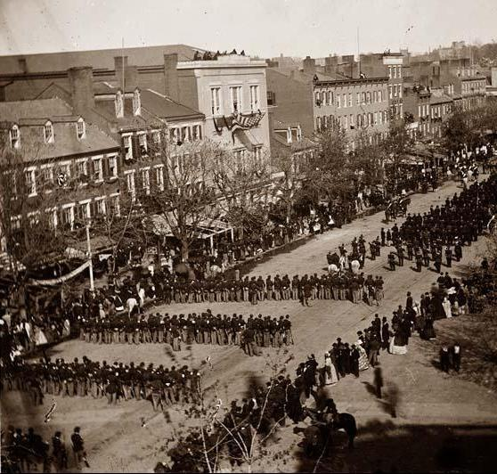
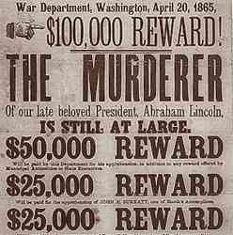
April 14, 1865
“Our American Cousin,” Ford’s Theatre, D.C.
John Wilkes Booth
Died next morning

