Slide 1
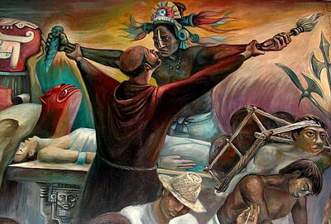
The Spiritual Conquest

Slide 2
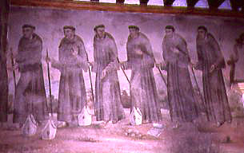
Evangelization
Jesuits, Franciscan, Dominicans
Priesthood of Spaniards & criollos
Secular clergy vs. missionaries

Slide 3
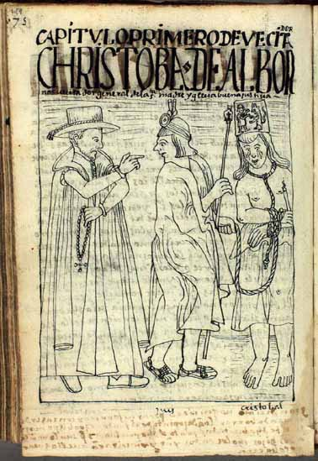
Financial Support
Plantations, ranches, factories
Tithe of 10%
Slaveowners
Moneylenders
Charged for services

Slide 4
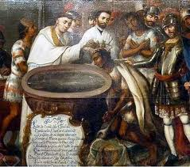
Changes in Daily Life
Baptism, saint’s names
Smaller family size
“Uprooting of the Idolatry”
Mild resistance
Syncretic faith
Communication barriers

Slide 5
Santidade
Runaway Indian & African Slaves
Brazil
Quilombos
Self-appointed “popes” and “missionaries”
1610 = 20,000 members

Slide 6
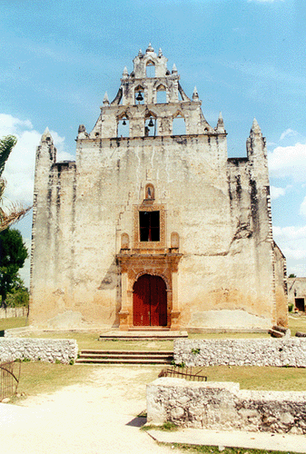
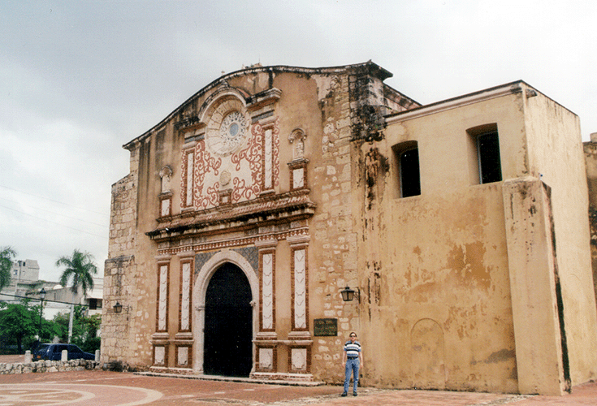

Slide 7
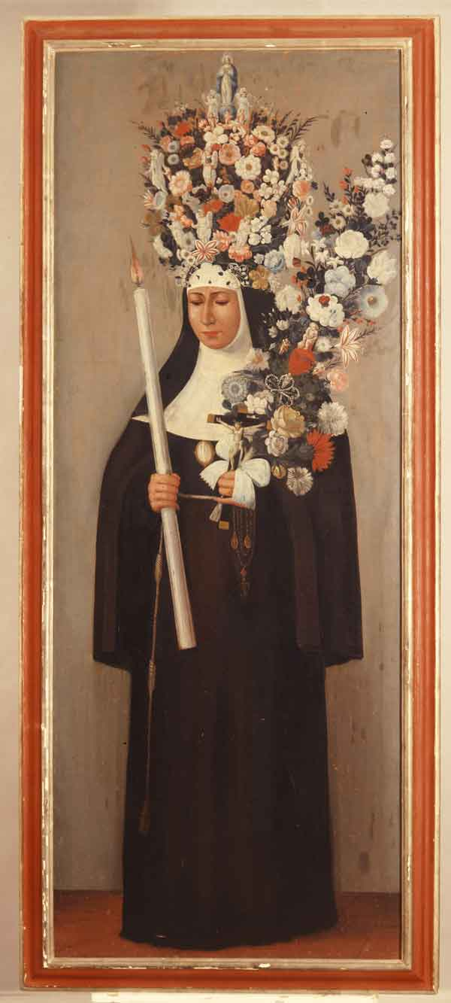
Convents
No missionary work
Nuns served in hospitals, schools, orphanages
“Family Honor”
Racial segregation
Black Veil vs. White Veil

Slide 8
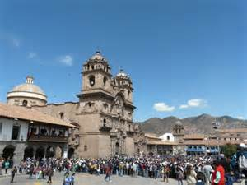
Santa Clara, Cuzco
1600 = 320 nuns, 148 servants, 128 slaves, 76 other women

Slide 9
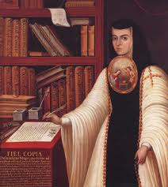
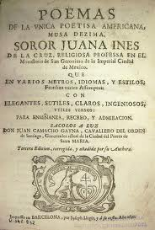
Sor Juana
1651-1695
Criolla, child prodigy
Poet & playwright for the viceroyal court
Joined convent at 19

