Slide 1
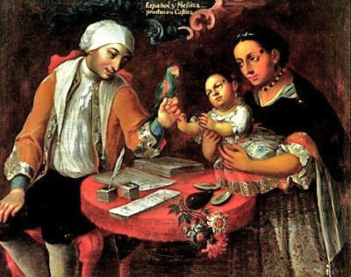
Race, Castas, & Honor in Colonial Society

Slide 2
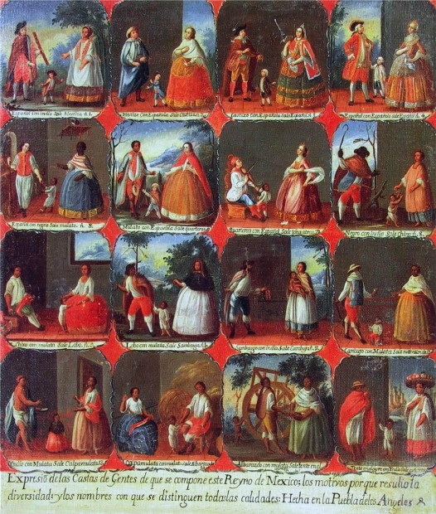
Social Hierarchy
Gente decente vs. gente de pueblo
Pardos, castas, color quebrado, lobos, coyotes, cabras & more

Slide 3
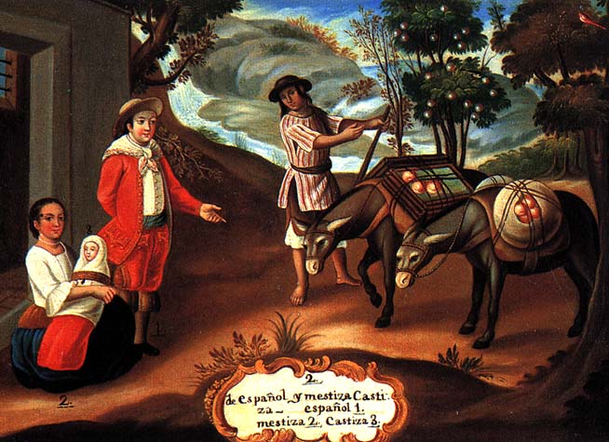
Peninsulares
White Spaniards born in Iberian peninsula
Overwhelmingly male
2 % of major cities
Claimed limpieza de sangre

Slide 4
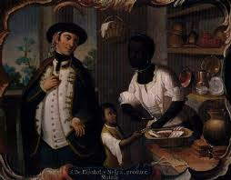
Criollos
Born in the Indies
Claimed limpieza de sangre

Slide 5
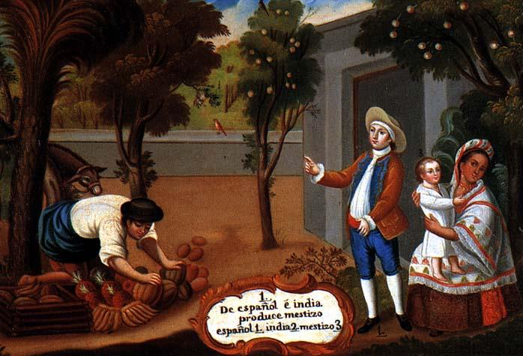
Mestizos & Mamelucos
Mixed Indian and Iberian ancestry
Generally exempt from tribute

Slide 6
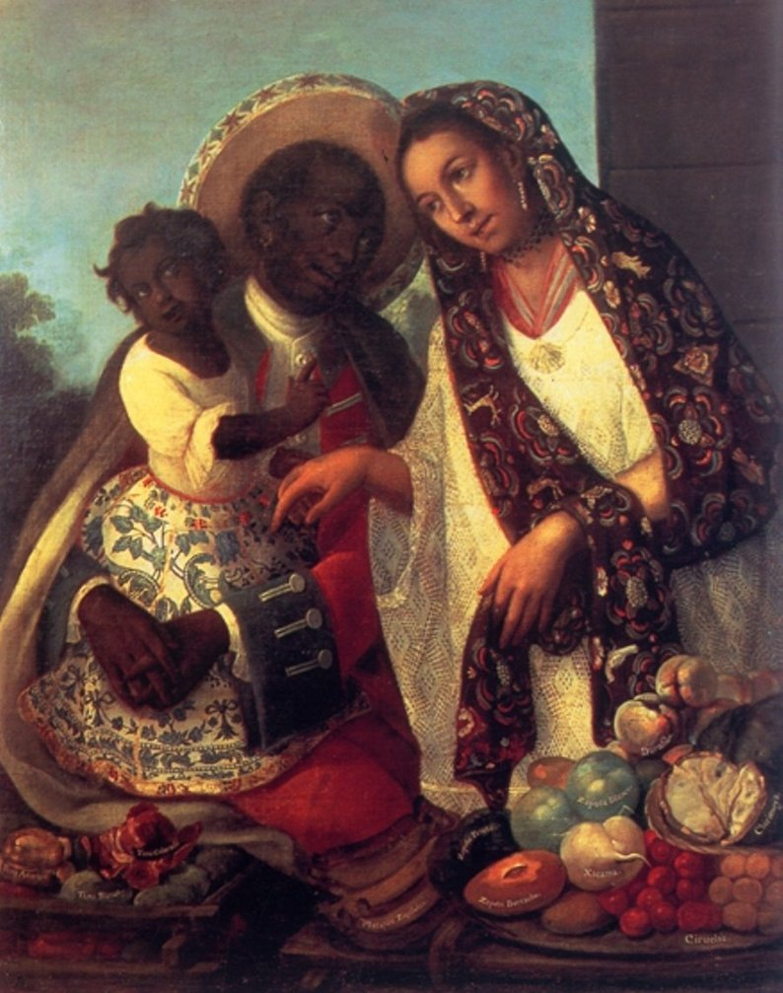
Casta paintings
Mid-eighteenth century art
Commissioned by Europeans
How to trace lineage?

Slide 7
Family Honor
Role of the patriarch within family & government
Recogimiento
Hombre de bien
Divorce & annulment
Illegitimacy & pregnancy
Prosecution of crime

Slide 8
Limits of Patriarchy
Wedding costs
¼ - ½ of baptized children listed as illegitimate in some towns
Recogimiento proved impossible
Widows guaranteed ½ of estate

Slide 9
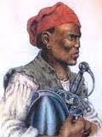
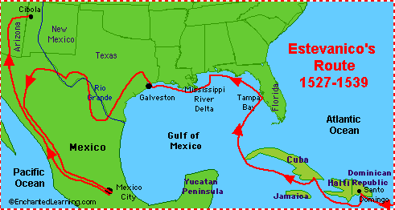
African Slavery
Esteban, 1528
1600 = 75,000 – 90,000 African slaves in the colonies
Hispaniola, 1567 = 30,000 slaves & 2,000 Spaniards

Slide 10
Maroon Communities
1503 = 1st maroon community found in Hispaniola
Runaways called cimarrones
Palenques & quilombos
Palmares = 30,000 at 1670
Venezuela = 20,000 cimarrones
Manumission

