Slide 1
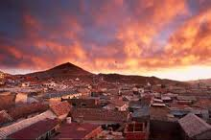
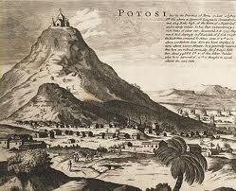
Indian Labor, Mining, & Potosì

Slide 2
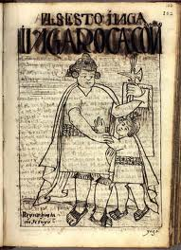
Cities and Labor
Mexico City/ Tenochtitlàn & Cuzco
Lima, Peru & Puebla, Mexico
1700 = Bogotà, 10,000 Indians & 3,000 Spaniards
Traza

Slide 3
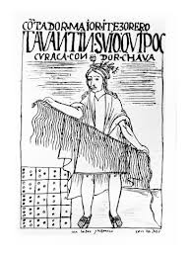
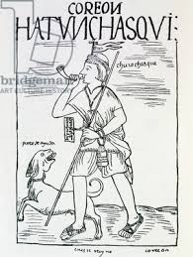
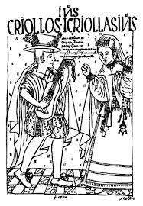
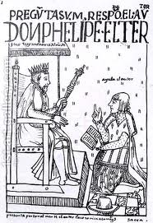
Indios Ladinos
Criticized by Spaniards
Legal spokespeople
Felipe Guaman Poma de Ayala

Slide 4
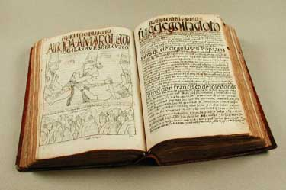
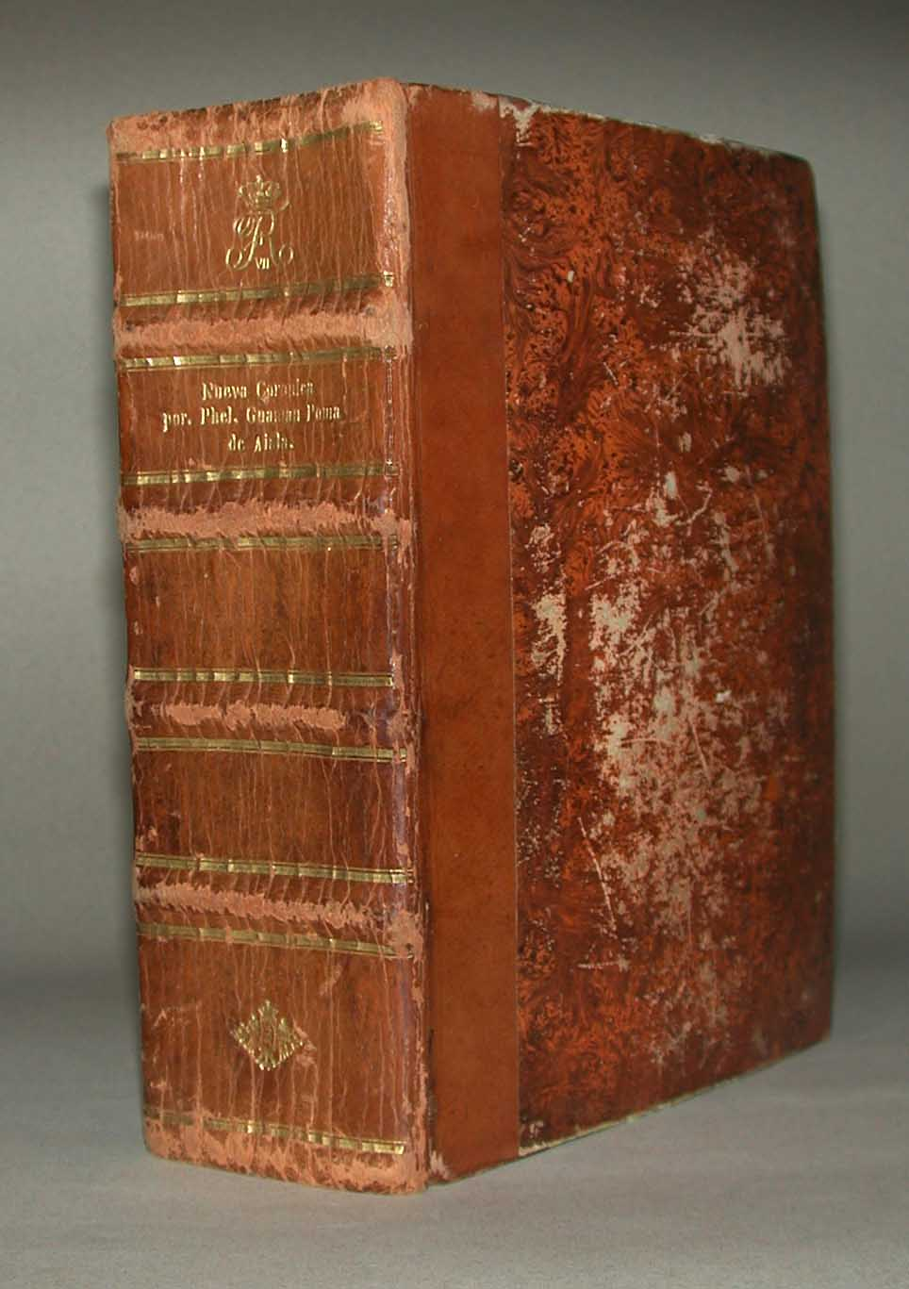
Primera nueva crònica y buen gobierno (1615)
Written directly to King Philip III
1,200 pages & 398 drawings

Slide 5
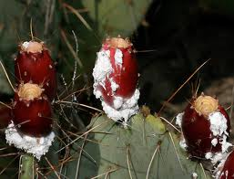
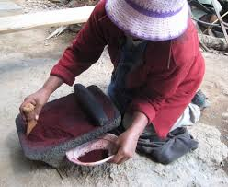
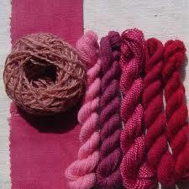
Cochineal
Produced by Mixtecs & Zapotecs in Southern Mexico
1700 = # 2 export from Mexico
Fee = 1 pound cochineal for 1.5 pesos

Slide 6
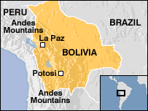
Potosì, Bolivia
1540s = Silver boom began
1590s = 330,000 pounds of silver ore per year
1610 = 150,000 total residents
1610 = 76,000 Indian residents

Slide 7
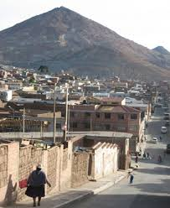
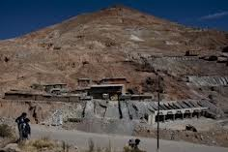
Mitayos
1573 = Toledo instituted the mita
One year of work every seven years
Mita restructured to entice workers
One week on, two weeks off
Ladders

Slide 8
