Slide 1
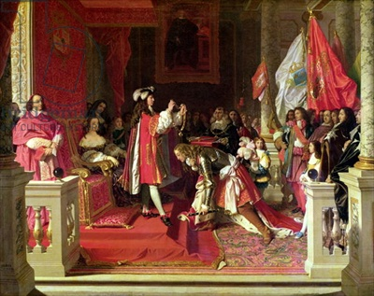
The Bourbon Reforms & Road to Independence

Slide 2
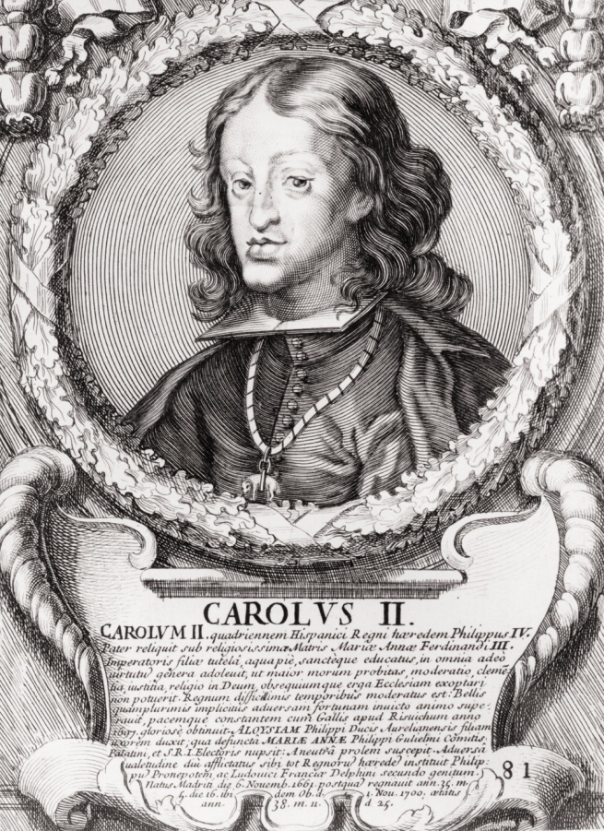
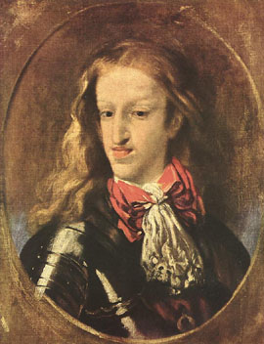
European Politics
1700 = Death of King Charles II
Population decline
Inflation
Less silver
France & England a greater threat

Slide 3
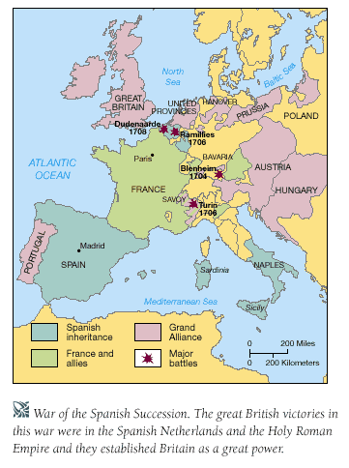
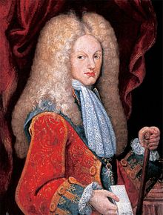
War of Spanish Succession
1700 – 1713
England & Austria vs. Spain & France
Philip V, grandson of King Louis XIV

Slide 4
The Bourbon Reforms
Tightened Spain’s control of the Indies
Increased taxes
Standing army

Slide 5
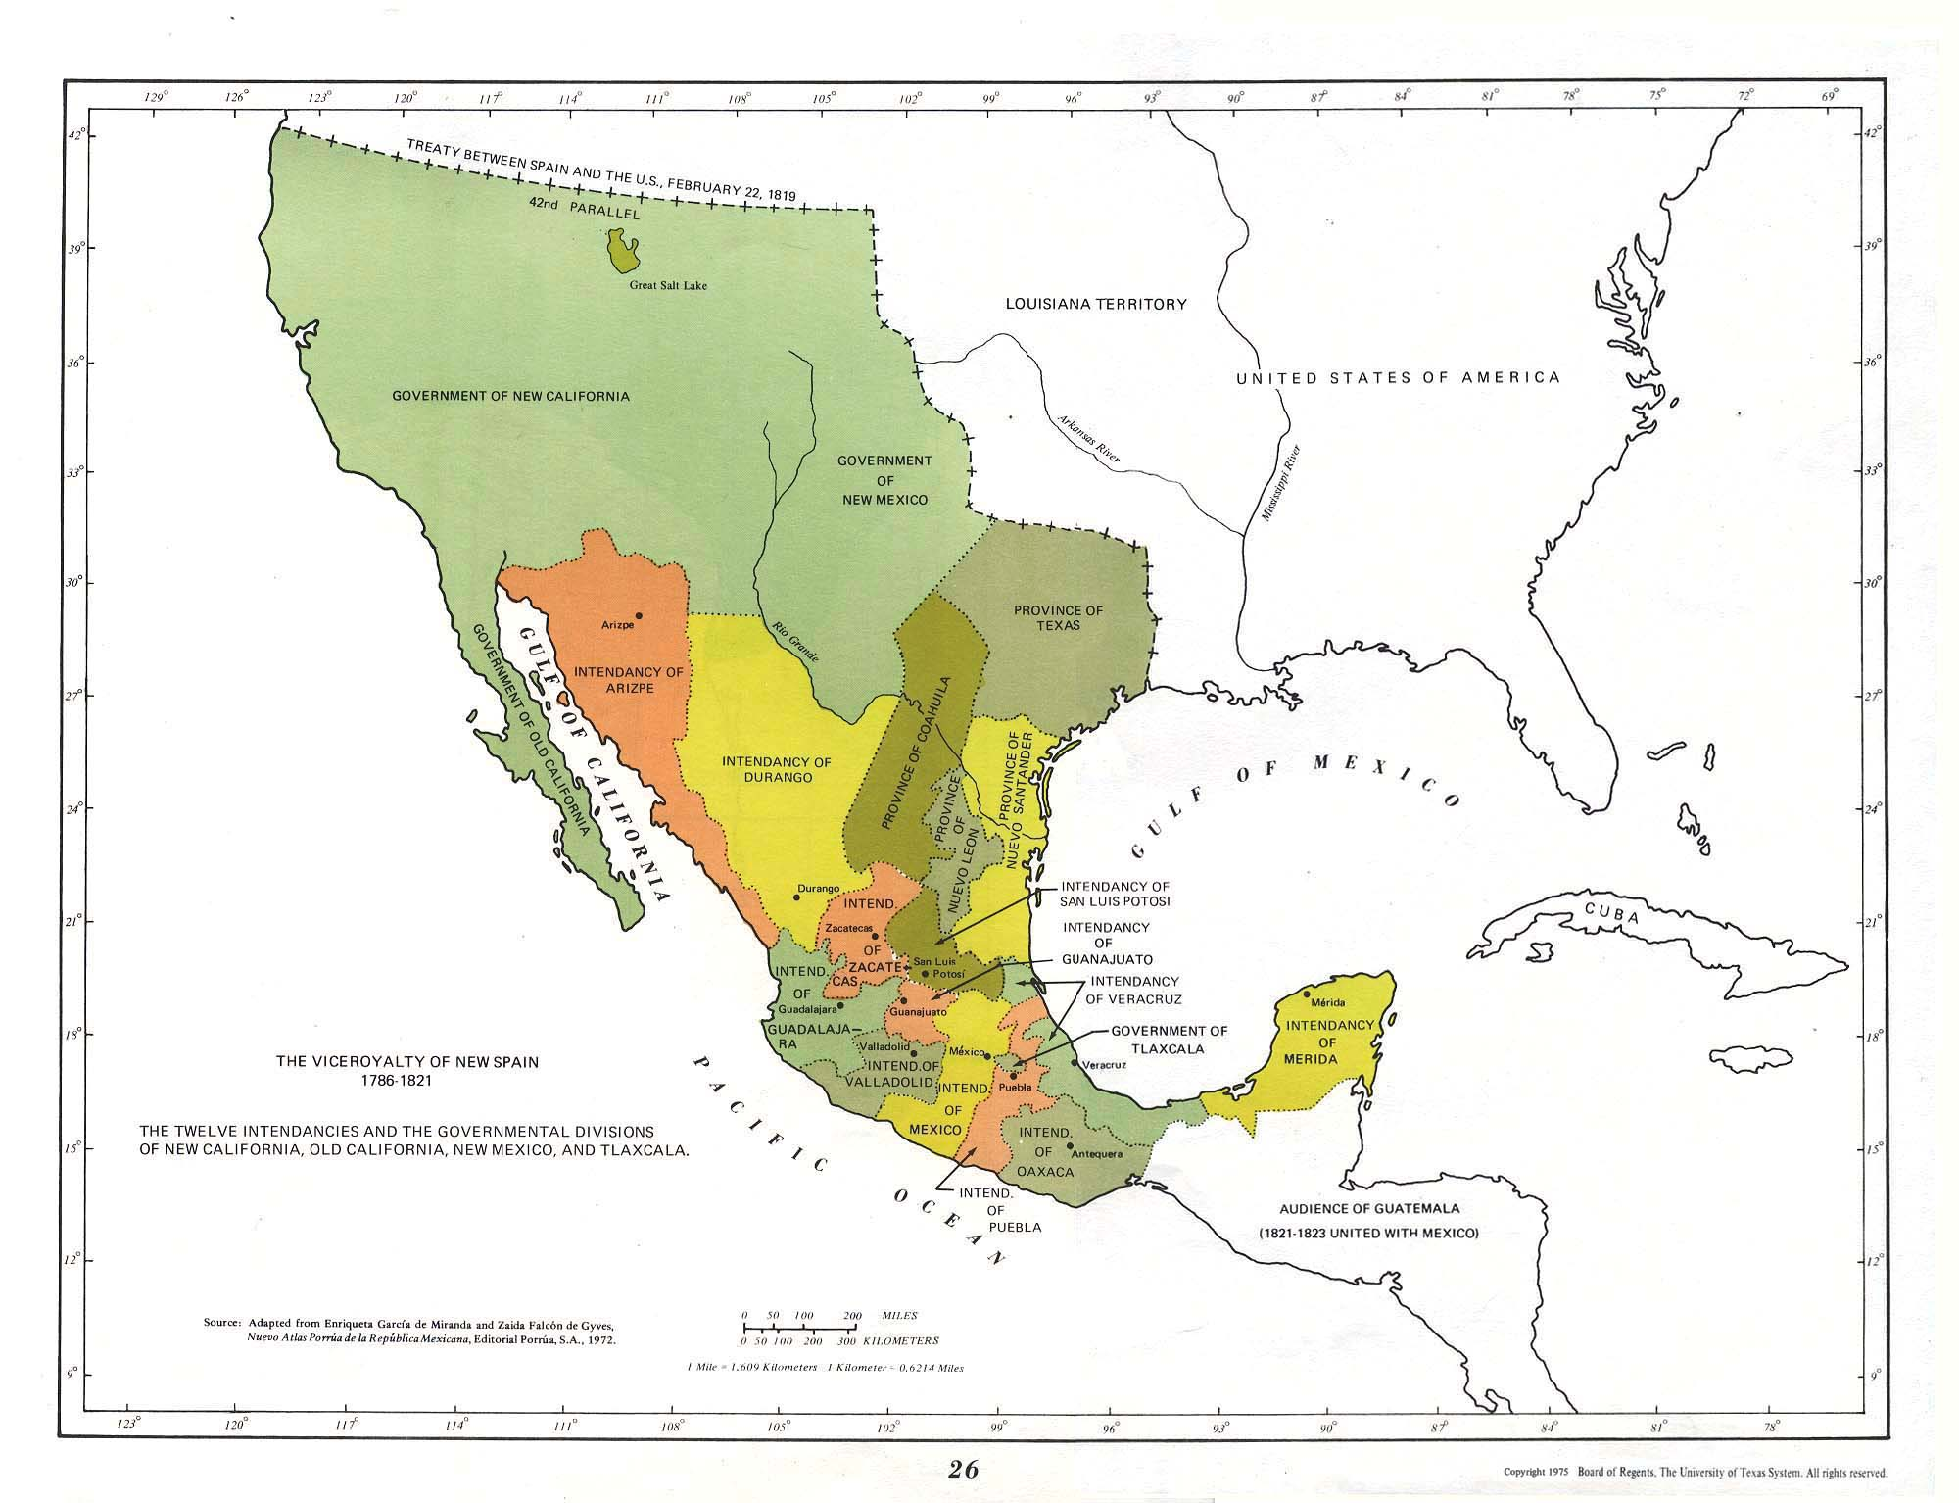
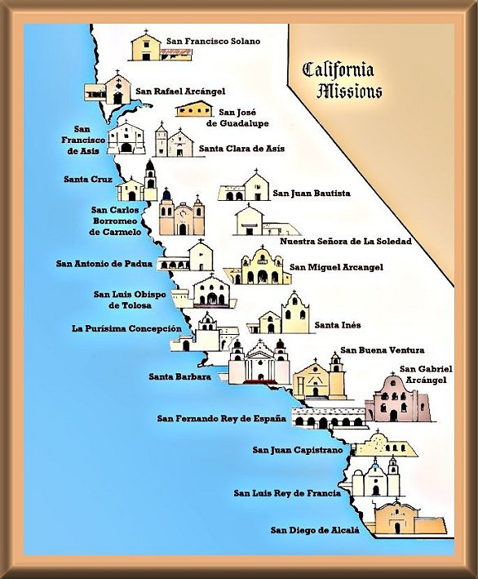
Northern Frontier
Military garrisons, missions, & settler communities
Texas & California

Slide 6
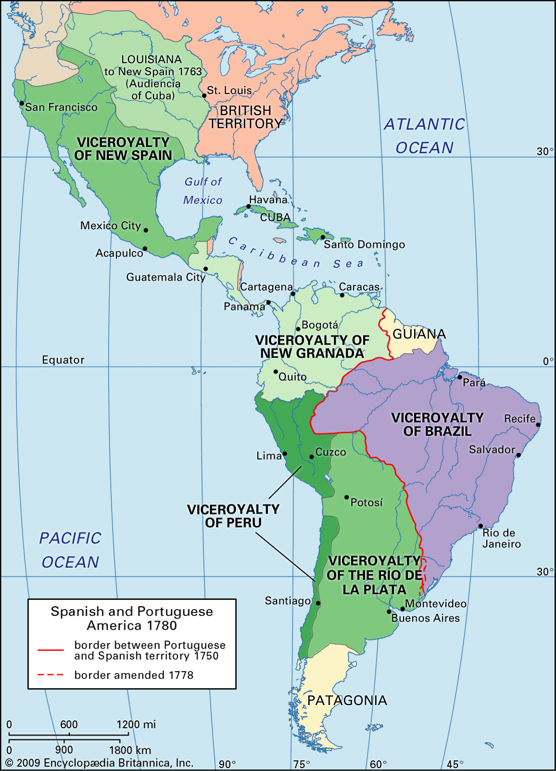
Reorganizing the Administration
“Intendants” arrived in 1764
Viceroyalty of New Granada (1739) = Ecuador, Colombia, Panama, Venezuela
Viceroyalty of La Plata (1776) = Bolivia, Argentina, Uruguay, Paraguay

Slide 7
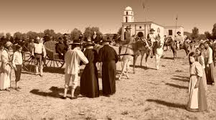
Reducing the Power of the Church
Wealth, land, political authority
Franciscans, Augustinians, Dominicans forced out of monasteries
Missions rented out rooms and stables
Expulsion of Jesuits (1767)

Slide 8
Social Change
Peninsulares awarded government jobs
Elite Criollos no longer able to purchase jobs
A civil response?

Slide 9
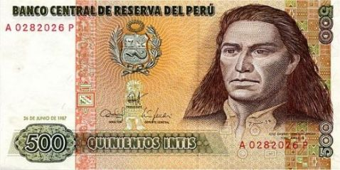
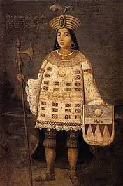
Rebellion in the Andes
Why?
Josè Gabriel Condorcanqui Noguera Tùpac Amaru (Tùpac Amaru II)
Kuraka of Tinta, a village on the Royal Road to Lima

Slide 10
Important Factors
November 1780 = Execution of corrupt corregidor
Mestizo & elite status of Tùpac Amaru II
Role of Micaela Bastidas
Failure to capture Cuzco
Execution in 1781
Final suppression of the rebellion in 1783

