Slide 1
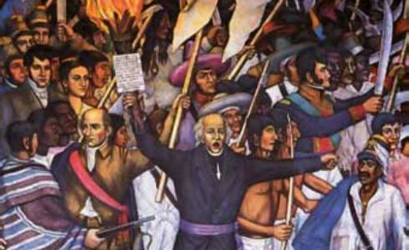
Independence, 1808 – 1824

Slide 2
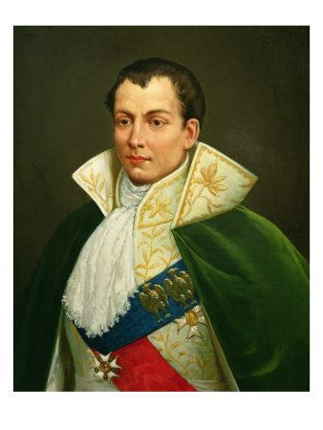
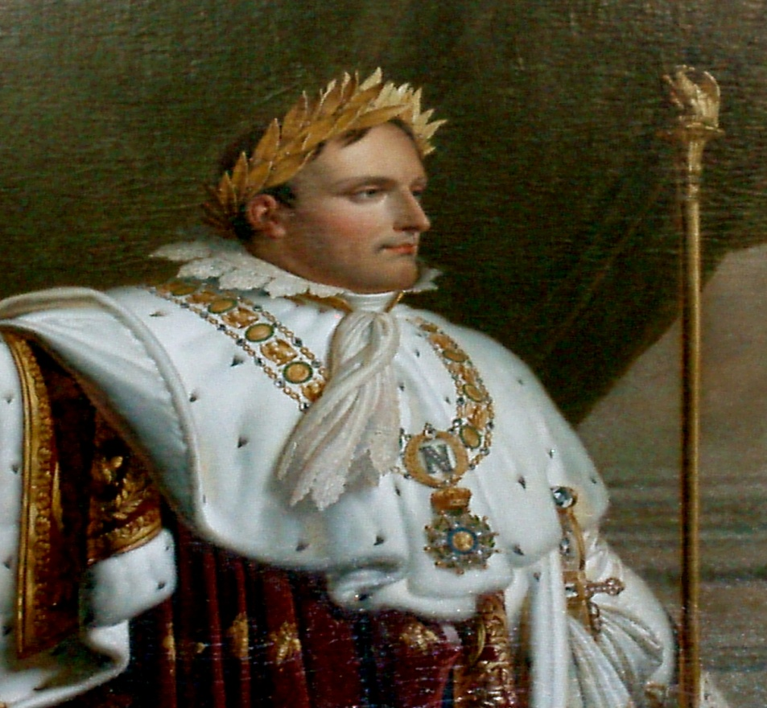
Why Independence?
“Age of Revolution”
Napoleon & Joseph Bonaparte
1808 = King Ferdinand VII removed
Napoleon
Joseph Bonaparte

Slide 3
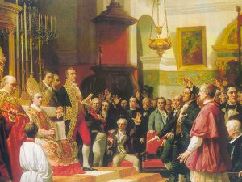
Representative Government, 1808 – 1814
The Cortes
Constitution of 1812
Cabildos for 1,000 + residents
Voting fears

Slide 4
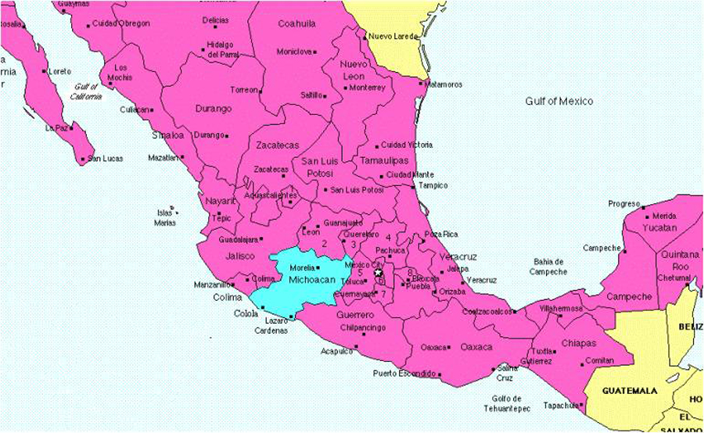
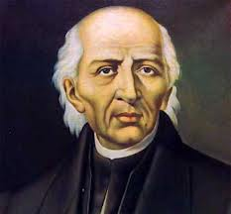
Rebellion in Mexico
The Bajìo & Morelia
Father Miguel Hidalgo Costilla
“El Grito de Dolores”
60,000 people = 50% Indians + 20% mestizos

Slide 5
“People driven by hunger and unemployment, pulled into the maelstrom of violence by the prospect of daily wages in the rebel forces, the easy pickings of looting, or simply to escape the depressed conditions of home.”
--Historian Eric Van Young

Slide 6
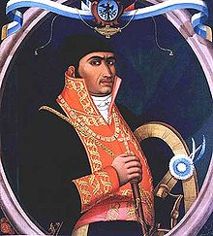
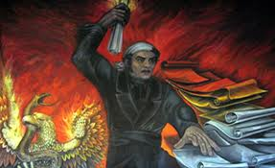
Josè Marìa Morelos
1811 – 1815

Slide 7
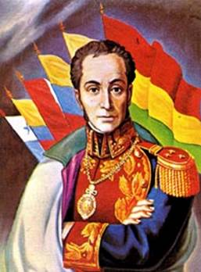
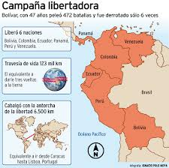
Venezuela
Experimental government, 1809
Simòn Bolìvar vs. Josè Tomàs Boves
Racial tension

Slide 8
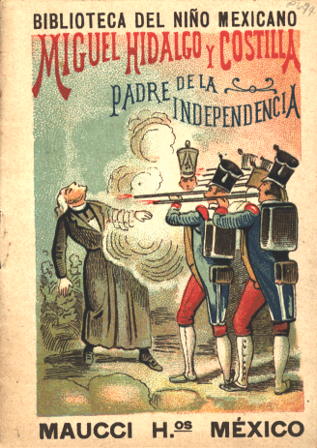
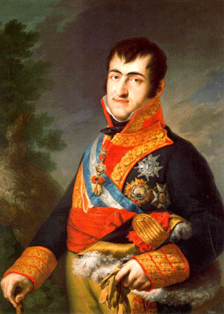
Phase II, 1814 - 1824
Hidalgo & Morelos dead in Mexico
Simòn Bolìvar hiding in Jamaica
King Ferdinand VII returns to throne

Slide 9
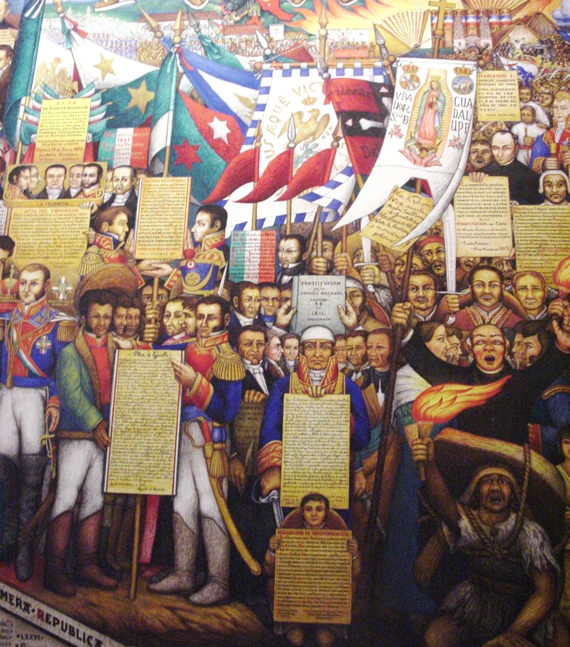
Mexico, 1821
Spanish army General Augustìn + Vicente Guerrero
Plan de Iguala, 1821

Slide 10
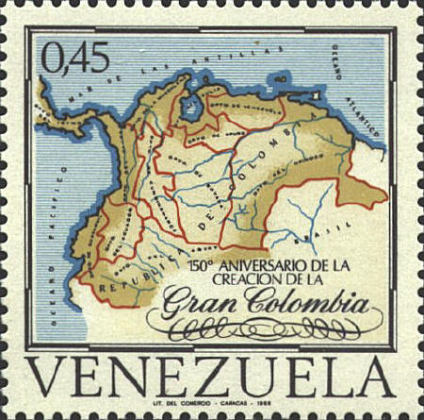
Venezuela, 1816 – 1822
Reversal of racial strategy
Republic of Gran Colombia (1822) = Venezuela, Colombia, Ecuador

Slide 11
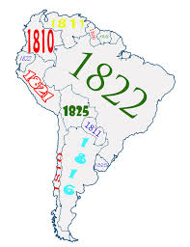
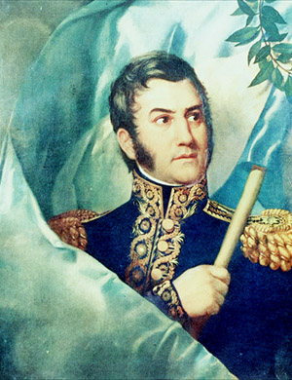
Rest of South America
Argentina & Chile, 1818
Josè de San Martìn
Peru, 1821 - 1825

Slide 12
New Government?
Republic with Executive, Legislative, Judiciary branches
Who will control national politics?

