Slide 1
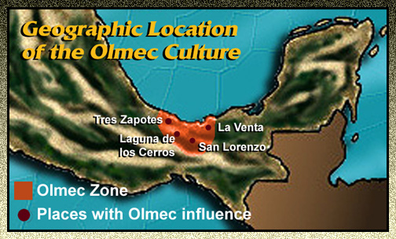
The Olmec, 1500 BCE – 400 BCE

Slide 2
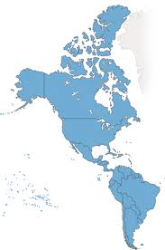
Migration to the Americas
Presence in the Americas for 35,000 – 40,000 years
Bering Strait
9,000 BCE = People reach the Tierra del Fuego
Hunters-Gatherers until 7,000 BCE

Slide 3
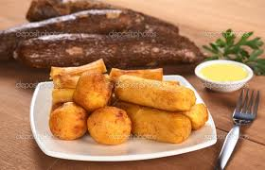
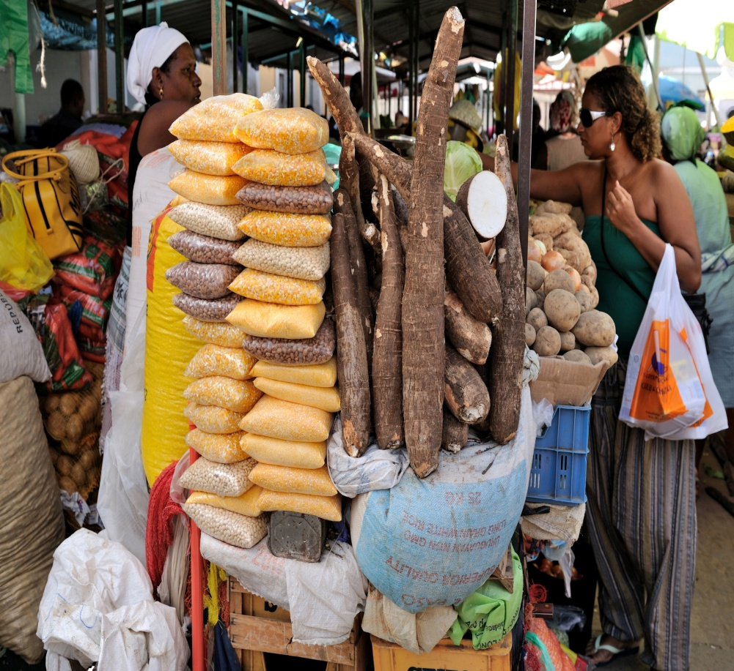
Agricultural Revolution
Mesoamerica = Corn
Caribbean = Manioc
Andes = Potato
Squash, beans, peppers, sunflowers
Manioc sold at market

Slide 4
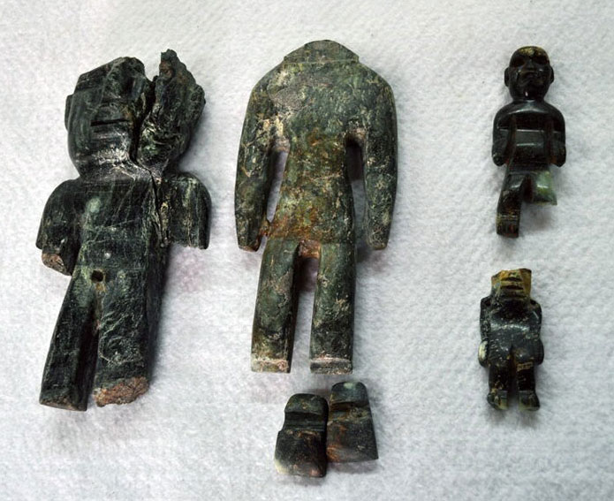
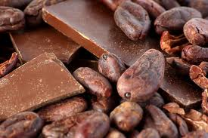
Social Class
Conspicuous consumption among the wealthy
Cotton clothing, jewelry, permanent housing, pottery
Role of men in society changes
Priests & Military warriors as castes

Slide 5
What is a “civilization”?
Dependent upon agriculture
Large and dense populations
Trade
Range of settlements (rural – urban)
Central governments
Social stratification
Specialized occupations

Slide 6
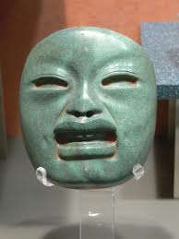
Who are the Olmec?
Tropical lowlands of Mexico
The “mother civilization”
“People of the land of rubber”
The rubber ball game
Trade

Slide 7
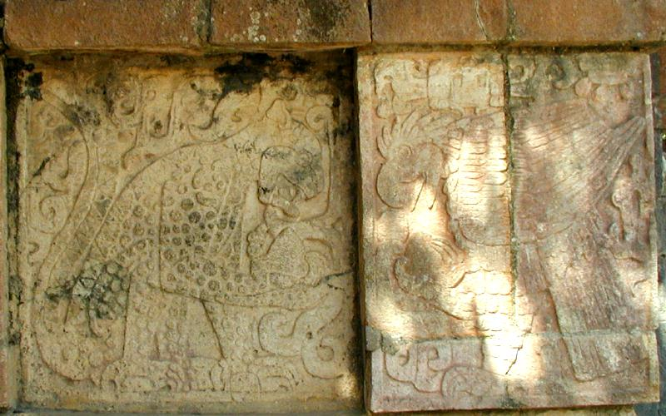
Olmec Religion
Cult of the Jaguar
Spread of religion as a factor in their rise to power
Toltec depiction of the jaguar at Chichen Itza

Slide 8
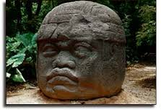
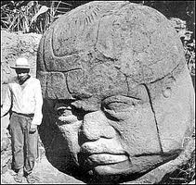
Olmec Heads
Basalt
8 statues of rulers or gods?

Slide 9
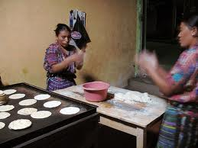
Olmec Trade
Jewelry, feathers, cotton, cacao beans, ceramics, jade figurines
Invention of the tortilla
Women and the comal
Cooking tortillas on a comal

Slide 10
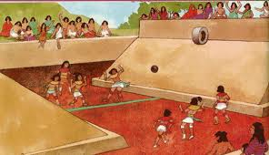
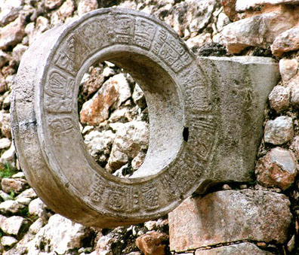

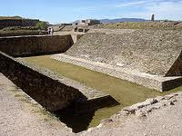
The Rubber Ball Game

Slide 11
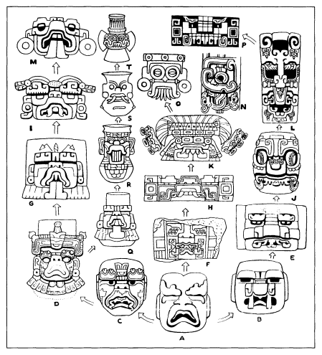
Olmec’s Legacy
Cult of the jaguar
Religious calendar
Astronomy
Trade
Agriculture/Food technologies
Hieroglyphic writing
Olmec rain god at A. Oaxaca, Central Mexico,
and Maya regions from left to right.

