Slide 1
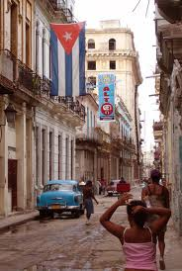
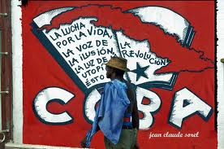
Cuba

Slide 2
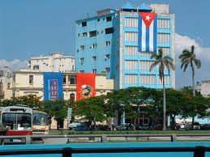
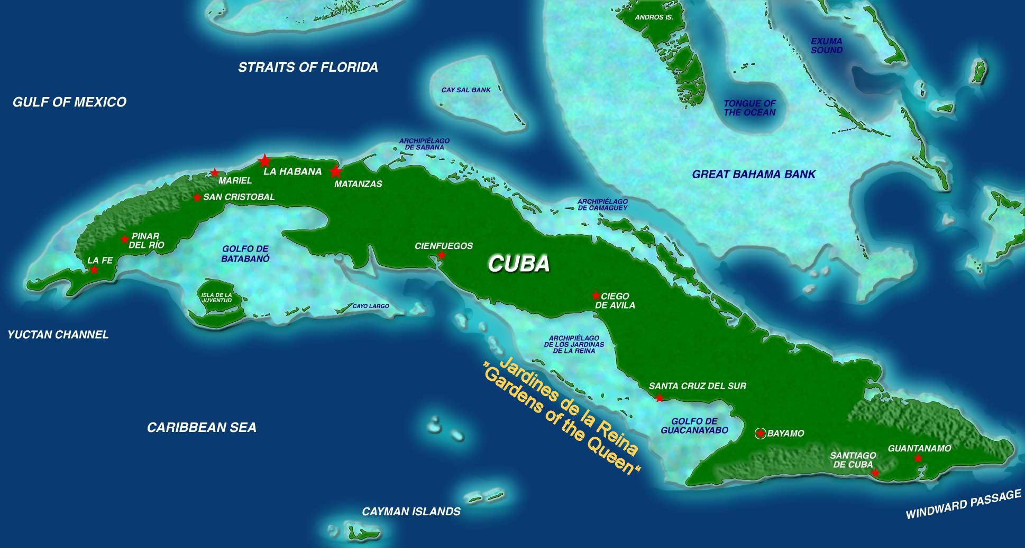
Geography
Mainland, Isla de Juventud, + 4,000 small islands
Mountains, jungles, rivers, valleys, swamps, forests
90 miles from Florida

Slide 3
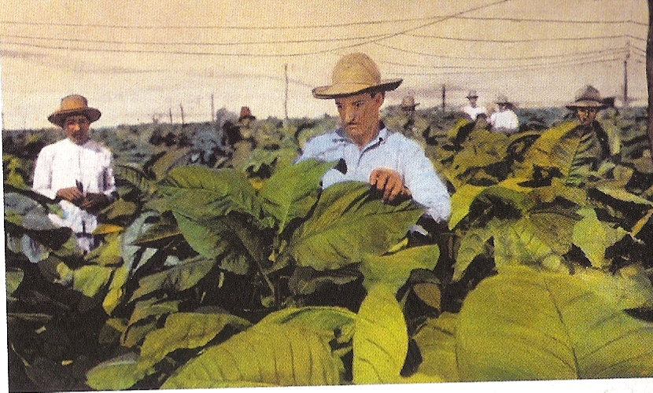
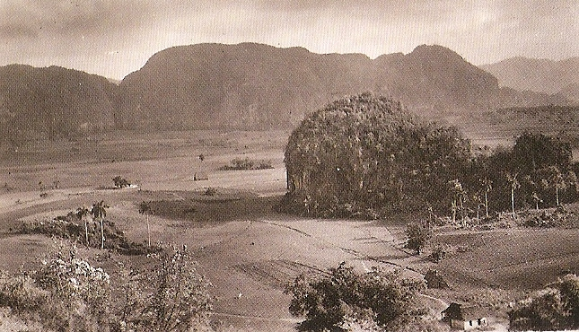
Multi-racial Society
40% Afro-Cuban population
1800 – 1865 = 600.000 African slaves arrived
Slavery abolished in 1886
Afro-Cubans in political power
Chinese-Cubans

Slide 4
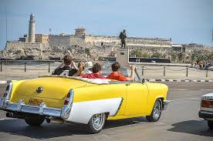
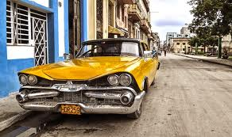
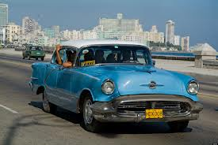
Why Classic American Cars?
Price in Cuba vs. price in U.S.
Detroit
Advertisements
1 car for every 42 people
Symbol of social inequality

Slide 5
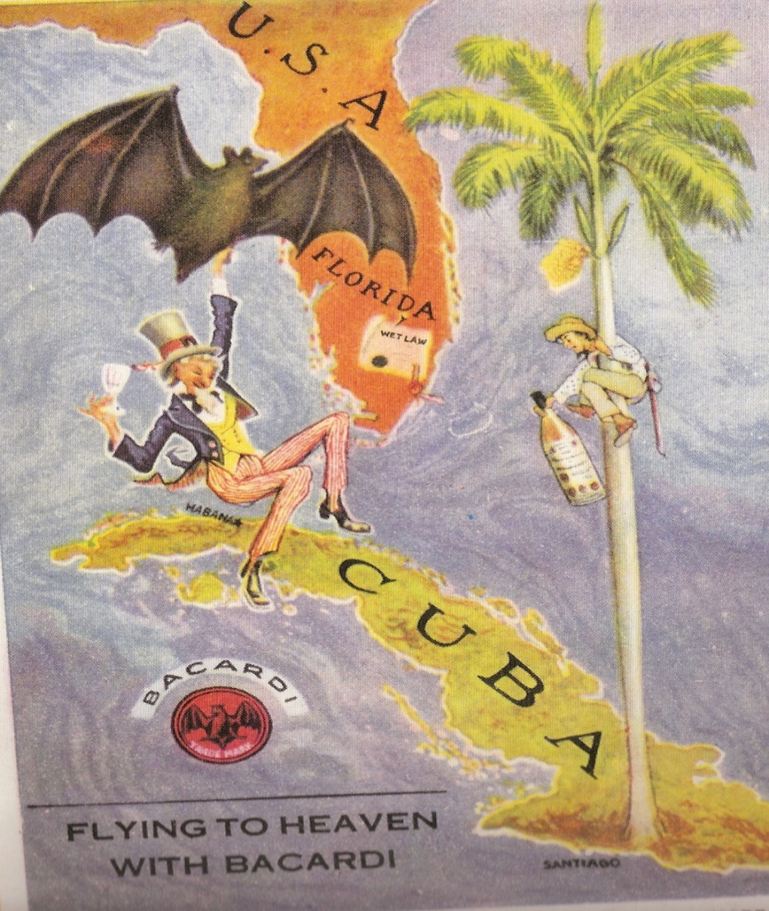
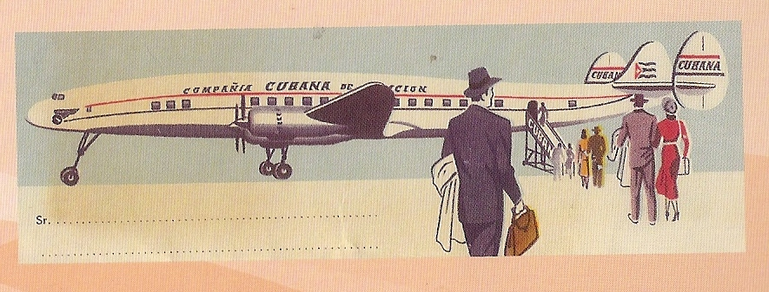
1950s
1950s = $713 million annual U.S. investment
1960 trade embargo
Cuba per capita income was 1/6 of per capita in U.S.
Cadillac

Slide 6
“Vast numbers of citizens cannot earn enough to live daily? Why were we buying Cadillacs when what we needed were tractors? We need tractors, not Cadillacs! The Cadillac costs thousands of dollars of our foreign exchange. The Cadillac does not plough, the Cadillac does not cultivate, the Cadillac does not produce!” –Fidel Castro

Slide 7
Colonial Roots
Pre-Columbian = 100,000 – 500,000 Taìnos
1513 = 4 African slaves from Hispaniola
1760 = post-Bourbon Reforms dominance of Havana
1762 = British control
Independence?

Slide 8
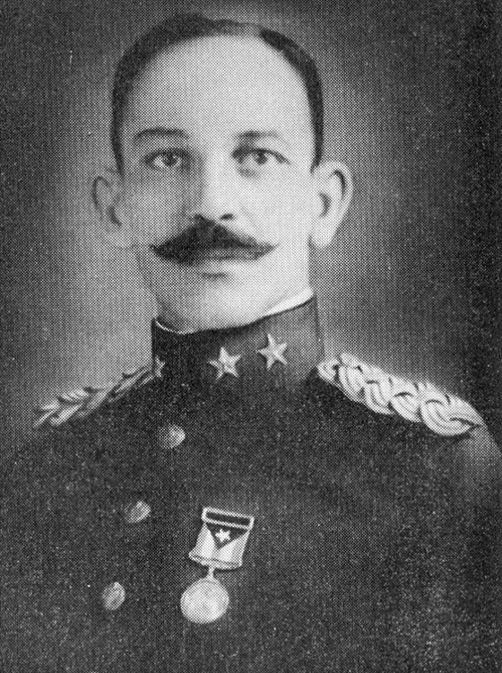
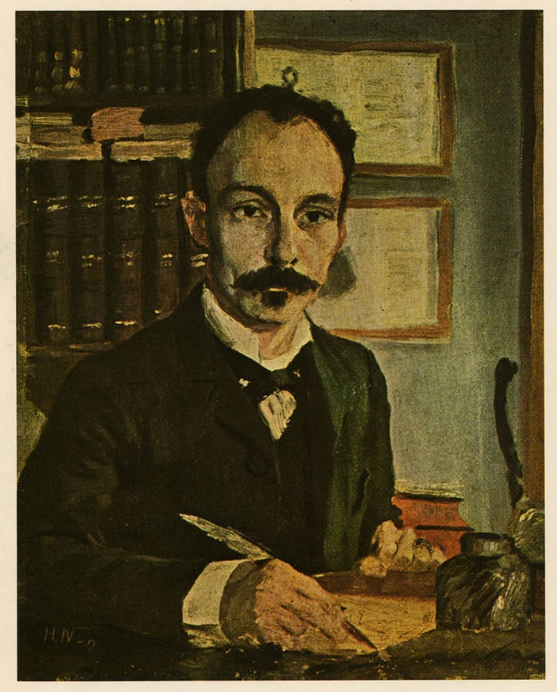
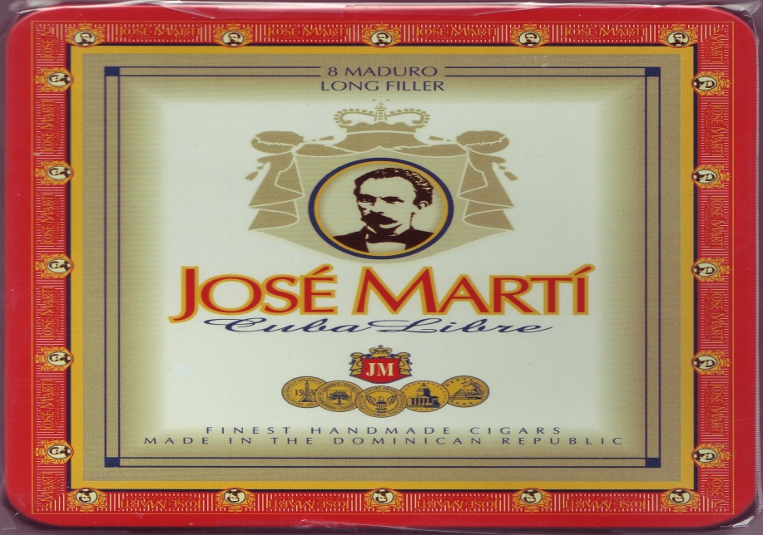
Josè Martì
Exiled to Florida & New York
Cuban Revolutionary Party
1865 = Led 6,000 in uprising

Slide 9
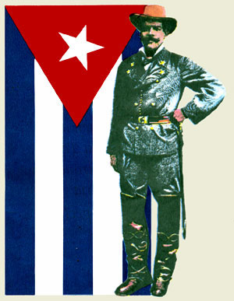
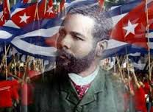
Antonio Maceo
Afro-Cuban
Killed in 1896
Military genius
“True independence”

Slide 10
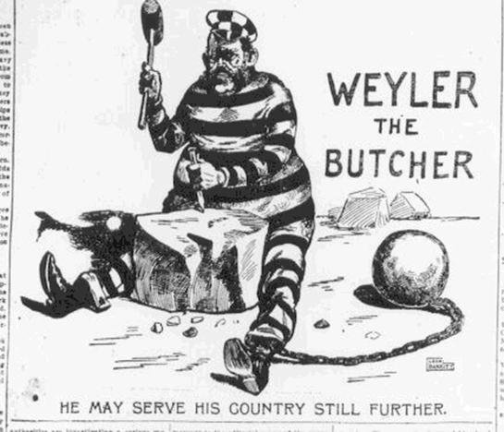
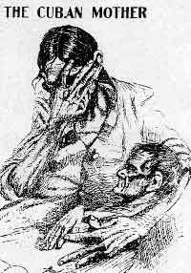
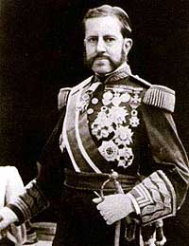
Valeriano Weyler
“The Butcher”
Reconcentration policy
1898 = 1/3 of Cubans in camps
400,000 dead

Slide 11
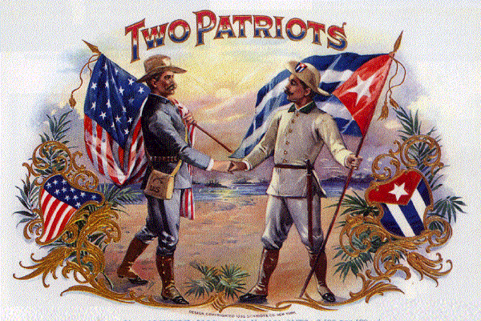
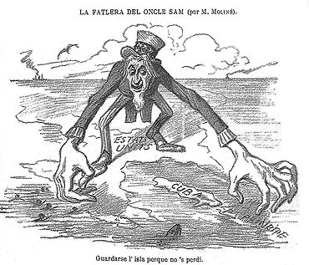
Spanish-American War, 1898
“Yellow Journalism”
Platt Amendment
Guantànamo Bay
U.S. corporations & investment

Slide 12
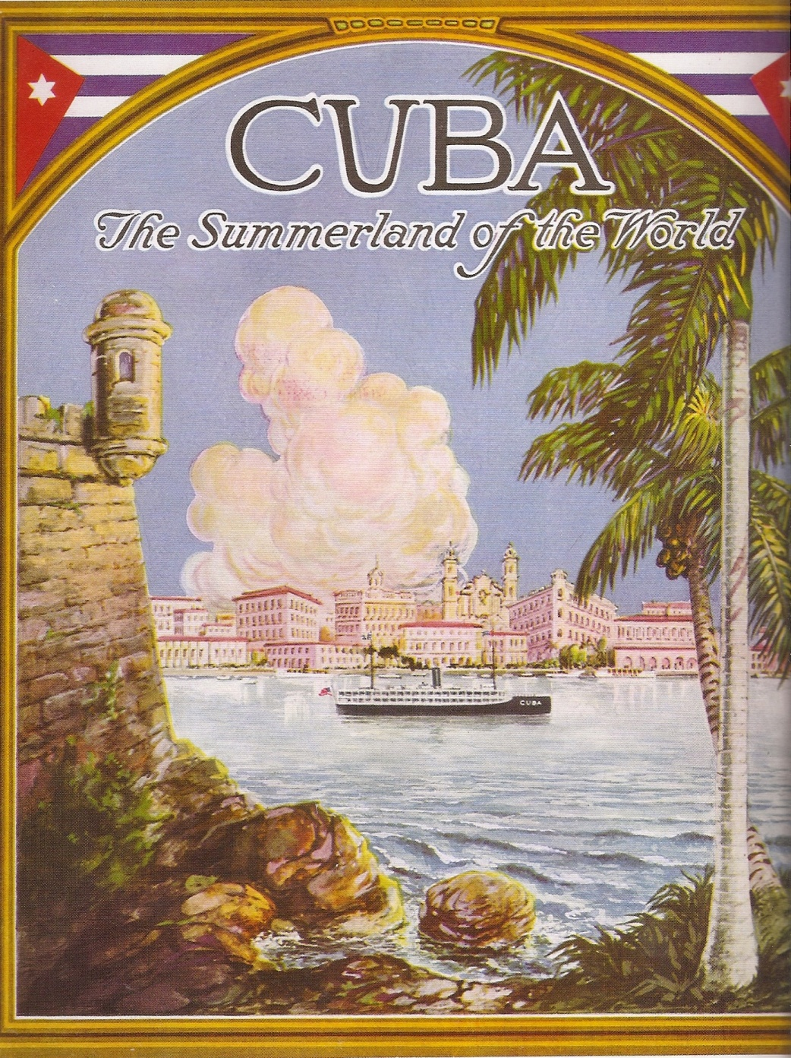
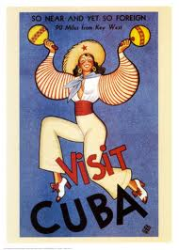
Economic Colonization
1902 = First Cuban president
“Jewel of the Caribbean”
Post-Prohibition allure

Slide 13
Sugar & Tobacco
Cohibas
One-crop, slave-based, export-oriented economy
80% earnings from sugar exports
75 – 80% purchased by U.S.
1920s = 75% of sugar mills owned by U.S.

Slide 14
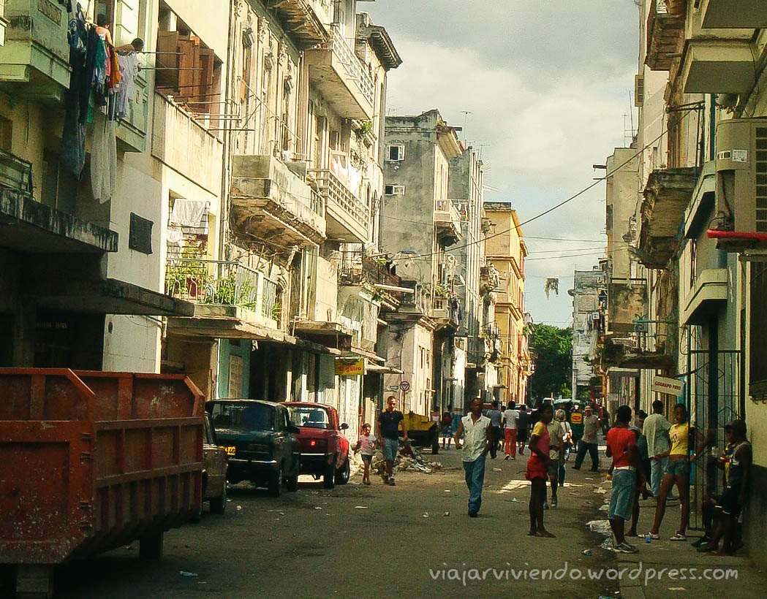
Economic Legacy for Revolution
Own, lease, or work?
“Llega y pon” housing
Connection between urban & rural poor

Slide 15
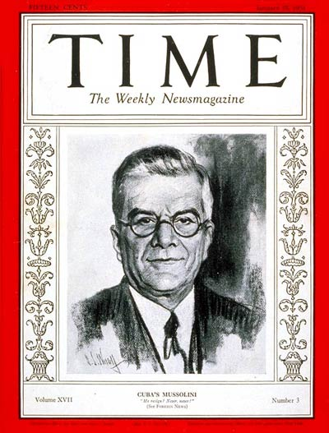
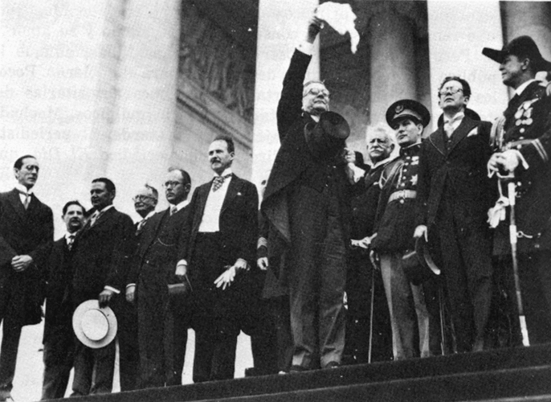
Gerardo Machado
President from 1925 – 1933
Julio Antonio Mella & the Communist Party

Slide 16
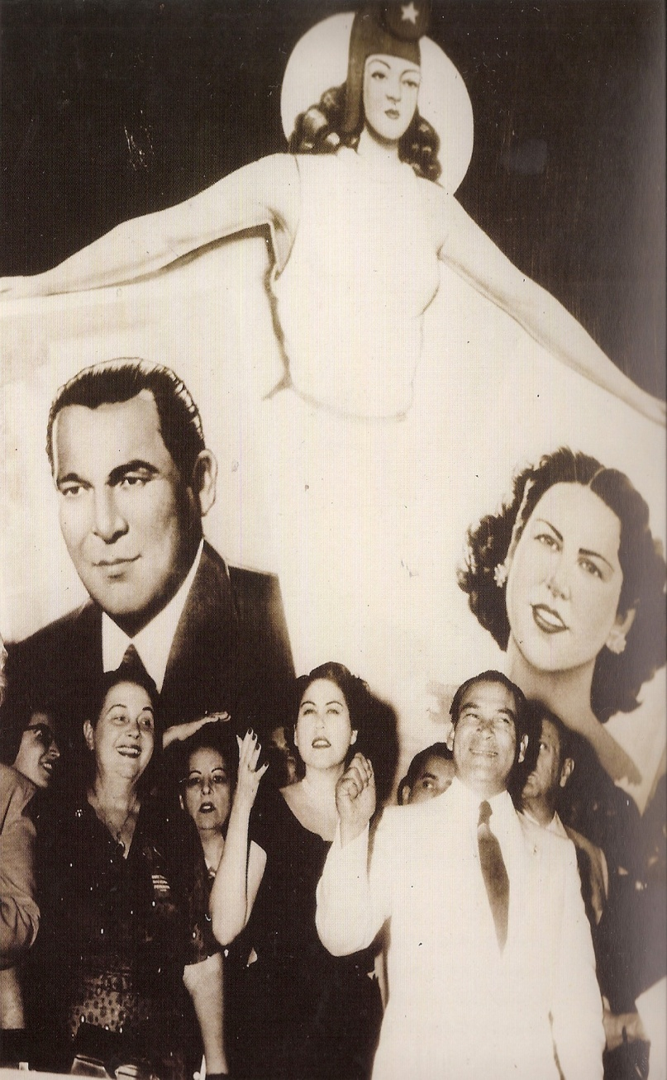
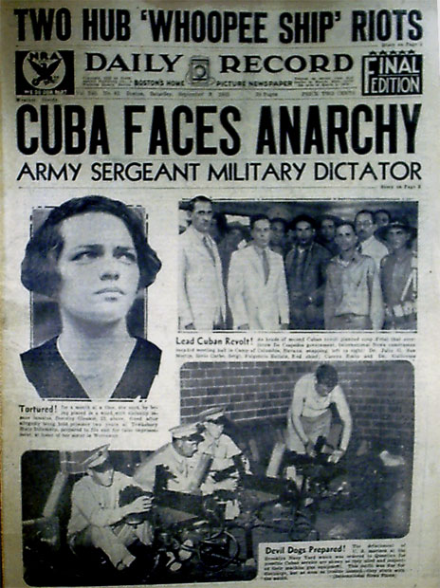
Sergeant Fulgencio Batista
Ramòn Grau San Martìn vs. FDR
President from 1940 – 1944
Coup in 1952 election

Slide 17
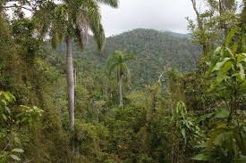
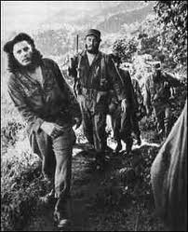
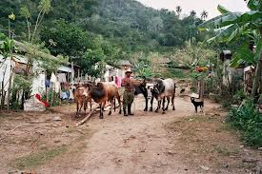
Fidel Castro
Born in 1927
Colonial Latin American path
Sierra Maestra mountains
Anti-Batista community

Slide 18
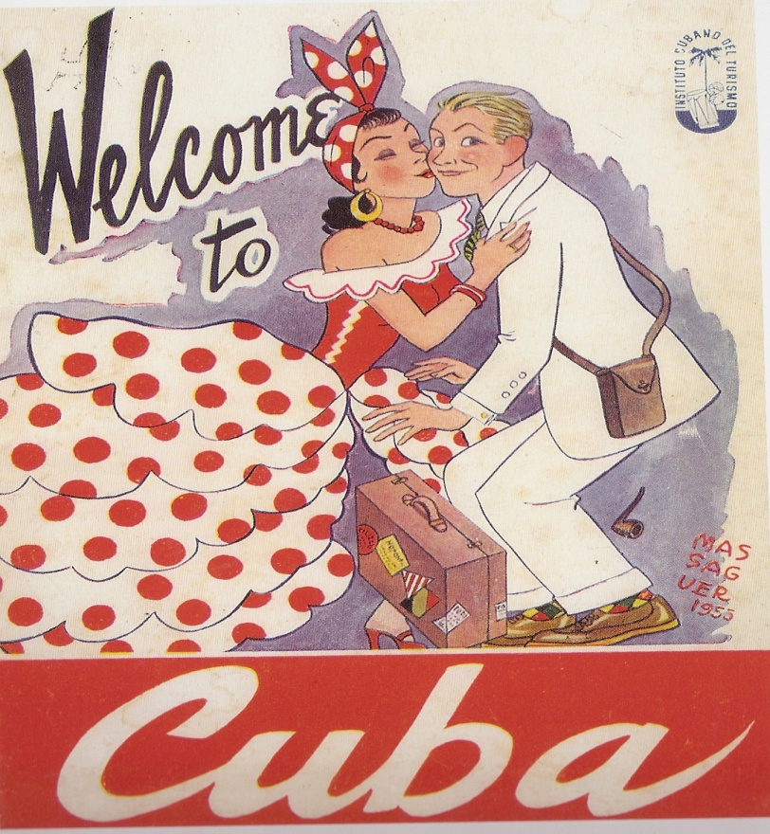
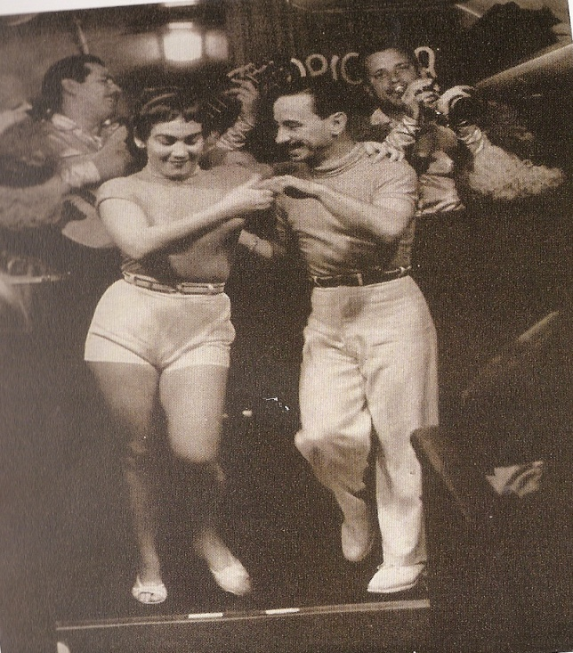
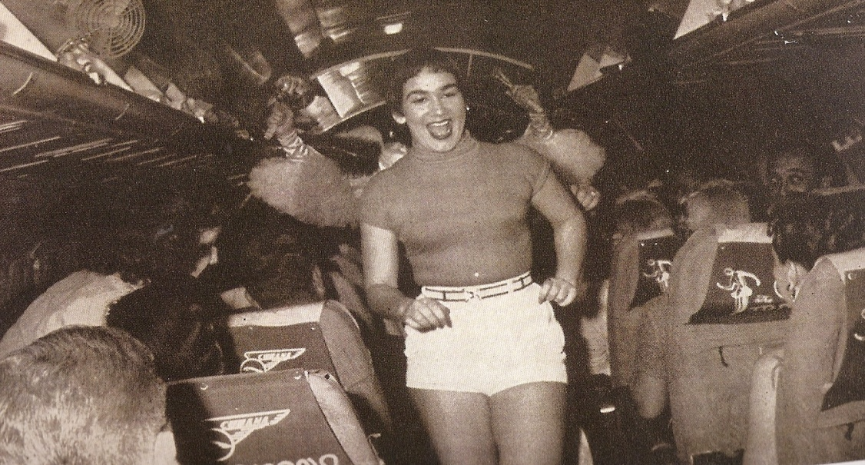
Tourist Shrine
Sin in the Sun
Cubana Airlines
American mafia
¼ of Cubans lived in poverty during Batista’s regime

Slide 19
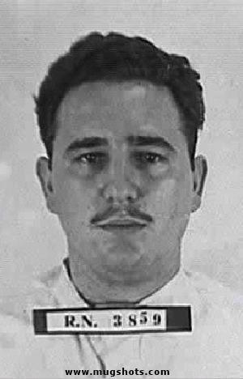
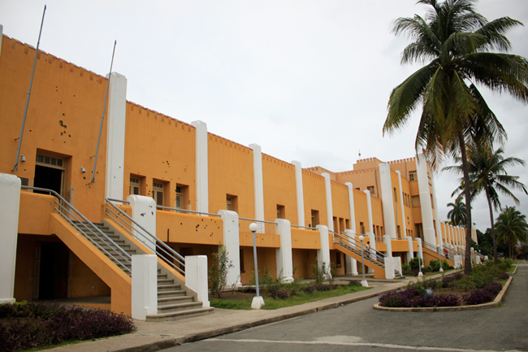
Moncada Barracks
Fidel + 165 others
Santiago de Cuba
July 26, 1953
70 dead, Raùl & Fidel sentenced to 15 years
“Condemn me. It does not matter. History will absolve me.”

Slide 20
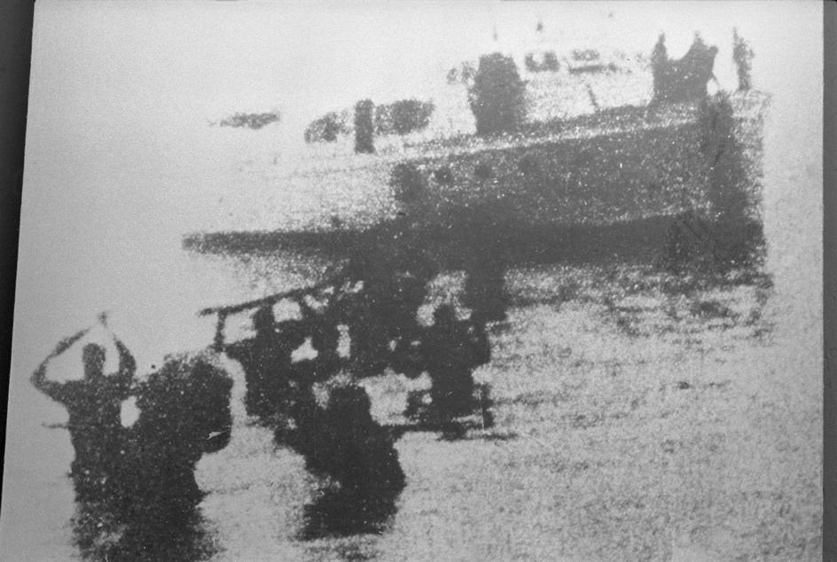
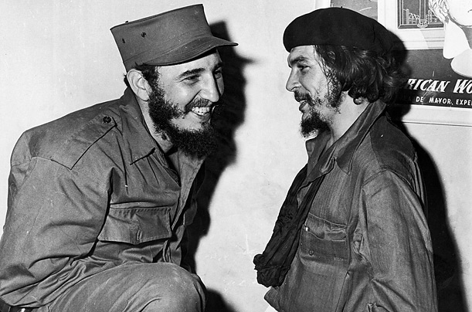
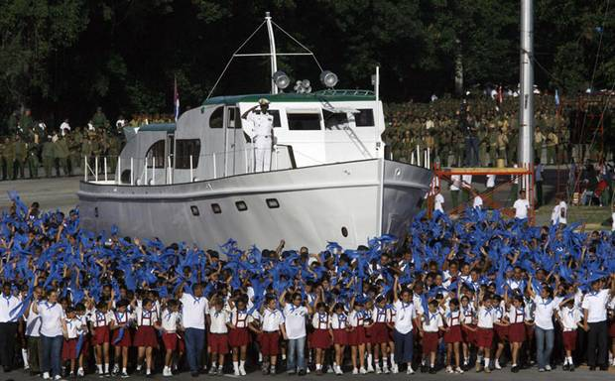
M-26-7 Revolution
Release in 1955
Che Guevara in Mexico
Granma, 12/2/56

Slide 21
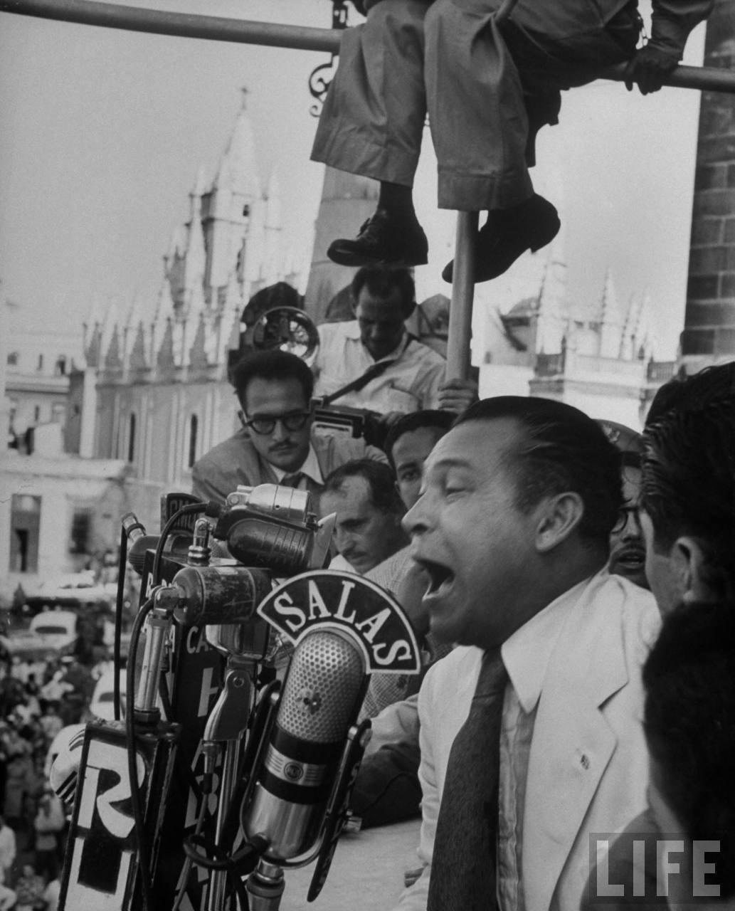
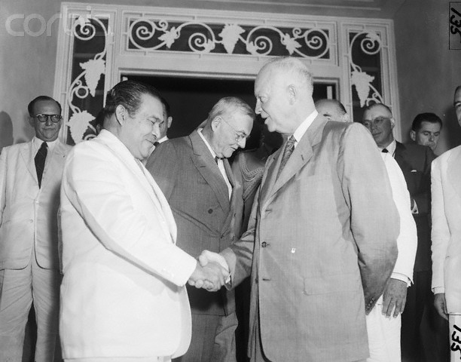
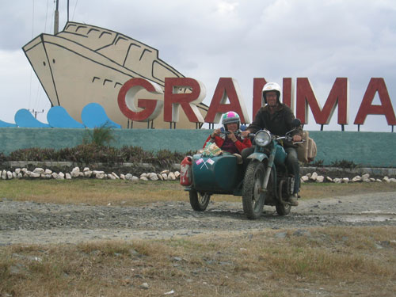
Batista’s Response
Servicio de Inteligencia Militar
1958 = Peak of hostility
Peasants of Sierra Maestra
Military differences

Slide 22
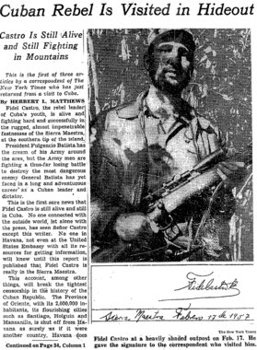
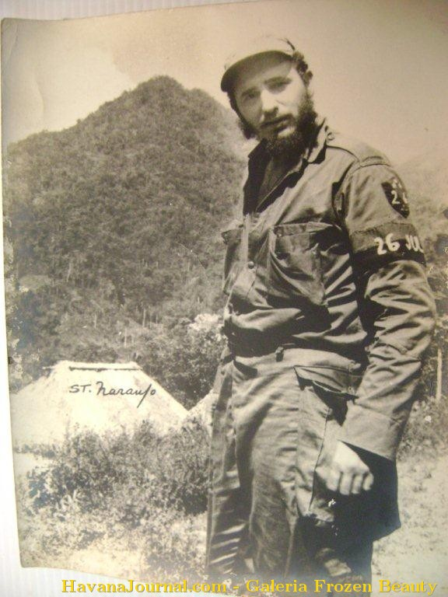
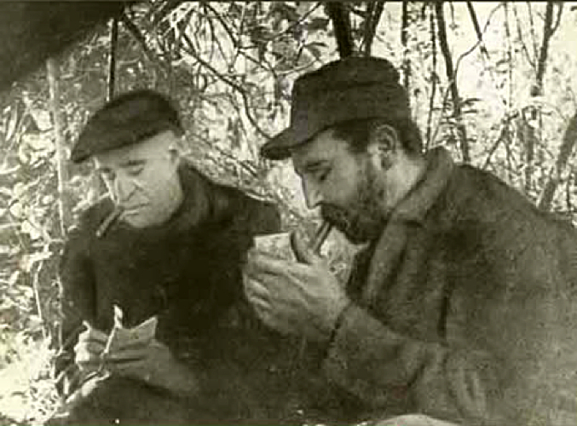
Press as a Weapon
Herbert Matthews, 1957, New York Times

Slide 23
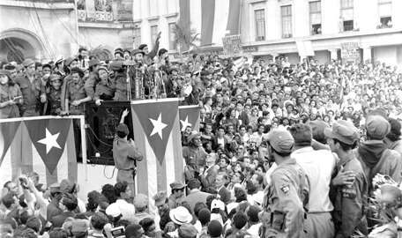
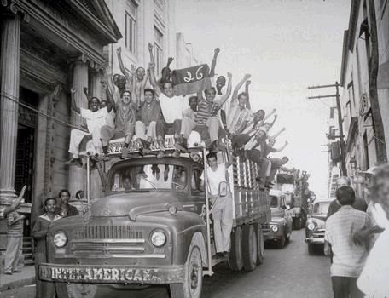
New Year’s Day, 1959
Batista fled by Cuban Air Force
Parking Meters
550 Batista supporters put to death in first 6 months
Doves, Fidel, & Obatalà

Slide 24
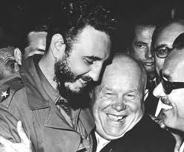
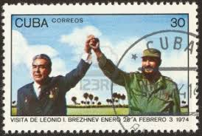
Changes in 1st Year
1) Nationalization of economy
2) Sharp swing toward Soviet Union
3) Establishment of dictatorship
4) Plans for egalitarian socioeconomic

Slide 25
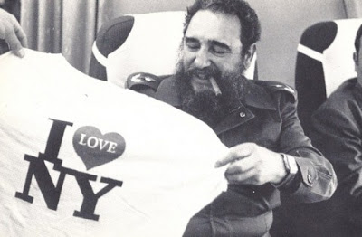

1959 = Welcomed by New York
Socialist or Communist?
National Institute of Agrarian Reform (INRA)
1960 = Seizures of businesses
1961 = Fidel’s Declaration
U.S. Embargo
Social programs
Role of Women

Slide 26


Why Castro?
Reaction against Batista
1959 = ¼ of Cubans illiterate, ¼ unemployed
Exile communities begin post-nationalization

Slide 27



Waves of Immigration
Post-Batista exodus
1979 = Visitation from U.S.
1980 = Mariel Boatlift =
125,000 Cubans
Post-Soviet crisis

Slide 28


Fall of the Soviet Union
Soviet Union had 84% of Cuba’s trade business
1989 – 1992 = Oil shipments fell by 86%, food imports by 42%
Riots, electricity & food shortages

Slide 29




Baseball
Botey?

Slide 30


Santerìa
Yoruba + Catholicism = Syncretic Santerìa
Olodumare + 400 Orishas
Santeros & animal sacrifice

Slide 31


Obatalà = Our Lady of Mercy, white & gold
Eelgua = Saint Anthony, black & red
Changò = Saint Barbara, lightning & dance
Yemayà = Our Lady of Regla, blue, mother orisha
Oshùn = Our Lady of Charity, patron saint of Cuba, El Cobre

Slide 32

Afro-Cuban Music
Syncretic
West African rhythm/drums + Spanish melodies/guitar + French Creole/Haitian contradanza + Taìno maracas
Guajira, rumba, son, mambo, conga, bolero, cha cha, pachanga, salsa

