Slide 1
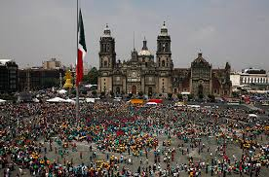
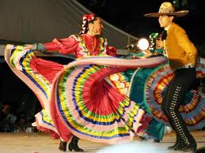
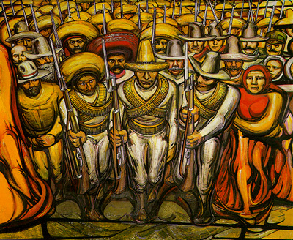
Mexico

Slide 2
Quick Facts
Estados Unidos Mexicanos
2,000 mile shared border
6-year presidential term (no re-election)
Over 110 million people
Oil, remittances, tourism, agricultural exports, manufactured goods
95% Spanish speakers
Mestizo 60%, “Indian” 30%, “White” 9%, “Other” 1%

Slide 3
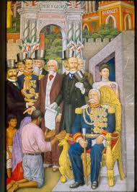
Early Political Instability
Independence in 1821
75 presidents in first 55 years (1821 – 1876)
Mid-1800s = Power of the church vs. “Liberalism”
2 National Dictatorships: Porfiriato (1876 – 1911) & P.R.I.

Slide 4
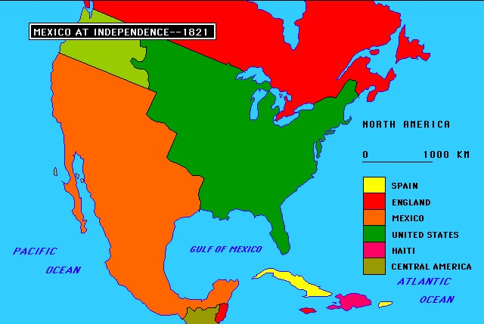
Mexico After Independence
Political disorder & physical decay
Spaniards expelled from Mexico
15 – 30% of adult men unemployed
New members of the upper class
1800 = 6 million people
1850 = 7.6 million people
1900 = 13.6 million people

Slide 5
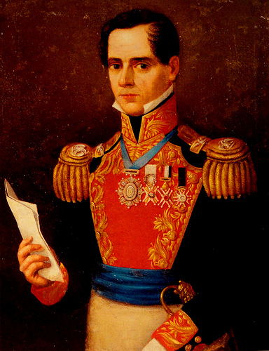
Church and the Military
Church controlled ½ of Mexico’s land
Military dominated national politics
Antonio Lòpez de Santa Anna, president 6 times
Caudillo

Slide 6
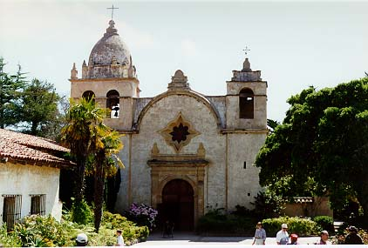
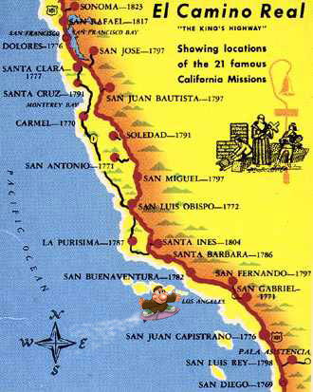
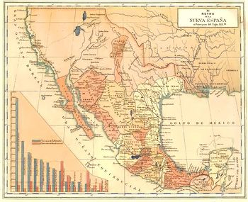
U.S. & Mexico
Southwest as periphery
Manifest Destiny
Missions

Slide 7
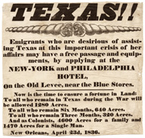
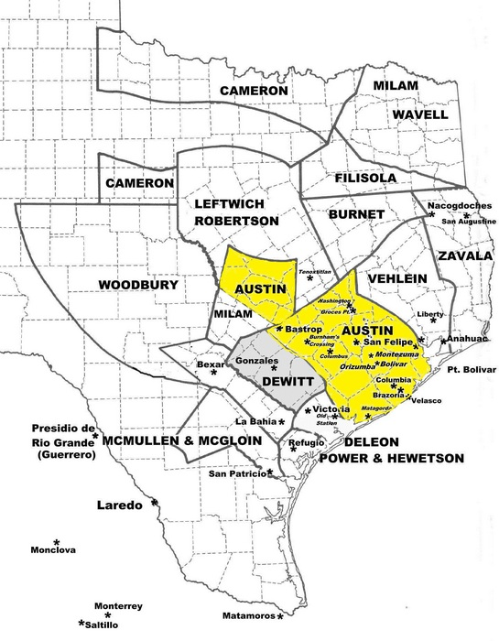
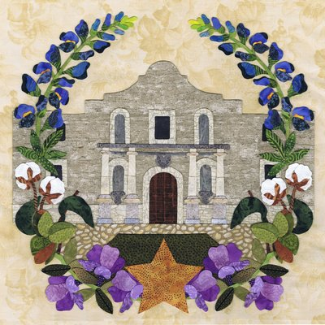
Texas Conflict
Stephen Austin & “Catholic” settlers, 1821
Mexico’s Emancipation Proclamation, 1829
Sam Houston & The Alamo, 1836
Lone Star Republic
Delayed Annexation

Slide 8
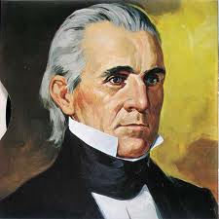
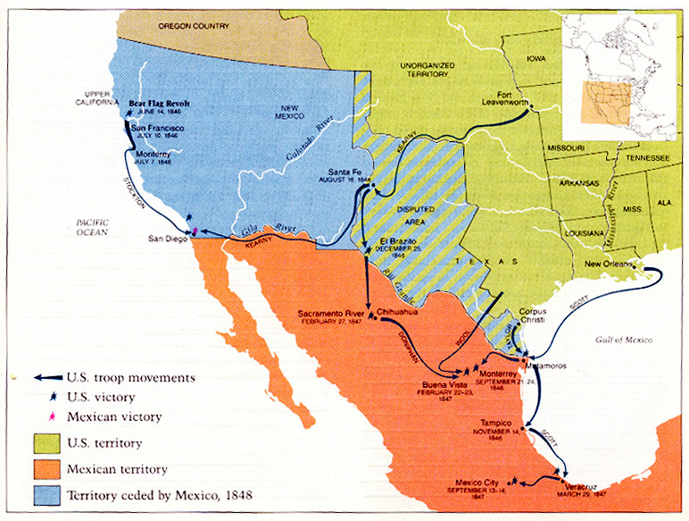
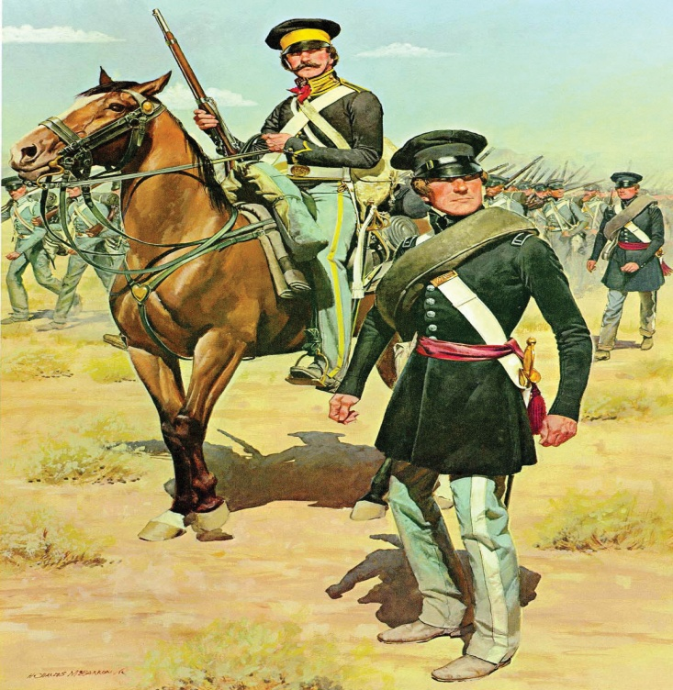
Mexican American War, 1846-1848
President Polk vs. Santa Anna
Treaty of Guadalupe Hidalgo
$15 million for ½ of Mexico

Slide 9
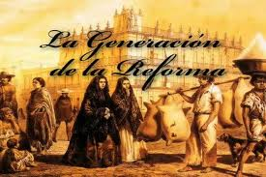
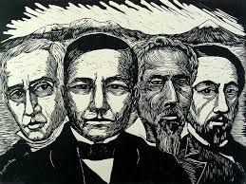
“La Reforma”
“Conservatives” vs. “Liberals” in Mexico City
Colonial traditions vs. Modernity
Decreasing the power of the Church

Slide 10
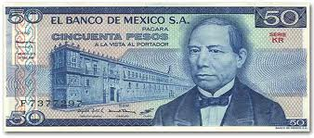
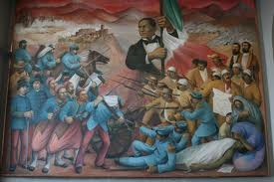
War of the Reform, 1858-1861
Benito Juàrez
Leader of La Reforma

Slide 11
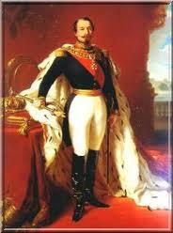
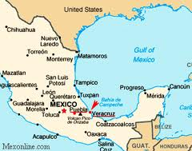
French Occupation
1861 = Juàrez issues 2-year moratorium on European debt
Louis Napoleon III
Battle of Puebla, May 5th, 1862

Slide 12
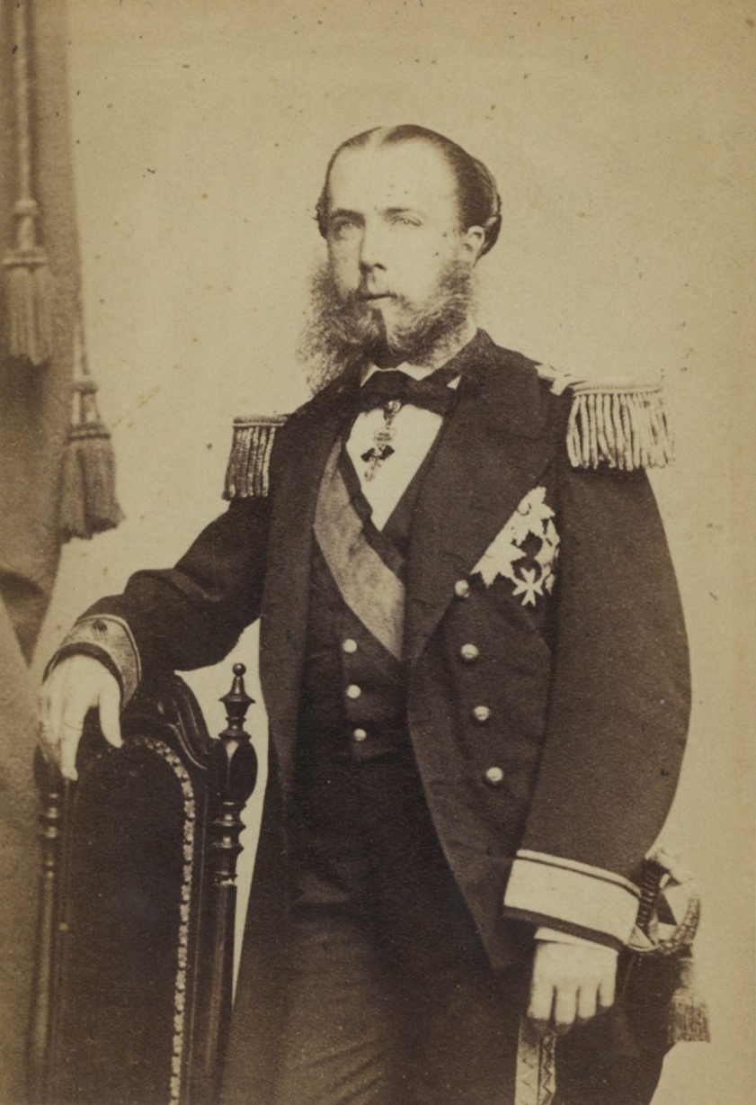
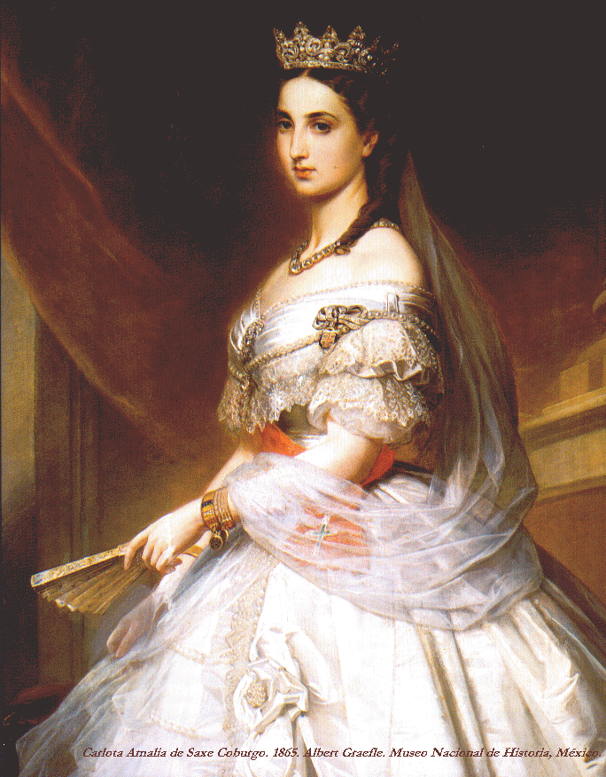
Maximilian Hapsburg & Empress Carlota
Defeated by Juàrez
Executed in 1867

Slide 13
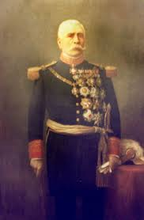
“Restored Republic”
Juàrez wins multiple re-elections
Election of 1871
Porfirio Dìaz
Coup against Sebastiàn Lerdo

Slide 14
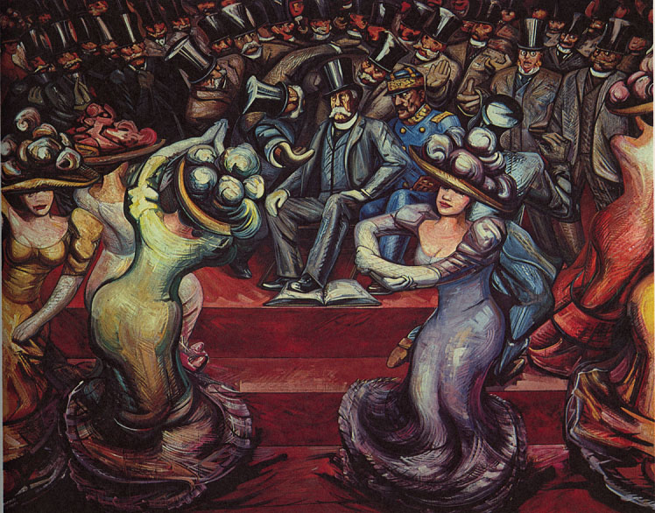
The Porfiriato, 1876 - 1911
Strengthened the federal government
35-year dictatorship
Rurales
Foreign investment, banking, railroads

Slide 15
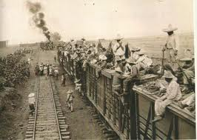
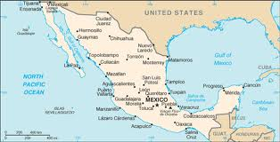
Geography & the Economy
North = Cattle ranches, laborers, cowboys, loss of land to railroads
Mexico City = Political center
South & Morelos = Peasants, land seized for sugar plantations

Slide 16
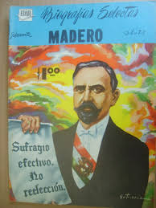
The Revolution: Phase 1
Young elite left out of political gains
Re-election in 1910
Francisco Madero & Anti-Re-election Party
Plan de San Luìs Potosì
Dìaz flees Mexico in 1911
Madero elected President in 1912

Slide 17
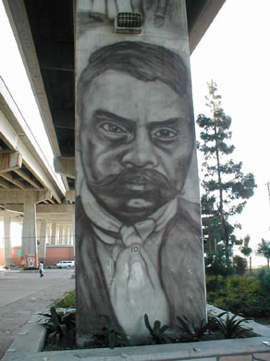
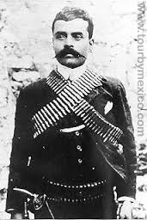
Emiliano Zapata
Based in Morelos
Interested in democracy and land reform
Leader of the landless southern peasants
Plan de Ayala

Slide 18
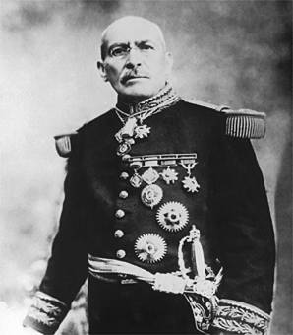
Phase 2: Rise of Huerta, 1913
Madero’s death, 1913
General Victoriano Huerta
Huerta vs. Zapata, Pancho Villa, Carranza

Slide 19
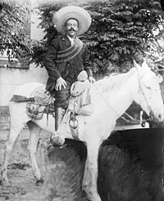
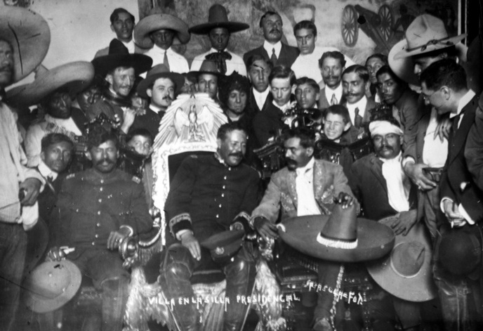
Pancho Villa
Horse thief, rancher, cowboy, bandit
Led army in Northern Mexico

Slide 20
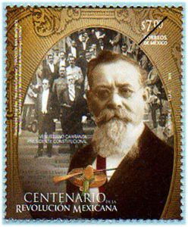
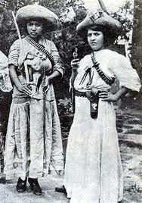
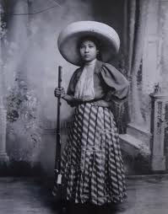
Venustiano Carranza
Elite politician from Coahuila
Plan de Guadalupe

Slide 21
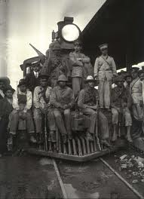
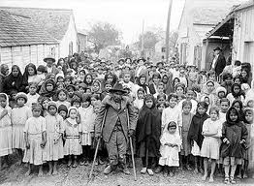
Phase 3: Civil War, 1914
The Tampico incident, 1914
Huerta resigns in 1914
Carranza takes control
Differences between revolutionaries became clear

Slide 22
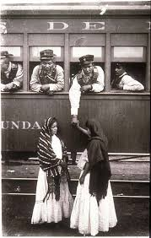
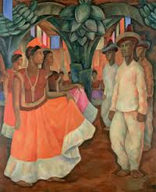
Phase 4: Carranza Solidifies Power
Obregòn vs. outlaw Villa, 1915
Zapatistas isolated in Morelos
Carranza’s Constitution of 1917

Slide 23
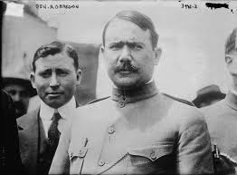
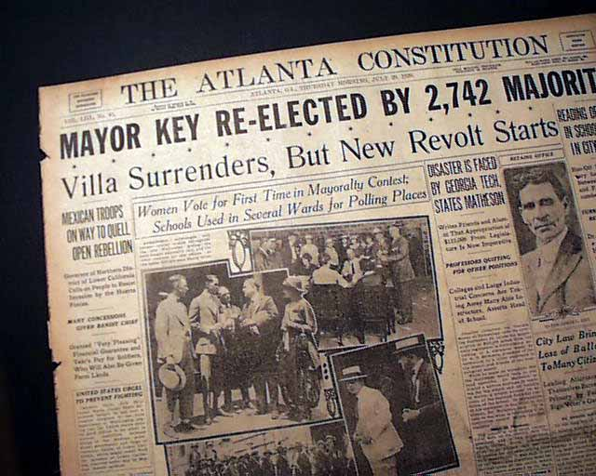
Phase 5: Obregòn in Power
Zapata killed in 1919
Carranza killed by his own guards
Villa surrenders in 1920
1 -2 million dead, Mexico left in political and economic ruin

Slide 24
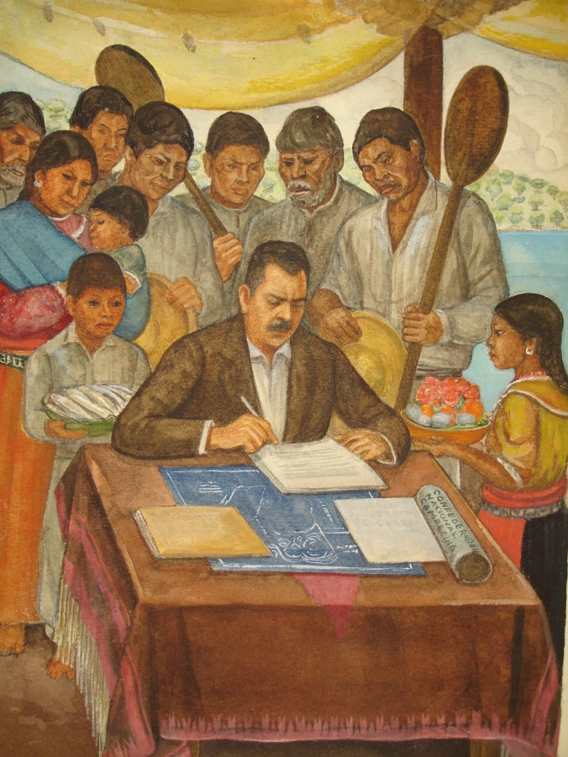
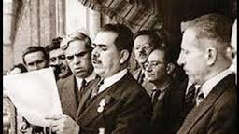
Làzaro Càrdenas, 1934 – 1940
Obscure army officer from Michoacàn
Enlarges power of the president
Land Reform of 44 million acres affected 800,000 Mexican campesinos

Slide 25
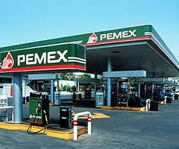
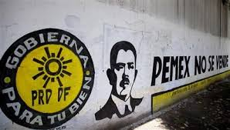
Mexican Oil
Mexican laborers vs. U.S. oil companies
Càrdenas nationalized 17 U.S. oil companies
PEMEX, Petròleos Mexicanos

Slide 26
“Soft Authoritarianism of the PRI”
PNR, The Revolutionary National Party, 1929
PRM, Party of the Mexican Revolution, 1938
President Càrdenas & 4 sectors
PRI, Institutional Revolutionary Party, 1946
Fraudulant elections, Televisa control
Limited competition

Slide 27
Poverty
2000 = 40% of Mexicans live in poverty
Wealthiest 10% control 40% of Mexico’s national wealth
Inflation
Agricultural exports

Slide 28
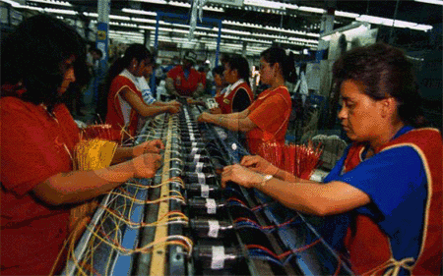
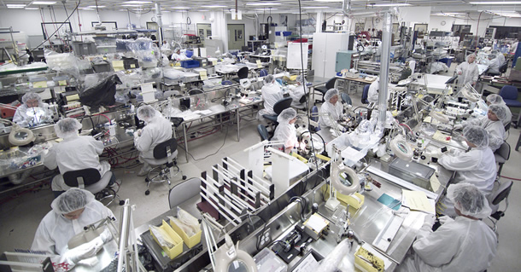
NAFTA
North American Free Trade Agreement with Canada, U.S., and Mexico, 1994
Attracted foreign investment
Maquiladoras & outsourcing
Hurt Mexican farmers

Slide 29
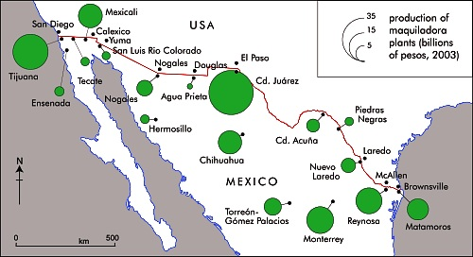
Maquiladoras
600 along the border
GM, Chrysler, Bali, IBM, Honeywell, Panasonic, Motorola, LG, Mattell, Fisher Price, Ford, Sony, Mercedes, Sanyo, Samsung, Toshiba
$4 - $9 daily wage
Women’s health concerns
Air & water pollution

Slide 30
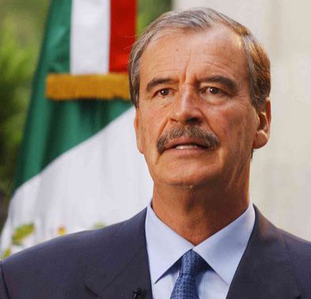

A New Era: 2000 election
PRI divided
Vicente Fox, PAN
CEO of Coca Cola Mexico, rancher from Guanajuato
2000 = Approval ratings of 85%

Slide 31


2006 Election: Return to the Past?
Felipe Calderòn, PAN vs. Lòpez Obrador , PRD
.58% difference in votes
30% believed in election fraud
Federales

Slide 32

Drug War

