Slide 1
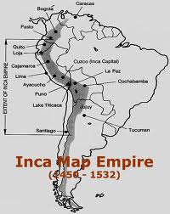
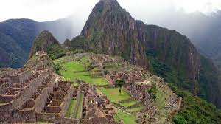
The Andeans & Inca

Slide 2
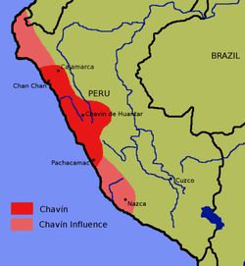
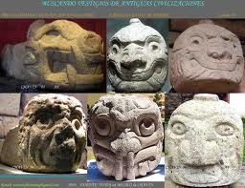
Chavìn de Huantar
400 BCE – 200 BCE
Northern Peru
Contemporaries of the Olmec
A religious site

Slide 3
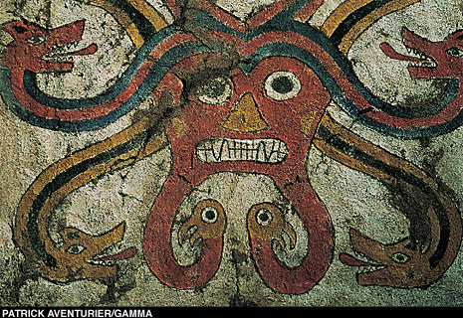
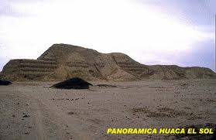
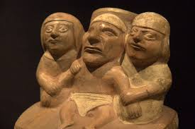
The Moche
600 CE – 800 CE
Coastal area of
Northern Peru
Engineers
Huaca del Sol
“The Decapitator”

Slide 4
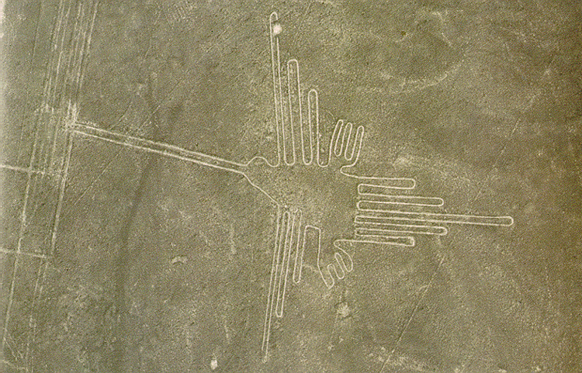
The Nazca
Southern coast of Peru
Contemporaries of the Moche
Geoglyphs
5 miles long

Slide 5
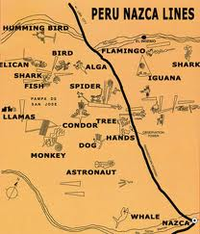
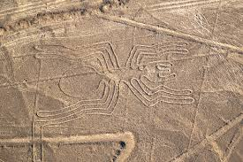
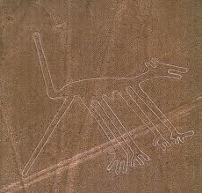

Slide 6
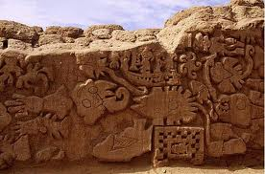
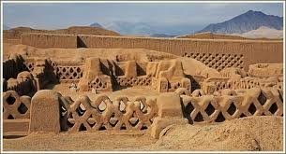
The Chimu
1200 – 1465
25,000 – 50,000 people
Chan Chan capital
Importance of artisans

Slide 7
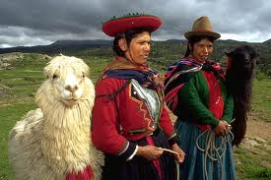
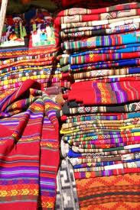
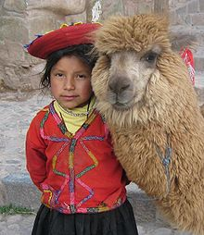
Andean textiles
Alpaca and llama hair

Slide 8
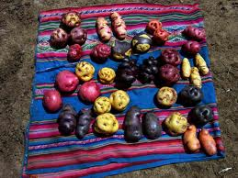
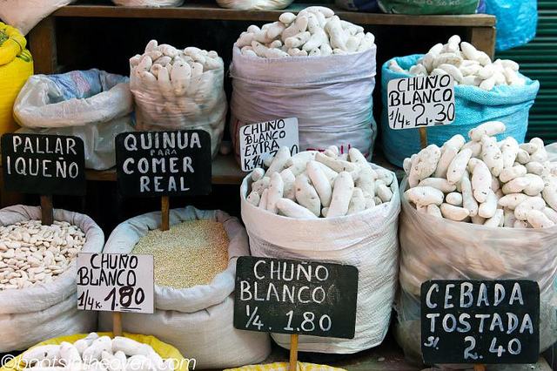
Andean food
Potatoes
Quinoa

Slide 9
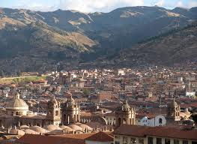
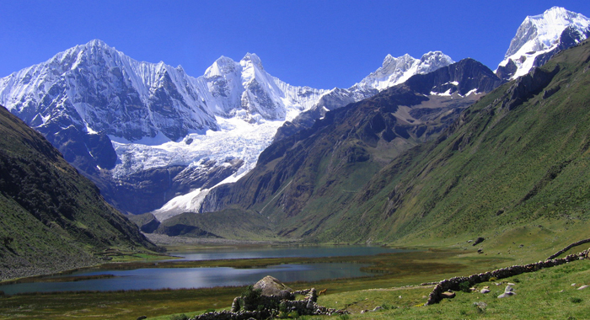
Geography
Tawantinsuyu (Land of the
Four Quarters)
Cuzco, capital
3 million – 12 million

Slide 10
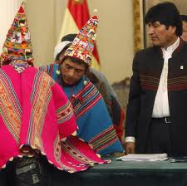
Intrusiveness
Mitmaq
Quechua
Aymara
Mita
40,000 workers
per year

Slide 11
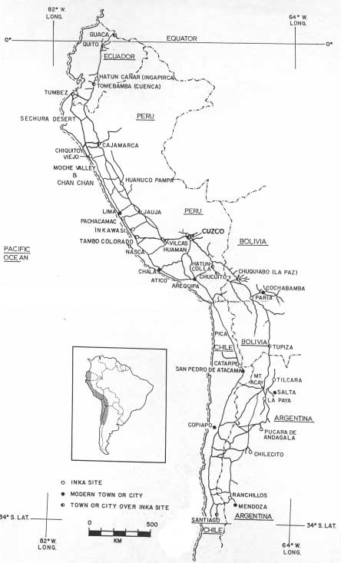
Roads
East-West and
two North-South routes
20,000 miles
Tambos
Relay-runners

Slide 12
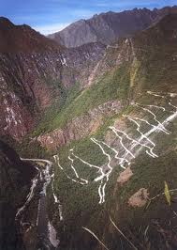
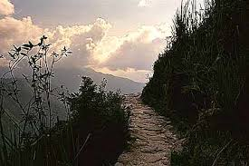
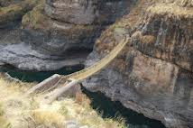

Slide 13
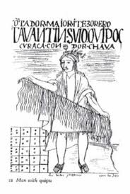
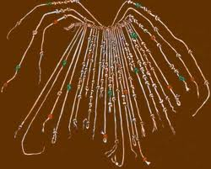
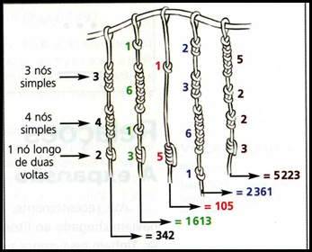
Quipos
Multi-color cords with knots
No written language

Slide 14
Reciprocity
Forced military & labor service
Warehouses to store food and supplies
Goods distributed by the government

Slide 15
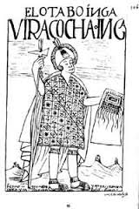
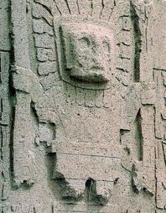
Religion
Sun god Inti
Creation god Viracocha
Forced worship
Human sacrifice for special occasions

Slide 16
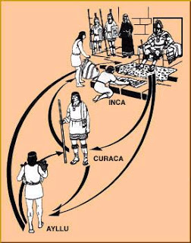
Ayllu
Independent community of households
Kuraka
No private property
Shared responsibilities
Yanaconas

Slide 17
Key Characteristics
Conquered groups by force
Forced labor and military service
Temples
Chosen by gods to rule
Built upon pre-existing traditions
Class distinctions
Government controlled food and economy

