Slide 1
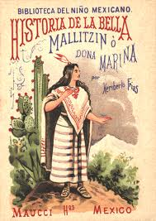
Aztec & Inca Women

Slide 2
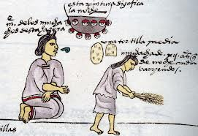
Gender Differences
Umbilical cord of girls = under the house
Umbilical cord of boys = given to warriors
Sweeping as a spiritual task

Slide 3
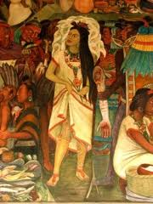
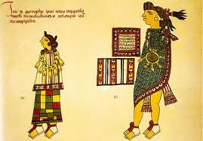
Aztec Makeup
Hair in buns
Axin as tribute
Blue tattoos

Slide 4
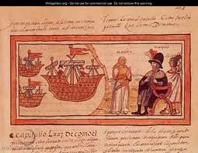
Marriage
20 – 22 years old
Wedding at groom’s house
Arranged by parents
Four days of prayer

Slide 5
Aztec Law
Death for adultery
Strict trial requirements to prove adultery
Divorce allowed
Remarriage allowed

Slide 6
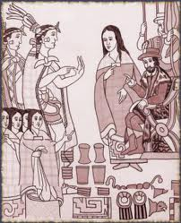
Malinche
Malintzin, Doña Marina, Malinche
Given to Cortès in 1519
Died in late-1520s
Martìn, Marìa, Juan Jaramillo

Slide 7
Acllas
Young Andean women
Chosen as concubines, wives, weavers, & other tasks
Considered an honor

