Slide 1
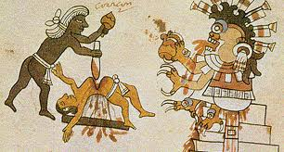
Human Sacrifice

Slide 2
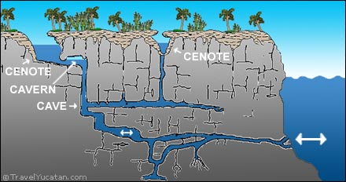
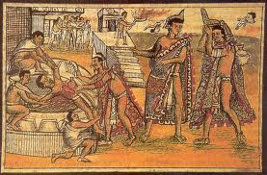
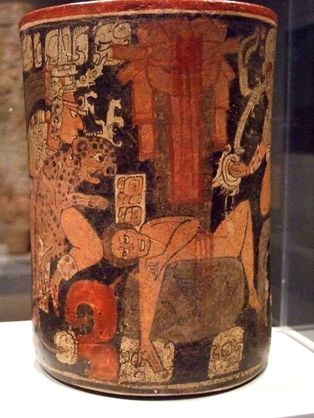
Mayan Bloodletting
Each day + special occasions
Cenote
Ear piercings

Slide 3
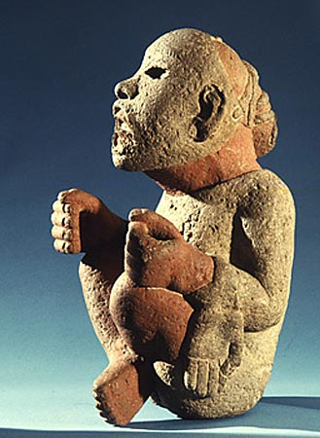
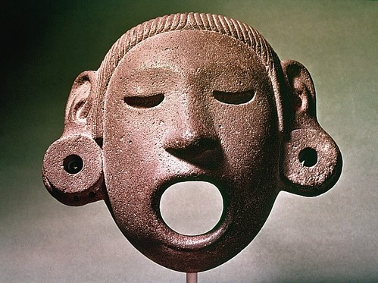
Xipe Totec
God of Spring
Flayed skins
Priests wore the skins

Slide 4
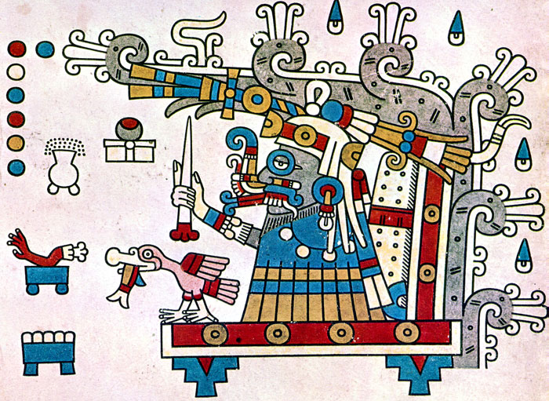
Tlaloc
God of rain
Preferred children
Death by drowning

Slide 5
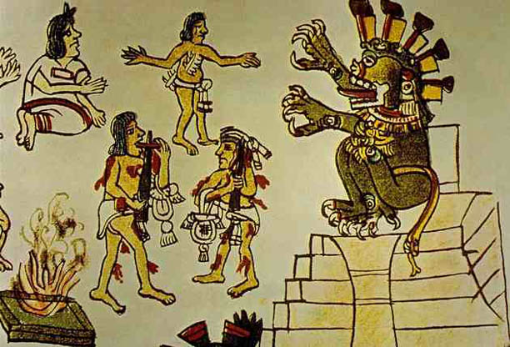
Why did sacrifice matter?
Pleasing gods
A way to avoid destruction
Projecting power of rulers

Slide 6
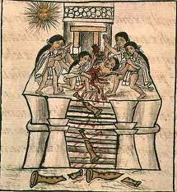
Gladiators?
Victims tied to disks
Wooden weapons

