Slide 1
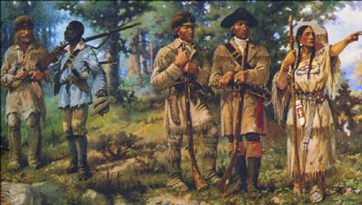
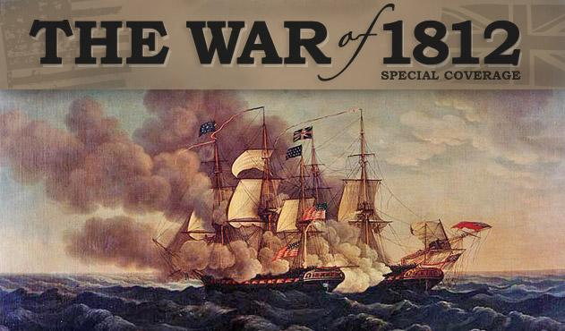
Diplomacy, Exploration, & War in the Early 1800s

Slide 2
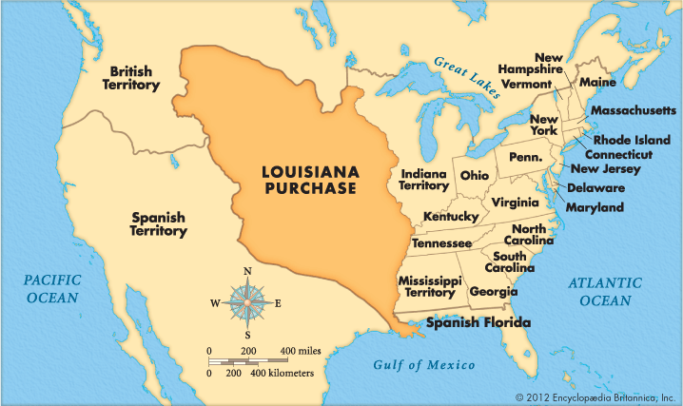

Slide 3
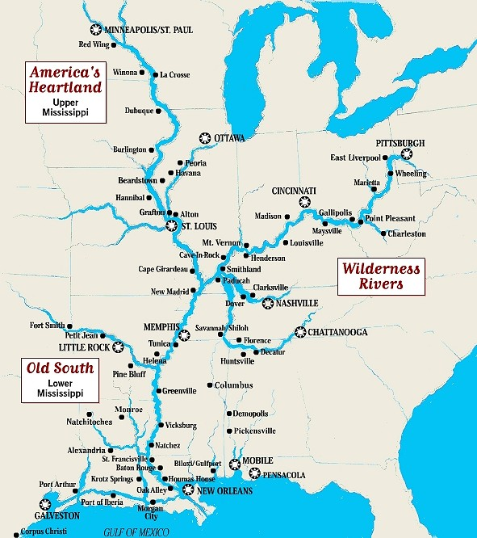
The Mississippi River
Strategic location for American farmers in Kentucky & Tennessee
Pickney’s Treaty
1800 = Spain returned Louisiana to France

Slide 4
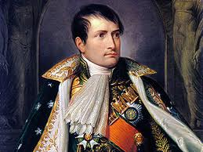
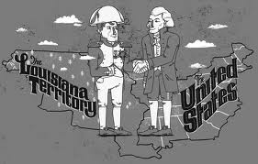
Sale of Louisiana
1803 = Negotiations with Napoleon
$15 million purchase
827,000 square miles

Slide 5
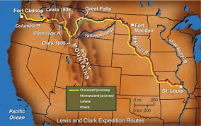
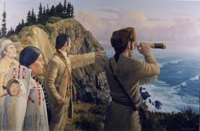
Lewis & Clark
Commissioned 6 months before LA Purchase
Meriwether Lewis, Captain William Clark, French interpreter, Shoshone Sacagawea
4,000 miles over 2 years

Slide 6
Jefferson’s Relationship with Native Americans
Paternalism
Expected complete assimilation
Promoted transition to yeoman farming
Government as creditor
Indian women

Slide 7
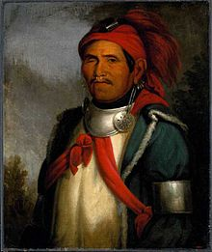
Tenskwatawa
The Shawnee Prophet
1805 = Spiritual Awakening
Prophetstown along the Tippecanoe River, Indiana

Slide 8
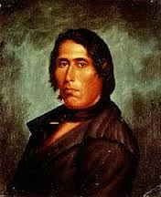
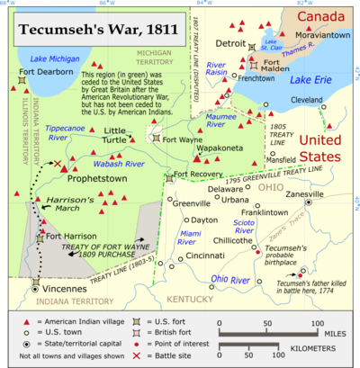
Tecumseh
Born in Ohio, 1768
Leader of Pan-Indian movement
Goal = Unite in order to fight land encroachment

Slide 9
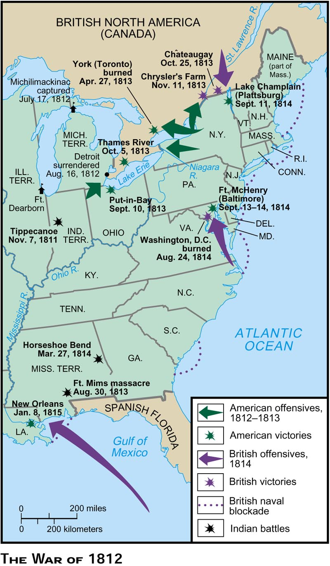
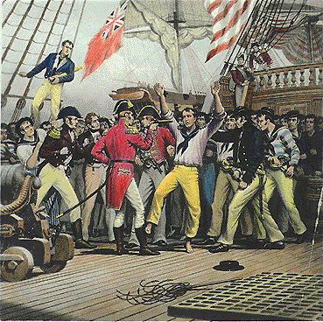
War of 1812
Settler vs. Indian + Britain vs. U.S.
“Peaceable Coercion”
British Navy impressed 6,000 Americans
Conflict in Ohio state + Indiana Territory

Slide 10
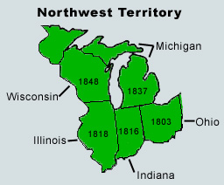
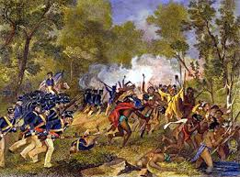
Indian Conflict
1810 = 230,000 white settlers in Ohio
40,000 in Northwest Territory (Indiana, Illinois, Michigan, Wisconsin)
70,000 Indians in Ohio + NW Territory
Alliance with Britain
Burning of Prophetstown

Slide 11
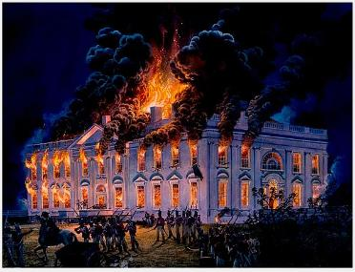
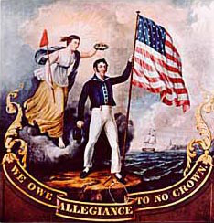
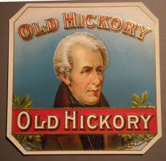
The 2nd American Revolution
Canada
The White House
Old Hickory
Treaty of Ghent

