Slide 1

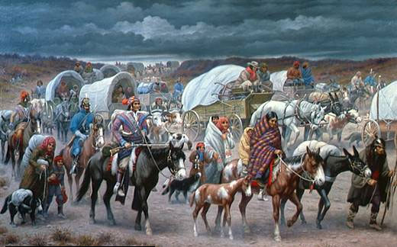
Indian Removal Policy

Slide 2
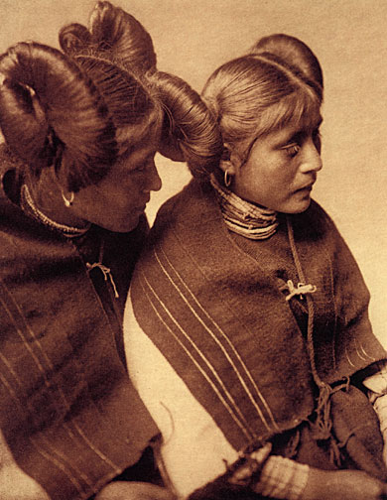
Demographics
1500 = 7 million Indians in North America
1600 = 3 million
2000 = 2, 476,000 ( .9% of U.S. population)
Over 500 federally-recognized tribes

Slide 3
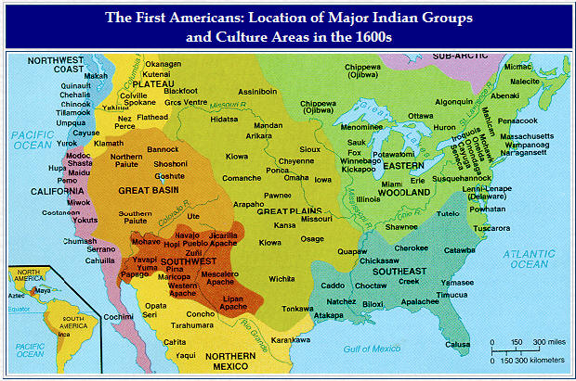

Slide 4
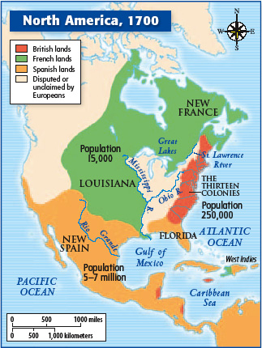
Contact with Spanish, French, British
Spanish and French contact = 16th century
British contact = 17th century
Religious conversion, intermarriage, gender roles?

Slide 5
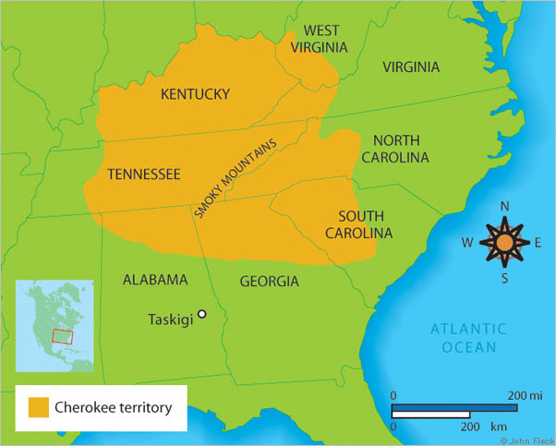
The Cherokees
Appalachia
Colonial Era = Most powerful tribe in Southeast
Deerskin trade
Land encroachment post-Revolution

Slide 6
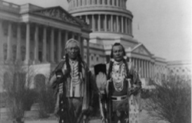
Changes in U.S. Approach
Indian negotiations treated as a diplomatic engagement with a sovereign nation
Constitution’s Supremacy Clause = President & Congress establish Indian policy to control the actions of state residents

Slide 7
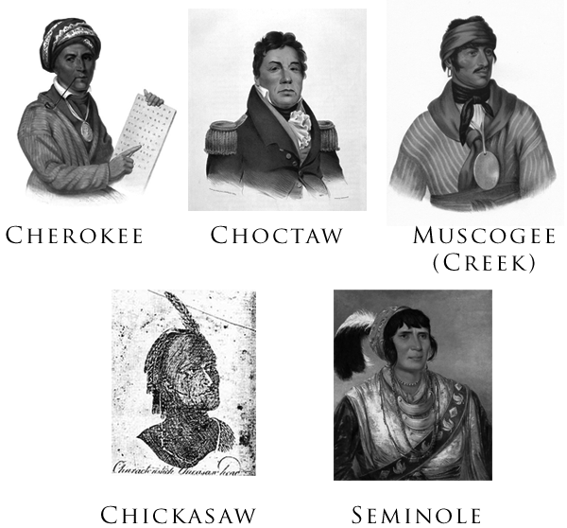
“Civilization Policy”
Henry Knox, Washington’s Secretary of War
1631 = 1st Praying Town in Puritan New England
1674 = 14 Praying towns with 1,111 Indians
5 Civilized Tribes = Choctaw, Creek, Cherokee, Chickasaw, Seminole

Slide 8
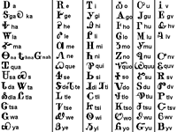
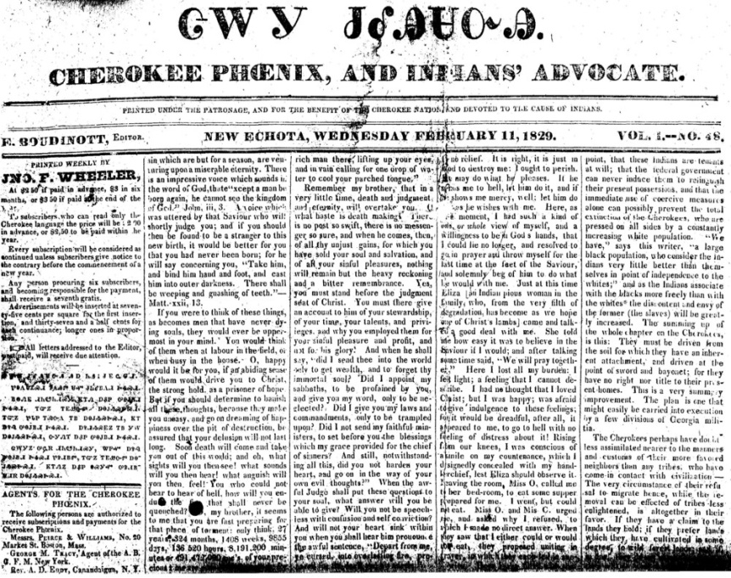
Cherokee Nationalism
Changes in division of labor, farming as “women’s work”
Private property, ferries, toll roads, slave ownership, Christian mission schools
Sequoyah’s syllabary of 85 symbols
Cherokee Phoenix, 1828
200 elite Cherokee men married white women

Slide 9
Opposition
Fertile land for cotton in Appalachia
Georgia claimed Cherokee land fell within the jurisdiction of state borders
Cherokees not allowed to testify in any legal case against whites
Creation of Indian Territory
1829 = Gold discovered in Georgia

Slide 10
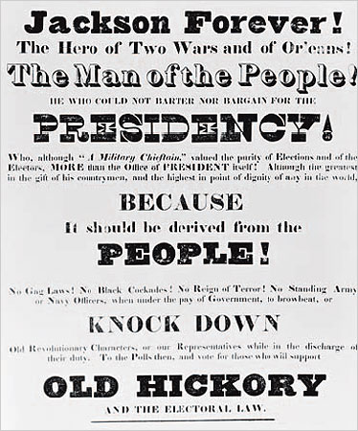
Indian Removal Act, 1830
1828 = Jackson elected with the support of Southern voters
16,000 Cherokee + rest of 5 Civilized Tribes
Divided American public
Worcester v. Georgia, 1832

Slide 11
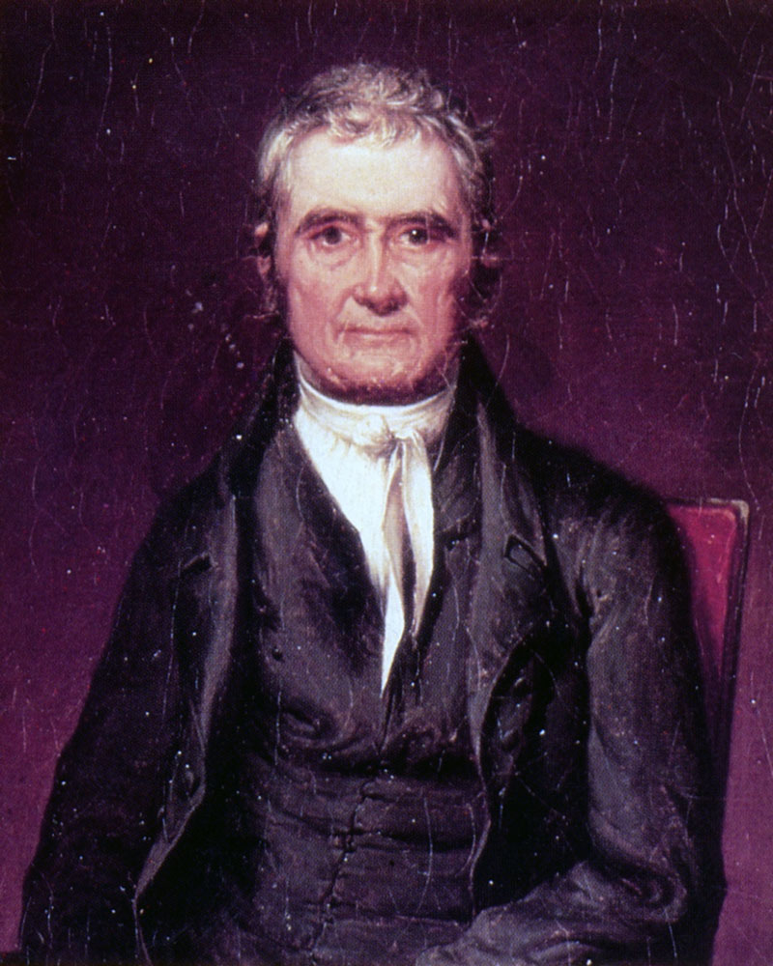
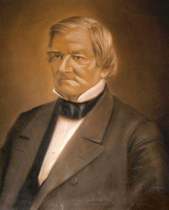
Cherokee a “domestic dependent nation” with sovereign rights”
--Chief Justice John Marshall
Treaty of New Echota, 1836
Chief Justice John Marshall
Cherokee Chief John Ross

Slide 12

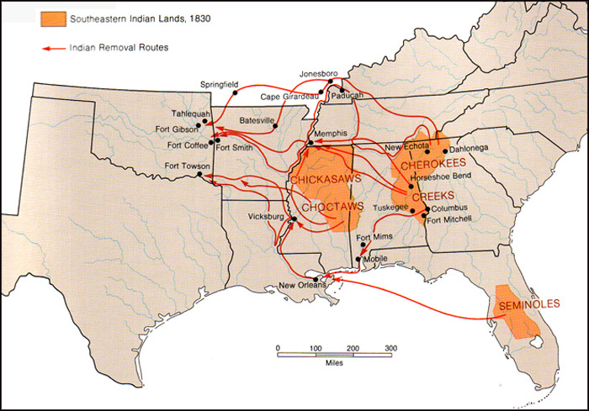
Trail of Tears, 1838 – 1839
Dysentery, measles, whopping cough, fever, hunger
Kept in stockades
¼ of 16,000 Cherokee died
15,000 Creek, 12,000 Choctaw, 5,000 Chickasaw, + Seminole
81 million acres of Cherokee land in 9 states to 160,000 acres in Oklahoma

