Slide 1
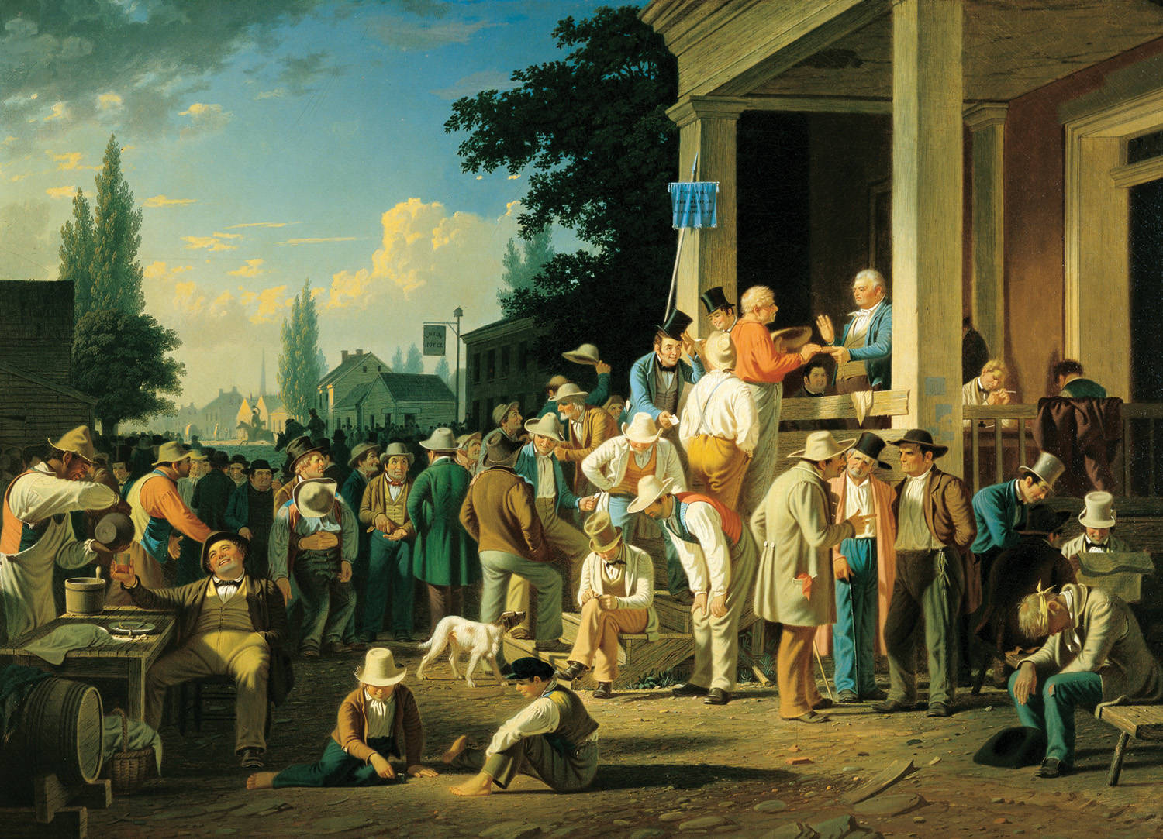
Jacksonian Democracy

Slide 2
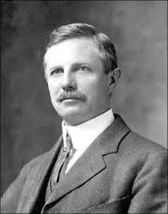
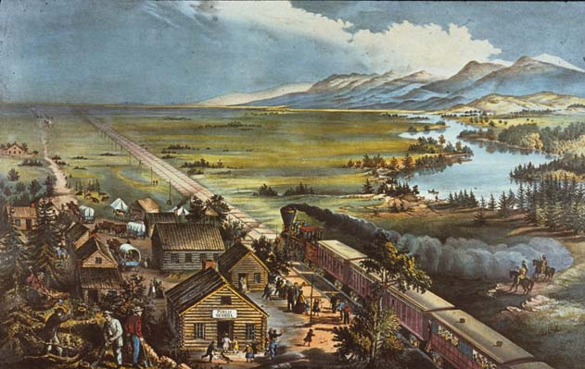
Frederick Jackson Turner’s Frontier Thesis
1893 Chicago World’s Columbian Expo
1890 = Frontier declared “closed”
Reassessed the significance of frontier in American life

Slide 3
“Wherever social conditions tended to crystallize in the East, whenever capital tended to press upon labor or political restraints to impede the freedom of the mass, there was this gate of an escape to the free condition of the frontier….Men would not accept inferior wages & a permanent position of social subordination when this promised land of freedom and equality was theirs for the taking.”
--Frederick Jackson Turner, 1893

Slide 4
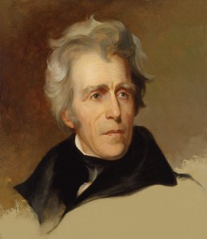
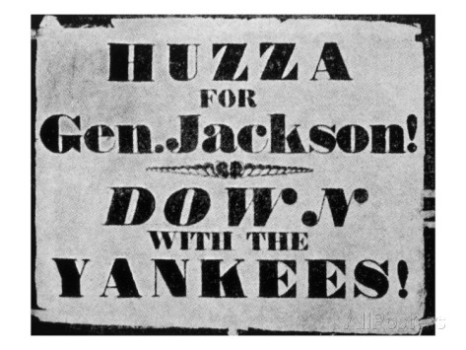
Andrew Jackson
Known for: Indian Removal, the Bank veto, and Jacksonian Democracy
1828 election = Massive popular election & turning point in American political life

Slide 5
Jacksonian Democracy
Spread of new practices & institutions that spread political power to people who did not have it before
Mass participation in elections
Rise of modern 2-party system
Democracy defined by popular sovereignty, majority rule through free elections

Slide 6
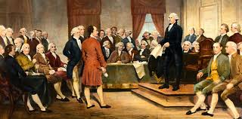
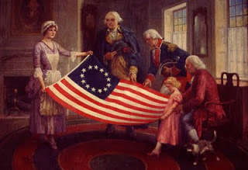
Early National Period
Strict and severe property requirements
Most political offices elected by representatives
Deferential political culture
Non-competitive & non-contested elections

Slide 7
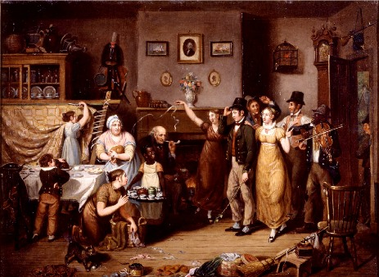
Changes in Suffrage
1820s = states rewrote constitutions to grant voting rights based upon white manhood
Poor white men now viewed as fit for self-government

Slide 8
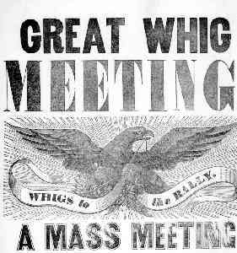
2-Party System
Creation of mass rituals
1790s = Federalists & Anti-Federalists to Federalists & Democrat-Republicans
1830s = Democratic Party became 1st modern, mass democratic party
Democrats vs. Whigs

Slide 9
Whigs vs. Democrats
Supported federal government spending on internal improvements like bridges, railroads, canals
Wanted to strengthen the infrastructure of U.S.
More critical of slavery
Northern
Populist rhetoric
Suspicious of all attempts to restrict slavery
Southern & frontier Western

Slide 10
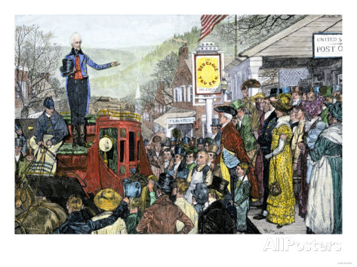
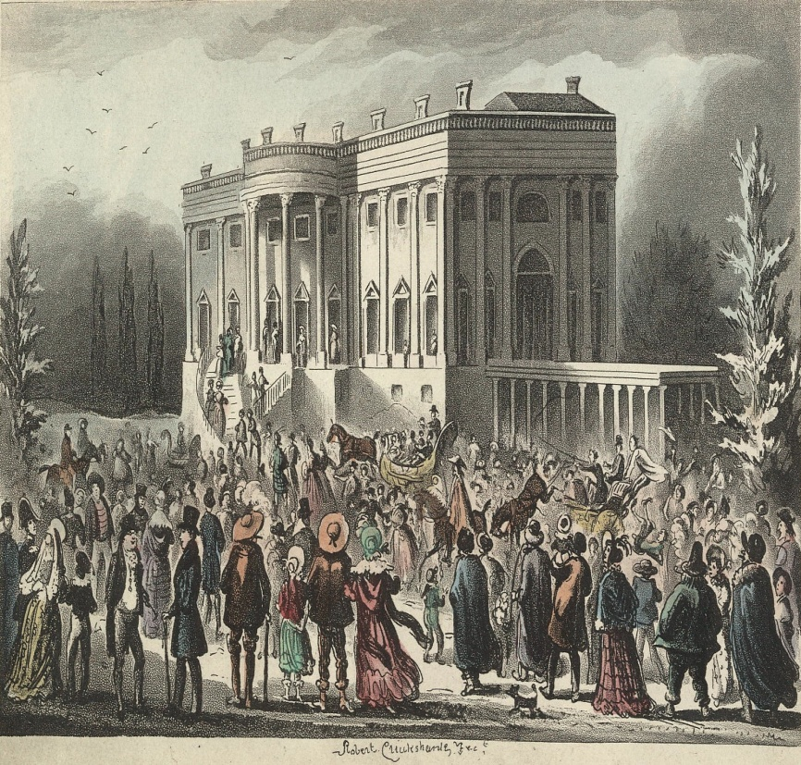
Boisterous Elections
Banners, floats, parades, riots
Elections associated with white, male, frontier behavior

Slide 11
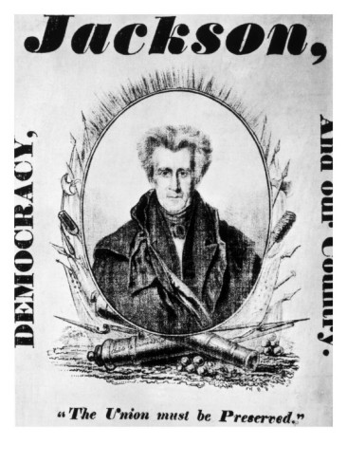
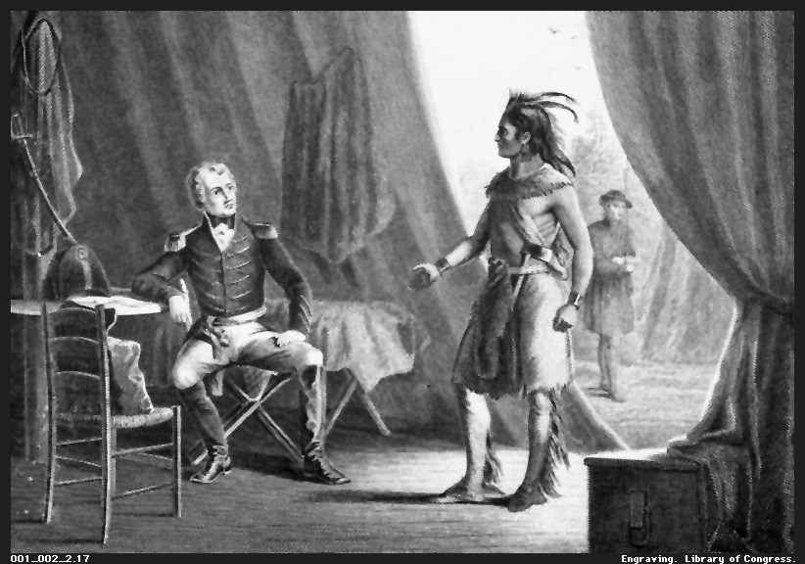
Jackson’s Background
Scotch-Irish Immigrant parents
Raised in Carolina frontier
Lawyer and War of 1812 military leader
“Old Hickory”

Slide 12
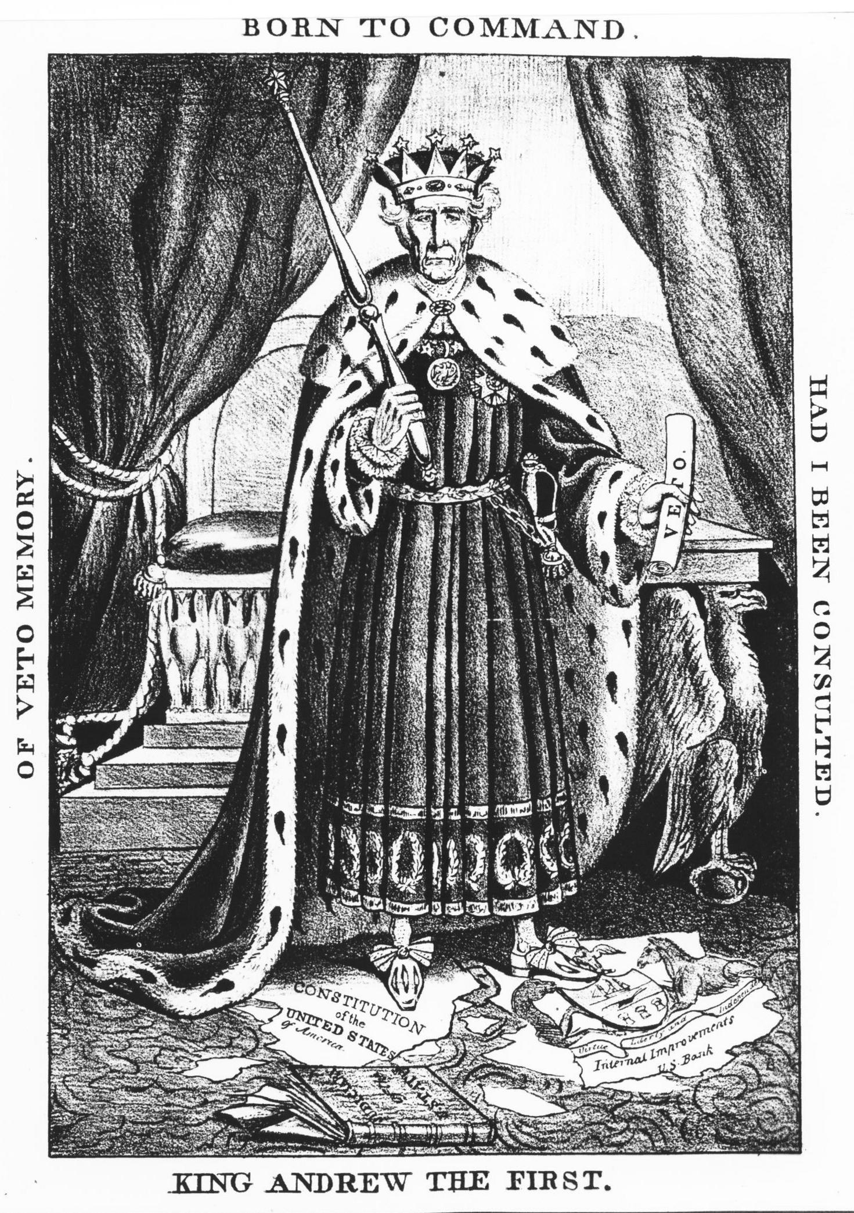
The Bank War
Bank of U.S. = Private corporation & central bank used by federal government
1st Bank of U.S. chartered in 1791
2nd Bank of U.S. started in 1816
1832 Jackson vetoed renewal of bank’s charter
1789 – 1829 = Presidential veto used 9 times
1828 – 1836 = Used 12 times
Led to Panic of 1837

Slide 13
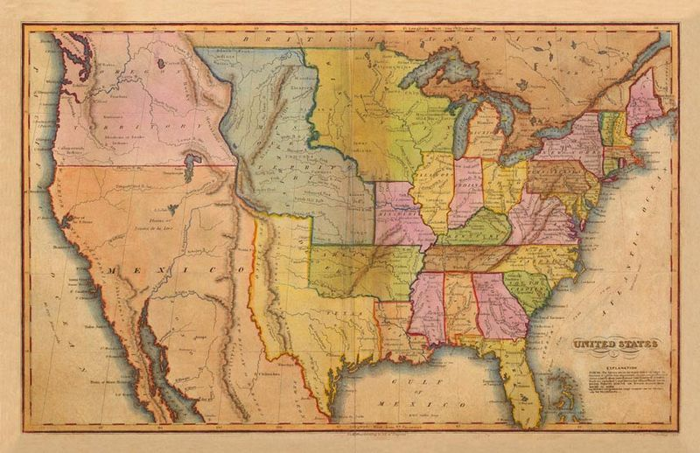
Global Perceptions of U.S.
Equality of condition vs. equality of opportunity

