Slide 1
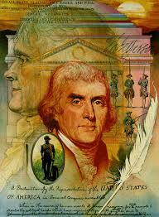
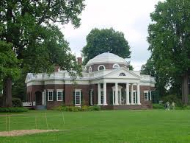
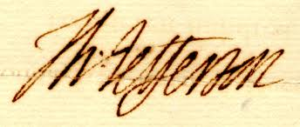
Jefferson: A Man of Contradictions

Slide 2
Key Themes of 19th Century
Western Expansion
Who are “The People” of the United States?
Industrialization & Urbanization
Sectionalism & Regionalism

Slide 3
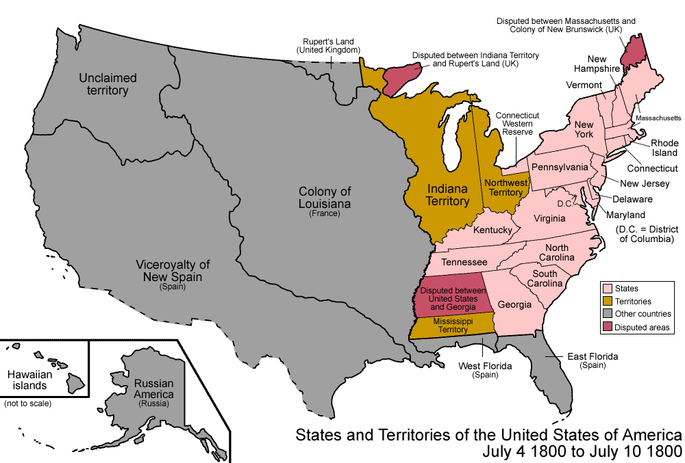
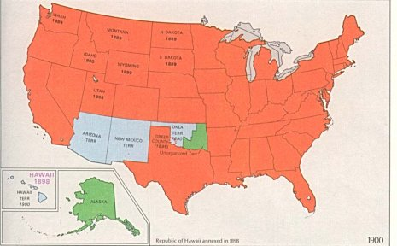
U.S. in 1800 vs. U.S. in 1900

Slide 4
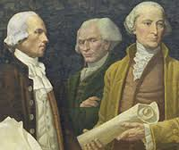
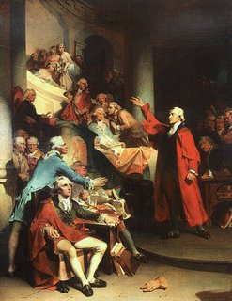
Party Politics in 1800
Federalists vs. Democrat-Republicans
Roots in Federalists & Anti-Federalists of 1780s
Jefferson = First Democrat-Republican president
Affiliation reflected in fashion

Slide 5
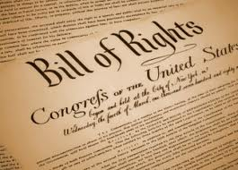
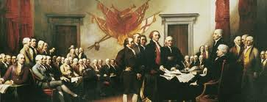
What is a Republic?
Society governed by free & equal citizens
Ownership of land or means of production symbolized potential to be an independent member of the republic

Slide 6
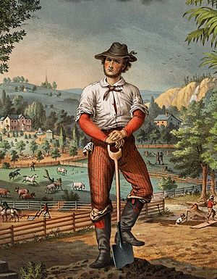
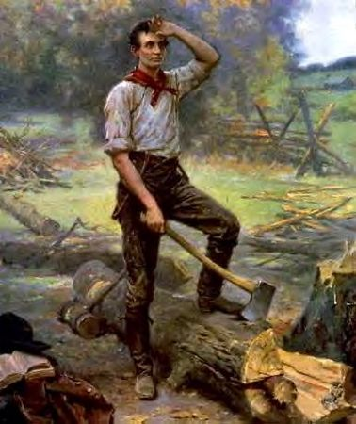
Jefferson & Land
Idealized the yeoman farmer
Assumed Indians were “on the verge of disappearing”
Rival conceptions of property ownership and property usage with Indians

Slide 7
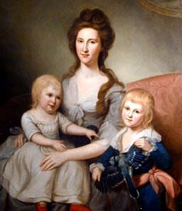
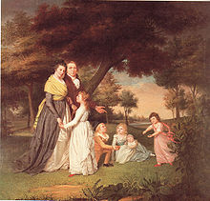
Republican Motherhood
Excluded from political membership & citizenship
New definition of womanhood for white, literate, middle-class and elite women

Slide 8
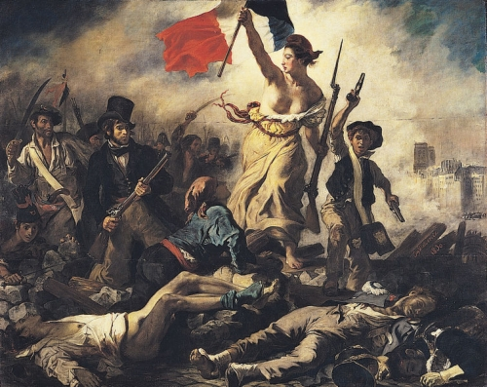
Contradiction # 1: Life of Wealth vs. Philosophy of Humility
Southern slaveholder & aristocrat from Virginia
Battled Northern Federalists to shape the nation
Fiercely supportive of France

Slide 9
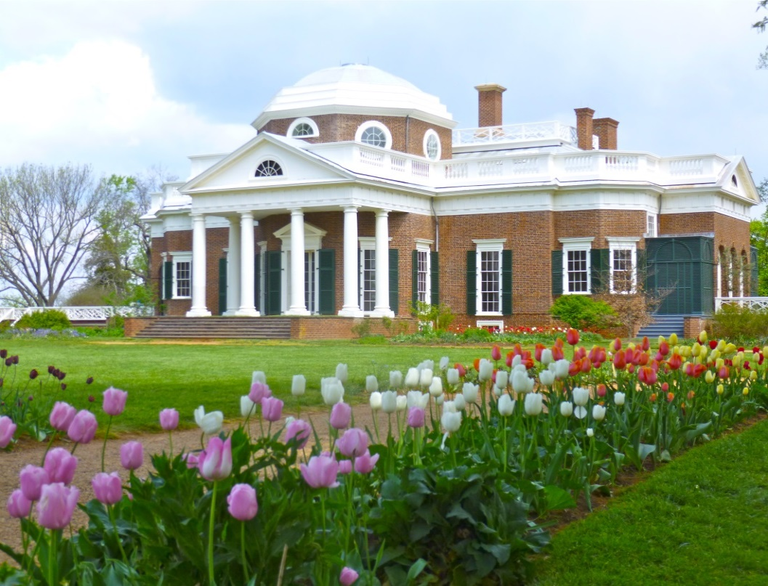
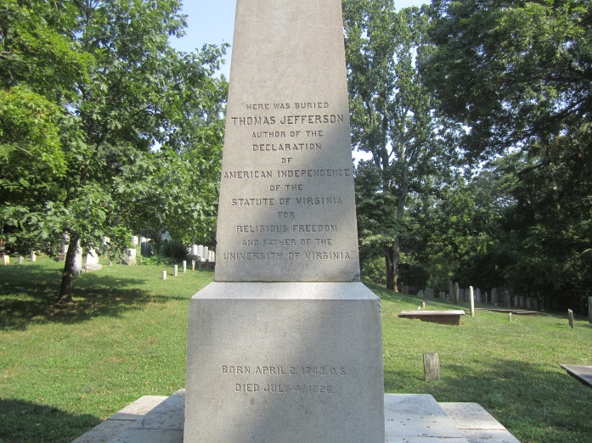
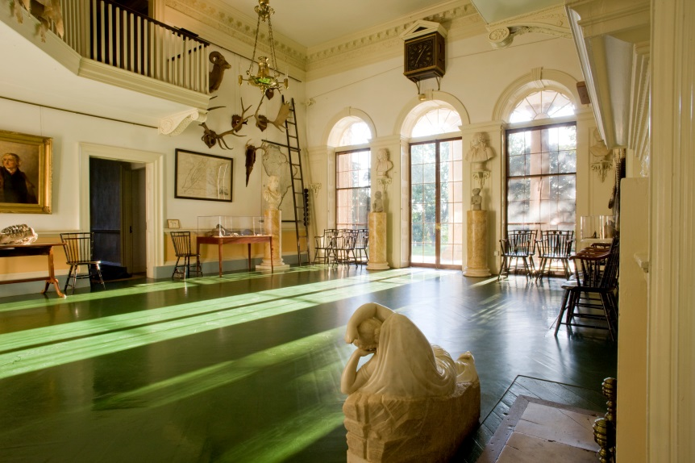
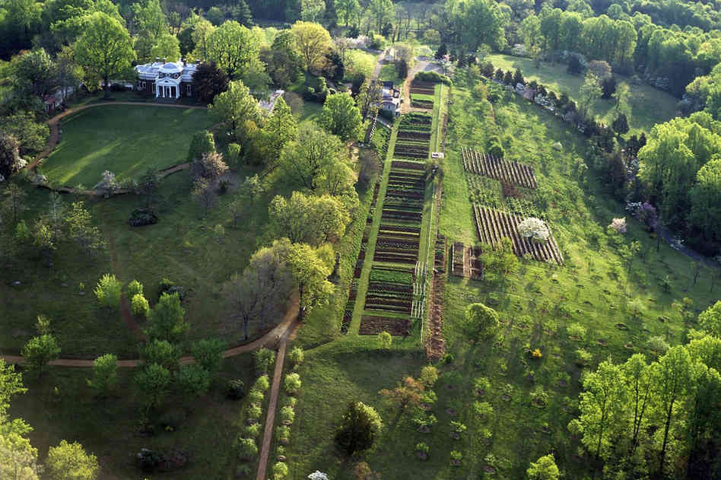
Monticello

Slide 10
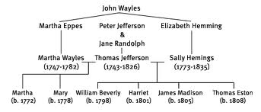
Sally Hemings
“Monticellan Sally”
Half sister of Martha Wayles Skelton Jefferson
Never freed in Jefferson’s lifetime

