Slide 1
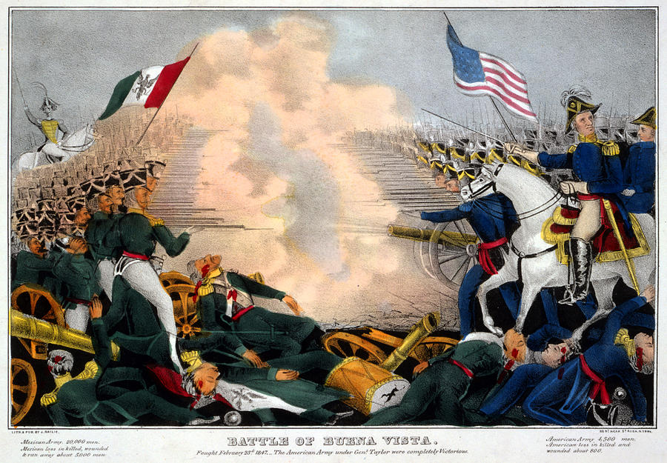
The Mexican American War,
1846 – 1848

Slide 2
Quick Facts
1846 = 325,000 Indians in the Southwest
6 million people in Mexico
Cost of war = $98 million U.S.
$15 million for 500,000 square miles
2,000-mile border

Slide 3
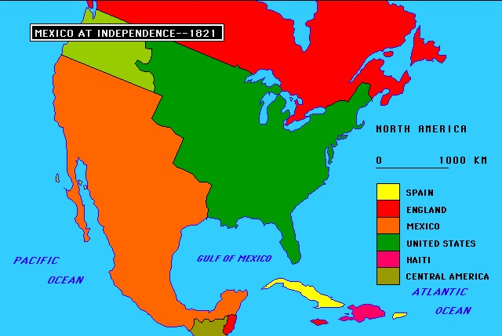
Mexico After Independence
Independence in 1821
75 presidents in first 55 years (1821 – 1876)
Political disorder & physical decay
Spaniards expelled from Mexico
15 – 30% of adult men unemployed

Slide 4
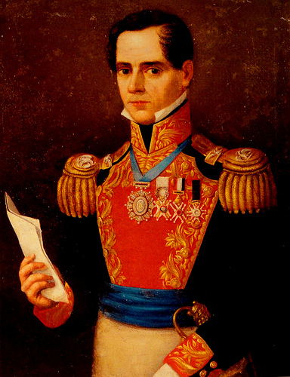
Role of the Military
Church controlled ½ of Mexico’s land
Military dominated national politics
Antonio Lòpez de Santa Anna, president 6 times
Caudillo

Slide 5
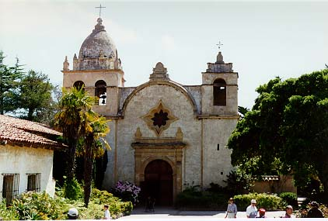
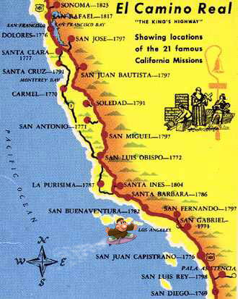
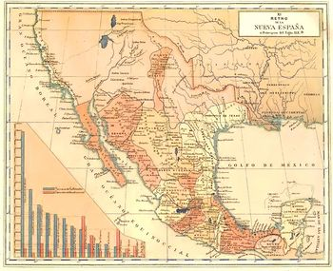
U.S. & Mexico
Southwest as periphery
Manifest Destiny
Missions

Slide 6
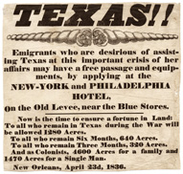
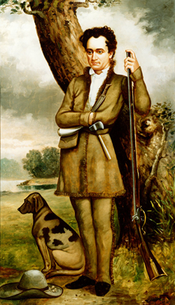
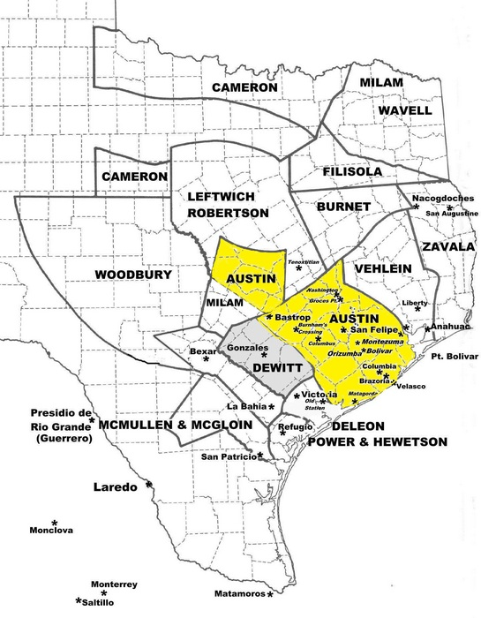
Texas Conflict
Stephen Austin & “Catholic” settlers, 1821
Mexico’s Emancipation Proclamation, 1829

Slide 7
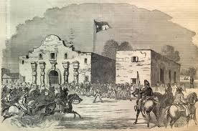

Lone Star Republic
Sam Houston & The Alamo, 1836
April 1836, Battle of San Jacinto
Delayed Annexation

Slide 8
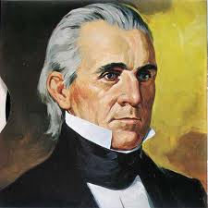
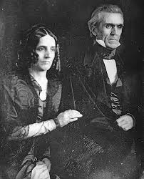
President Polk
Young Hickory
“Slaveholding exterminator of Indians”
“Mr. Polk’s War” tied to Manifest Destiny & civilizing impulse

Slide 9
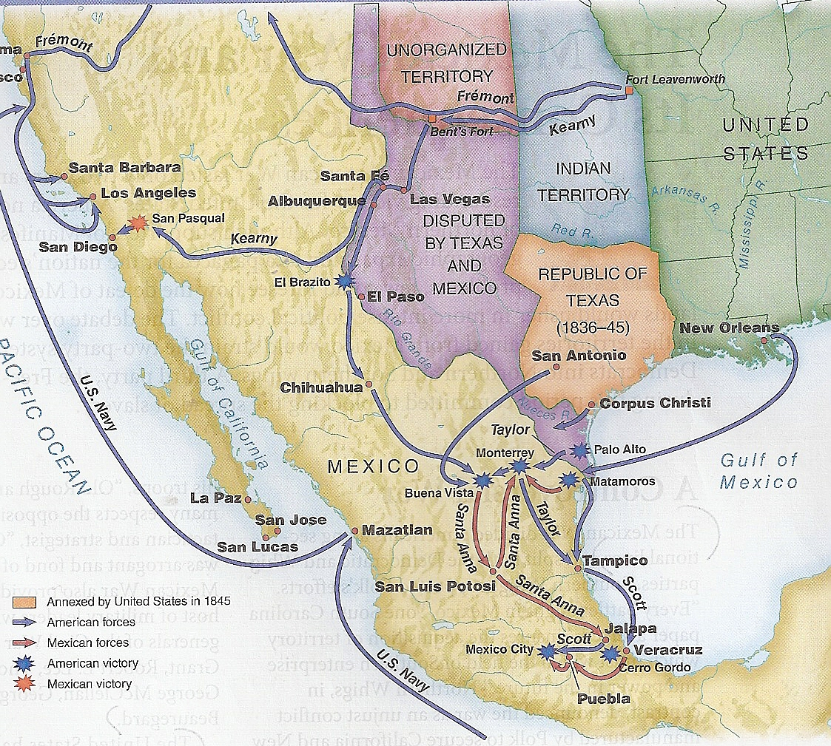
How Did the War Begin?
General Zachary Taylor
Rio Grande vs. Nueces River
150 mile difference

Slide 10
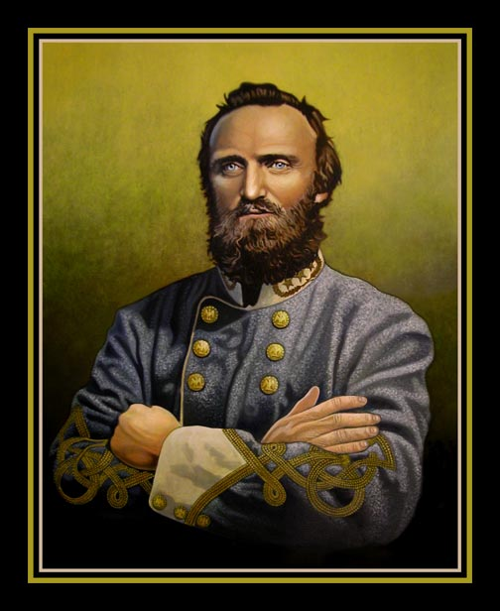
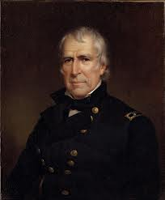
Transformation of Military
7,000 soldiers grew to 100,000 post-war
Public involvement
Zachary Taylor, Winfield Scott, Ulysses S. Grant, Robert E. Lee, Stonewall Jackson, PGT Beauregard
Technological superiority

Slide 11
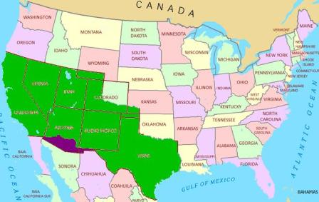
Treaty of Guadalupe Hidalgo
$15 million
Rights of Mexicans in U.S. protected by law

