Slide 1
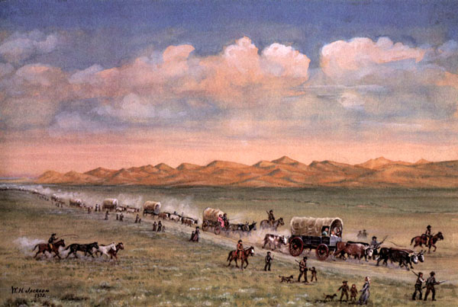
The Overland Trail

Slide 2
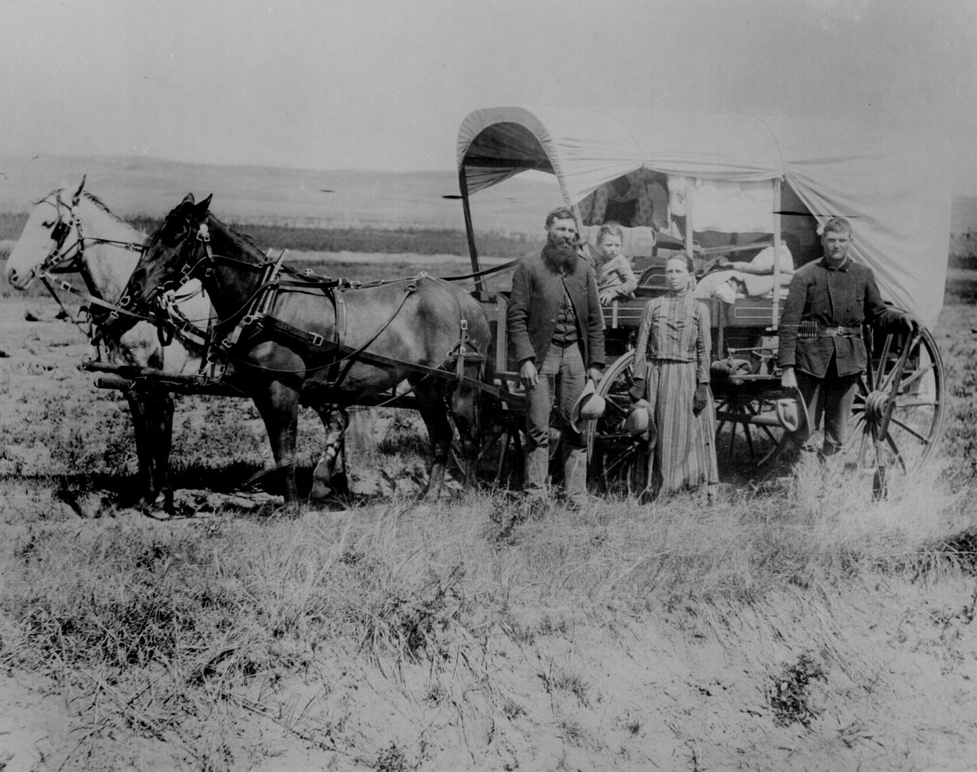
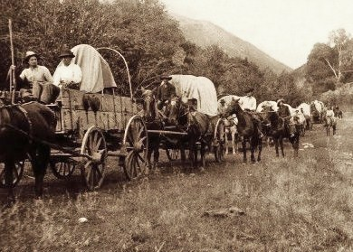
Mobility
“The perpetual restlessness of the average American.”
1840 – 1870 = 350,000 men, women, children journeyed across the Rocky Mountains

Slide 3
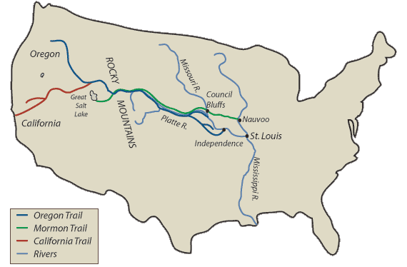
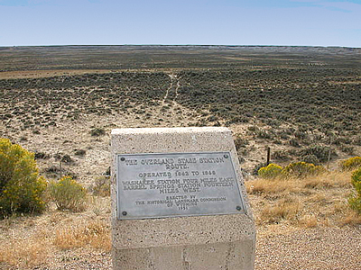
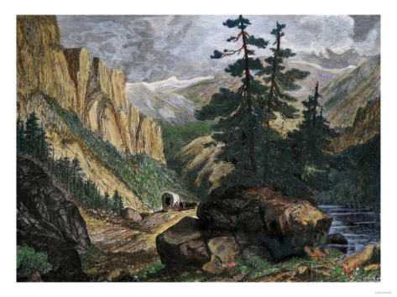
Overland Trail
2,4000 mile wagon trail
6 – 8 months
“Free land,” gold & silver mining
Panic of 1837

Slide 4
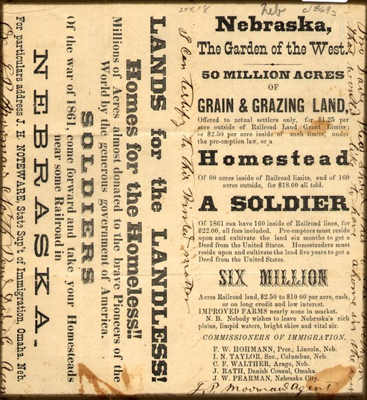
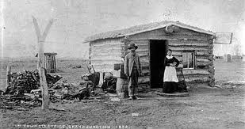
Homestead Act of 1862
80 million acres available
160 acres for 5 years of improvement

Slide 5
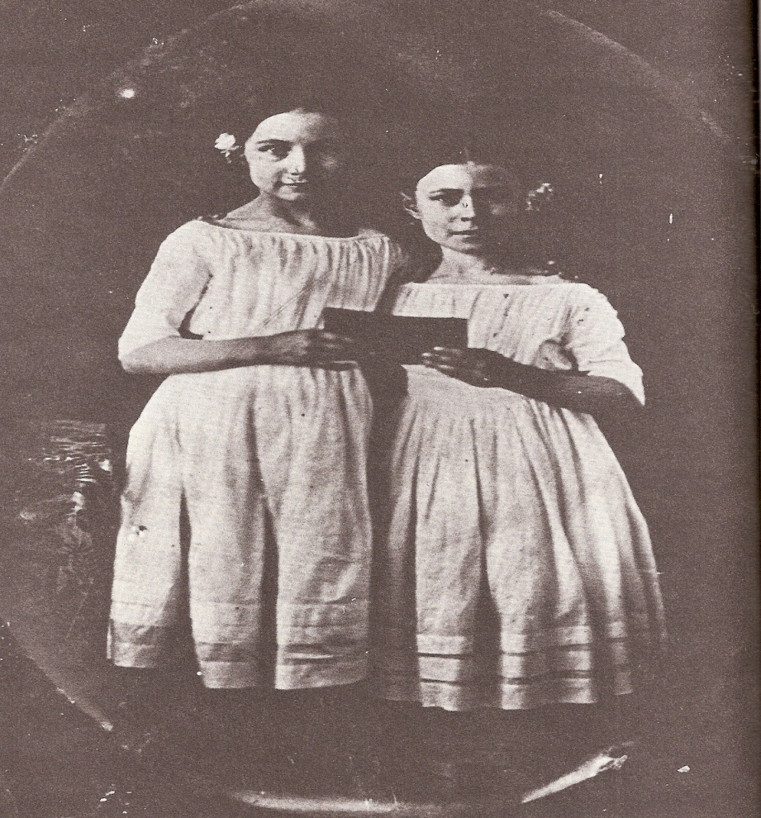
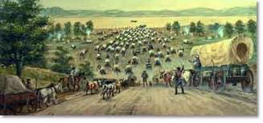
Who Traveled?
Wagon parties of 450 – 500 wagons
Missouri, Illinois, Iowa, Indiana
“Jumping Off Points”
Experienced but afraid

Slide 6
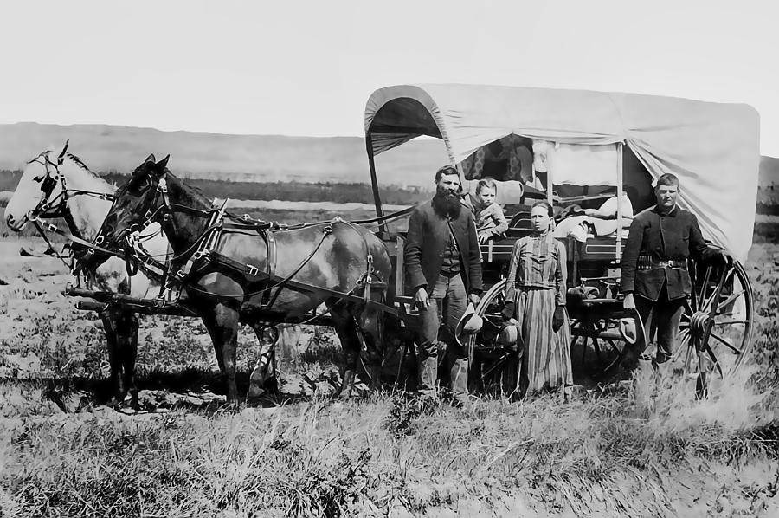
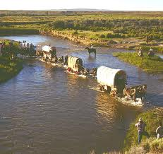
Preparations
Prairie wagons pulled by oxen
Amphibious
$500 – $1,000
200 pounds flour, 150 pounds bacon, 10 pounds coffee, 20 pounds sugar, 10 pounds salt

Slide 7
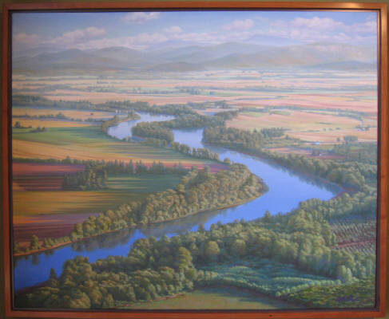
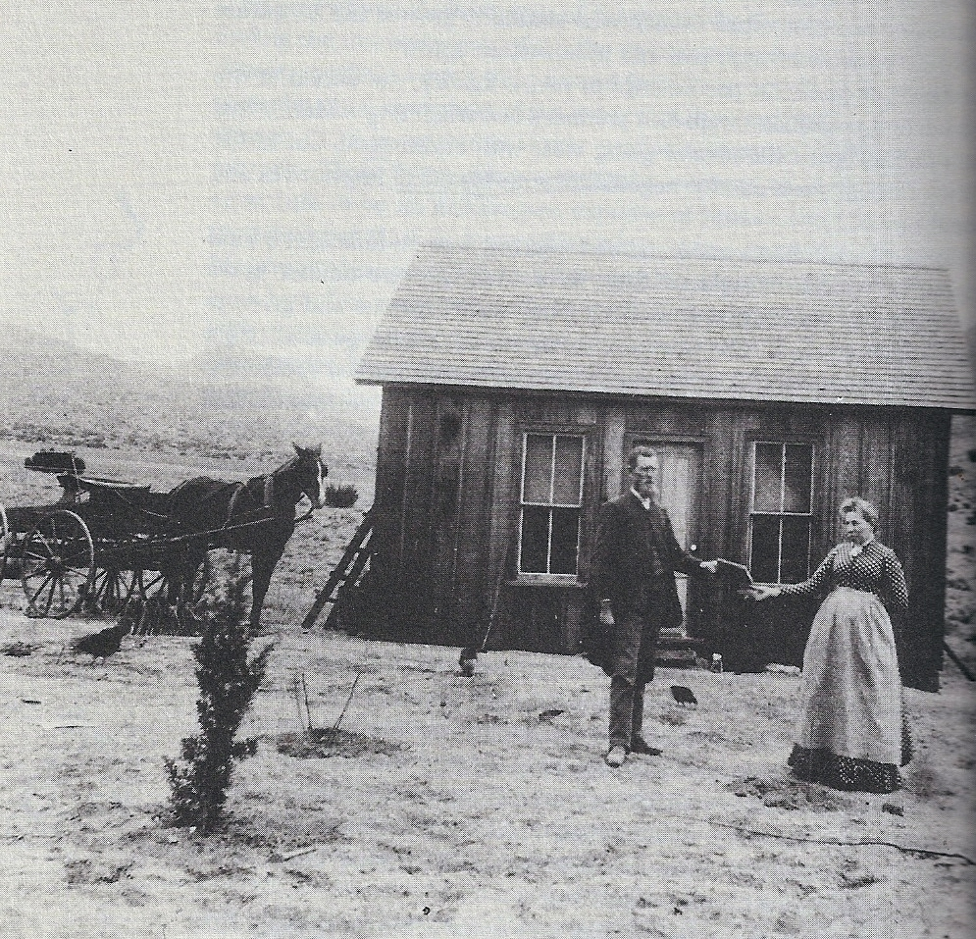
High Expectations
“The pigs are already cooked, with knives and forks sticking in so that you can cut off a slice whenever you are hungry.”
--Propaganda about Oregon

Slide 8
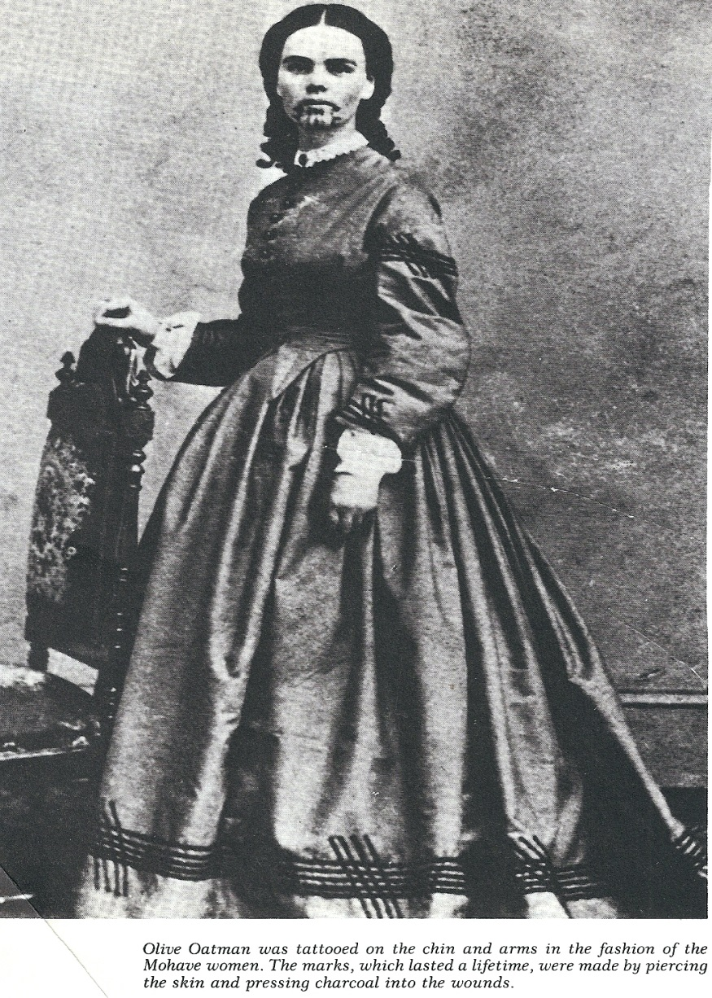
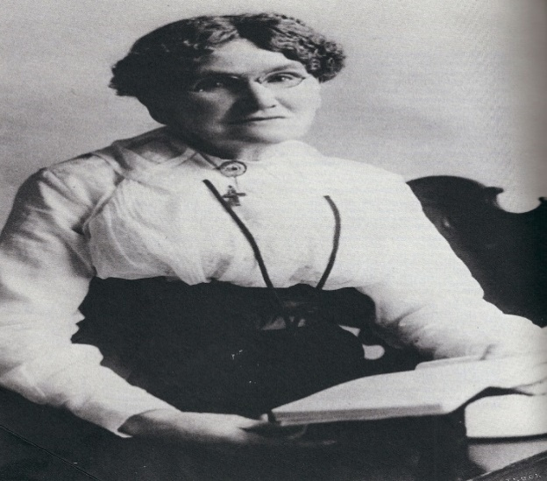
Gendered Expectations
Varied perspectives on Indians
Traditional & non-traditional roles
Style of dress
Rite of passage
for men

Slide 9
“I’ve often been asked if we did not suffer with fear in those days but I’ve said no we did not have sense enough to realize our danger we just had the time of our lives but since I’ve grown older and could realize the danger and the feelings of the mothers, I often wonder how they really lived through it all and retained their sense. Crossing the Deschutes River, the women took their places in the boats, feeling they were facing death. The frail craft would get caught in a whirlpool in the water dashing over and drenching them through and through. The men would then plunge in the cold stream and draw the half drowned women and children ashore, build fires and partly dry them and the bedding, and start on again. The women preferring to try it afoot, but that was no pleasure trip, carrying a small child in arms whilst another one or two clung to their skirts whilst they climbed over fallen trees and rocks. There were both deaths and births on the way, the dead were laid away in packing boxes, but could not be covered so deep but the prowling Savage would exhume them to get the clothes they were buried in, then leave the body for the hungry Wolf, that left bones to be gathered up and reinterred by the next company that passed along. All those things sorely taxed their powers of endurance.”
--Nancy Hembree Snow Bogart

Slide 10
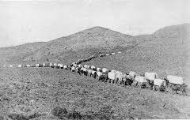
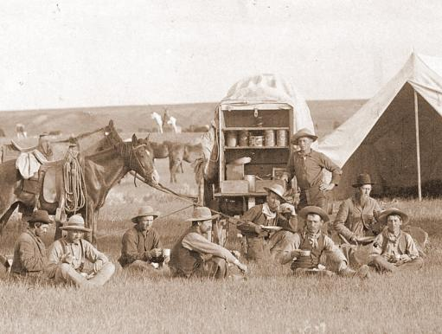
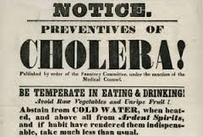
Disease
Cholera outbreaks = 1832 – 1834, 1848 – 1854
Dysentery, measles, typhoid, smallpox
Families brought opium, quinine, citric acid

Slide 11
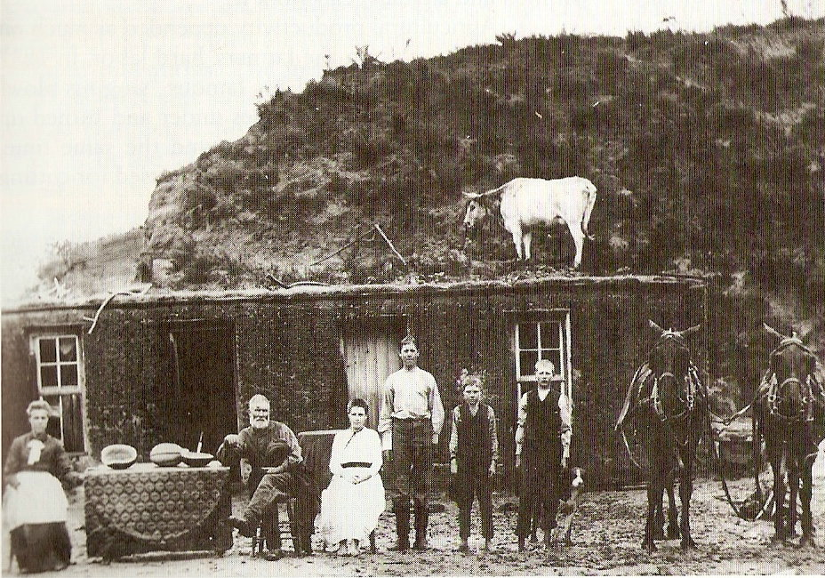

Slide 12
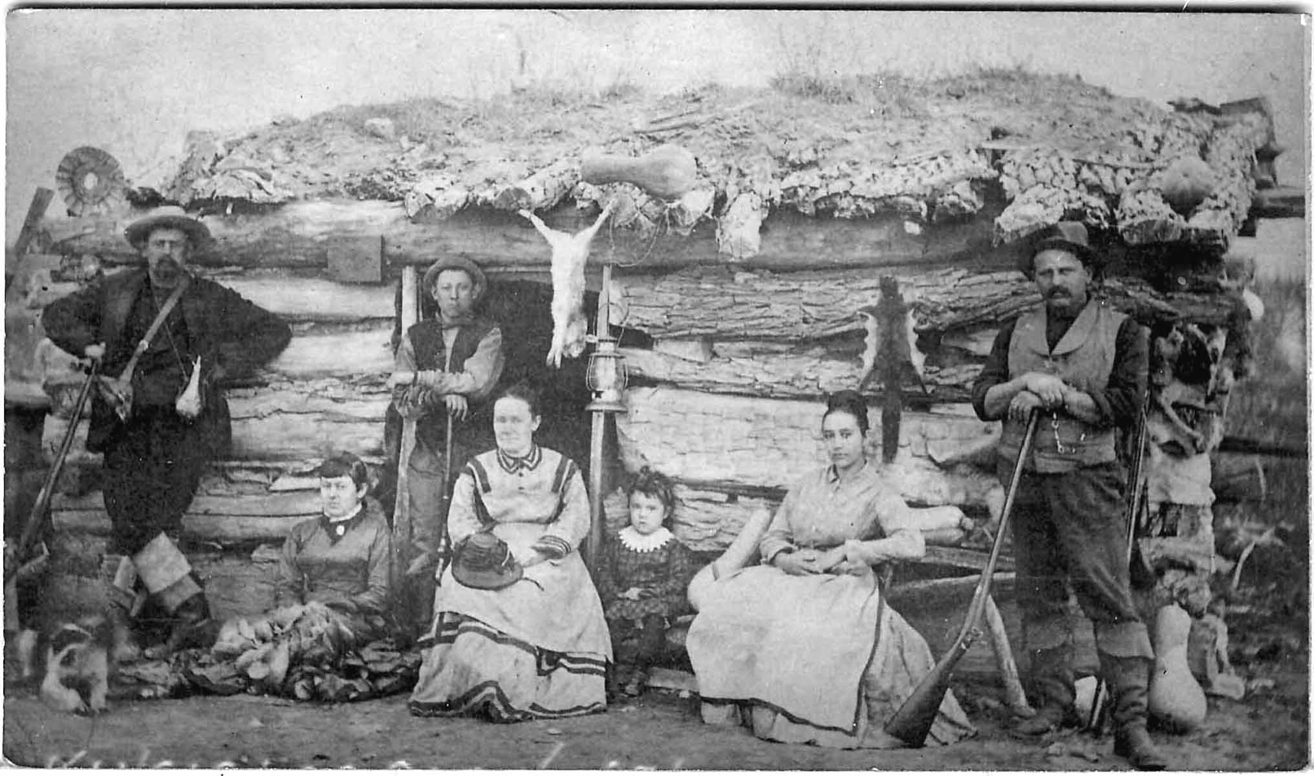
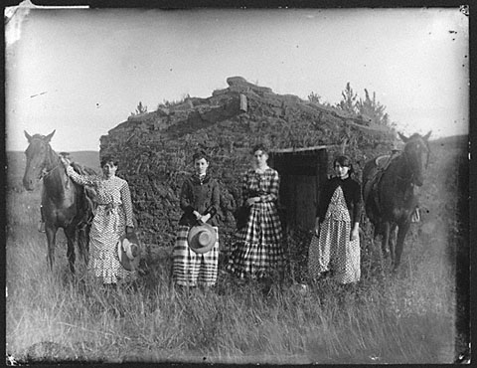
Morrill Land Act, 1862

