Slide 1
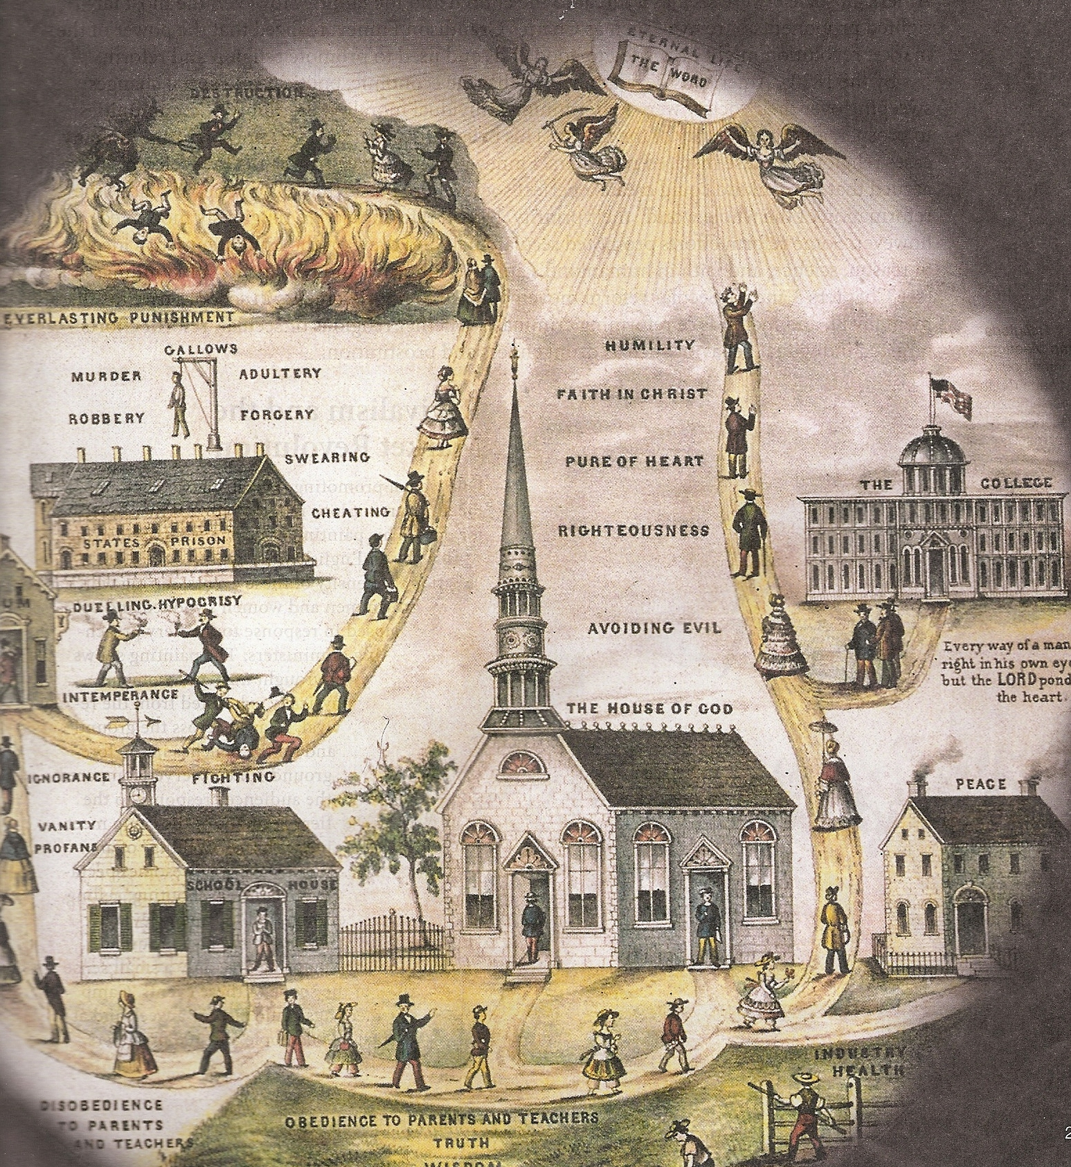
19th Century Religious & Reform Movements

Slide 2
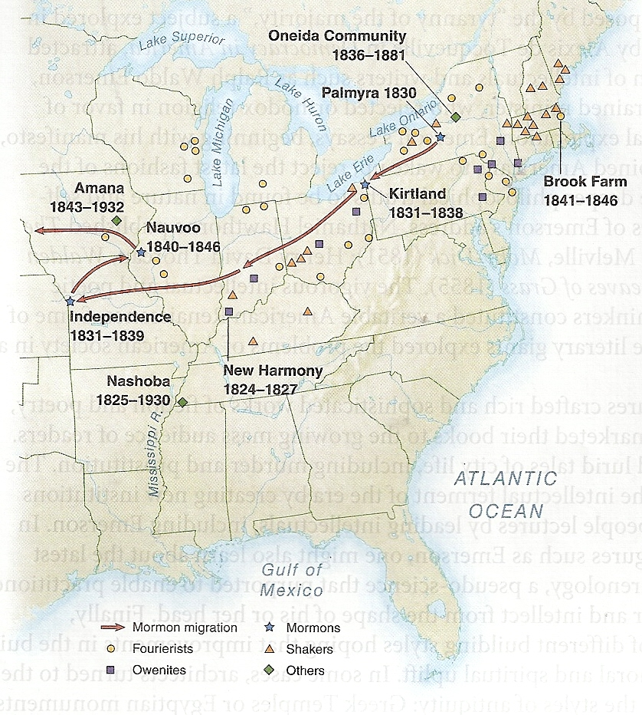
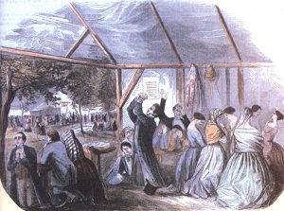
“Burned Over District”

Slide 3
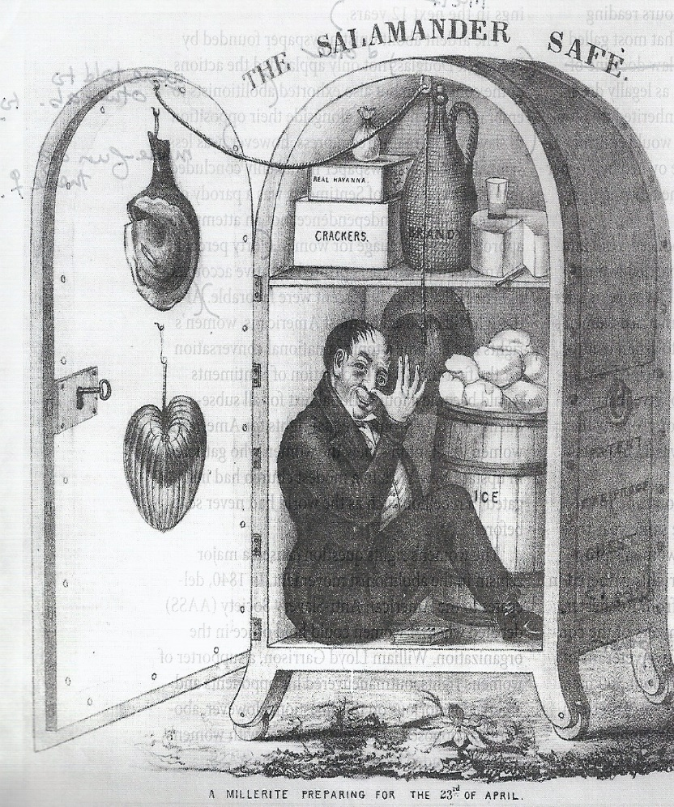

Millerites
William Miller
Millennium in March 1843, then Oct. 22, 1844

Slide 4
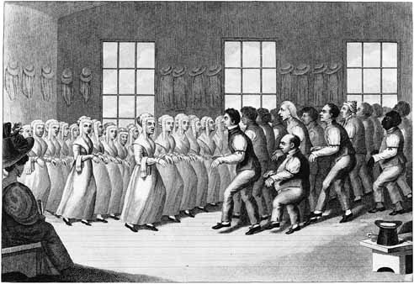


United Society of Believers in Christ’s Second Appearing
The Shakers
Mother Ann Lee
No private property, procreation, marriage, parenthood

Slide 5
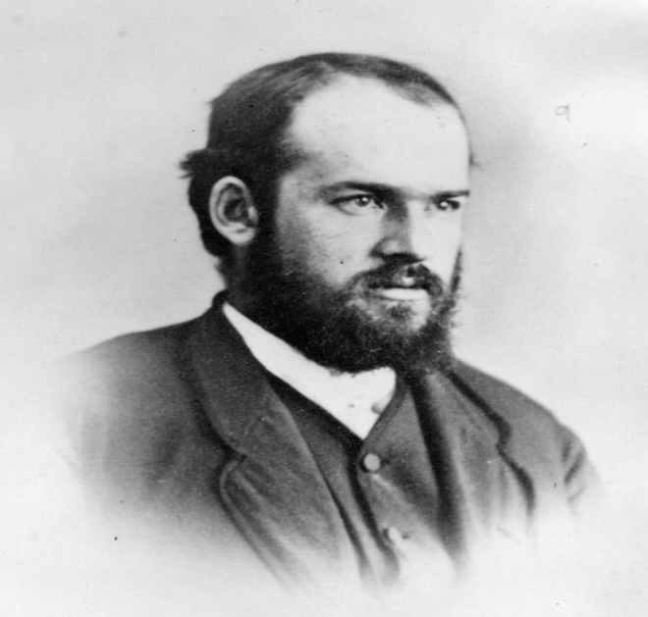
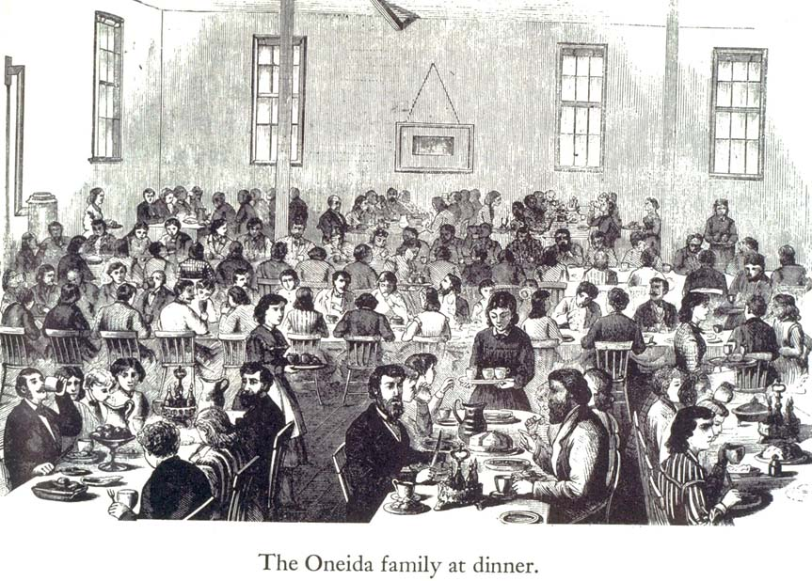
Oneida
John Humphrey Noyes
Methodist Perfectionism
“Complex Marriage”

Slide 6
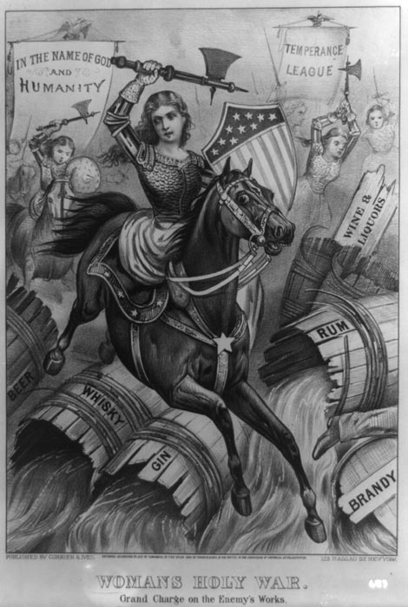
Major Reform Campaigns
Self-improvement
Free education
Sabbatarianism
Temperance
Penitentiaries & Asylums
Moral Reform

Slide 7

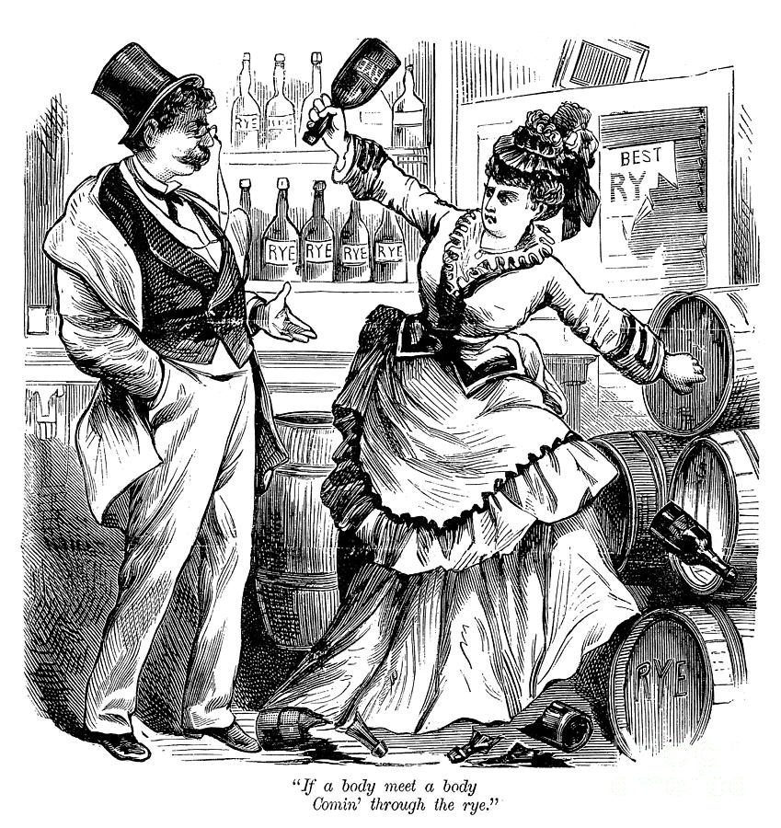
Key Characteristics
Women conformed to expected behavior
Voluntary Associations
Northern
Bodily & impulse control
Disciplinary Intimacy
Volunteers were morally implicated

Slide 8
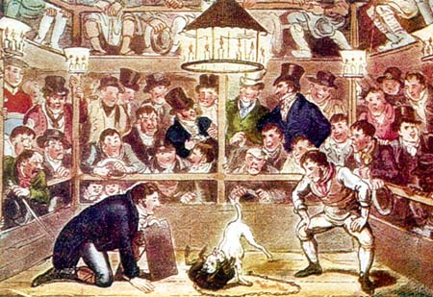
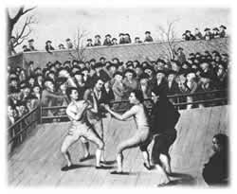
Anti-Gambling
Judgment towards nature of earned wealth

Slide 9
Promoting Education
1815 = 33 colleges
1835 = 68
1848 = 113
Great Awakening Colleges = Amherst, Wesleyan, Emory, Duke, Mount Holyoke, Oberlin, Notre Dame

Slide 10
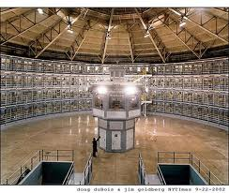
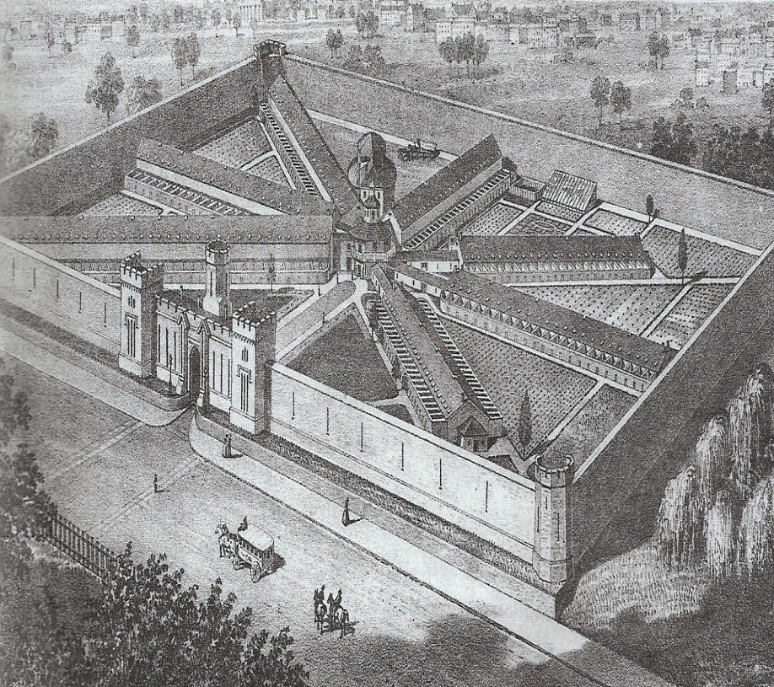
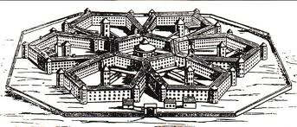
Criminal Justice
Ossining Prison, Hudson River Valley
Eastern State Penitentiary, Philadelphia
Panopticon

Slide 11
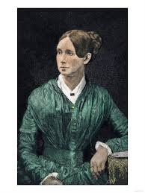
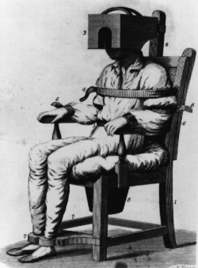
Asylums
Dorothea Dix
Massachusetts House of Corrections, 1841
1860 = 28 out of 33 states had public asylums

Slide 12
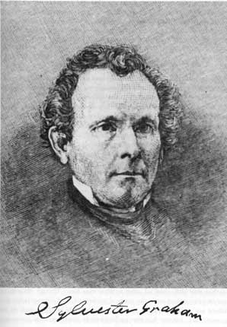
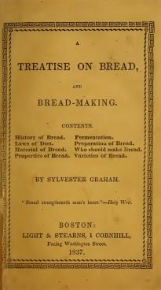
Sylvester Graham
No stimulants, bland diet
Overtaxed bodily system, sensual life as causes of all disease

Slide 13
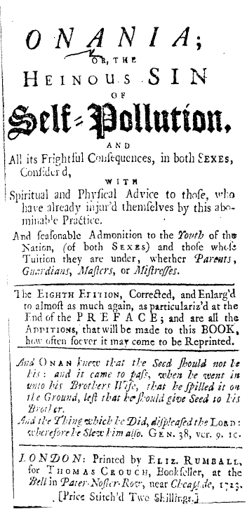
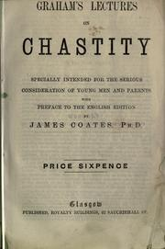
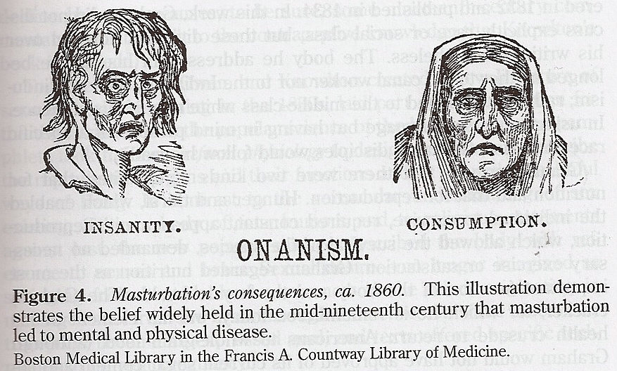
Anti-Masturbation Campaign
Parental involvement & middle-class respectability
New concept of childhood innocence

Slide 14
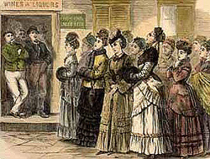
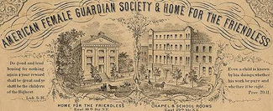
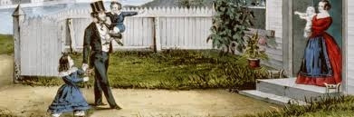
Women’s Involvement
Movement outside the home
Socialization
No official political authority

