Slide 1
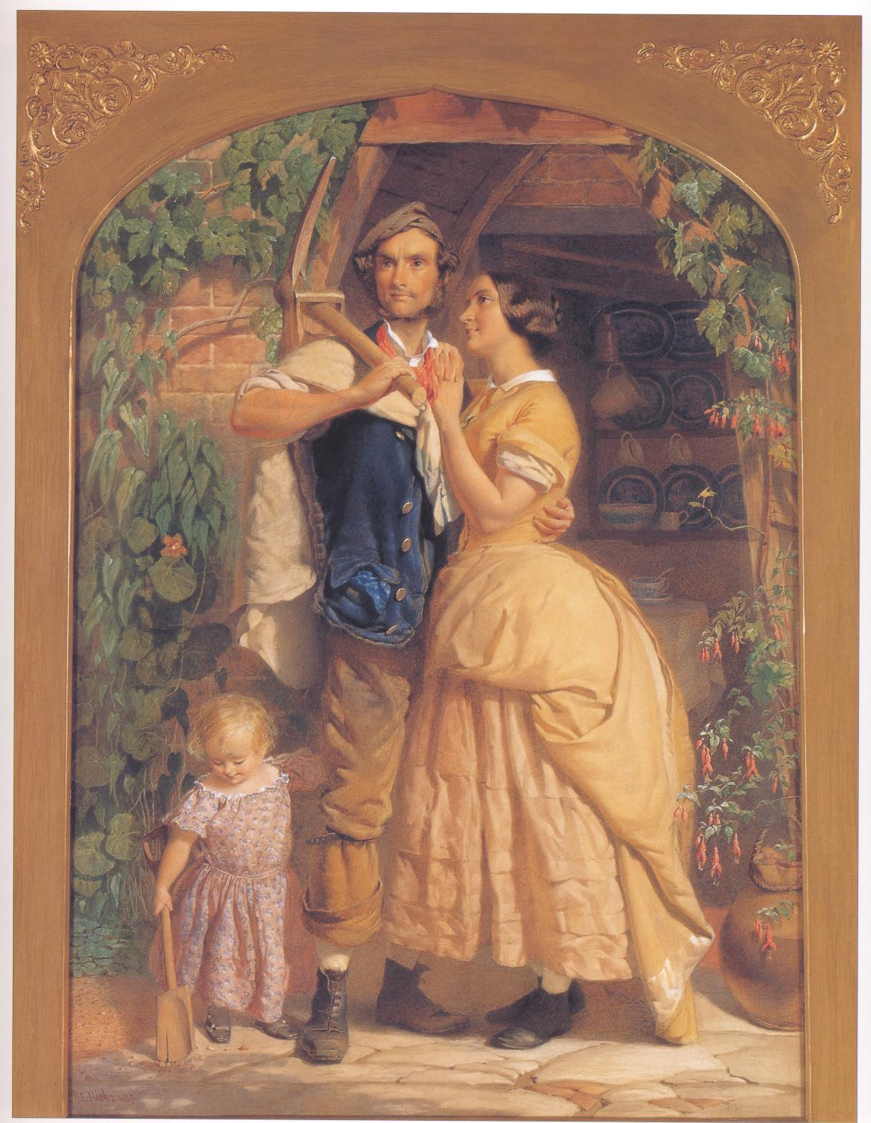
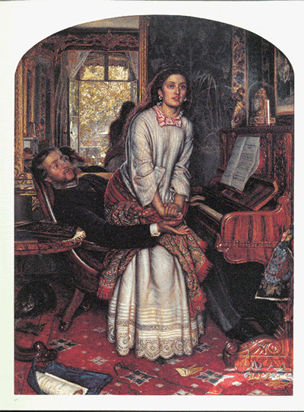
Sex & Gender in Antebellum America

Slide 2
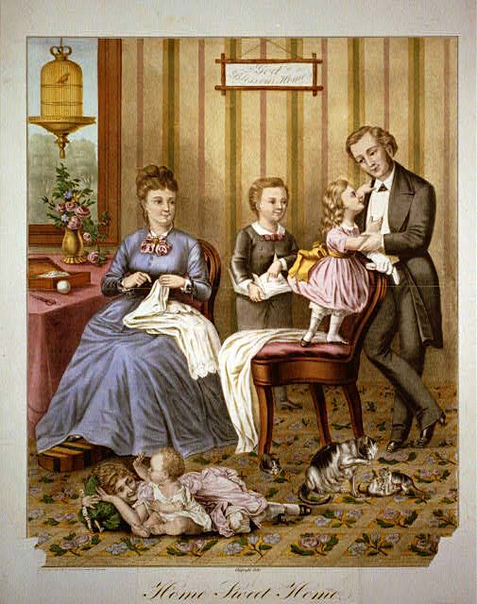
Rise of Non-Traditional Gender Roles
New goal = Nuclear family as a property-owning unit
Expansion of the market economy
Growth of wage labor
Class divisions
Mobility

Slide 3
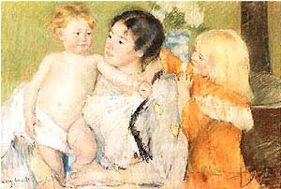
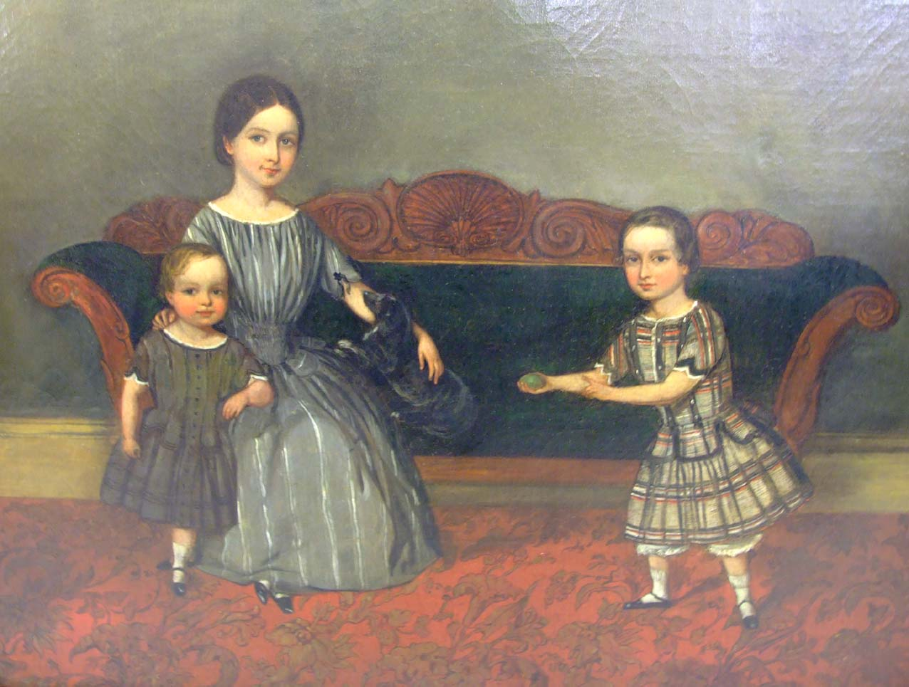
Cult of Domesticity
A counterpoint to the Market Revolution
Class-specific cultural ideal rooted in biological difference
“Separate spheres”

Slide 4
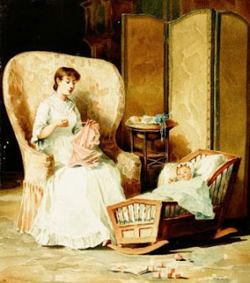
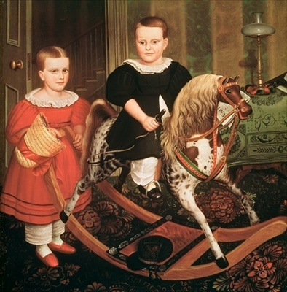
Women’s Sphere
Enclosed, limited, private space
Elevation in status
Decline in birth rate
Transformation of the physical space of the home

Slide 5
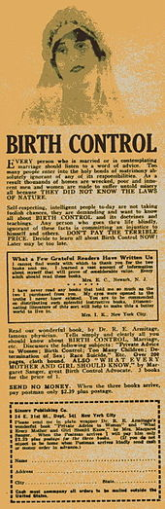
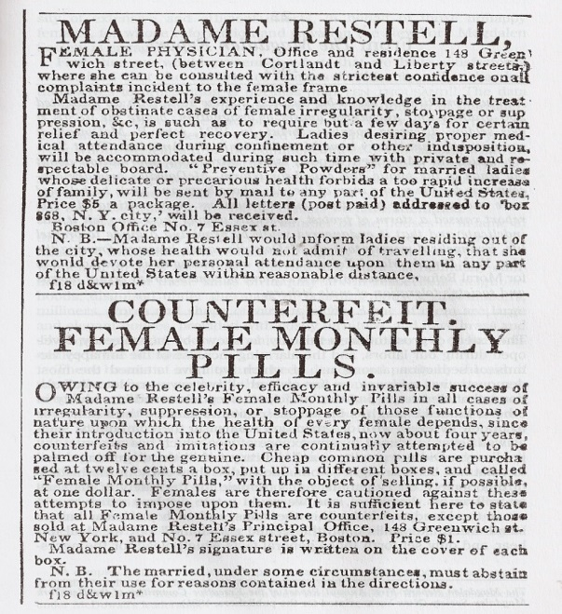
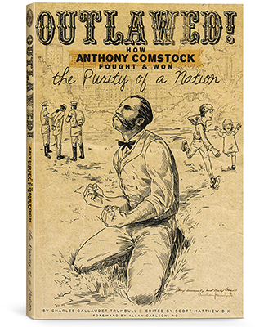
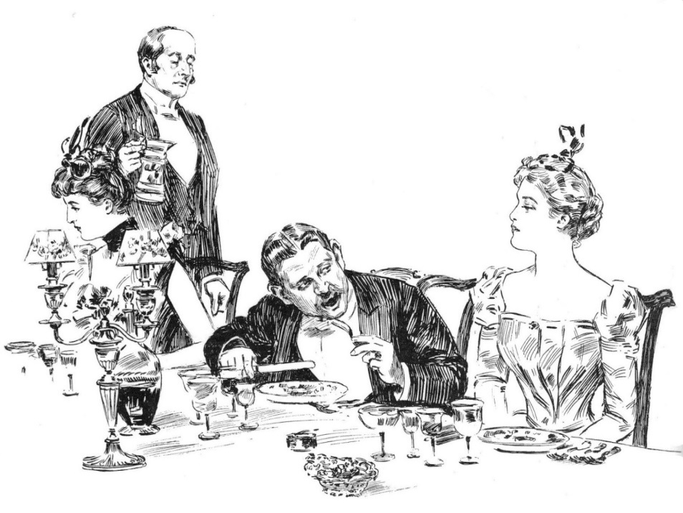
Sex in Antebellum America
“Victorian” behavior
1873 Comstock Law

Slide 6
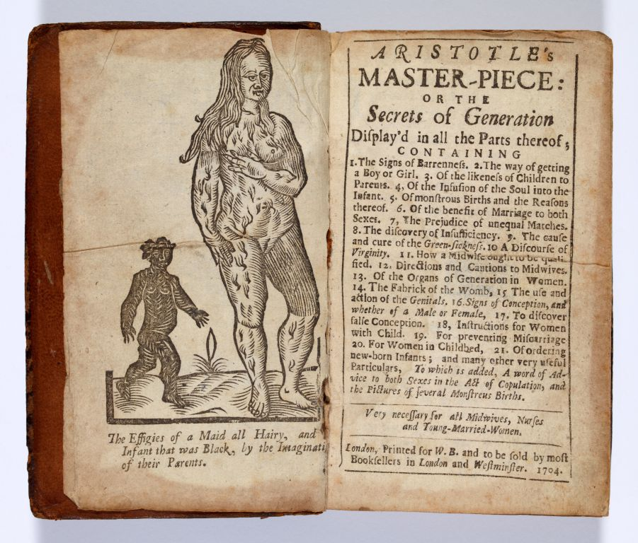
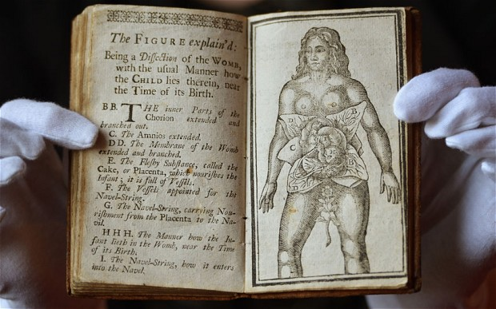
Aristotle’s Masterpiece
1684, England, anonymous authors
Galen’s One-Sex Model
4th century – 18th century
1st female skeleton illustration made in 1733

Slide 7
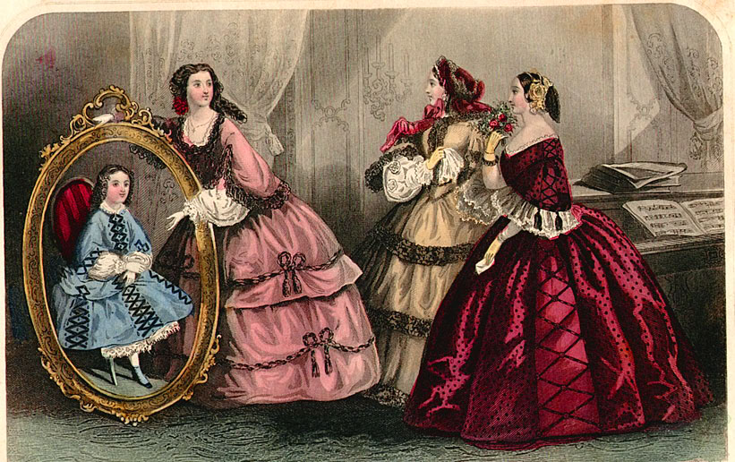
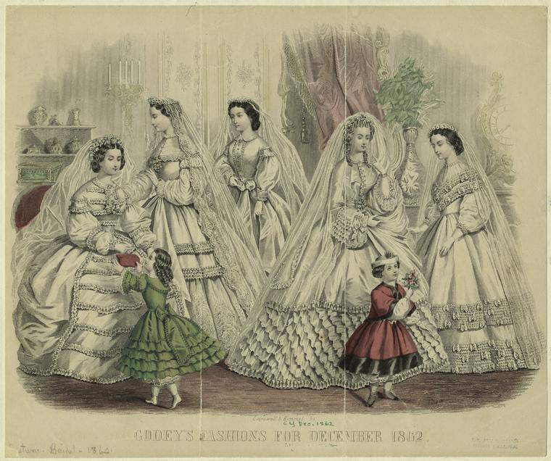
Godey’s Lady Book
1860 = 160,000 subscribers

Slide 8
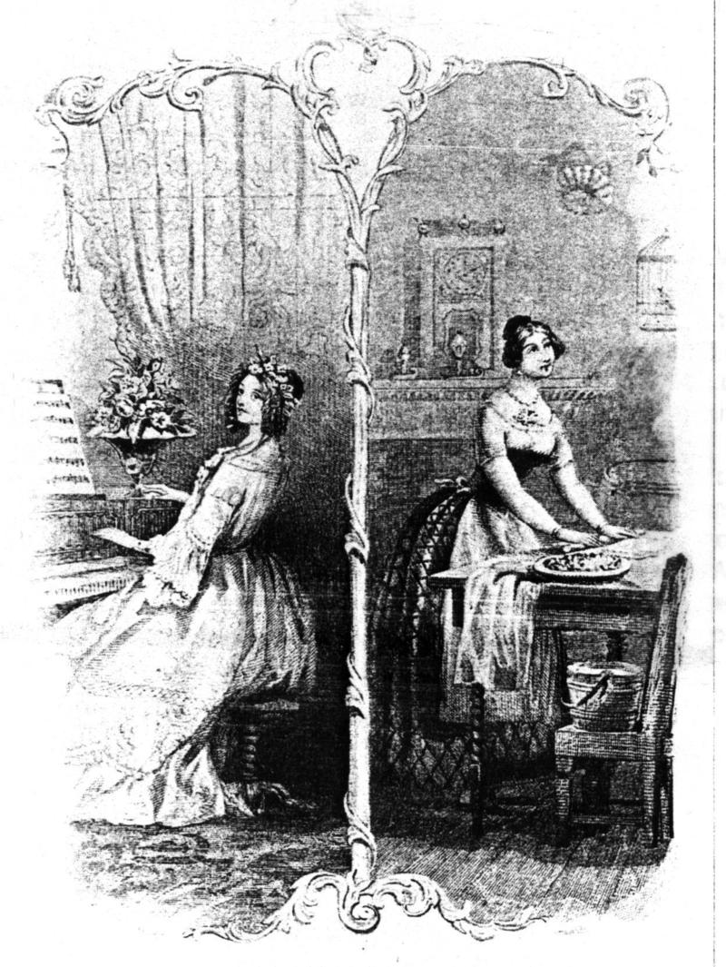
Passionlessness
Middle-class manliness emphasized self-control
White, middle-class femininity emphasized lack of sexual desire
Rise of female illnesses

Slide 9
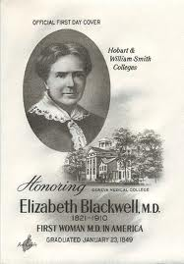
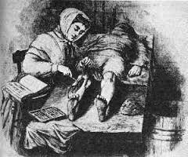
Limitations
Medical community
Banned from political activity
Elizabeth Blackwell

Slide 10
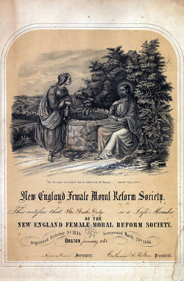
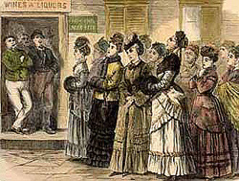
Moral Reform
1830s & 1840s = “A Woman’s Crusade”
1837 = New York Female Moral Reform Society had 15,000 members
Why such appeal?

