Slide 1
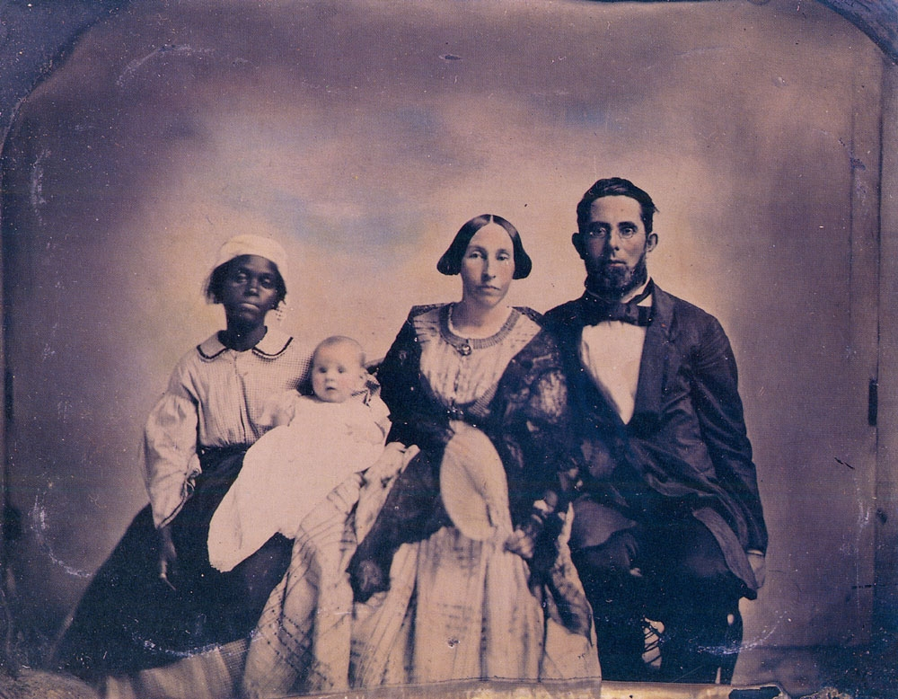
Southern Society & Slavery

Slide 2
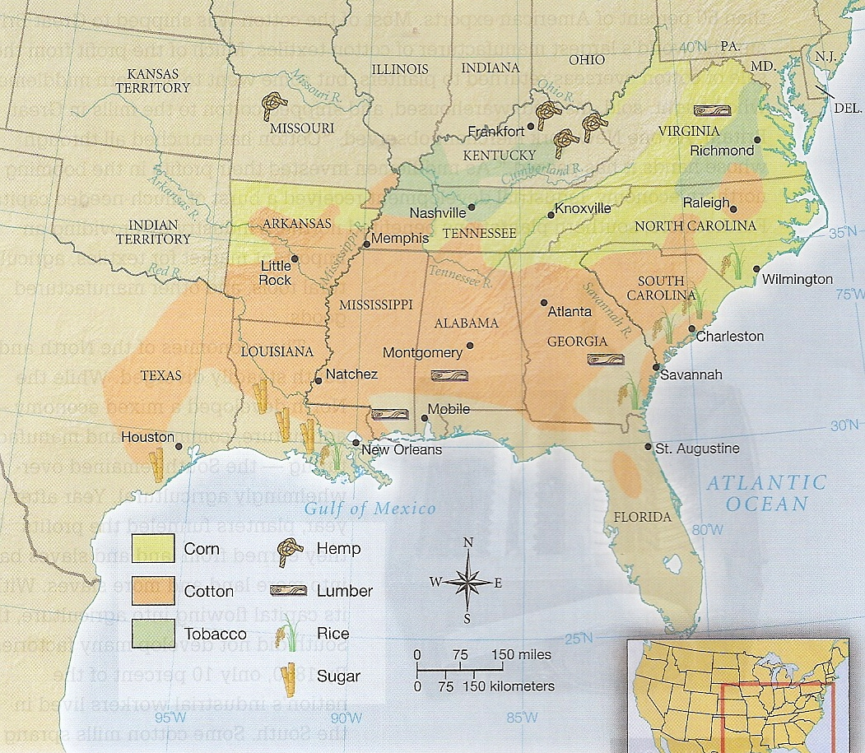
Slave Labor in the South

Slide 3
Statistics
1860 = 4 million slaves in the South, ¼ of white families owned slaves
3,000 families owned 100 slaves or more (less than 1% of the Southern population)
Typical slaveholder = 100 acre farm, less than 10 slaves
Sugar-Louisiana, Rice-South Carolina, Virginia-Tobacco, Cotton-Black Belt

Slide 4
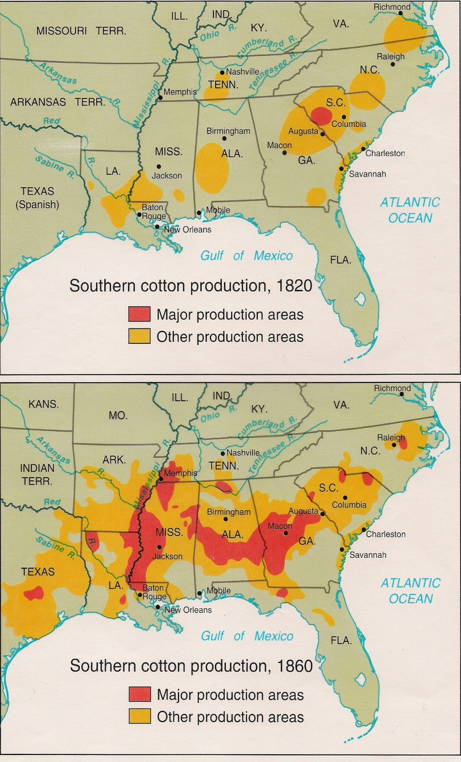
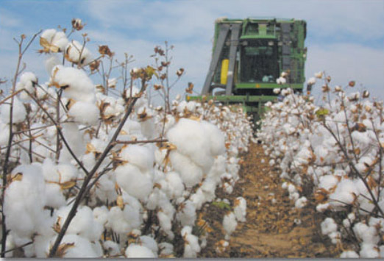
Cotton
Most headed to Britain’s textile mills or Northern U.S. mills

Slide 5
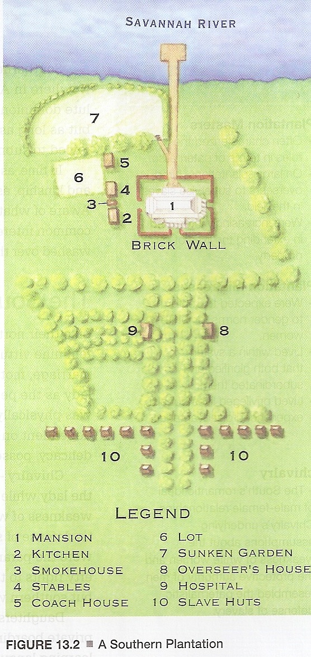
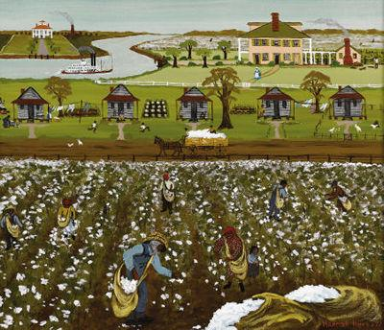
The Planter Class
Cavalier vs. Yankee
Culture of honor vs. culture of thrift

Slide 6
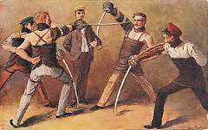
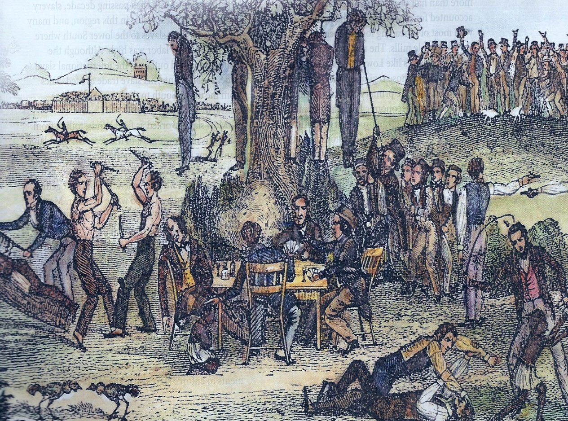
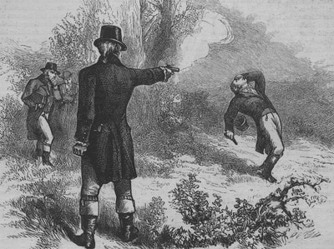
“Affair of Honor”
Dueling
Post-1830s = Prohibited by law

Slide 7
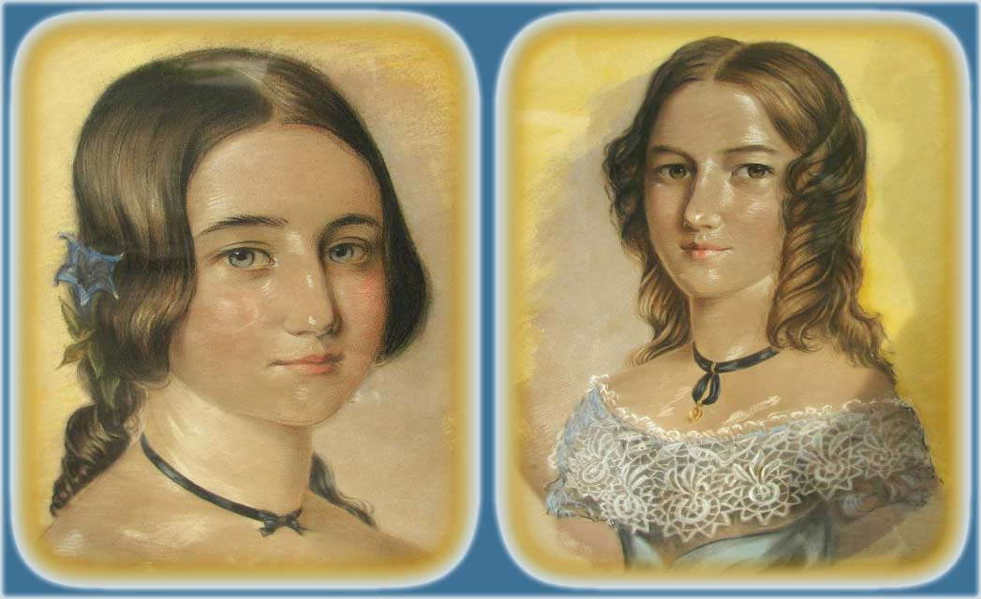
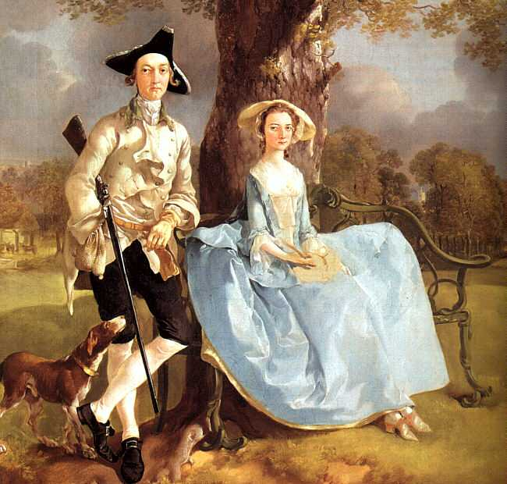
Southern White Women
Slave master vs. slave mistress
Role in pro-slavery argument

Slide 8
Poor Whites in the South
20% illiterate
Why support slavery?
1860 = 500,000 immigrants & 30,000 European Jews in slave states
Baltimore, New Orleans, Maryland, Missouri, Louisiana, Texas
No social power

Slide 9
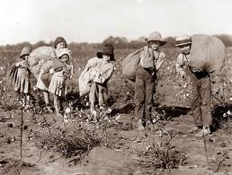
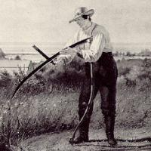
Yeoman Farmers
1860 = ¾ owned no slaves
Economic success depended on planter class
Tenant farmers = 30 – 50% of whites

Slide 10
Southern Free Black Communities
1860 = 6% of black southerners were free
250,000 free blacks in the South
Baltimore, Richmond, New Orleans, Charleston, Memphis, Mobile, Natchez
Few legal & social rights

Slide 11
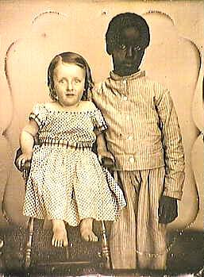
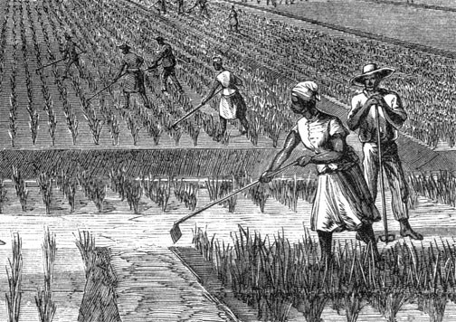
Slave Labor
1787 = Northwest Ordinance outlawed slavery in Ohio, Indiana, Illinois, Michigan, Wisconsin
1808 = International slave trade outlawed
Field hands
Controlled through system of rewards & punishments

Slide 12
Slave Codes
“The power of the master must be absolute to render the submission of the slave perfect.”
No firearms, literacy, assembly, insulting or striking whites, testifying against whites in court
Execution of slave came with compensation to owner

Slide 13
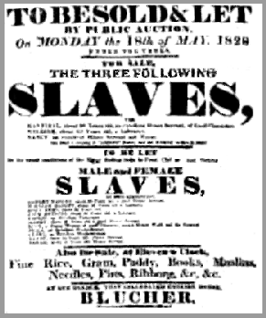
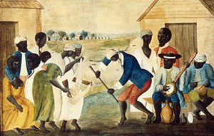
Slave Families
1/3 of slave marriages & ½ of slave children separated
Jumping the Broom
Life expectancy = 30 – 33 years
Running away

Slide 14
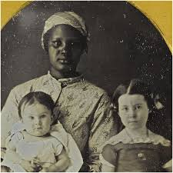
Sexual Control of Slaves
Interracial relationships
“A slave woman is at the mercy of the father, sons, or brothers of her master.”
--Frederick Douglass

Slide 15
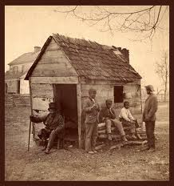
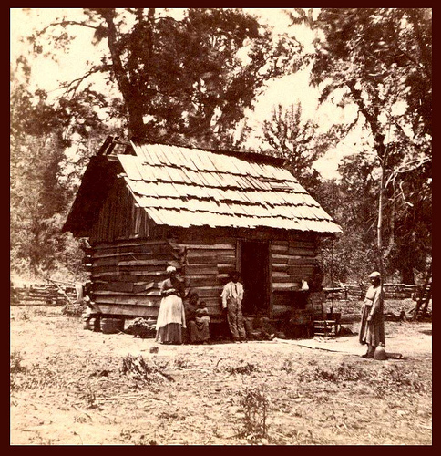
Slave Quarters
12’ x 12’, 1-room huts
Multiple families
Worked sunup to sundown with some holidays
Syncretic religion

Slide 16
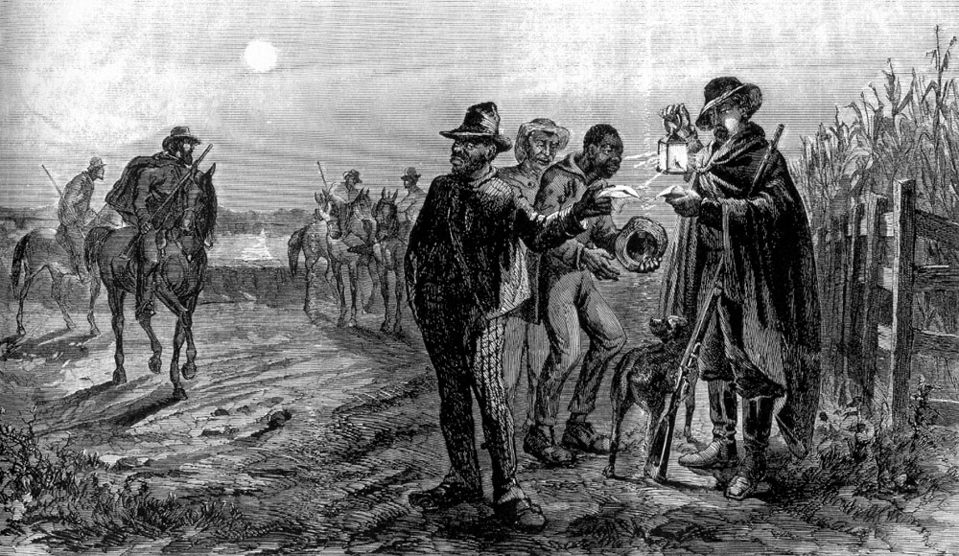
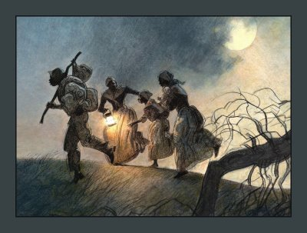

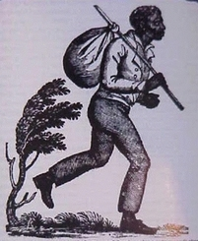
Resistance
Short term running away
Vigilante groups

Slide 17
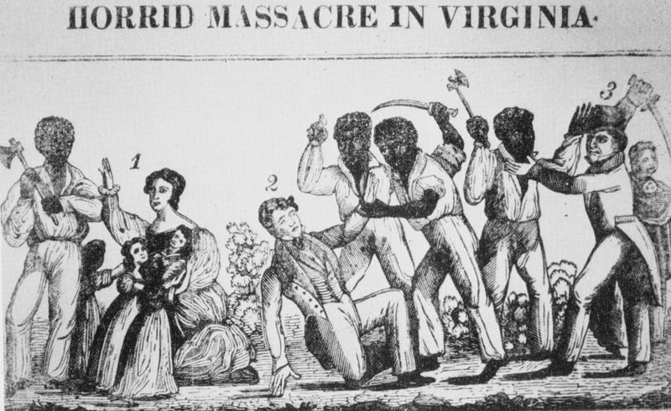
Nat Turner Revolt, 1831
250 slave revolts in U.S. + 250 on slave ships
Stono Rebellion
1828 = Apocalyptic vision
Lay-preacher led 60 slaves
55 whites killed
Transformed the national debate about slavery

