Slide 1
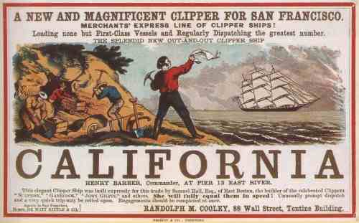
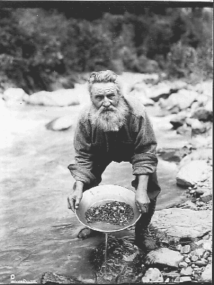
The Gold Rush

Slide 2
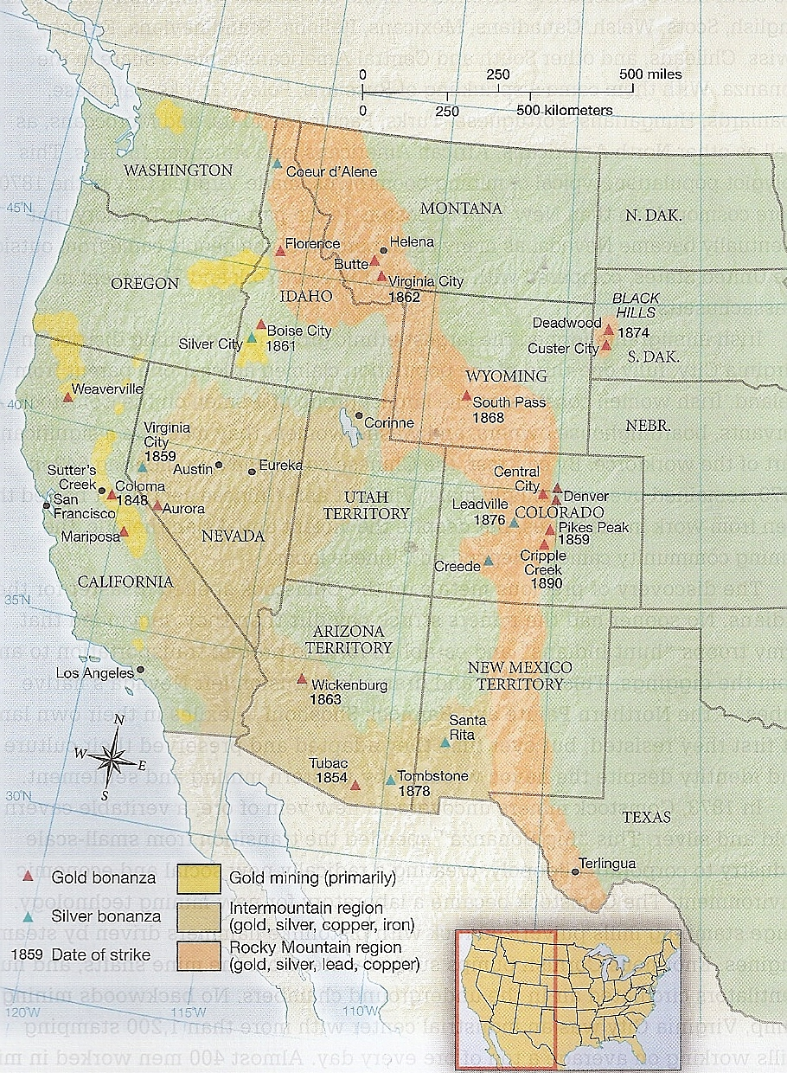
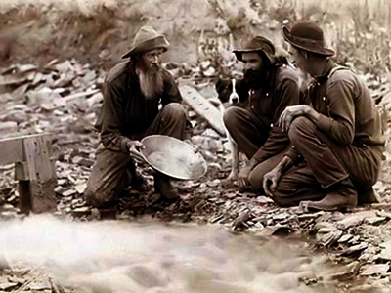
49’ers
Sutter’s Mill, CA in 1848
Surface mining
Pre-1848 = 5,000 migrants
1849 = 30,000 migrants
1850 = 55,000 migrants
Global community

Slide 3
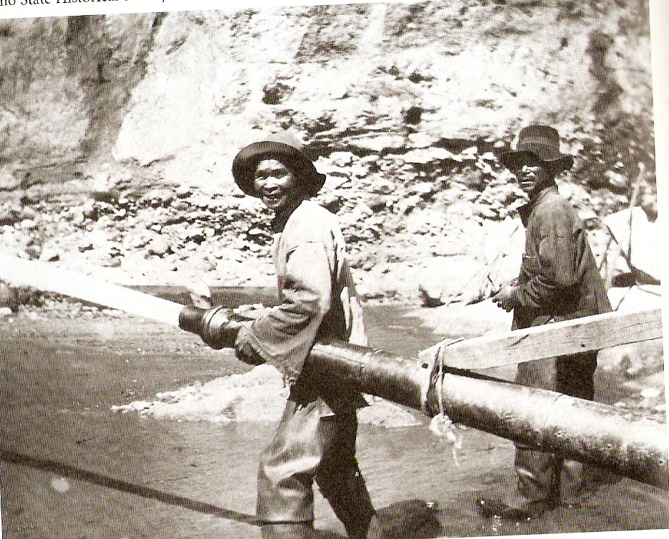
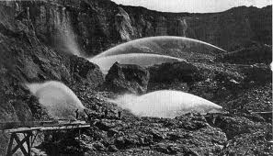
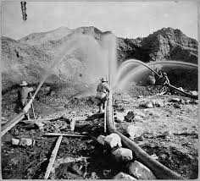
Hydraulic Mining
1860s & 1870s
Corporate investment
Colorado, Nevada, Montana, South Dakota, Idaho, Wyoming, Arizona

Slide 4
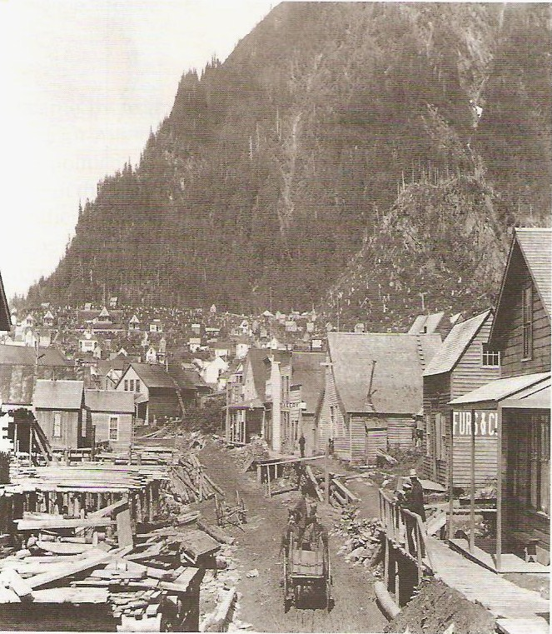
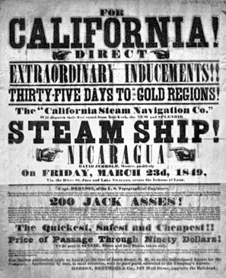
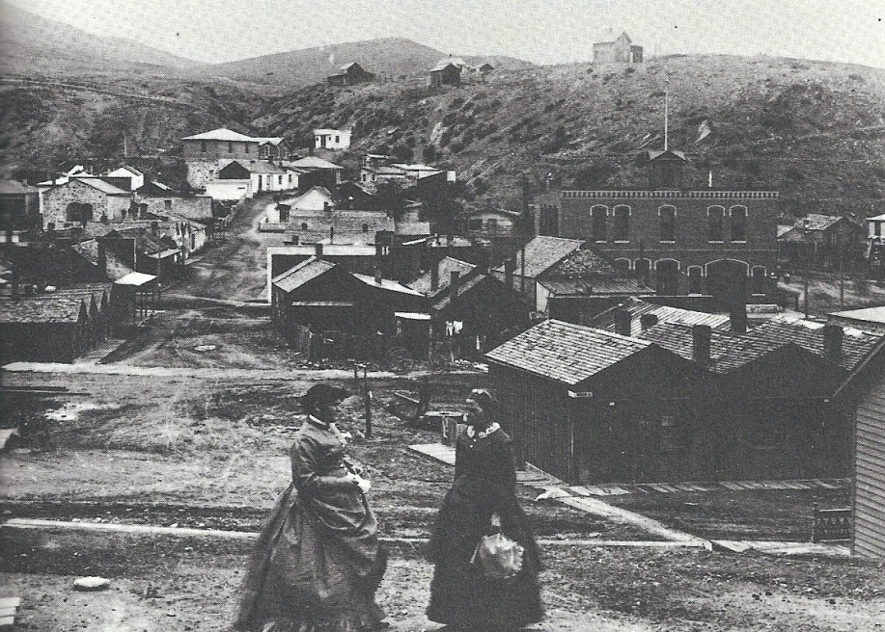
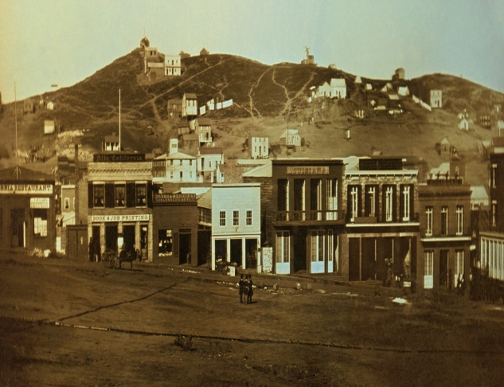
Mining Camps
“Instant cities”
Saloons
1849 = 100,000 in CA
1852 = 220,000

Slide 5
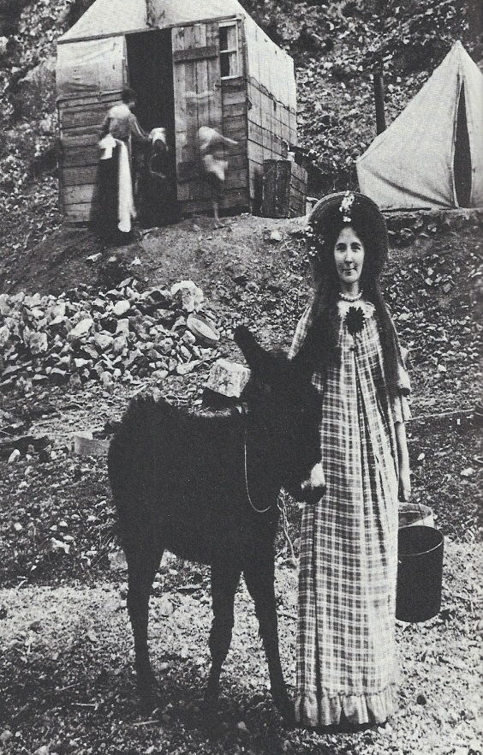
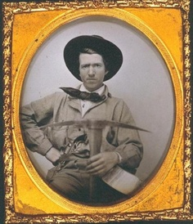
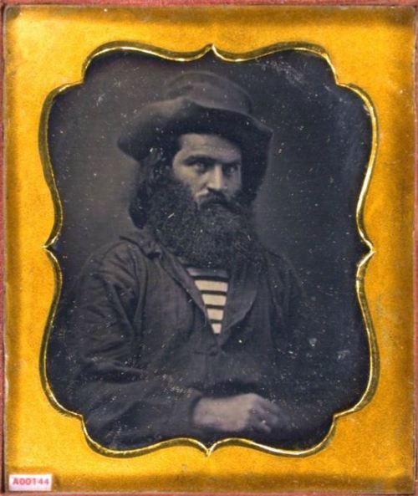
Gender Imbalance
Bachelor environments
Eliza Farnham’s quest, 1849
Prostitution
Businesswomen

Slide 6
“I should like to give you an account of my work if I could do it justice. We have a store in the size of the one we had, in the morning the boy gets up and makes a fire by 7 o’clock when I get up and make the coffee, then I make the biscuit, then I fry the potatoes, then broil 3 pounds of steak, and as much liver, while the woman is sweeping and setting the table, at eight the bell rings and they are eating until nine. I do not sit until they are nearly all done. I try to keep the food warm and in shape as we put it on in small quantities, after breakfast I bake six loaves of bread then four pies, or pudding, then we have lamb, for which we have nine dollars a quarter, beef, and poor, baked turnips, beets, potatoes, radishes, salad, and that everlasting soup, every day, for tea we have hash, cold meat, bread and butter sauce and some kind of cake. I have cooked every mouthful that has been eaten except in one day and a half that we were on a steamboat excursion. I make six beds every day and do the washing and ironing. You must think I’m very busy and when I dance all night I am obligated to trot all day and had I not the Constitution of six horses I should have been dead long ago but I’m going to give up in the fall whether or not as I am sick and tired of work.”
--Mining Camp Boardinghouse owner Mary Jane Megquir

Slide 7
“I often think how disagreeable it used to be to do cooking in the presence of men sitting about the room. This I have to bear ever since I have been here. At times it seems as though I cannot endure it any longer. The cooking and eating room is always filled with five or more men. They are so filthy, they require a great deal of cleaning wherever they go, and this wears out a woman very fast. I hardly know how to describe the feelings at the prospect of a clean comfortable closet to pray in alone.”
--Mining Camp Resident Narcissa Whitman

Slide 8
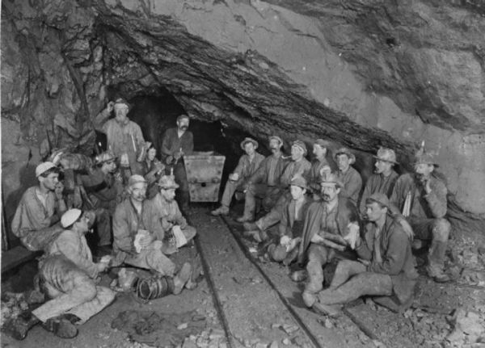
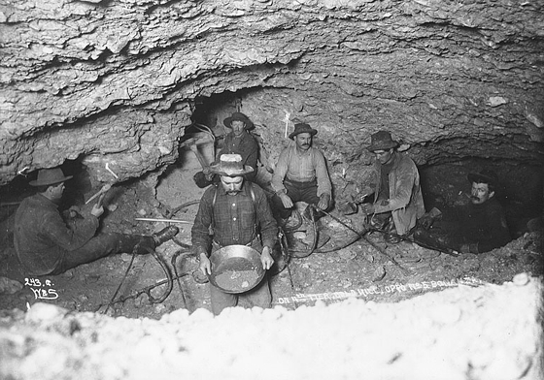
Diversity in the Mining Camps
Germans, Mexicans, Chinese, French, Cornish, Welsh miners
Slaves
CA’s approach to slavery

Slide 9
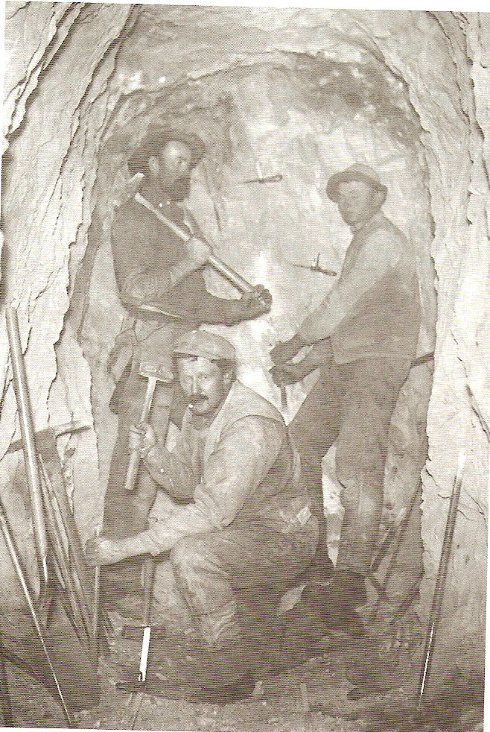
Unrealistic Expectations
1848 wages = $15 - $20/day
1852 = $2 - $3/day
Treaty of Guadalupe Hidalgo
Foreign Miner’s License Tax

Slide 10
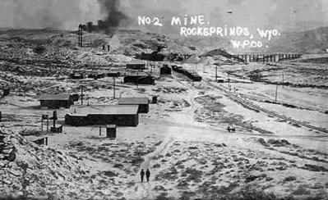
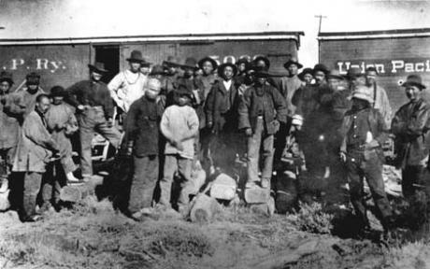
Chinese Miners
1849 – 1880s = 250,000 Chinese in CA
1870 = 25% of Idaho, 10% of Montana
Rock Springs, WY 1885

Slide 11
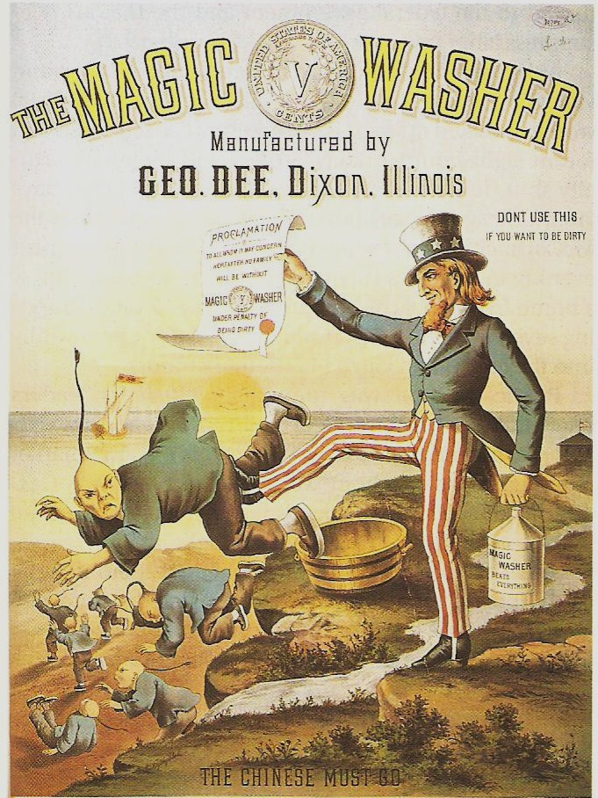
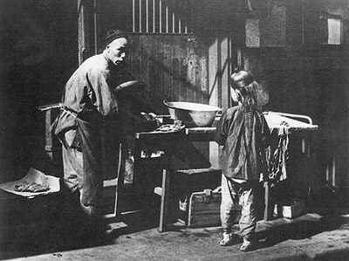
The Chinese Exclusion Act, 1882

