Slide 1
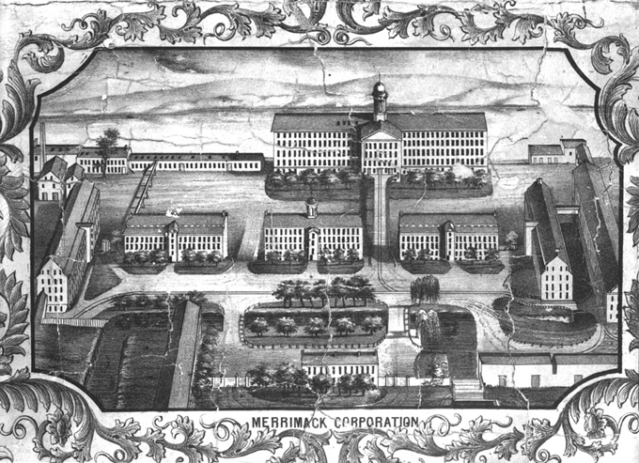
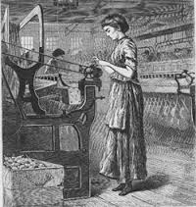
The Market Revolution, Women, & Work

Slide 2
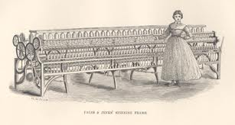
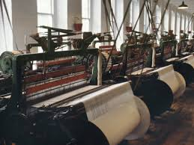
Transformation of the American Economy, 1815 – 1848
Transformation in technology, transportation, communications, & agriculture
Psychological & ideological revolution in the meaning of work
Loss of social status for skilled workers

Slide 3
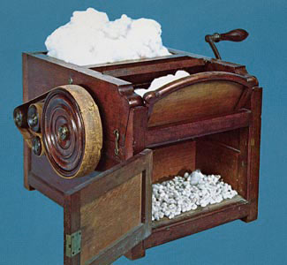
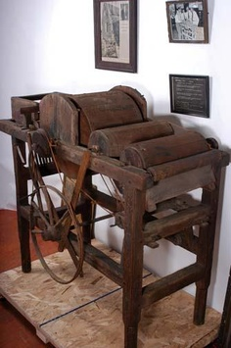
Differences in North vs. South
North = free labor economy with industry, urbanization, and immigration
South = cash crops, slave labor, less manufacturing
“Competence” vs. surplus
Cotton Gin = 1 pound cotton/1 day vs. 50 pounds/1 day

Slide 4
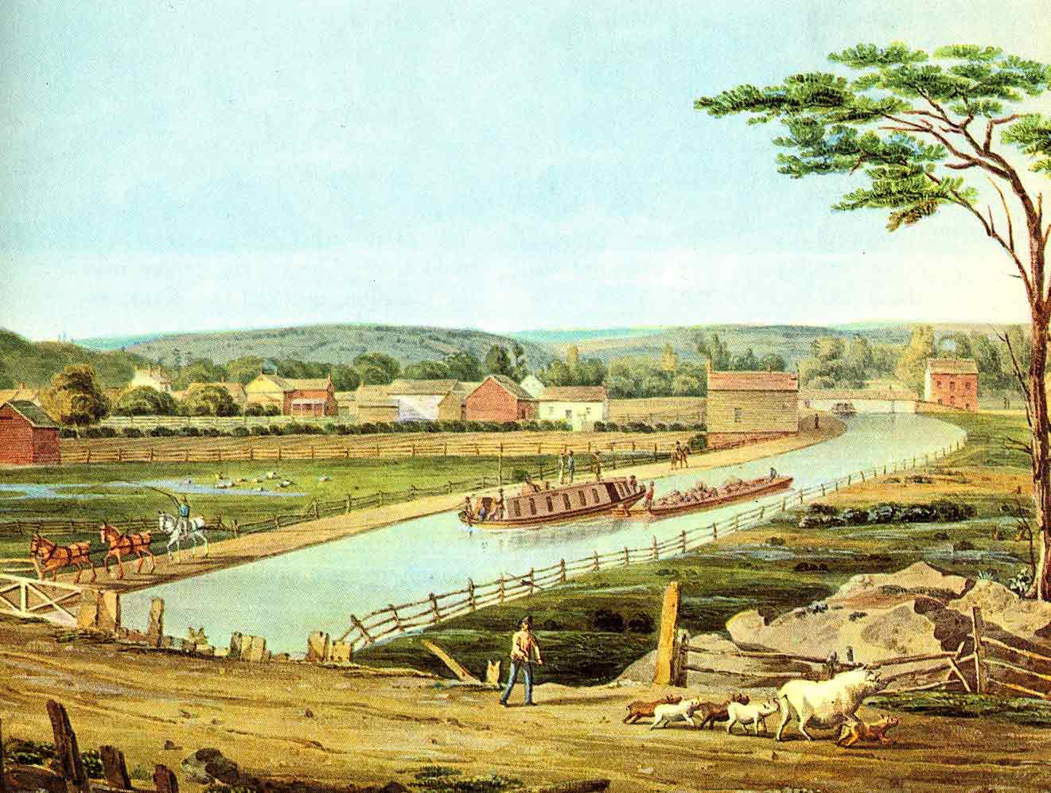
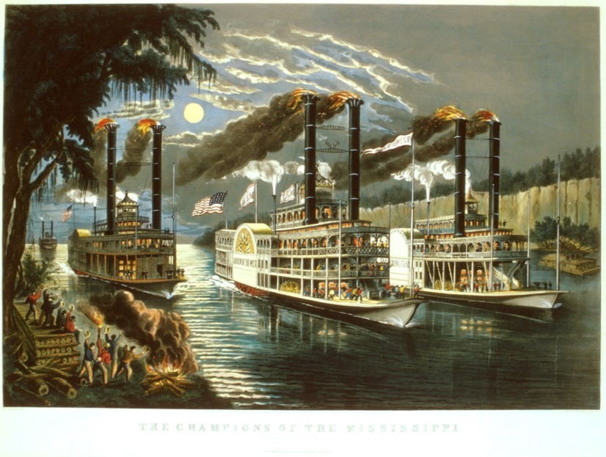
Transportation
4,000 miles of roads in Northeast by 1820
Steamboat
Canals
Railroads

Slide 5
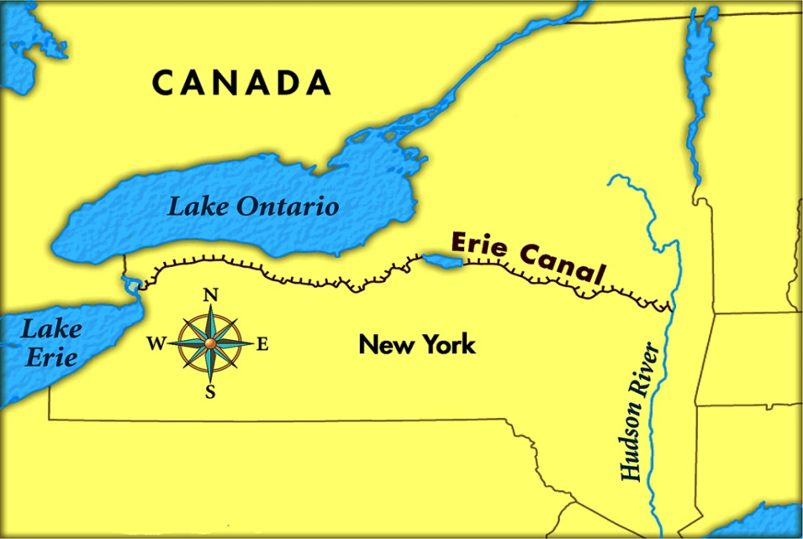
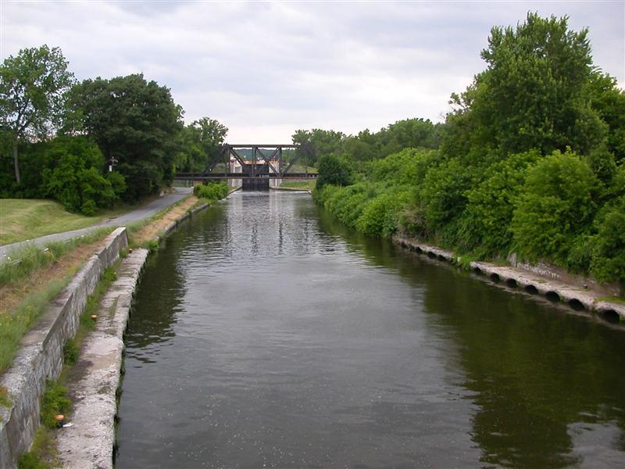
Erie Canal, NY
Completed in 1825
$7 million
350 miles between Albany & Buffalo
Led to construction of 3,300 miles of canals between 1825 – 1845

Slide 6
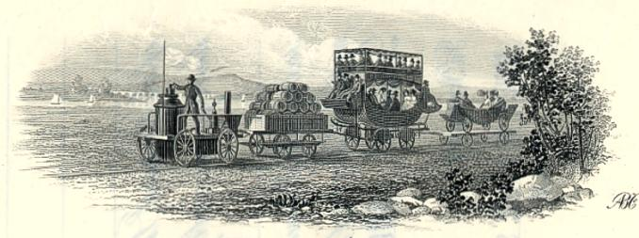
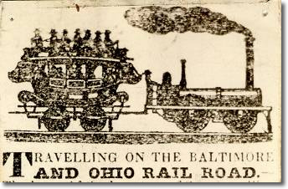
Railroads
1829 = Baltimore & Ohio Railroad, 13 miles
1830s = 20 – 100 miles, 15 – 20 mph

Slide 7
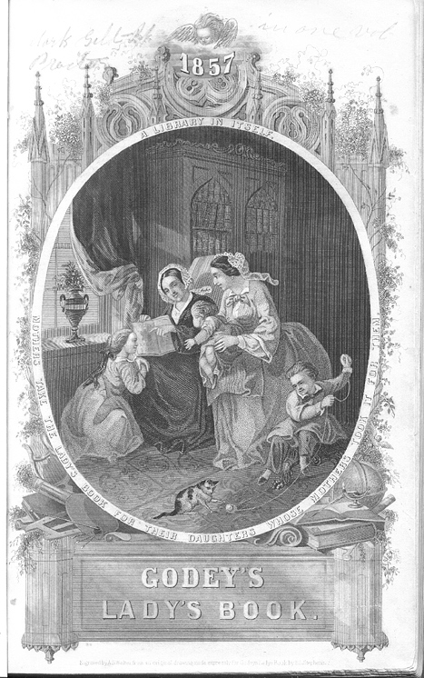
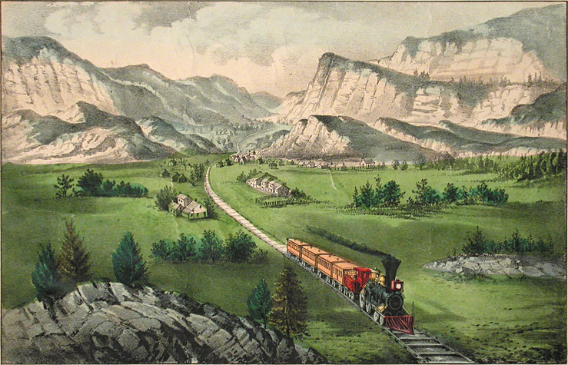
Access to Print
1801 = 200 newspapers vs. 1,200 in 1835
Magazines vs. almanacs
Catalogs
1834 = Currier lithographs

Slide 8
Changes in the Meaning of Work
Rise of small factories
De-skilling of production
Women and the “putting out system,” 60 – 70 hours/week
Owners, managers, wage workers replaced artisans
Workplace discipline & industrial time
North = Wage labor replaced bound labor

Slide 9
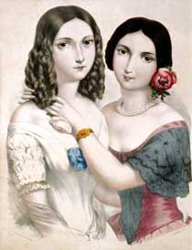
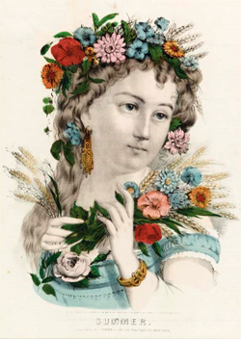
Emergence of Class-Consciousness
Was Antebellum America a classless society?
Middling sort
Salary vs. wage, skilled vs. unskilled

Slide 10
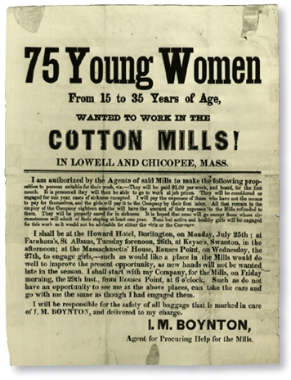
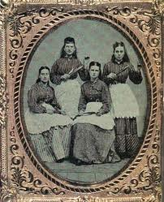
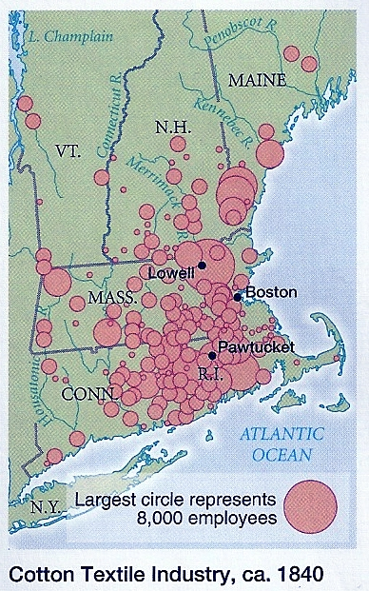
The Lowell Mill System
1st fully-integrated textile factory
Water-powered machinery
Peaked in New England, 1830s & 1840s
1825 = 22 mills in Lowell vs. 1850 = 50 mills

Slide 11

Textile Machine

Slide 12
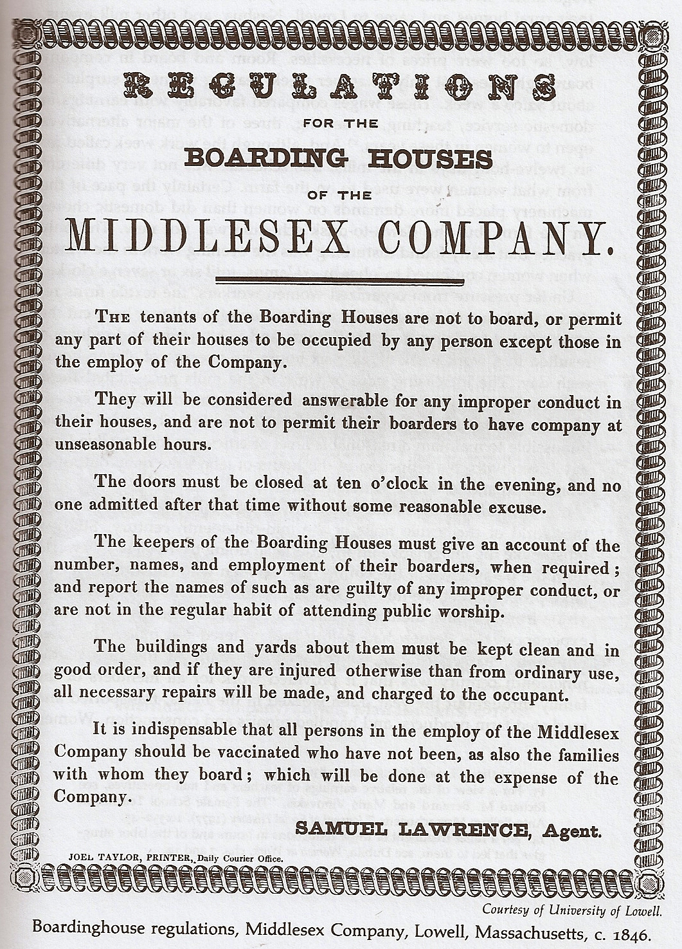
Daily Lives of the Mill Girls
Company-owned boardinghouses
$2 - $3 for a 75 hour/week
Hazardous work conditions

Slide 13
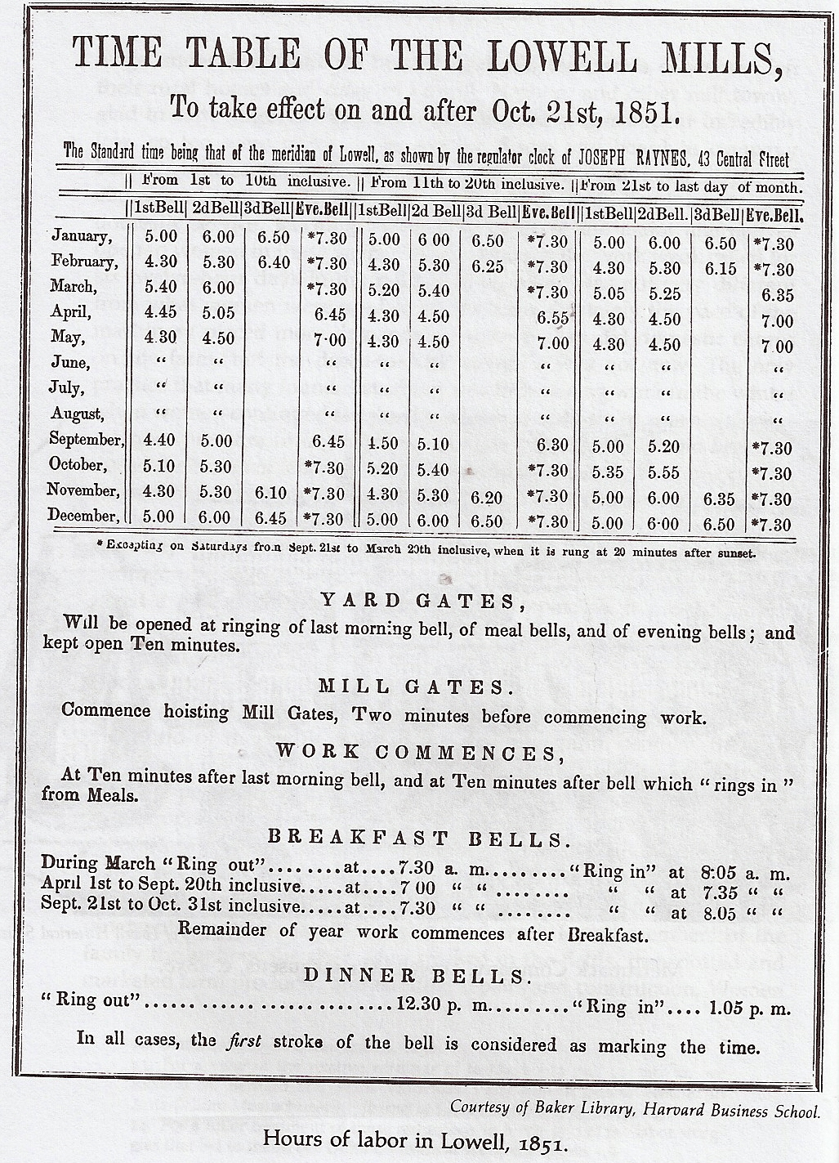
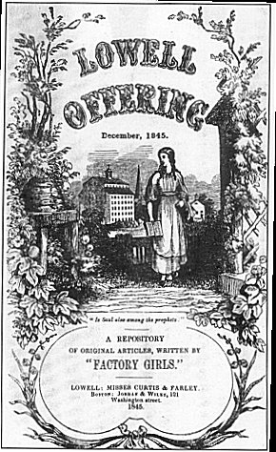
“The Lowell Offering”
Benefits?
1835 = General strike for a 10 hour day

Slide 14
Female Academies
Growth of public schools for white children, ages 6 – 11
1830 = Male and female literacy rates near equal in North
1830 = 75 colleges open for men in U.S., 0 for women
1790 = 10 female academies vs. 1830 = 200
3 years of general education + “feminine subjects”

Slide 15
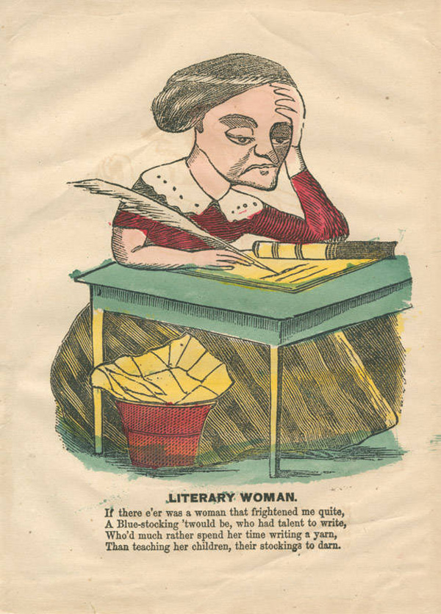
Bluestockings
“When girls become scholars who is to make the puddings and pies?”
--1840s reaction to
female academies

Slide 16
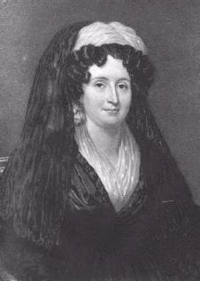
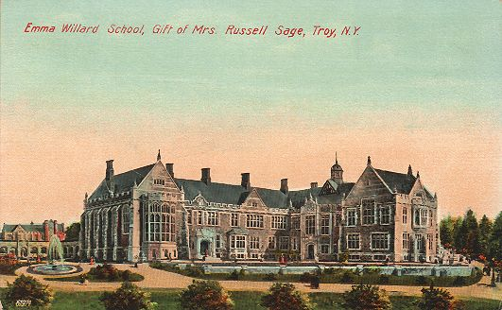
Emma Willard
Born in 1787, Connecticut
1821 = Opened Troy Female Seminary, NY
1821 – 1871 = 12,000 graduates
Graduates became teachers, writers, school superintendents

